Slide 1
Relational Algebra
Chapter 4

Slide 3
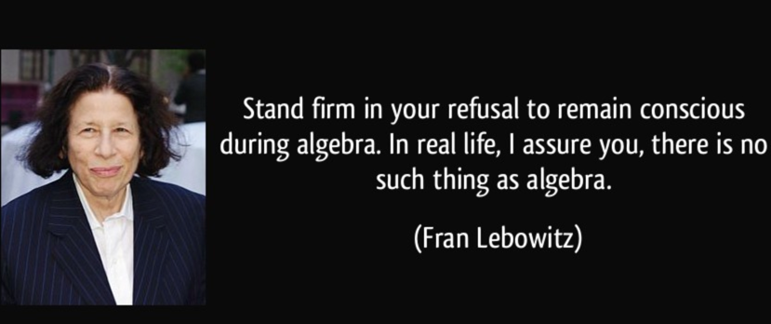
What is it?
Theoretical Foundations of Queries
Questions to the Database regarding Data
Queries in Relational Algebra are formulated using a collection of operators
Examples
$π$
$σ$
$⋈$

Slide 4
Introduction and Schemas
Assumptions
Sailors
Boats
Sid | Sname | Rating | Age
22 | Dustin | 7 | 45
31 | Lubber | 8 | 55
58 | Rusty | 10 | 35
32 | Andy | 8 | 25
Bid | Bname | color
101 | Interlake | Blue
102 | Interlake | red
103 | Clipper | Green
104 | Marine | red
Reserves
Sid | Bid | Day
22 | 101 | 10/10/96
58 | 103 | 11/12/96

Slide 6
Relational Algebra
Foundations of Queries
Fundamental Properties
Every operator accepts a relations (one or two) as input
Every operator returns a relation as output
This property allows formation of complex queries.
Operators
$π$
$σ$
$ρ$
Set operators: $∪ ∩ − ×$
$⋈$

Slide 7
Select Operator $(σ)$
Formal notation
$R^{′}=\begin{matrix}σ \\ conditions\end{matrix}\left(R\right)$
Works on the horizontal dimension (tuples)
Sid | Sname | Rating | Age
22 | Dustin | 7 | 45
31 | Lubber | 8 | 55
58 | Rusty | 10 | 35
32 | Andy | 8 | 25
17 | Popeye | 10 | 40

Slide 9
Examples on Selection
$R^{′}=\begin{matrix}σ \\ Sailors.age>40\end{matrix}\left(Sailors\right)$
Sid | Sname | Rating | Age
22 | Dustin | 7 | 45
31 | Lubber | 8 | 55
58 | Rusty | 10 | 35
32 | Andy | 8 | 25
Sid | Sname | Rating | Age
22 | Dustin | 7 | 45
31 | Lubber | 8 | 55

Slide 10
Examples on Selection (2)
$R^{′}=\begin{matrix}σ \\ \begin{aligned}Sailors.rating>=8 \\ and Sailors.age>50\end{aligned}\end{matrix}\left(Sailors\right)$
Can apply multiple conditions: AND OR ($∧ ∨$)
Can apply multiple selections instead
$R^{′}=\begin{matrix}σ \\ Sailors.rating≥8\end{matrix}\left(Sailors\right)$
${Final}^{′}=\begin{matrix}σ \\ R′.age≥50\end{matrix}\left(R′\right)$
Sid | Sname | Rating | Age
22 | Dustin | 7 | 45
31 | Lubber | 8 | 55
58 | Rusty | 10 | 35
32 | Andy | 8 | 25
Sid | Sname | Rating | Age
31 | Lubber | 8 | 55

Slide 12
Rename Operator ($ρ$)
Alias for relation names and/or column names
$ρ\left(newName, oldName\right)$
Examples
$ρ\left(S,Sailors\right)$
Returns a relation S with the same data as Sailors. Now we can use S instead of Sailors
$R^{′}=\begin{matrix}σ \\ \begin{aligned}S.rating>=8 \\ and S.age>50\end{aligned}\end{matrix}\left(S\right)$
$ρ\left(S(sid→sid1,rating→rate),Sailors\right)$
Returns a relation S with the same data as Sailors, with same columns, except sid is now sid1 and rating is now rate.

Slide 13
Project Operator ($\prod{R}$)
Formal notation
$R^{′}=\prod_{columns}{\left(R\right)}$
Works on the vertical dimension (attributes)
Will only show unique values.
Sid | Sname | Rating | Age
22 | Dustin | 7 | 45
31 | Lubber | 8 | 55
58 | Rusty | 10 | 35
32 | Andy | 8 | 25

Slide 14
Examples on Projection
Sid | Sname | Rating | Age
22 | Dustin | 7 | 45
31 | Lubber | 8 | 55
58 | Rusty | 10 | 35
32 | Andy | 8 | 25
$ρ\left(S,Sailors\right)$
$R^{′}=\prod_{S.sname,s.age}{\left(S\right)}$
Sname | Age
Dustin | 45
Lubber | 55
Rusty | 35
Andy | 25

Slide 15
Examples on Projection(2)
Sid | Sname | Rating | Age
22 | Dustin | 7 | 45
31 | Lubber | 8 | 55
58 | Rusty | 10 | 35
32 | Andy | 8 | 25
$ρ\left(S,Sailors\right)$
$R^{′}=\prod_{S.rating}{\left(S\right)}$
Remember: Unique values only!
Rating
7
8
10

Slide 17
Mixing Operators
More useful when mixing selections and projections
Example
Get sailor names whose age is greater than 40.
$ρ\left(S,Sailors\right)$
$R^{′}=\prod_{S.sname,}{\left(S\right)}$ ------------------→ R’ only sname
${Final}^{′}=\begin{matrix}σ \\ R′.age>40\end{matrix}\left(R′\right)$
Can we do this?!!
Correct result:
$ρ\left(S,Sailors\right)$
$R^{′}=\begin{matrix}σ \\ S.age>40\end{matrix}\left(S\right)$
${Final}^{′}=\prod_{S.sname,}{\left(R′\right)}$

Slide 18
Set Operations: Union

Slide 20
Set Operations: Intersection and Set Difference

Slide 21
Examples on Set Operators
Sid | Sname | Rating | Age
28 | yuppy | 9 | 35
31 | Lubber | 8 | 55
44 | guppy | 5 | 35
58 | Rusty | 10 | 35
Sid | Sname | Rating | Age
22 | Dustin | 7 | 45
31 | Lubber | 8 | 55
58 | Rusty | 10 | 35
Sid | Sname | Rating | Age
22 | Dustin | 7 | 45
28 | yuppy | 9 | 35
31 | Lubber | 8 | 55
44 | guppy | 5 | 35
58 | Rusty | 10 | 35
$$=$$

Slide 22
Examples on Set Operators (2)
Sid | Sname | Rating | Age
28 | yuppy | 9 | 35
31 | Lubber | 8 | 55
44 | guppy | 5 | 35
58 | Rusty | 10 | 35
Sid | Sname | Rating | Age
22 | Dustin | 7 | 45
31 | Lubber | 8 | 55
58 | Rusty | 10 | 35
Sid | Sname | Rating | Age
31 | Lubber | 8 | 55
58 | Rusty | 10 | 35
$$=$$

Slide 24
Examples on Set Operators (3)
Sid | Sname | Rating | Age
28 | yuppy | 9 | 35
31 | Lubber | 8 | 55
44 | guppy | 5 | 35
58 | Rusty | 10 | 35
Sid | Sname | Rating | Age
22 | Dustin | 7 | 45
31 | Lubber | 8 | 55
58 | Rusty | 10 | 35
$$−$$
$$=$$
Sid | Sname | Rating | Age
22 | Dustin | 7 | 45

Slide 25
Cross Product:

Slide 26
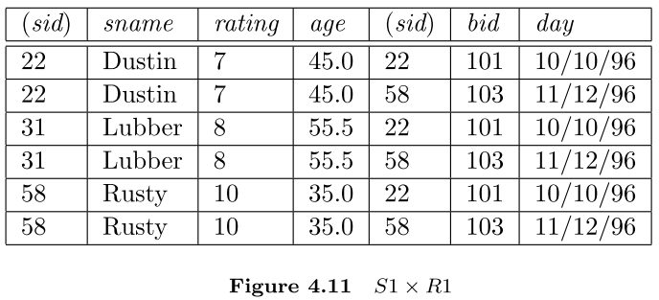
Example:
Sid | Sname | Rating | Age
22 | Dustin | 7 | 45
31 | Lubber | 8 | 55
58 | Rusty | 10 | 35
Sid | Bid | Day
22 | 101 | 10/10/96
58 | 103 | 11/12/96
$$×$$
$$=$$

Slide 28
Condition Join
The most general version of the join operation accepts a join condition c and a pair of relation instances as arguments, and returns a relation instance

Slide 29
Condition Join Example

Slide 31
Equijoin
A common special case of the join operation R S is when the join condition consists solely of equalities of the form R.name1 = S.name2, that is, equalities between two ﬁelds in R and S.
The schema of the result of an equijoin contains the ﬁelds of R (with the same names and domains as in R) followed by the ﬁelds of S that do not appear in the join conditions.

Slide 32
Natural Join
A further special case of the join operation R S is an equijoin in which equalities are speciﬁed on all ﬁelds having the same name in R and S.
In this case, we can simply omit the join condition.

Slide 34
Examples
Find the names of Sailors who have reserved boat id = 103
Find the names of Sailors who reserved a red boat
Find the color of boats reserved by lubber

Slide 35
Examples (2)
Find the names of sailors who have reserved at least one boat
Find the names of Sailors who reserved a red boat or a green boat
Find the names of Sailors who reserved a red AND a green boat

Slide 37
Examples (3)
Find the sids of sailors with age over 20 who have not reserved a red boat

Slide 38
Examples (4)
Sid | Bid | Day
22 | 101 | 10/10/96
58 | 103 | 11/12/96
22 | 107 | 1/2/98
Find the sids of sailors who reserved at least two different boats
Sid | Bid | Day | Sid’ | Bid’ | Day’
22 | 101 | 10/10/96 | 22 | 101 | 10/10/96
22 | 101 | 10/10/96 | 58 | 103 | 11/12/96
22 | 101 | 10/10/96 | 22 | 107 | 1/2/98
58 | 103 | 11/12/96 | 22 | 101 | 10/10/96
58 | 103 | 11/12/96 | 58 | 103 | 11/12/96
58 | 103 | 11/12/96 | 22 | 107 | 1/2/98
22 | 107 | 1/2/98 | 22 | 101 | 10/10/96
22 | 107 | 1/2/98 | 58 | 103 | 11/12/96
22 | 107 | 1/2/98 | 22 | 107 | 1/2/98

