Slide 1
Bakery Shop Online

Slide 2
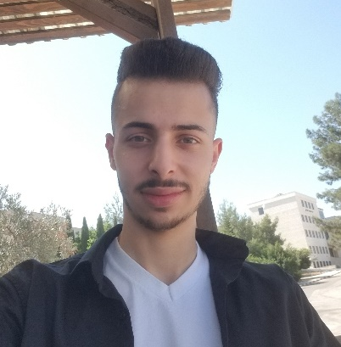
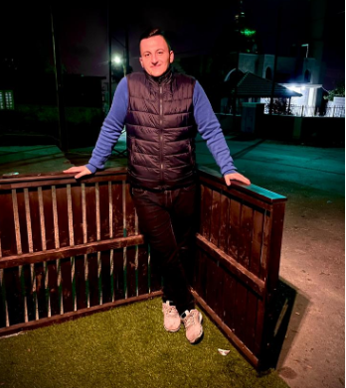
AnGrY NeRdS – G5
Manager
Waseem Sayara
Designer
Anas Barakat
Secretary
Mohammad Ghannam
Programmer
Yazid Muaket

Slide 3
Business Description
Our Business is an Online Bakery Shop, our main purpose is to serve our customers online by building a software which can be used in either in an online website or a mobile app.
The application offers a menu of our baked products with attached photo of the product with common price that all people expect (1$ to 50$), Most of our visitors are expected to be public (normal) people, restaurants, mini/super markets and wedding halls.
Our Shop is located in clean area in middle of Jerusalem city, the Bakery name is “Angry Nerds” which contain a head bakery who has the full control on our bakery employees about their work and what they bake etc., moving into the website, it provides a shopping cart system which enables the customer to add/remove products that he wishes to, or edit quantity desired to be bought per product selected, and the price for each item and the balance for the whole cart, once the customer is satisfied with his order, he can purchase it by filling a checkout page, then the website prompt the customer to choose from different payment methods that the website offers, then delivery system steps in by asking the user to enter the time & location required and in order to deliver different types of bakeries & products for our online customers, after a specific order has been made, the website provides a feedback system that enables the customer to give his opinion about the whole service.
The business is structured as a sole proprietorship, operating under the manager Waseem A. Sayara, Secretary Mohammad A. Ghannam, Designer Anas S. Barakat and Programmer Yazid A. Muaket.

Slide 4
Scenario Example : Making an Order
Normal:
When a customer logged in properly with valid credit card and sufficient balance to make an order, he started shopping by searching for a specific product or checking the menu and several categories (sales, special orders, favorites, history, etc.), the customer browse several products, once he has found a product, he read the details of the product he wants to obtain more information such as (Ingredients, addons, etc.), then he added the item to the cart, once the customer is satisfied with his order and his cart is ready, he decided to buy it, then he filled the Checkout page with proper information about the payment and delivery info (Time and Location), at last the system will move the purchased cart to the order’s history sections.
Alternative:
Sofian logged in and started shopping with a visa card that has 47.5$, after the he added items to the shopping cart, the cart ended with an overall value of 50$ which exceeds the amount of money in his visa card only less than 10%, in this case he can decide to complete the order by paying the rest in cash.
Error:
If Salma logged in the website with an expired visa card and started shopping by adding items in the cart, and then in the process of Checkout, the system will warn Dina visa card was invalid or expired then her order will be drafted or canceled.
Error:
Salma logged in and started shopping with a visa card that has 47.5$, after the she added items to the shopping cart, the cart ended with an overall value of 50$ which exceeds the amount of money in his visa card only less than 10%, but she decider not complete the order, so the order will be drafted and canceled.
Error:
Salma logged in and started shopping with a visa card that has 30$, after the she added items to the shopping cart, the cart ended with an overall value of 50$ which exceeds the amount of money in his visa card over than 10%, so the order will be drafted and canceled.

Slide 5
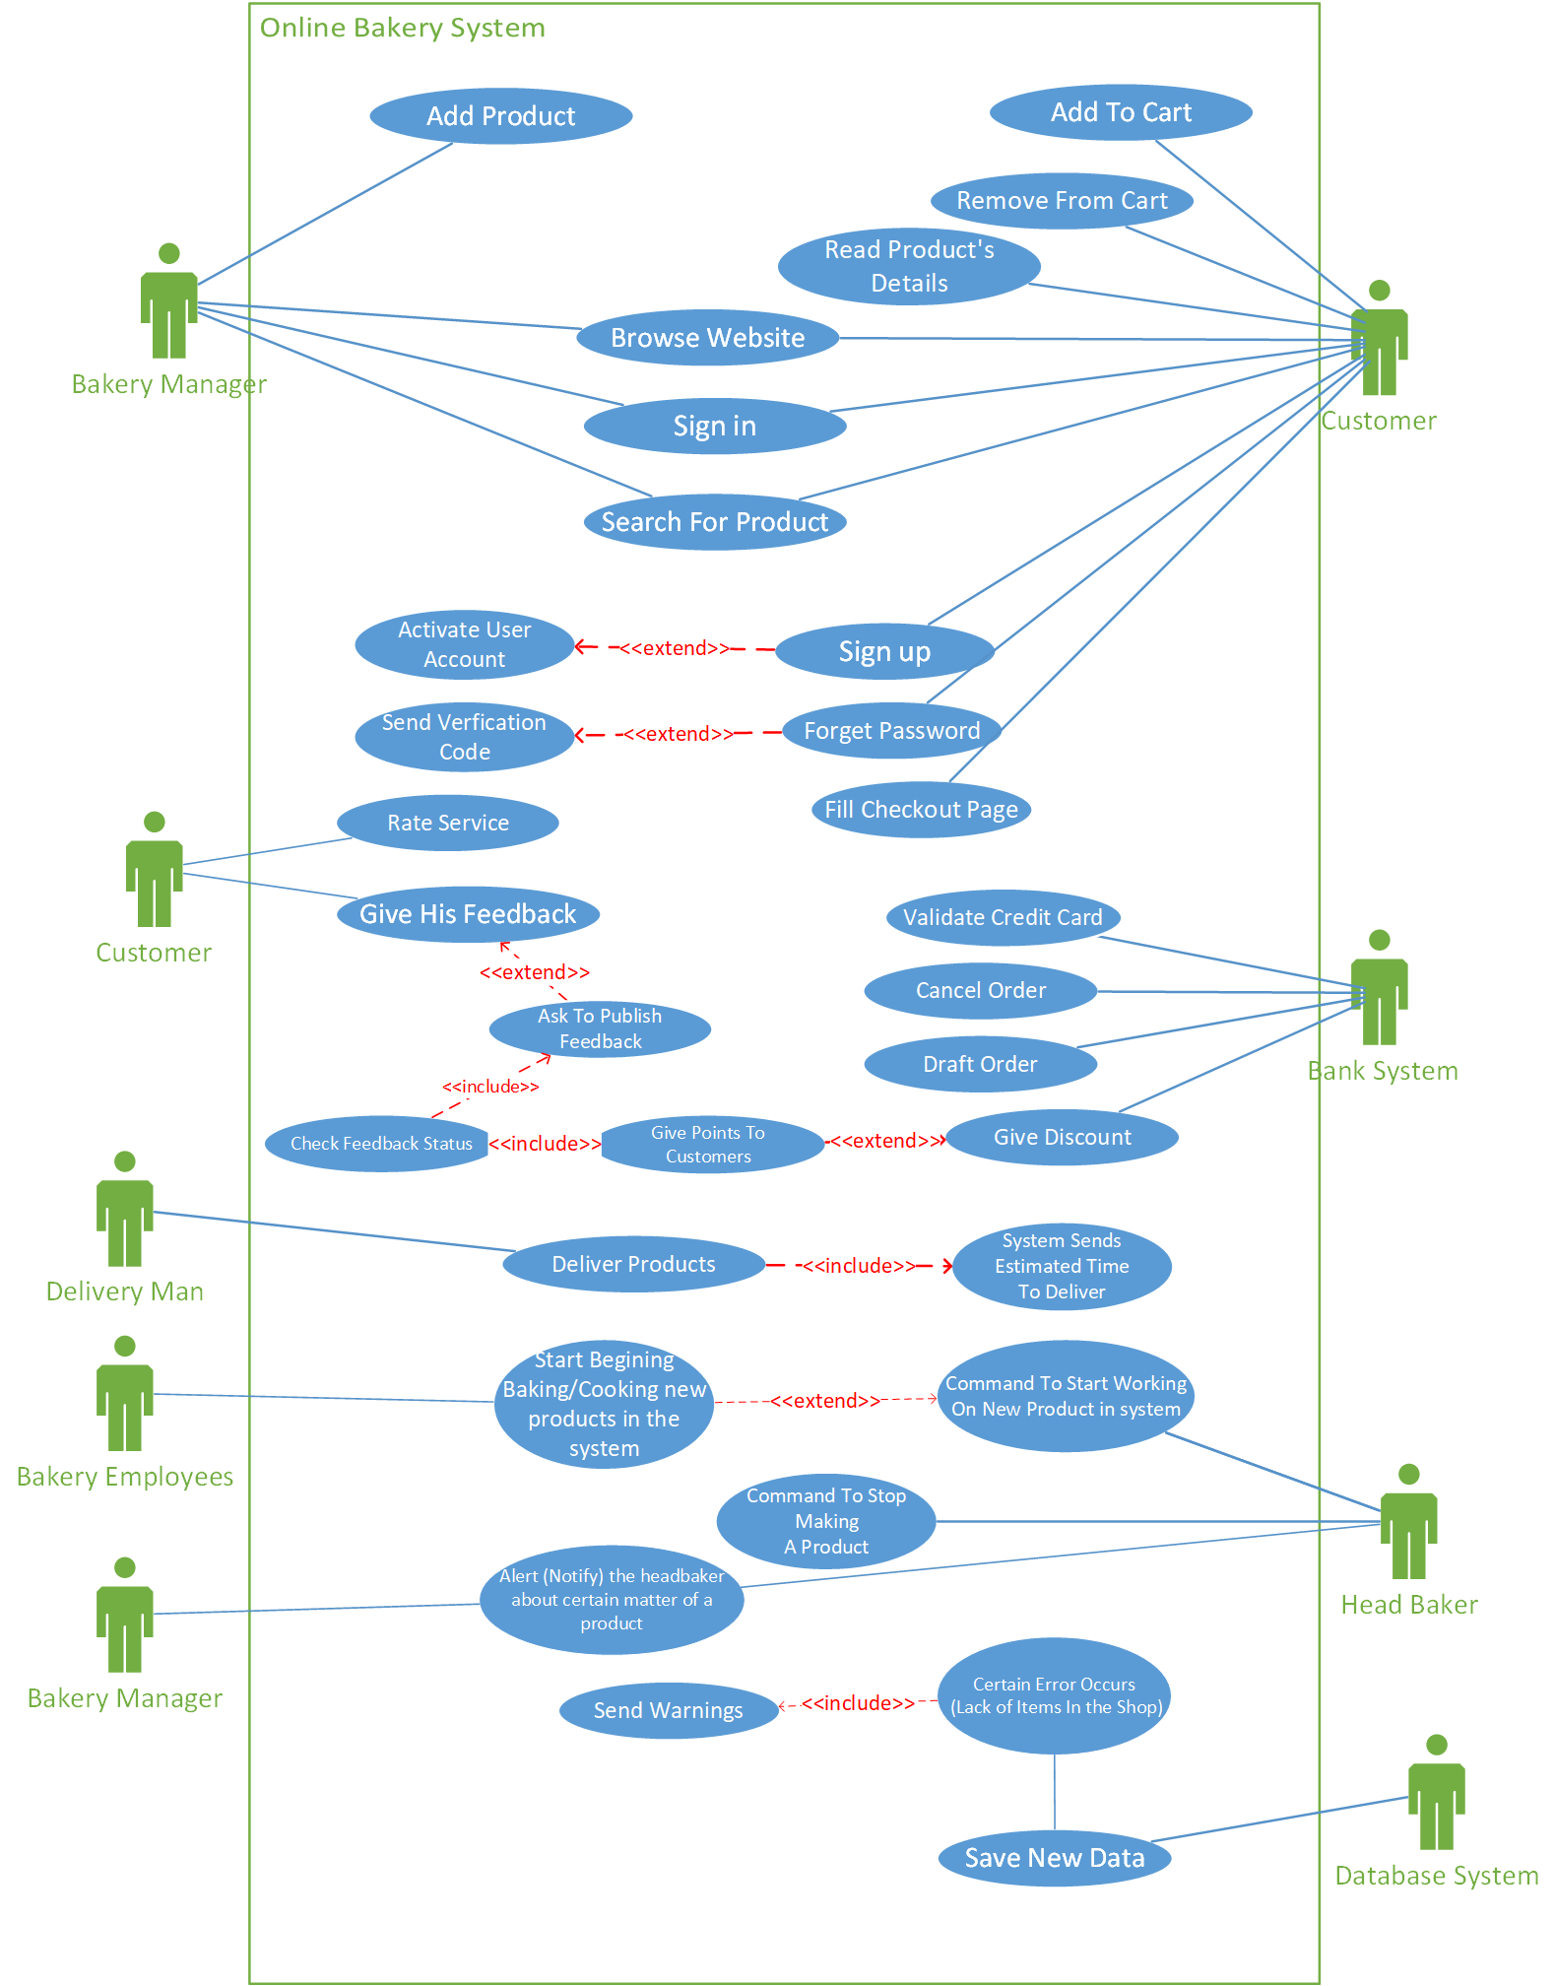
Use Case Diagram

Slide 6
Use Case Specification : Adding Product to Shopping Cart
Actor | Customer.
Description | It’s a process occurs when the customer has an intuition to buy a product, it is basically moving the wanted product to a section called Shopping Cart, after that he has two options: either he continues to browsing and shopping or he can fill the checkout in order to purchase the product(s) in the Shopping Cart.
Pre-Conditions | The Customer has a registered account in the system and has logged in successfully to the website.
Sequence/flow of events | Customer visits the website and wants to order a/some product/s. The Customer logs into the website The Customer starts shopping & looking for a desired item. Customer chooses a product he wishes to buy & starts checking extra information found in the information page about it. Customer is satisfied in buying the product then clicks “Add to Shopping Cart” button to send their product to the shopping cart.
Data | Product’s ID, Product’s Name, Product’s Image, Product’s Price.
Stimulus/Triggers | The Price of a Product. “The customer adds a product after realizing its price is affordable”. No shipping fees. Discount offers (Sales). The Image of a Product. “The customer likes a product from its image and decided to add it to the shopping cart”. The Product’s Rating and Good Reviews. The Previous knowledge for a specific Product.
Post-Conditions/ Response | The item(s) have been added to the customer’s Shopping Cart. The Shopping Cart Balance is updated.
Comments | Adding products to the shopping cart is very useful when considering buying many products in same order, the cart system keeps track of your added products.

Slide 7
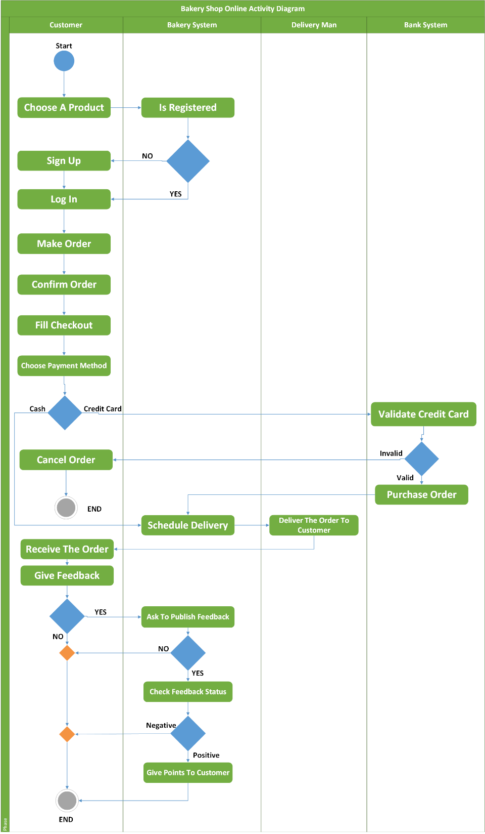
Activity Diagram

Slide 8
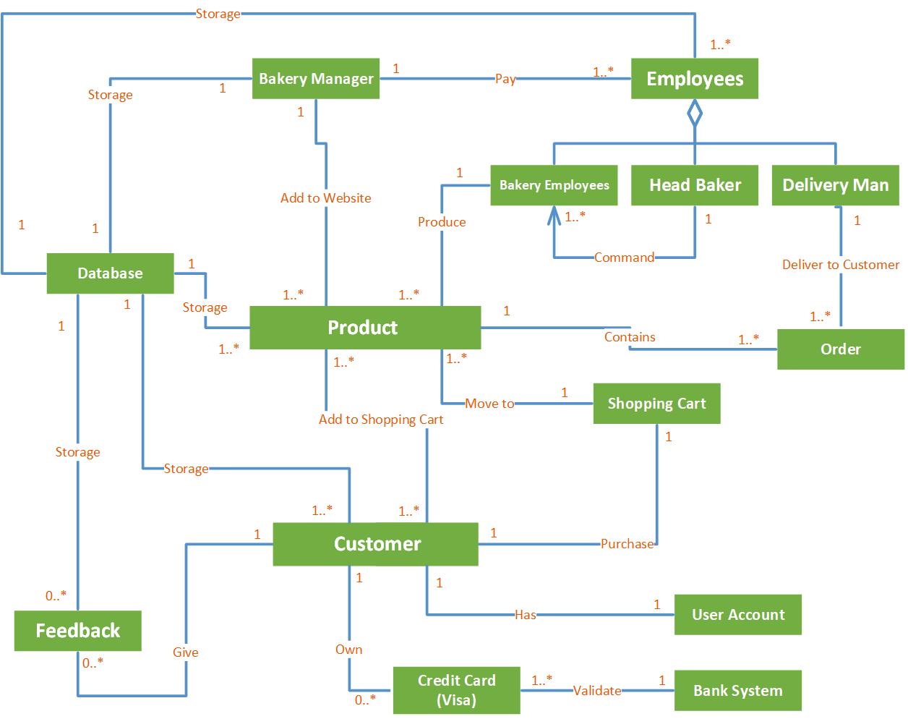
Class Diagram

Slide 9
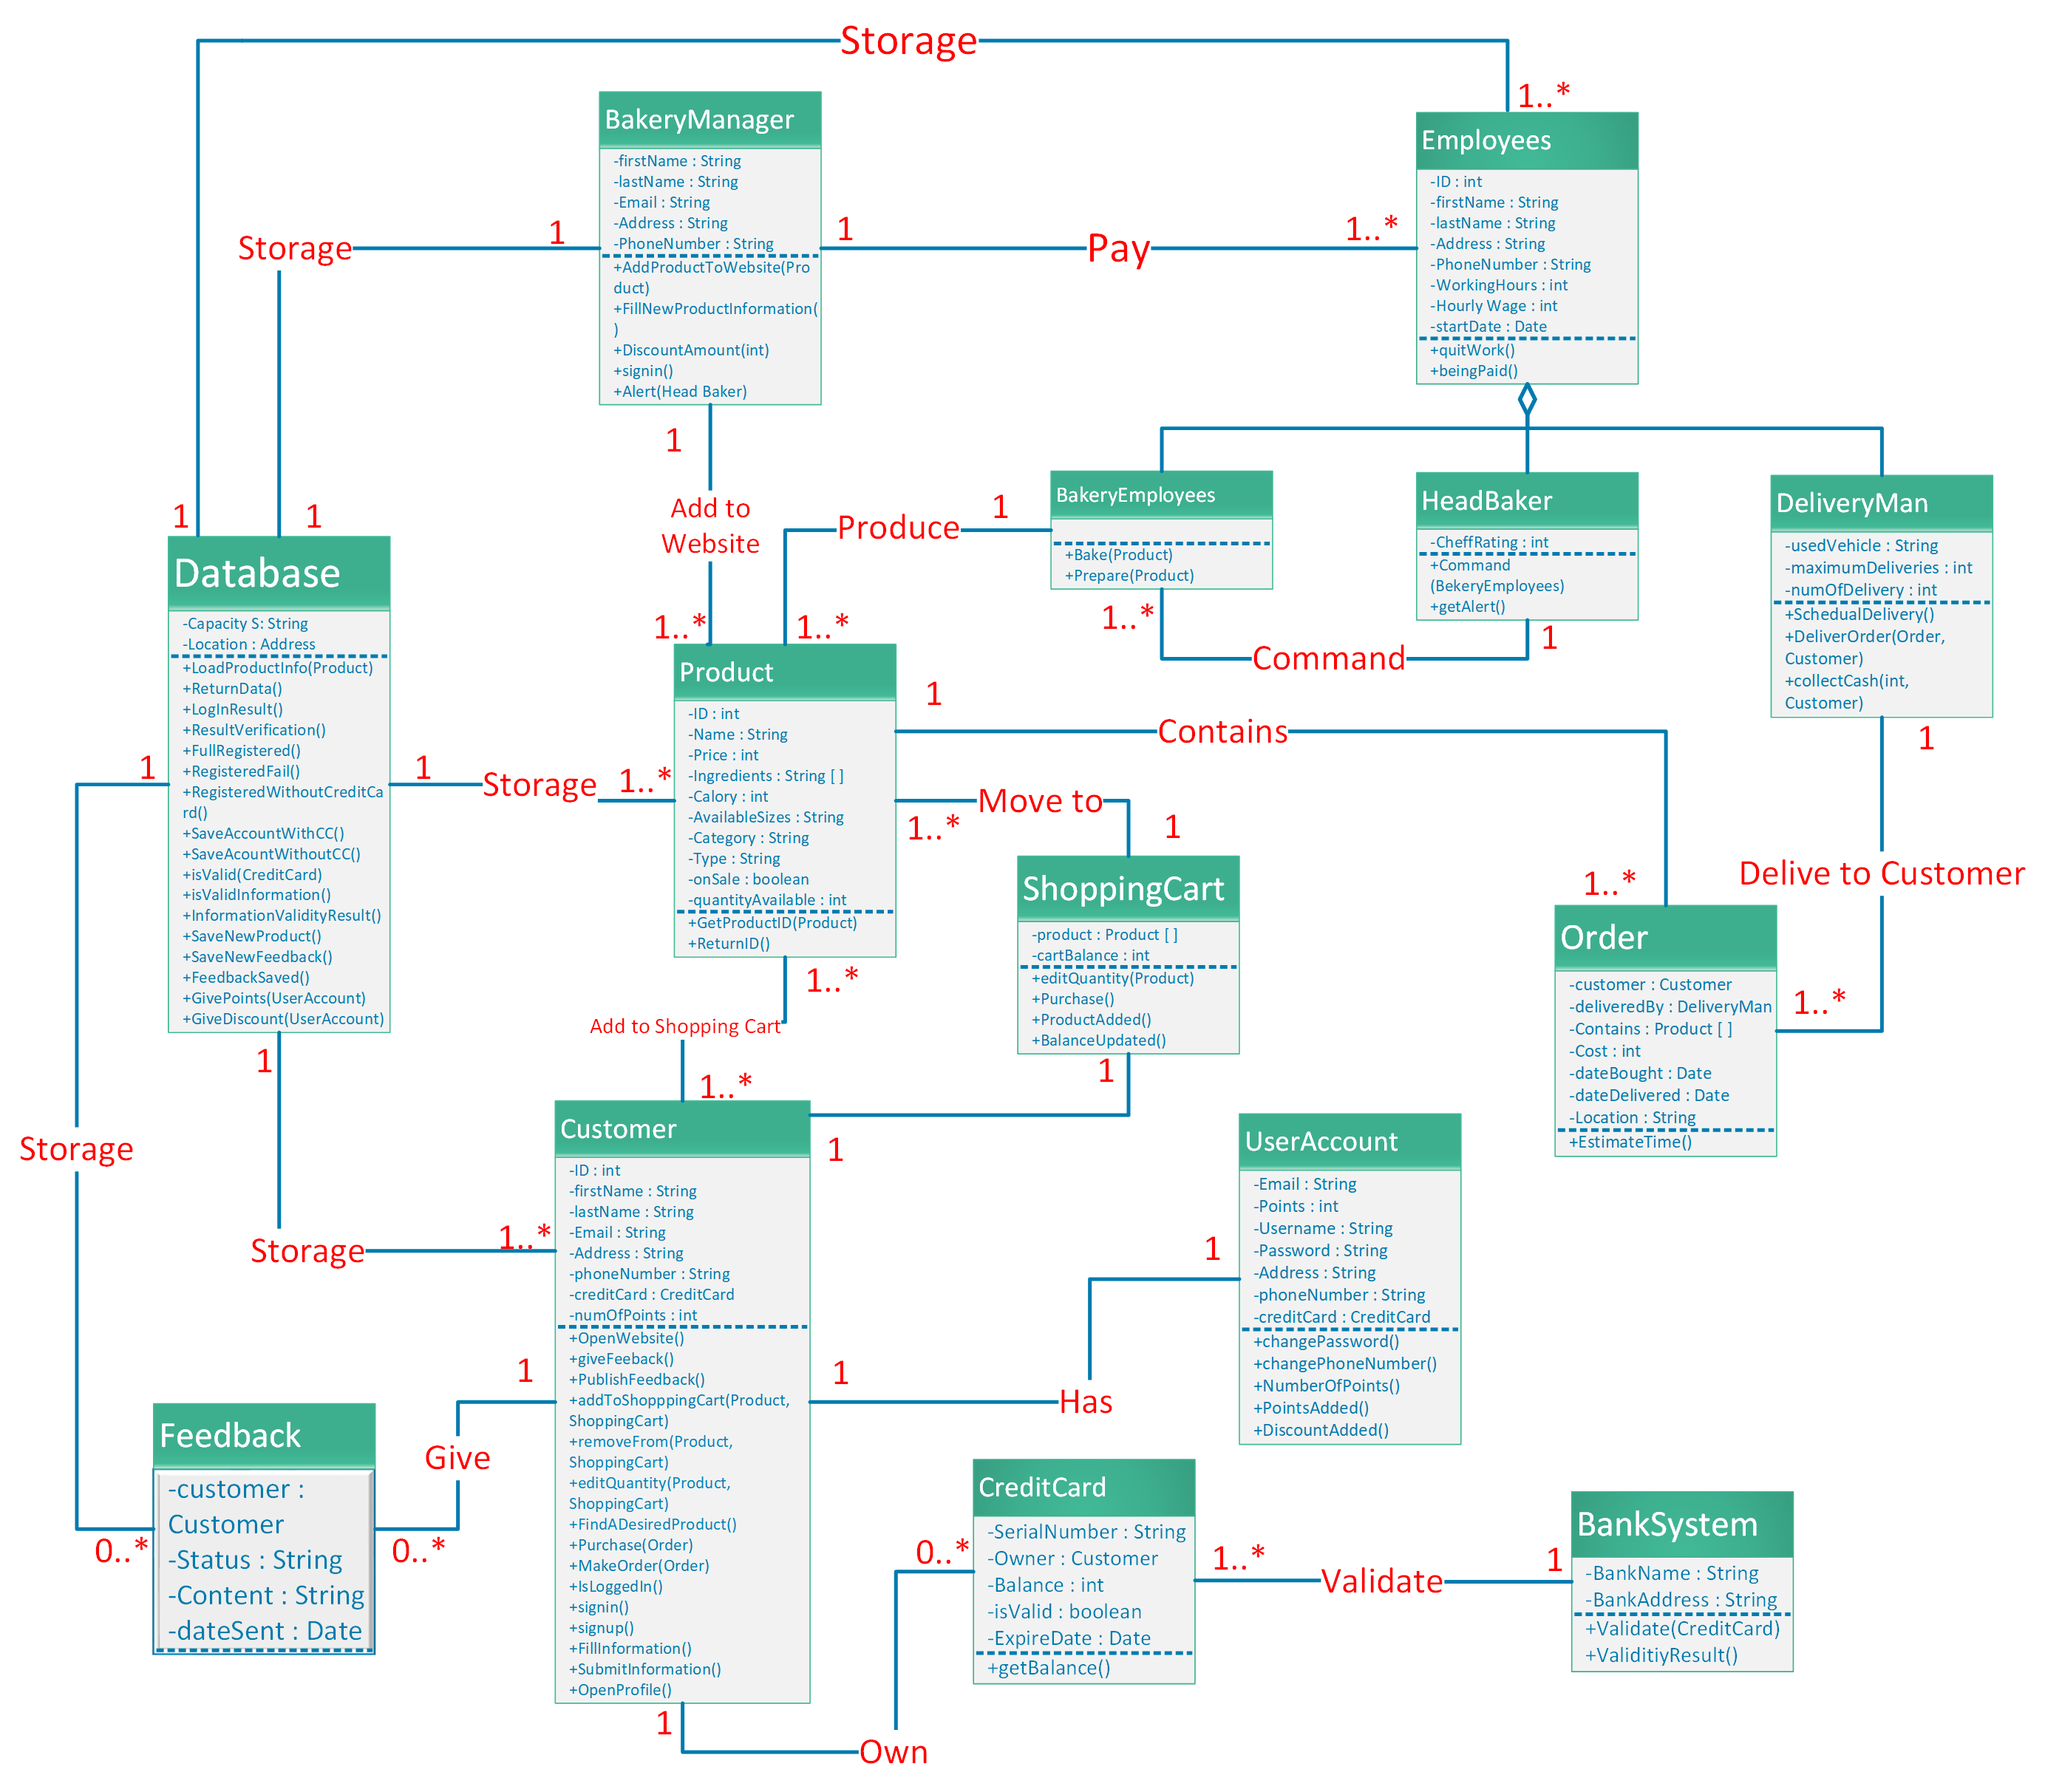
Detailed Class Diagram

Slide 10
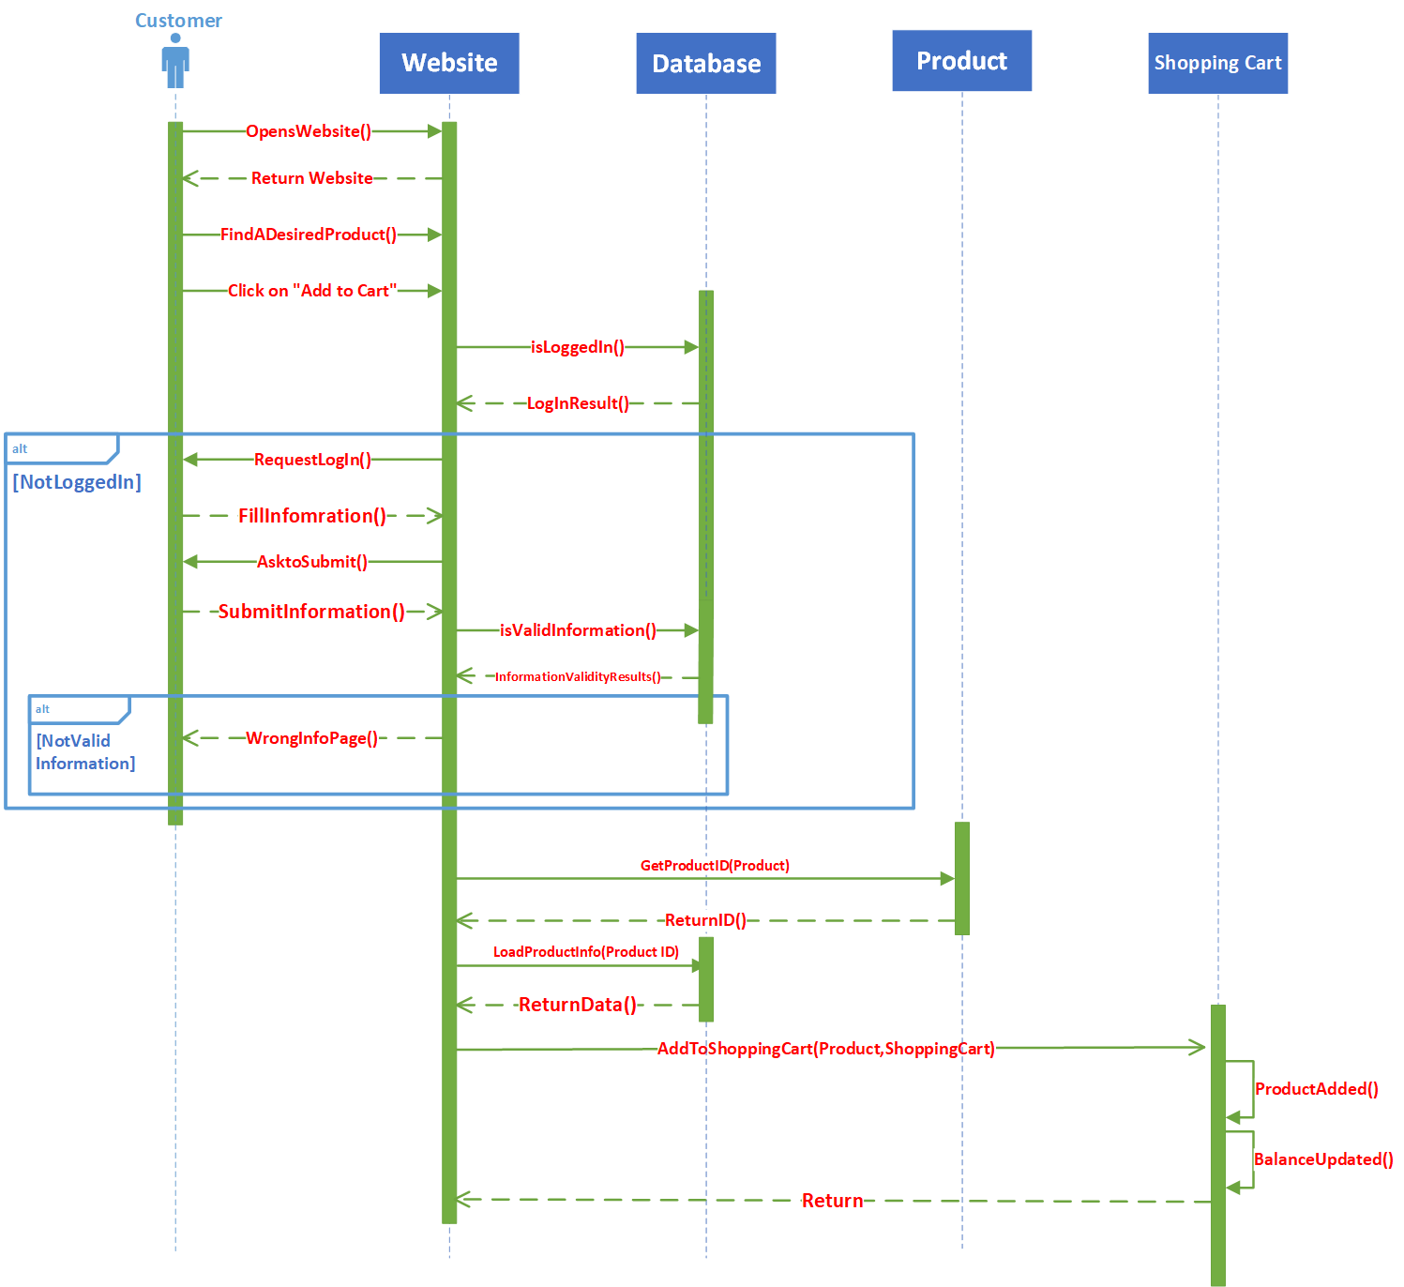
Detailed Class Diagram

Slide 11
Design Goals
General Goals:
High cohesion: our system will put related classes and methods together.
Low coupling: our system will use models that are independent of each other, in which any change in one component will almost has no effect on the other components.
Specific Goals:
Reliability: our system will always have a backup in case of any system failures and will be up and running within a few minutes in case of any failure.
User-friendly: our system will be easy to use by all types of customer on the first try.
Security: our system deals with money and sensitive data are used, like credit cards data and other, so high level of security is needed to keep all data safe.

Slide 12
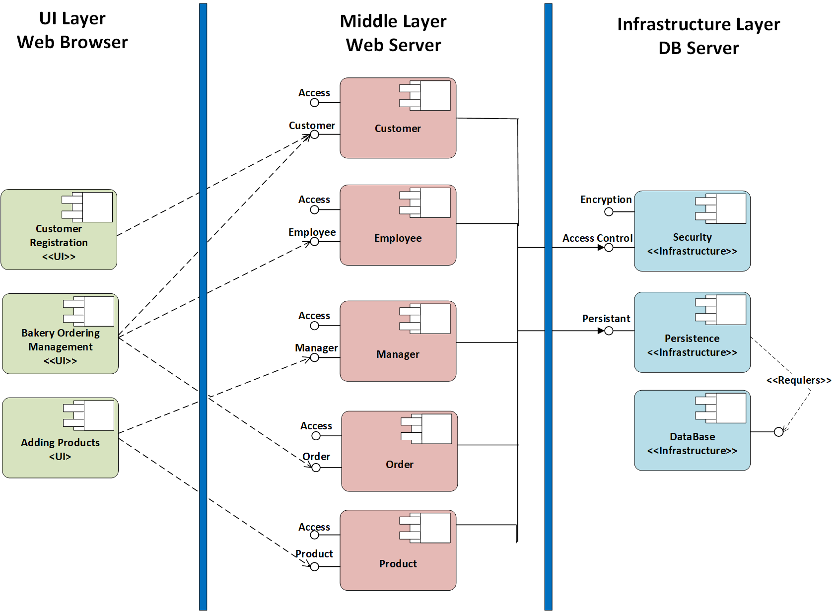
Architecture Diagram

Slide 13
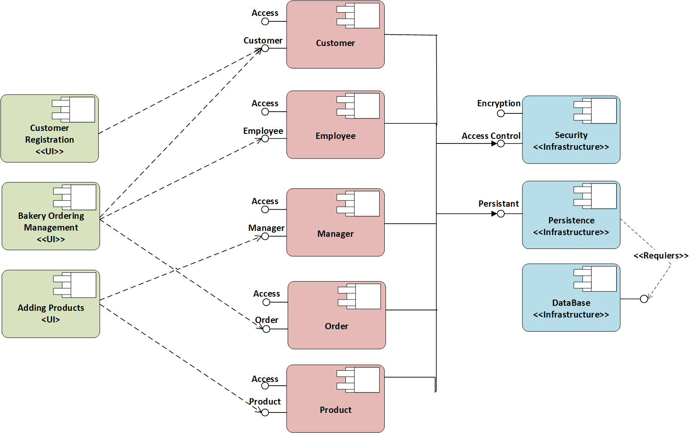
Component Diagram

Slide 14
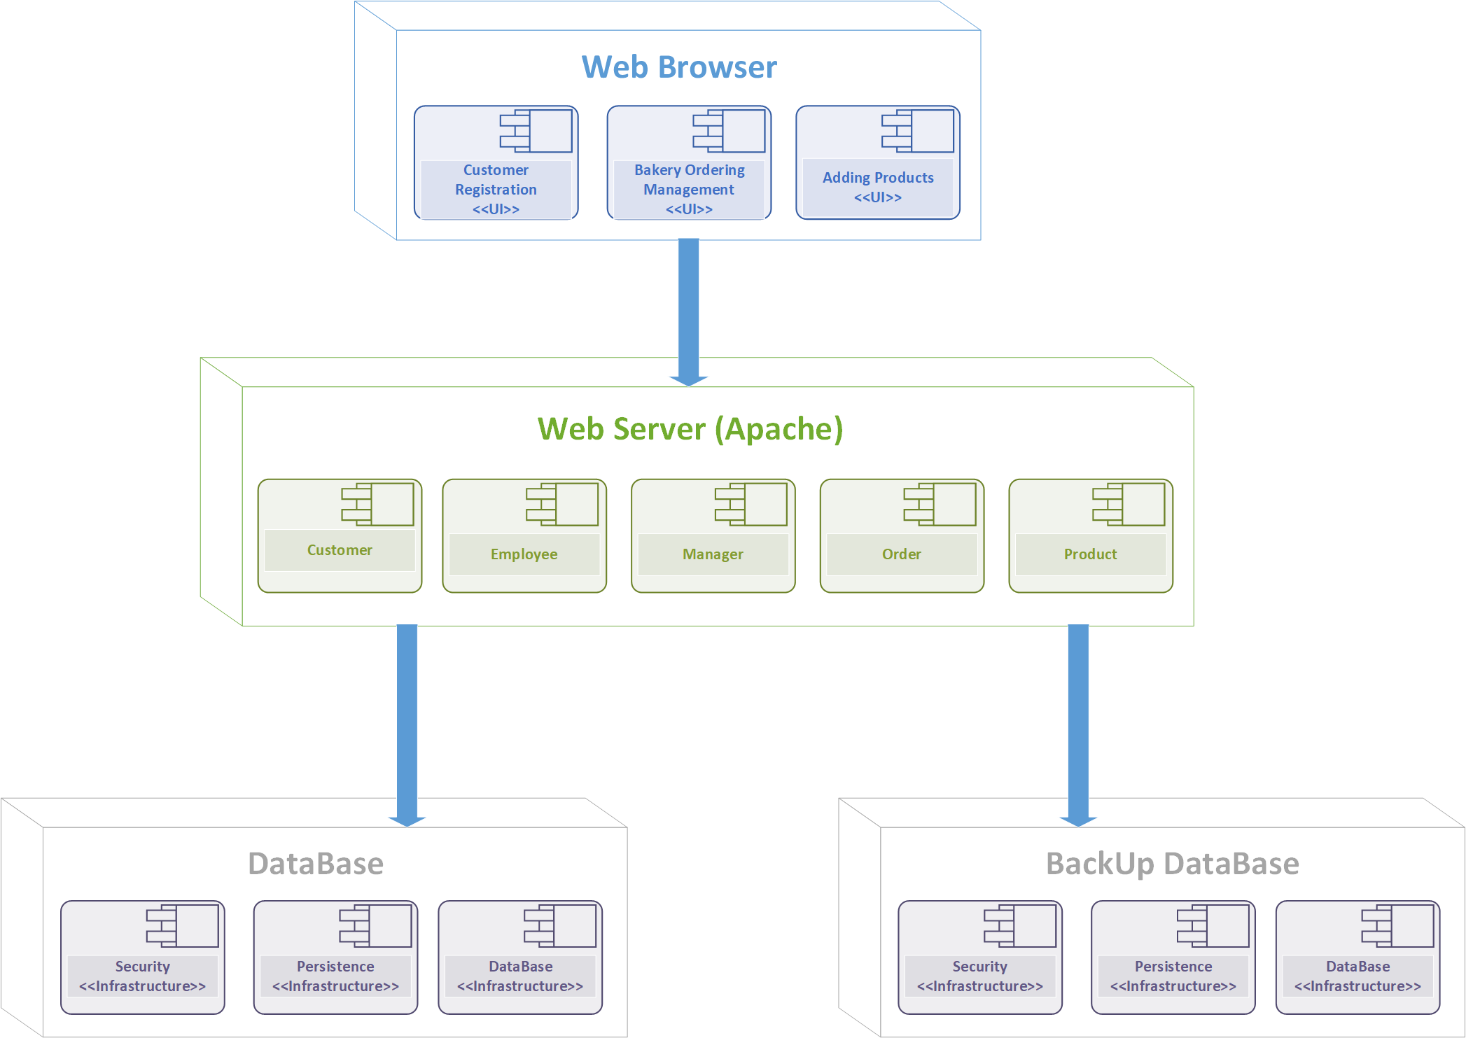
Deployment Diagram

