Slide 1
Faculty of Engineering and Technology Department of Computer Science Software Engineering COMP433 Final Group Project Presentation
Instructor: Prof. Adel Taweel
Date: December 23, 2019

Slide 2
Group Name: OutOfIndex
Group Number: G1
Group Members: Simon Asmar: 1162643. Sabry Alawy: 1162074. Laith Marzouka: 1160827. Layth Abufarhah: 1162636.
Role of Each Member: Project Manager: Simon Asmar. Secretary: Sabry Alawy. Technical Architect: Laith Marzouka. Programmer: Layth Abufarhah.

Slide 3
Business description
We are a flight booking company that operates and find the best deals on flights in all of Europe and the middle east. We work with international banks to operate our business. Our decisions are made by our Management team that is dispersed internationality and there are weekly meetings that take place, where we set goals and check on the progress of each department using dashboards. Our main source of income is booking flights for customers.
We are looking to develop a software that can help us cope up with the fast paced market. We would like to make it easier for our customers to look and use our services, easier payments and processing of international payments (to help expand our costumer base), multi language support and aid with the management of the employees on the flights.

Slide 4
Use case diagram

Slide 5
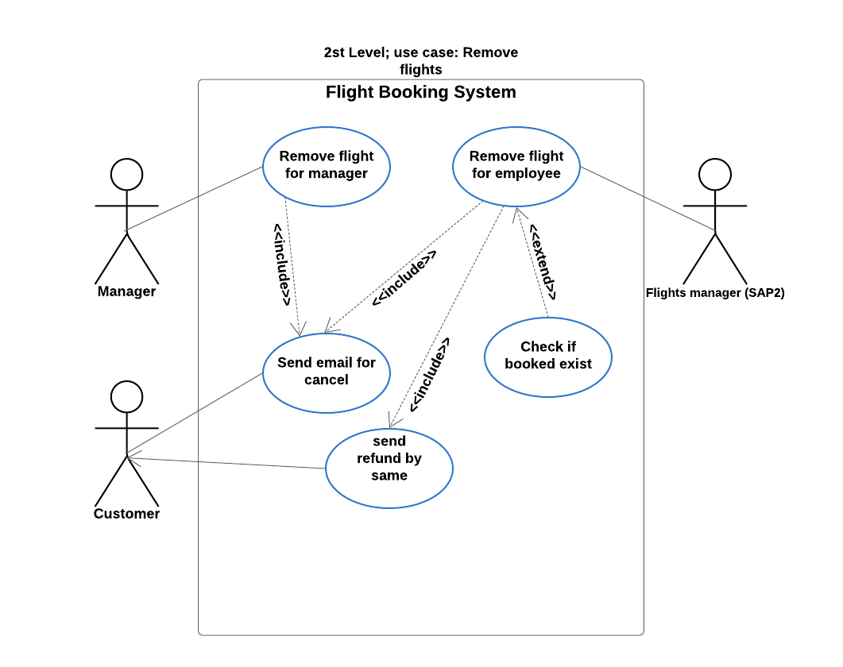

Slide 6
Activity diagram

Slide 7
Overall Analysis Class Model

Slide 8
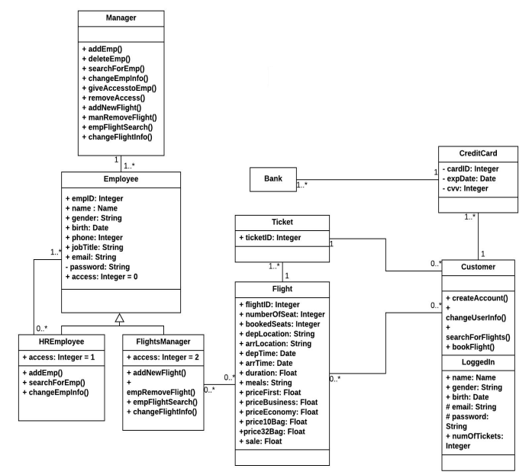
Overall Detailed Class Model

Slide 9
Sequence diagram

Slide 10
State diagram

Slide 11
Design Goals
Goal 1: High Cohesion We shall try keeping the classes and methods that are related to each other in a single place so that they form a logically single, atomic component. As an example, we combined the search engine along with the booking and payment functionalities in one component since they are highly dependent.
Goal 2: Low Coupling We shall try separating unrelated classes and methods as much as possible to make a single unit independent from others by minimizing the number of connections between two or more component. As an example, we separated the employee component into two individual components (HR, flight manager) since they work independently and irrelative to each other.
Goal 3: Robustness Our project is critical to the customer’s profit and any failure shall cost them money and question their reliability (data lost/manipulated ... etc.). So, our system must be as failure-tolerant as possible to all situations of failure. The servers used will be of good quality, and a back-up web and database servers which are located in a different place shall be provided as well.

Slide 12
Overall architecture

Slide 13
Component diagram

Slide 14
Deployment diagram

Slide 15
Questions?

Slide 16
The End

