Slide 1
Meals Online System
Ahmad Salameh
Rinad Lahlooh
Ehab Amriah
Ahmad Dar Khalil

Slide 2
Outline :
User requirements
Usecase Actors analysis
Usecase diagram
Activity Diagram

Slide 3
User requirements
1. Website shall has four categories that are for :
  A. Breakfast meals.
  B. Lunch meals.
  C. Dinner meals.
  D. All other dishes we have including sandwiches with Drinks, dessert and snacks.
2. The site shall give the user search field to search about any meal easily.
3. Each meal in each category shall be with its price, a brief description and offers it may has (for school, employee etc.).

Slide 4
4. The website shall ask people who will use it to sign up before making their order.
5. The payment methods are:
  A. When we deliver their orders to them not before that.
  B. Pay online.
6. The registration form will ask user to enter his name, phone number, his identity and the address the user wants us to deliver meals. In the home page, we want a brief description about us and some contacts details.

Slide 5
Usecase Actors :
Manager: This actor represents someone who can access the whole system with user name and password, add meal , remove meal, and modify meal information.
User: This actor represents someone who can access the whole system with user name and password, view available meals, search for meal , and reserve any meal .

Slide 6
Waiter : this actor represents someone who is added to the system by the manager , displays all his reservations, every meal is sent, it puts it received, update status for any meal (This meal reserved or not), and he also deal with any reported problems related with the system and redirect them to IT stuff.
Bank: if the user choose payment through Visa Card,, this actor validate vise card .

Slide 7
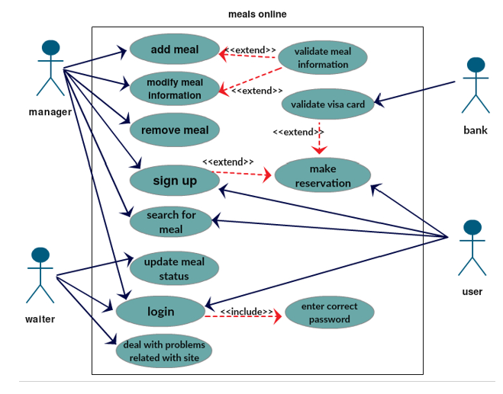
Usecase diagram :

Slide 8
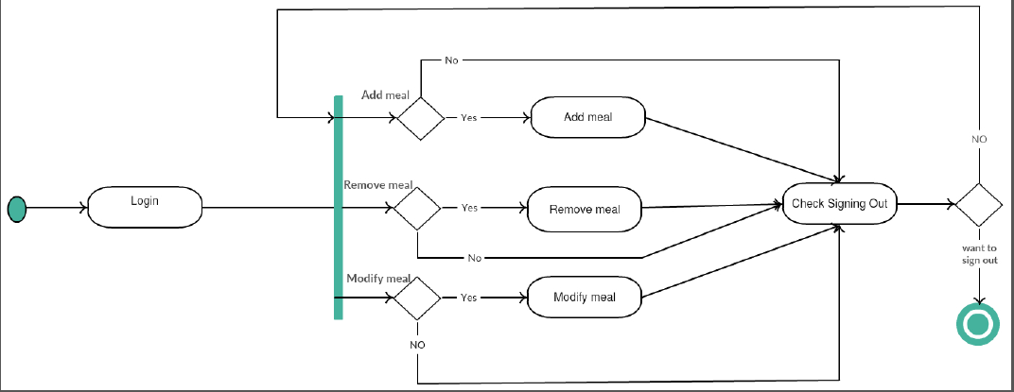
Activity Diagram (Manager point of view )

Slide 9
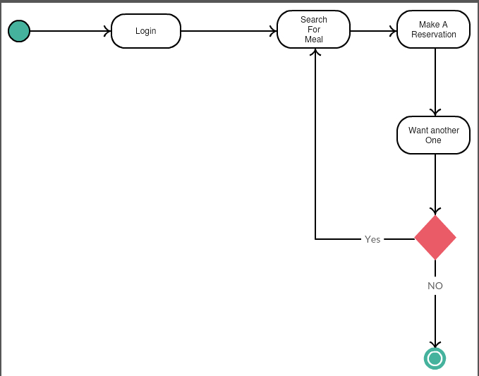
Activity Diagram (user point of view )

Slide 10
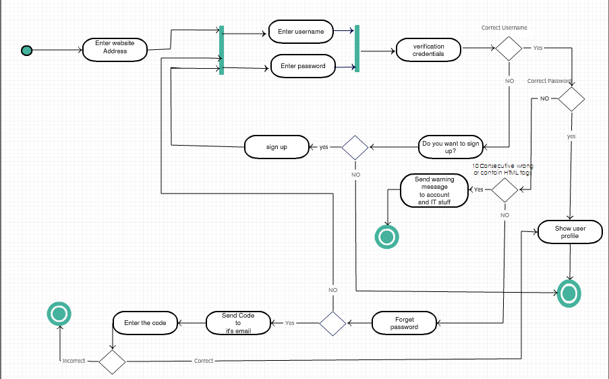
Instance Activity diagram (login)

Slide 11
