Slide 1
Computer Science Department
Second Semester 2017/2018
Instructor: Adel Taweel
Comp433 – Software Engineering
Presentation – Developer Group – G1
Students:
Maryam Shaheen #1140427: Manager
Nourhan Abu Sharbak #1150640: Secretary
Eman Ghazawneh #1152278: Technical architect
Ahmad Thabet #1150312: Programmer
Sanaa Bader #1151763: Tester

Slide 2
Introduction Car Insurance Broker - Business description
This system proposes easier management policy between the broker; Who owns the business system and works with the Insurance company, and the customer; Who wants to buy an insurance for his car. Our system must specify three main components, the broker details, the customer details and the insurance policy details.
The system must give a general information about the broker including his name, insurance company/companies working with, email, mobile number, and a certification from all companies working with.
The customer details must be filled for every new customer including his name, family name, gender, age, car/cars licenses, Email, phone number, SSN (social security number)/passport number, address, post number, password (to log-in to his online account), car/cars model that are needed to be insured and a visa card for online payment. Also, we need an annually update for the customer information.
Also, an insurance policy details are needed to avoid any misunderstanding between the customer and the broker and the customer must agree to all policies the broker provides.

Slide 3
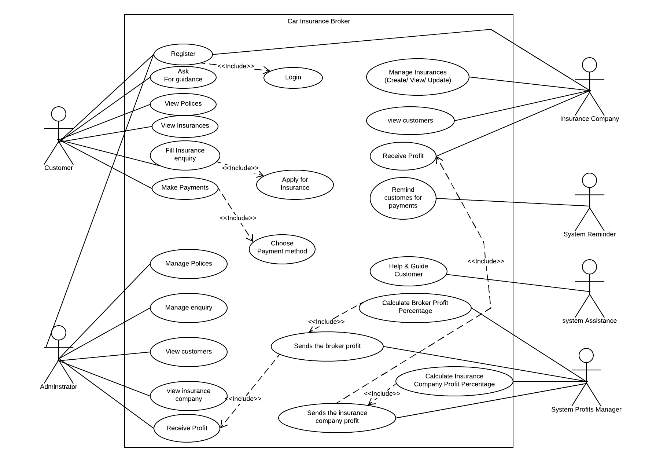
Overall Use Case Diagram

Slide 4
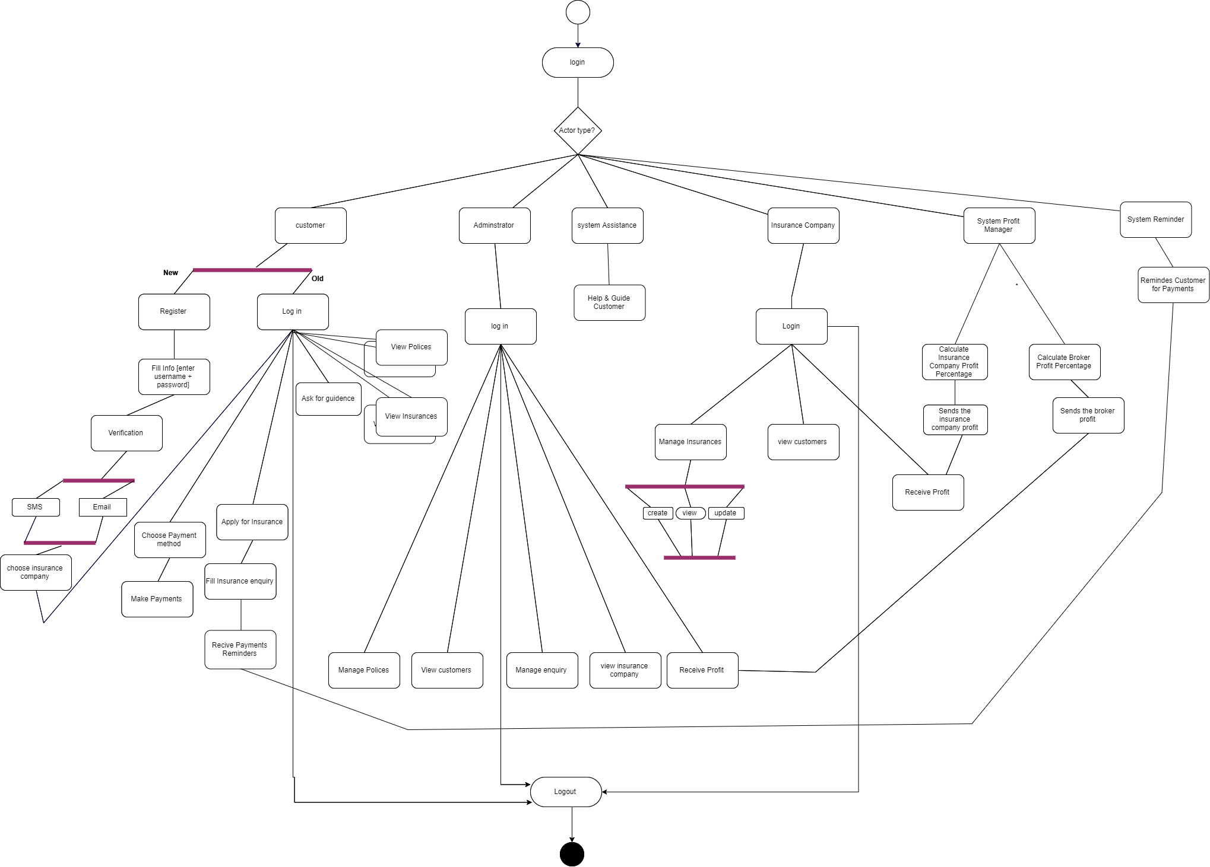
Overall Activity diagram

Slide 5
1- System Class modelling and Analysis
system analysis CLASSES and description
Assistance: assistance responsible for help and guide the user/customer of the system in any issue.
Employee: This class represents a person who can register to the system, create insurance, review insurance, view customers, and he/she can change his/her password and profile settings after logging in.
Reminder: This class represents someone who reminds the customer of the deadline for payments.
Insurance Company: This class represents someone who registers on the system, manage customers, manage payments, also he/she can manage policies, and change his password and profile settings after logging in.
Admin: This class represents the Administrator of the system, it has all of his information, and he is allowed to manage stuff such as, enquiries and policies in addition to receive profits.
Customer: This class represents someone who registers on the system, see and ask for car assurance, search for policies and view them, also he/she can ask for guidance for how to use the system, change his password and profile settings after logging in. And after choosing assurance, he can pay cash or by visa card, also he can communicate with the assurance company.

Slide 6
ANALYSIS CLASS model

Slide 7
DETAILED CLASS model/Diagram

Slide 8
OBJECT diagram

Slide 9
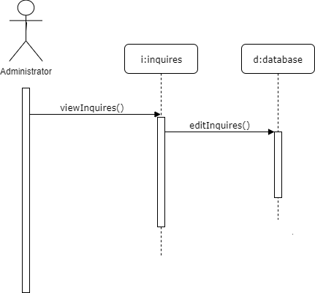
2- System Sequence & State modelling and Analysis
SEQUENCE diagrams
1- Admin view and edit inquiries sequence diagram (by Ahamad)

Slide 10
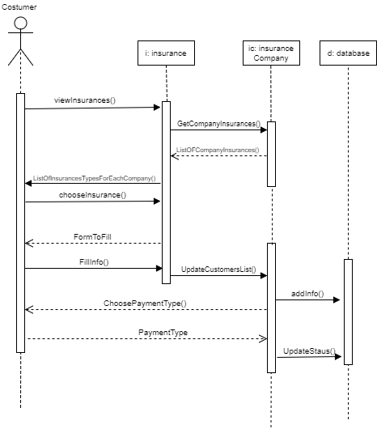
2- Customer applying for insurance sequence diagram (By Maryam)

Slide 11
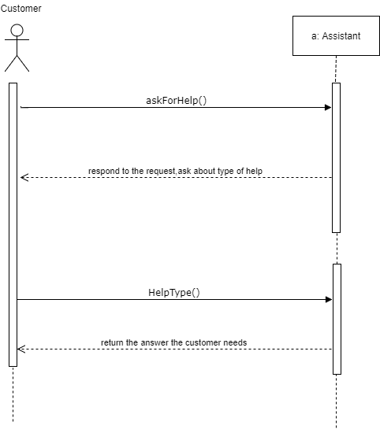
3- Customer asking for assistance sequence diagram (By Sanaa)

Slide 12
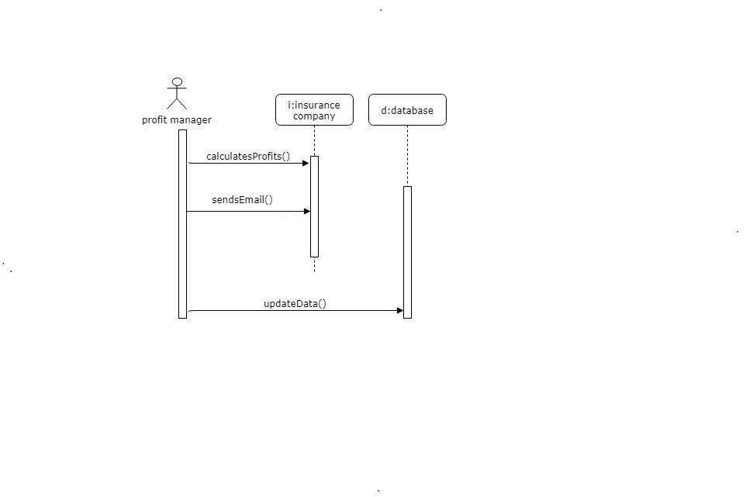
4- Profit manager for insurance company sequence diagram (By Nourhan)

Slide 13
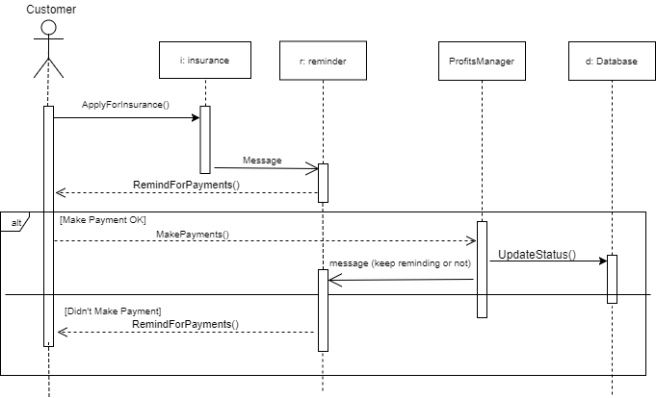
5- System reminder sequence diagram (By Eman)

Slide 14
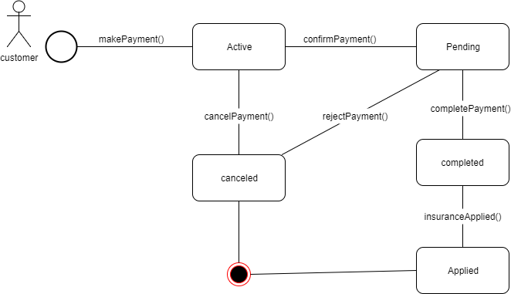
One STATE diagram (By Ahmad)

Slide 15
System and architectural Design
Description of design goals (By Eman)
General Goals:
High cohesion: Classes that interact to perform a certain function are placed together in one component that provides the service of said function.
Low coupling: If a class has interactions that relate to different components, copies of that class are made and distributed among the components so as to lower the rate of interaction between them
Specific Goals:
User friendliness: Achieved by providing the customer with several user interfaces.

Slide 16
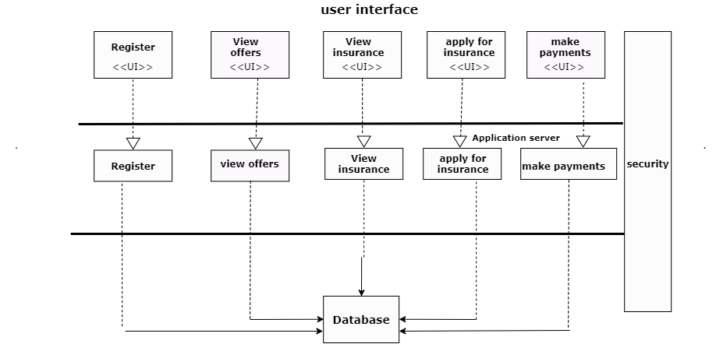
Architecture diagram (By Nourhan)

Slide 17
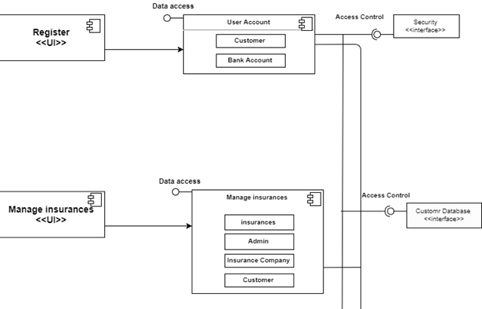
Component diagram (By Maryam)
To be continued →

Slide 18
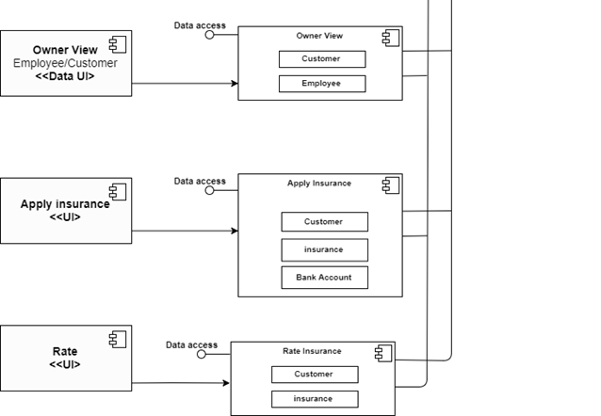
Cont.

Slide 19
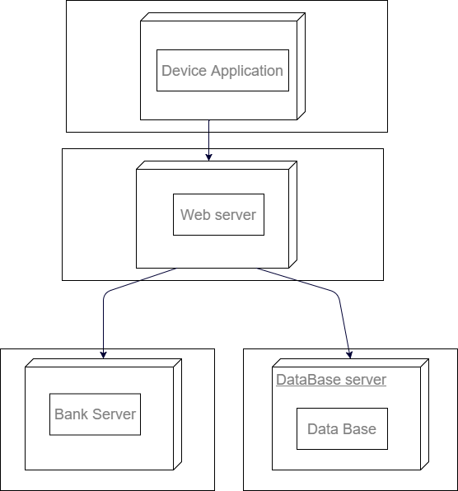
deployment diagram (By Sanaa)

Slide 20
Thank you for listening

