Slide 1
Introduction to Computer
Yafa Nimer Ahmad Abu Layya.
1201212.

Slide 2
Jaffa city
Jaffa is an Arab city located in the occupied state of Palestine. It is considered one of the oldest cities on the Palestinian coast located on the Mediterranean Sea, knowing that it is 7 km south of the mouth of the Auja River, and 60 km northwest of Jerusalem. Jaffa occupies a geographical area It is estimated at 17.51 ​​km2, of which 1.38 km2 was confiscated by the Jews, and this area was used; For construction, housing, and agricultural purposes.
I love Yafa city

Slide 3
The name
As for the name of the city, it has been fixed throughout the ages, with some distortion; It was known in the Pharaonic, Greek and Roman eras as (Juba, or Yuba), and the Arabs and Muslims mentioned it as (Yafa); An indication of the beauty it has been known for since its inception.

Slide 4
Inhabitants of Jaffa
The population of Jaffa at the beginning of the 20th century was approximately 40,000, with Arabs making up four-fifths of them.
In the thirties of the 20th century, the population nearly tripled; Where it reached about 150,000 people, and with the increase in the number of Jewish immigrants to Jaffa.
The beginning of the nineties of the 20th century to about 350,000 people.
The city’s population by 2009 amounted to about 400,000 people, of whom 15,800 were Arabs.

Slide 5
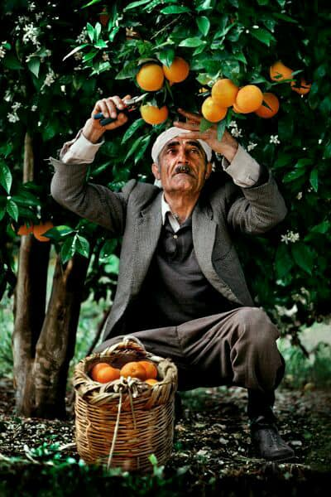
Yafawi ya Bordaqan: Some history of the orange of Jaffa
The Jaffa orange tells a lot about its history. Its history is its history, a determinant of the features of its social and economic life, and a distinctive mark in the memories of its people and their personalities. In later years, many types of oranges appeared, and with him the journey of prosperity of the Jaffa orange began, and he became a permanent visitor to European countries.

Slide 6
The End
The Jaffa orange is the scent of the return that was robbed by the occupation, we will return one day to the orchards, and the time will come to pick the oranges, we will eat it one day with loved ones and friends in the port of Jaffa, We will row in the sea and catch fish, and we will sing what Fairuz sang:
ودخلناها مينا يافا
يا طيب العَوْدِ إلى يافا
وملأنا الضفة أصدافا
يا أحلى الأيام بيافا
كنّا والريح تهب تصيح نقول سنرجع يا يافا
واليوم الريح تهب تصيح ونحن سنرجع يا يافا
وسنرجع نرجع يا يافا وسنرجع نرجع يا يافا
The conclusion

