Slide 1
Introduction to computer
Mohammed Assi
1200975
Section1

Slide 2
Artificial intelligence (AI)
Artificial intelligence: is the simulation of human intelligence processes by machines, especially computer systems. Specific applications of AI include expert systems, natural language processing, speech recognition and machine vision.
Weak AI systems include video games such as the chess example from above and personal assistants such as Amazon's Alexa and Apple's Siri .You ask the assistant a question, it answers it for you. Strong artificial intelligence systems are systems that carry on the tasks considered to be human-like.
Artificial intelligence (AI)

Slide 3
The Name
It is considered that humans intelligence is real intelligence. Human beings are the creator of machines and giving them the ability of decisions making. Also, machines and robots cannot become exactly like humans because we are having a very complex body structure. This is the reason Artificial Intelligence got its name.

Slide 4
Chart showing how artificial intelligence is growing
Much has been made of China’s rising AI prowess (see “China’s AI awakening”) and its growing rivalry with the US. As the data shows, Europe is also a huge hub of AI activity. But it seems that three main centers of power are emerging.

Slide 5
Why is artificial intelligence important?
AI is important because it can give enterprises insights into their operations that they may not have been aware of previously and because, in some cases, AI can perform tasks better than humans. Particularly when it comes to repetitive, detail-oriented tasks like analyzing large numbers of legal documents to ensure relevant fields are filled in properly, AI tools often complete jobs quickly and with relatively few errors.
Today's largest and most successful enterprises have used AI to improve their operations and gain advantage on their competitors.

Slide 6
SmartArt
Artificial intelligence
Human
Computer
Companies
A graphic showing that artificial intelligence connects humans and computers to serve companies, and that artificial intelligence can be used by everyone.

Slide 7
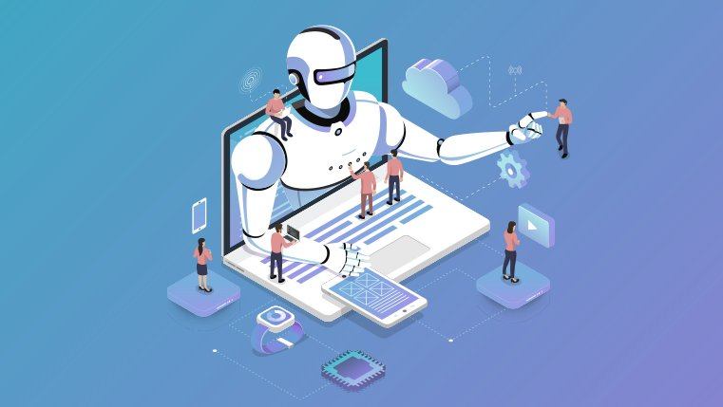
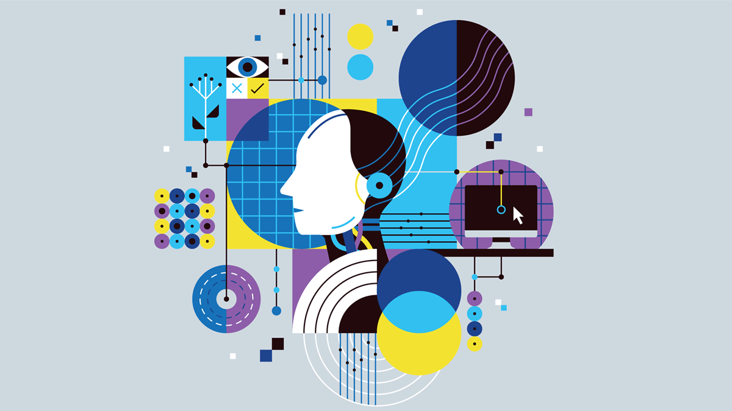
AI

Slide 8
references
https://searchenterpriseai.techtarget.com/definition/AI-Artificial-Intelligence
https://www.investopedia.com/terms/a/artificial-intelligence-ai.asp
https://intellipaat.com/community/36262/why-is-artificial-intelligence-called-artificial-intelligence
https://www.technologyreview.com/2018/12/12/138682/data-that-illuminates-the-ai-boom/
The End

