Slide 1
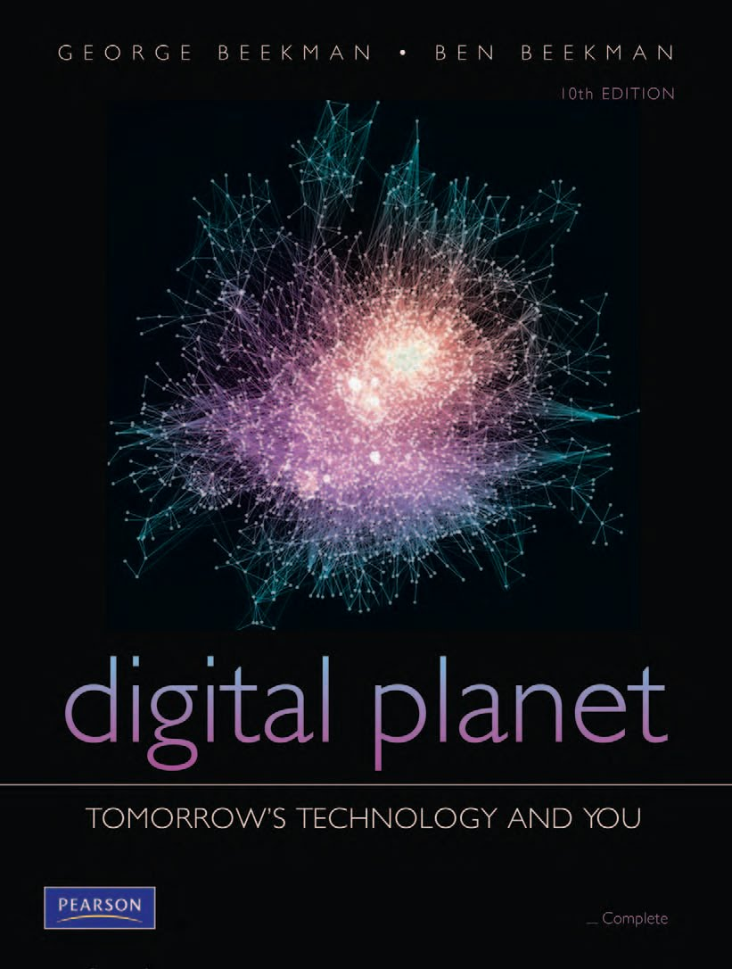
Digital Planet:
Tomorrow’s Technology and You
George Beekman • Ben Beekman
Tenth Edition
Copyright © 2012 Pearson Education, Inc. publishing as Prentice Hall
Notes:
‹#›

Slide 2
Digital Planet: Tomorrow’s Technology and You
Chapter 1
Exploring Our Digital Planet
Copyright © 2012 Pearson Education, Inc. publishing as Prentice Hall
Notes:
‹#›

Slide 3
Chapter 1 Objectives
Describe digital technology’s critical role in our lives
Discuss several key trends in the evolution of computers and digital technology
Describe the major types of computers and their principal uses(استخدامات رئيسية)
Explain how the growth and evolution of the Internet is changing our lives

Slide 4
Objectives (cont.)
Explain how our information age differs from any time that came before
Discuss the social and ethical impact of information technology on our society

Slide 5
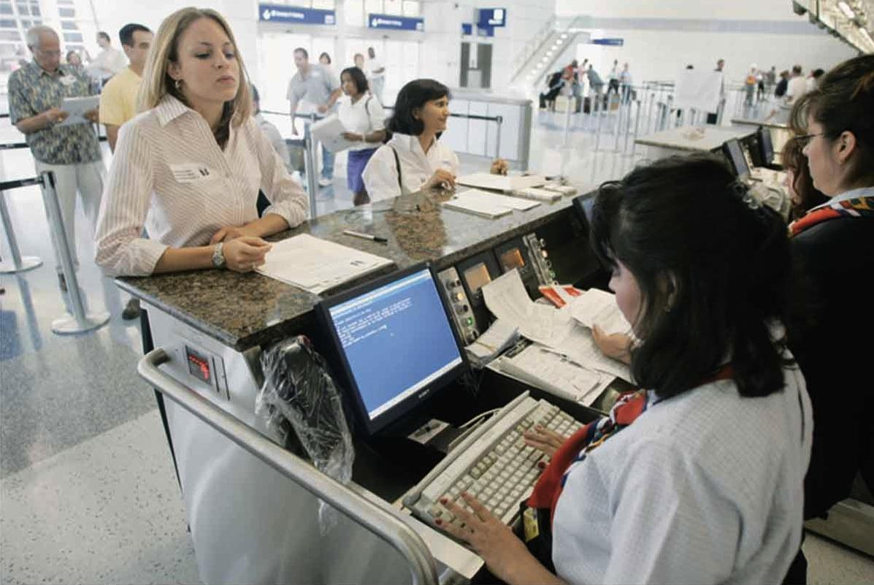
Living in a Nondigital World
Computers are everywhere.
Our lives are directly affected when they do not operate.
Computers have infiltrated(تسللت) our lives so we do not know how to function without them.
Notes:
What if no computers?

Slide 6
Computers in your daily life
How many of you do not have:
Email account? Facebook account? Viber? Whatsapp? Smart phone? PC? Laptop? Internet? 3G?
Why do you use them:
Learning? Communication & Socialization? Dating? Media & News? Shopping? E-intifada? Work? …..
What type of problems do you face:
Legal? Official? Social?
What is the difference between you and your dad/mam?

Slide 7
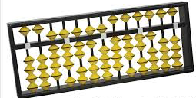
Computers in Perspective(انطباع،المنظور)
Computers have been with us for a short time but are built on centuries of insight(تبصر) and effort.
Early humans counted with fingers or rocks.
The abacus was used by Babylonians and Chinese for thousands of years.
By early 19th century, the need for more accurate calculating tools became evident(أصبح واضحاً).
Charles Babbage and Ada Lovelace imagined the construction of the Analytical Engine.

Slide 8
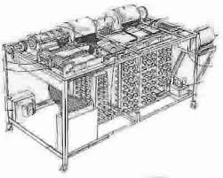
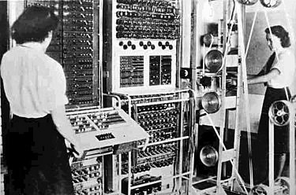
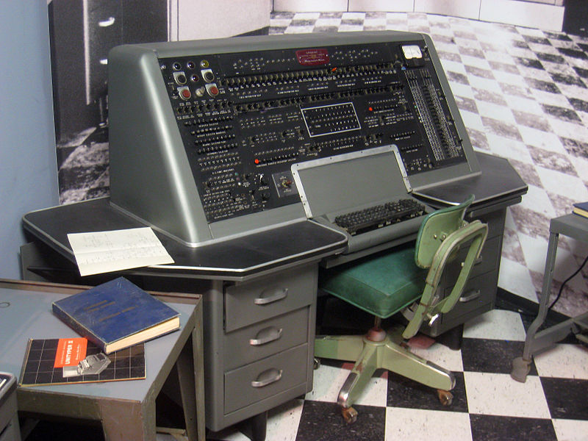
Computers in Perspective (cont.)
Brief history of computers
1939—Atanasoff-Berry Computer created
1943—Alan Turing developed Colossus
1944—Mark I completed to compute ballistics tables
1945—ENIAC completed
1951—UNIVAC I (the first general-purpose commercial computer) was delivered to the U.S. Census Bureau

Slide 9
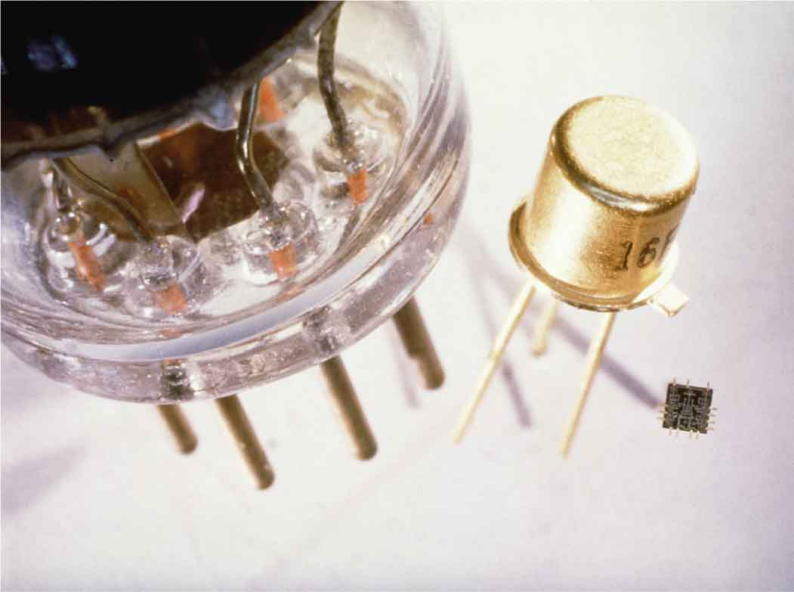
Computers in Perspective (cont.)
Computer hardware
Early computers used vacuum tubes.
Tubes were replaced by transistors.
By mid-1960s, more powerful machines were based on integrated circuits—small silicon chips containing hundreds of transistors.
A vacuum tube, a transistor, and an integrated circuit.

Slide 10
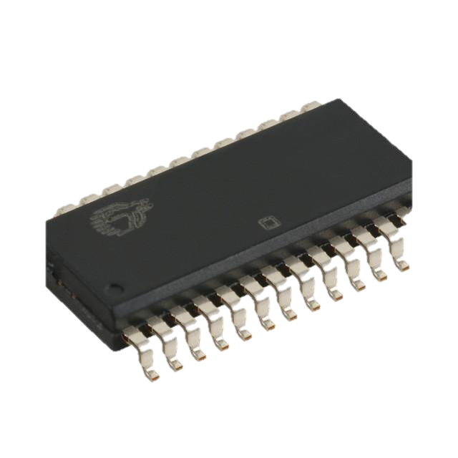
Computers in Perspective (cont.)
Benefits of integrated circuits (ICs)
Reliability (موثوقية): Less prone(أقل عرضة) to failure
Size (حجم): Single chips could replace entire boards
Speed (سرعة): Electricity had shorter distances to travel
Efficiency (كفاءة): Small chips used less electrical power and created less heat
Cost (تكلفة): Mass production techniques made it easy to manufacture inexpensive chips

Slide 11
Embedded Systems أنظمة مضمَّنة
Embedded system: A microprocessor used as a component of a larger system
More than 90% of microprocessors are hidden inside common household and electronic devices:
Thermostats, traffic lights, cars
Wristwatches, toys, game machines
TVs, camcorders, ovens
Anything powered by electricity—battery or house current—is candidate(مرشح) for microprocessor implant(زرع)
Notes:
Wristwatches

Slide 12
Personal Computers
Personal computer: Designed to be used by one person at a time
Tool for enhancing productivity, creativity, communication
Desktop computer has several components:
Tower (containing microprocessor and other components)
Monitor, keyboard, mouse, speakers
Some house all components in monitor casing

Slide 13
Workstations
Workstation: A high-end desktop computer with massive computing power.
Used for computationally intensive(الحوسبة المكثفة) interactive applications
Large-scale scientific data analysis
Line separating workstations and desktop computers becoming less distinct.

Slide 14
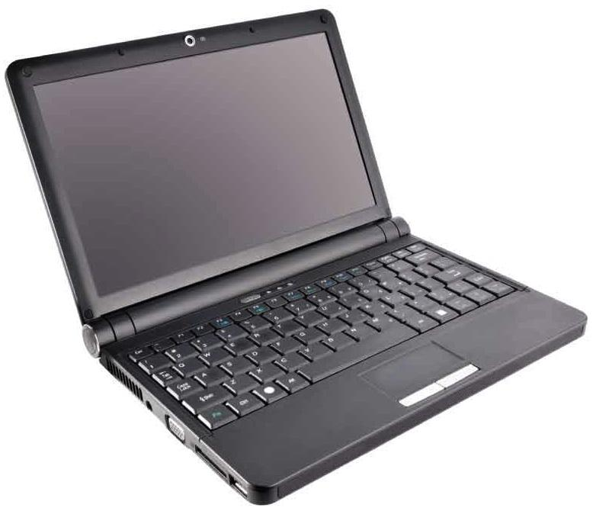
Portable Computers
Laptop computers—sometimes called notebook computers—designed for portability
Netbooks are extra-small, extra-light, no-frills computers

Slide 15
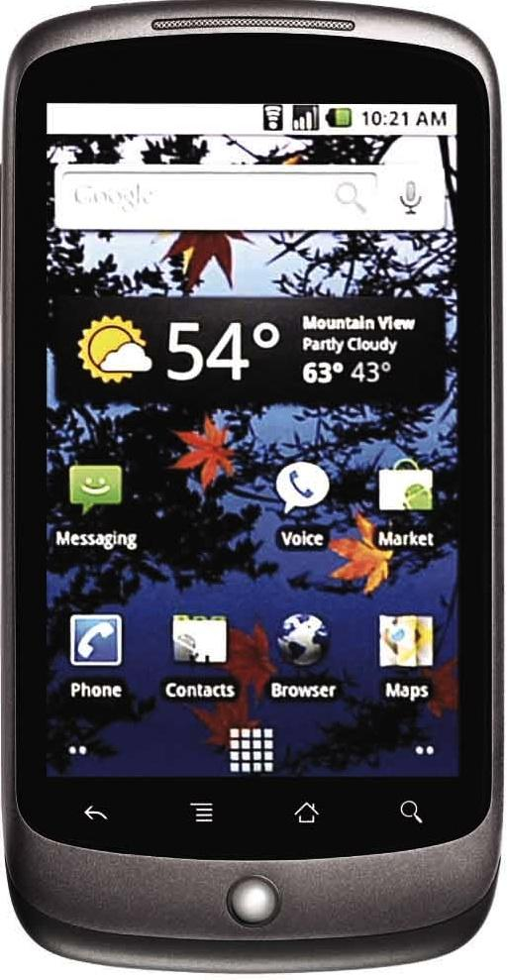
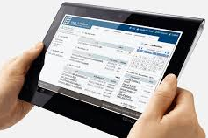
Handheld Devices
Personal digital assistants (PDAs)
Smart phones combine the functions of a phone, camera, PDA, game machine, and music/video player.
Tablet computers bridge the gap between smart phone and notebook/netbook PC.
Smart phone

Slide 16
Servers
Server: A computer that provides other computers connected to a network with access to data, programs, and other resources
Any desktop computer can be used as a server but some are specifically designed for this purpose.
Servers have faster processors, more memory, or faster network connections.
Often clustered together in groups to increase processing power

Slide 17
Computer Connections: The Internet Revolution
Internet: Work began on experimental network in the in late 1960s as it evolved it became known as the Internet.
In 1990s, software became more usable.
The Internet was transformed from text-only to include pictures, animation, sounds, and video.
The World Wide Web (WWW) became accessible to millions who connect through a Web browser.

Slide 18
Computer Connections: The Internet Revolution (cont.)
Growth of the Internet
Widespread email and Web use
Few million users in 1990s—about two billion users today
Internet’s population reflects population at large
More than half are now female
Areas with no Internet access are harder to find

Slide 19
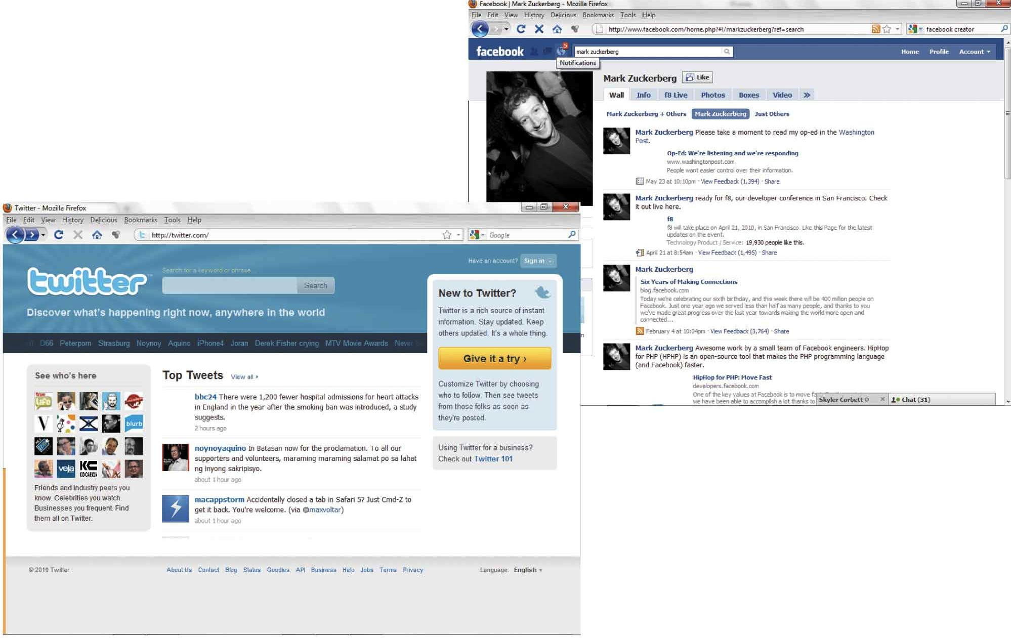
Computer Connections: The Internet Revolution (cont.)
Web 2.0 sites are built around contributions from Web users
My Space
Facebook
Twitter
YouTube
Google Maps

Slide 20
Into the Information Age
10,000 years ago, people learned to domesticate animals and grow their own food.
Agricultural age: Lasted until about 200 years ago
Industrial age: Advances in machine technology ushered(بشرت ، أعلنت) in this age
Information age: A convergence(جمع ، لقاء) of computer and network technology—where most people earn their living working with words, numbers, and ideas
عصر المعلومات، حيث اصبح الناس في دخلهم ووظائفهم يعتمدون على الحاسوب، وتعددت وتنوعت الوظائف والمهارات المتعلقة بالحاسوب

Slide 21
Living with Digital Technology
In 1943, Thomas Watson, Sr., declared that the world would not need more than five computers.
Since then, computers have evolved from massive, expensive, unreliable calculators into (mostly) dependable(جدير بالثقة), versatile(متعددة الجوانب والإستعمالات) machines.
Who could have imagined netbooks, iPhones, PlayStations, Google, Facebook, YouTube, Twitter, eBay, robot moon rovers, or laserguided “smart bombs”?

Slide 22
Phases of the Information Age
Institutional computing phase (حوسبة احتياجات المؤسسات), starting about 1950: large, expensive mainframes.
Personal computing phase (حوسبة احتياجات فردية), starting about 1975: millions of PCs joined mainframes.
Interpersonal computing phase (حوسبة احتياجات مجموعات من الافراد), starting about 1995: networks connected the PCs and mainframes.
Collaborative computing phase (حوسبة اجهزة متصلة بسحابة), starting about 2005: smart phones, tablets, and other digital devices join PCs on the Internet; migration to Internet “cloud”.

Slide 23
Explanations: Clarifying Technology
Computer hardware and software details change every few years.
Internet is evolving even faster.
Most of the underlying concepts(المفاهيم الأساسية) remain constant.
It is important to understand the basics to keep up with the changes.
تطور تكنولوجيا المعلومات يسير بسرعة هائلة جدا
يجب فهم اساسيات هذه التكنولوجيا للتمكن من فهم التكنولوجيا القادمة

Slide 24
Applications: Digital Technology in Action
Everyone can benefit from knowing the following:
Network applications
Word processing and desktop publishing
Spreadsheets and databases
Graphics and image processing
Audio, video, and multimedia
Programming and customized problem solving
Artificial intelligence(الذكاء الإصطناعي)
هذه تقنيات هامة يجب على الجميع فهم اساسياتها

Slide 25
Implications: Social and Ethical Issues
Potential risks of digital technology امور مرتبطة بتكنولوجيا المعلومات يجب فهمها
Threat to personal privacy (الخصوصية)
Hazards of high-tech crime (جرائم الكترونية)
Difficulty of defining and protecting intellectual property (حقوق الملكية)
Threat of automation and the dehumanization of work (استبدال البشر بالتكنولوجيا )
Abuse of information for political and economic power (الابتزاز الالكتروني)
Dangers of dependence on complex technology (الاعتمادية على التكنولوجيا)
Emergence of biodigital technology (التكنولوجيا الحيوية)

Slide 26
Computer Ethics
الأخلاقيات والحاسوب
Know the rules and the law.
Don’t assume that it’s okay if it’s legal.
Think scenarios.
When in doubt, talk it out.
Make yourself proud.
Remember the golden rule.
Take the long view.
Do your part.

