Slide 1
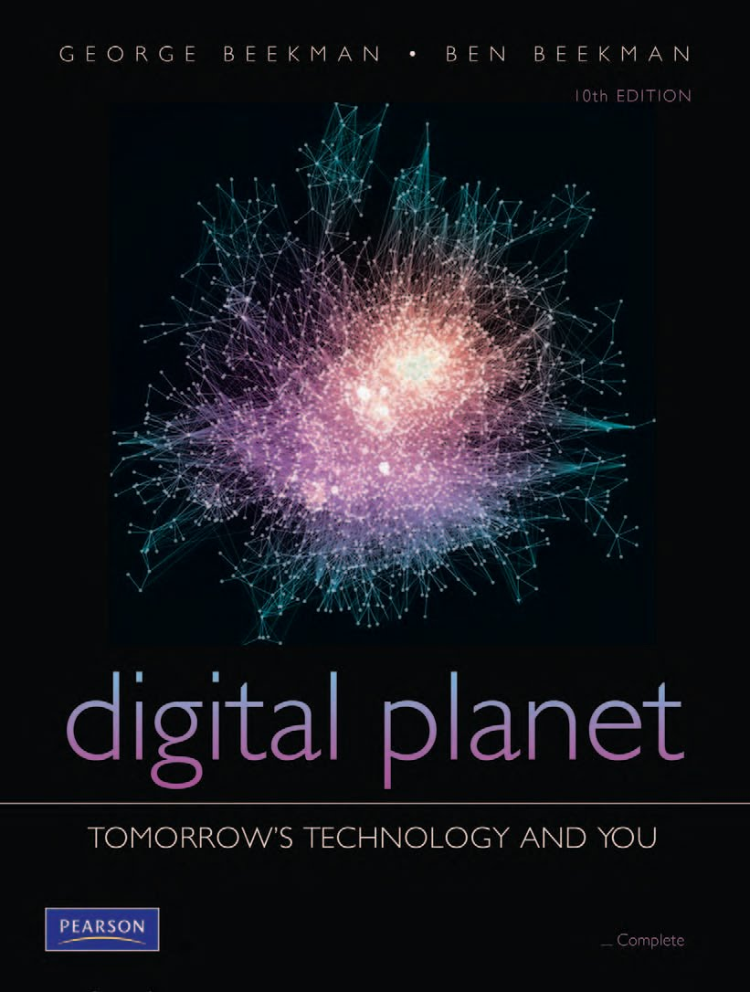
Digital Planet:
Tomorrow’s Technology and You
George Beekman • Ben Beekman
Tenth Edition
Copyright © 2012 Pearson Education, Inc. publishing as Prentice Hall
Notes:
‹#›

Slide 2
Digital Planet: Tomorrow’s Technology and You
Chapter 2
Hardware Basics
Inside the Box
Copyright © 2012 Pearson Education, Inc. publishing as Prentice Hall
Notes:
‹#›

Slide 3
Chapter 2 Objectives
Explain in general terms how computers store and manipulate information (تخزين البيانات)
Describe the basic structure and organization of a computer (معمارية الحاسوب الداخلية)
Discuss the computer system’s main internal components and the ways they interact (أجزاء الحاسوب)
Explain why a computer typically has different types of memory and storage devices (انواع الذاكرة)

Slide 4
What Computers Do
Four basic operations:
Receive input: Accept information from outside world
Process information: Perform arithmetic or logical operations on information
Produce output: Communicate information to outside world
Store information: Store and retrieve information from memory and storage devices

Slide 5
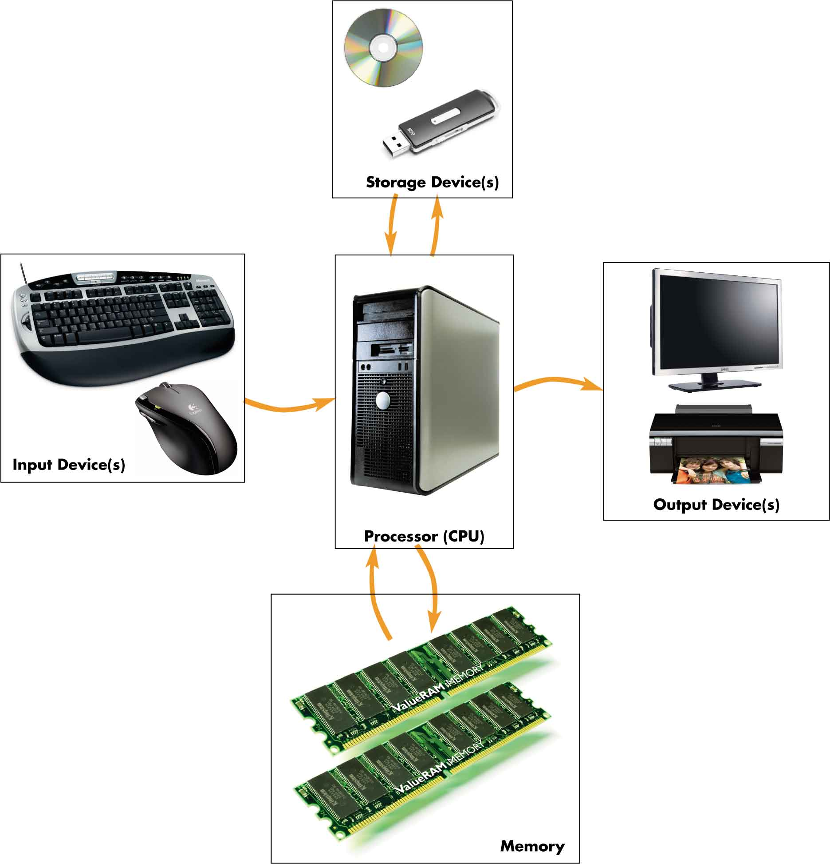
What Computers Do (cont.)
Hardware components
Input devices
Output devices
Microprocessor (CPU)
Memory and storage devices
Primary storage
Secondary storage
Peripherals

Slide 6
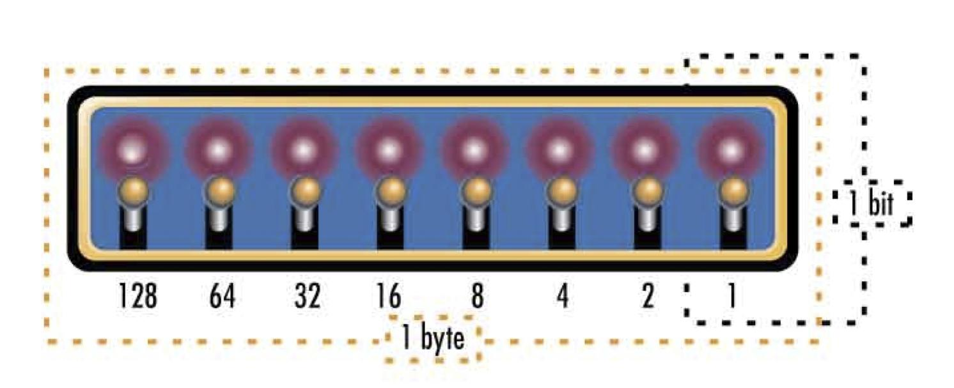
Bit Basics
Bit: From Binary digit
Smallest unit of information computer can process
Can have one of two values: 0 or 1
Byte
Collection of 8 bits
Can represent 256 different messages (256 = 2⁸)

Slide 7
Bits as Numbers
Denotes all numbers with combinations of 0s and 1s
Decimal numbers automatically converted to binary
Binary number processing hidden from user
Decimal | Binary | Decimal | Binary
0 | 0000 | 5 | 0101
1 | 0001 | 6 | 0110
2 | 0010 | 7 | 0111
3 | 0011 | 8 | 1000
4 | 0100 | 9 | 1001

Slide 8
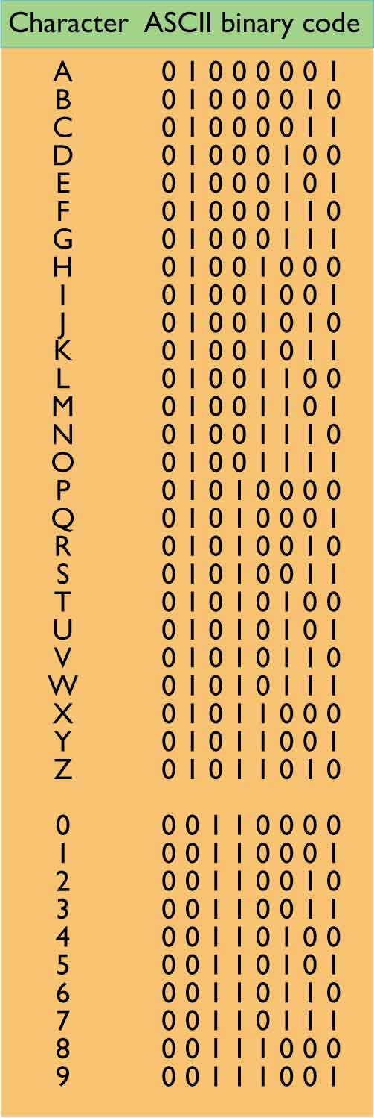
Bits as Codes
Codes represent each letter, digit, and special character
ASCII: Most widely used
Each character is a unique 8-­bit code
256 unique codes for 26 letters, 10 digits, special characters
Unicode: Supports more than 100,000 unique characters

Slide 9
The World’s Languages
ASCII character set was originally designed to include only English-language characters from 0 to 127
Unicode’s international standard character set allows for more than 100,000 distinct codes to include Chinese, Korean, Japanese, and Arabic characters

Slide 10
Bits, Bytes, and Buzzwords
Byte = 8 bits or one character in ASCII
Kilobyte (KB, K)
Megabyte (meg, MB)
Gigabyte (gig, GB)
Terabyte (TB)
Petabyte (PB)
≈ 1,000 bytes
≈ 1,000 KB or 1 million bytes
≈ 1,000 MB or 1 billion bytes
≈ 1 million MB or 1 trillion bytes
≈ 1 quadrillion bytes

Slide 11
The Computer’s Core: CPU and Memory
A digital computer is a collection of on/off switches designed to transform information from one form to another. بوابات المنطقية داخل الحاسوب لتحويل البيانات من شكل لاخر
The user provides the computer with patterns of bits—input—and the computer follows instructions to transform that input into a different pattern of bits—output—to return to the user.

Slide 12
The CPU: The Real Computer
CPU often called “processor” المعالج الدقيق
Performs transformations of input into output
Interprets and executes instructions in programs
Performs arithmetic and logical data manipulations
Communicates with other parts of the computer system indirectly through memory

Slide 13
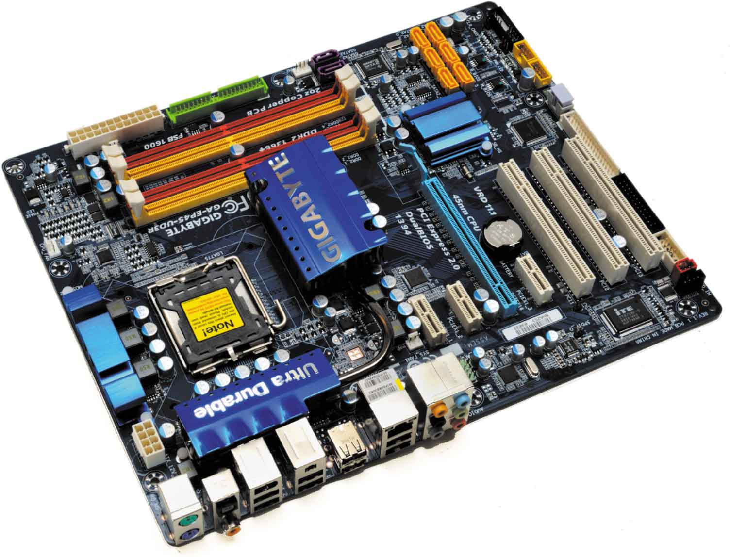
The CPU: The Real Computer (cont.)
Modern Microprocessor
Complex collection of electronic circuits
CPU housed with other chips on circuit board
Circuit board containing computer’s CPU is called motherboard

Slide 14
The CPU: The Real Computer (cont.)
Choosing a Computer
Type of CPU is important part of decision
Two important factors to consider:
Compatibility (التوافقية)
Performance (الاداء)

Slide 15
Compatibility (توافقية)
note that not all software is compatible with every CPU.
Every processor has built-in set of instructions.
CPUs in same family are generally backward compatible.
Designed to process instructions handled by earlier models
AMD processors made to be compatible with Intel.
Programs written for Linux can’t run on Windows.

Slide 16
Performance (الاداء)
ما هي سرعة جهازك؟
Some processors faster than others
Performance is determined by:
Speed of internal clock—measured in gigahertz (GHz)
Architecture of processor
Number of bits processor can process at one time
Typically 32 or 64 bits—called word size
Heat generated increases with clock speed

Slide 17
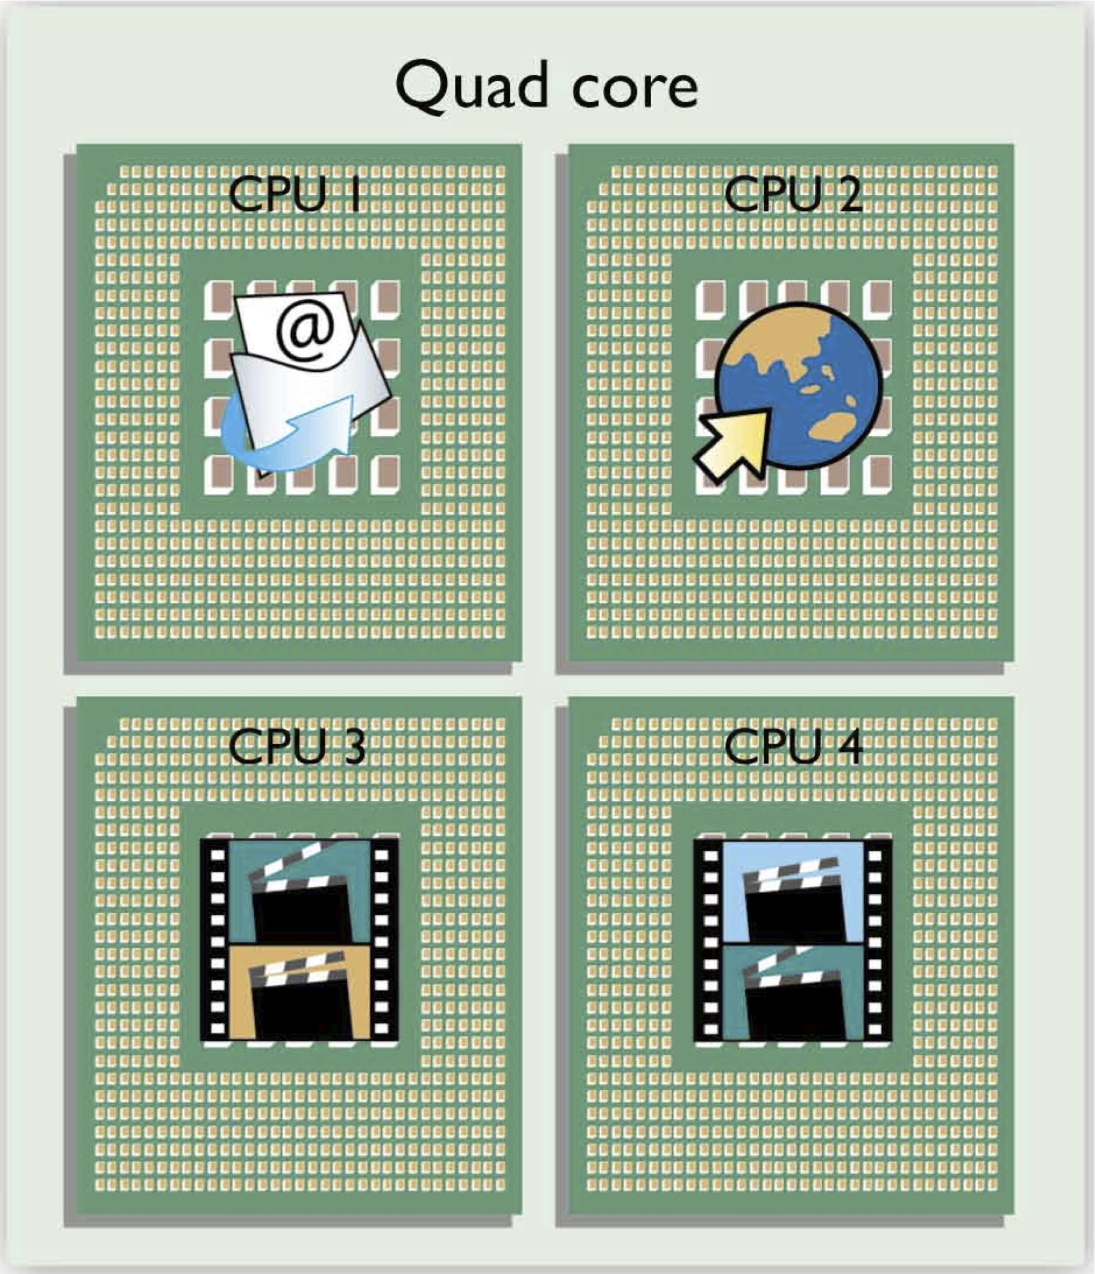
Performance (cont.)
Multicore Processors
Single chip contains multiple CPUs (cores)
Run simultaneously
Divide work
Most new PCs have at least two cores.
Quad core becoming common

Slide 18
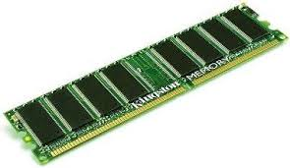
The Computer’s Memory
الذاكرة
Random access memory (RAM) ذاكرة الوصول العشوائي
Most common type of primary storage
Stores program instructions and data temporarily
Memory locations have unique addresses
Volatile—disappears when power is turned off
ذاكرة الوصول العشوائي هي الذاكرة الرئيسية في الحاسوب، تستعمل لتخزين التعليمات والبيانات، خلية في الذاكرة لها عنوان خاص وفريد. نفقد كل ما في الذاكرة عند انقطاع الكهرباء

Slide 19
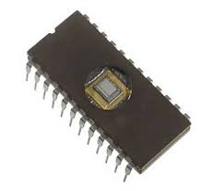
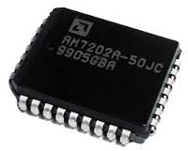
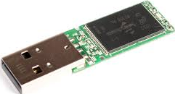
The Computer’s Memory (cont.)
Read-only memory (ROM) ذاكرة القراءة فقط
Information is etched on chip when manufactured
Stores start-up instructions and other critical information
Complementary metal-oxide semiconductor (CMOS)
Special low-energy type of RAM
Flash memory ذاكرة وميضية
Can be written and erased repeatedly
Used for digital cameras, cell phones, handheld computers

Slide 20
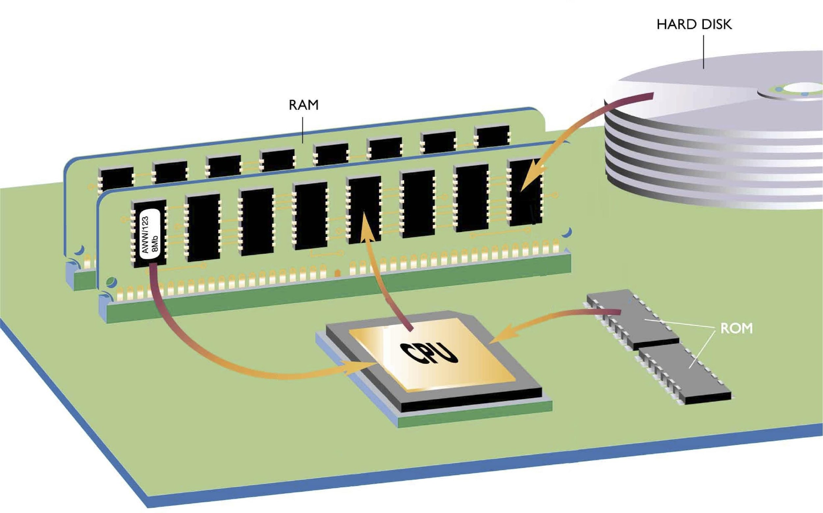
Memory
When starting a computer, the CPU automatically begins executing operating system instructions stored in ROM.
The executing instructions help the system start up and tell it how to load the operating system—copy it from disk into RAM.
Once instructions for the operating system are loaded into RAM, the CPU is able to execute them.

Slide 21
Buses
الناقل
لنقل البيانات بين المعالج والذاكرة واجهزة التخزين
Information travels between components on the motherboard through wires called internal buses or just buses.
Buses: Bridges between processor and RAM
Buses connect to:
Storage devices in bays
Expansion slots
External buses and ports

Slide 22
Ports
منافذ
Computer has variety of ports to meet diverse needs
Video port(s) to connect monitors
Audio ports to connect speakers and/or headphones
USB ports to connect keyboards, pointing devices, printers, cameras, disk drives, portable storage devices, and more
Some ports connected directly to system board
Others connected to expansion cards

Slide 23
Peripherals
الاجهزة الطرفية/الملحقات
Slots and ports make it easy to add peripherals to computer system.
Some peripherals, such as keyboards and printers, serve as communication links between people and computers.
Other peripherals link computer to other machines.
Still others provide long-term storage media.

Slide 24
Chapter 2 Summary
A computer manipulates patterns of bits represented by two symbols: 0 and 1.
Bits can be grouped into coded messages that represent alphabetic characters, pictures, colors, sounds, and other kinds of information.
The microprocessor follows software instructions to perform calculations and logical manipulations that transform input data into output.

Slide 25
Summary (cont.)
Not all CPUs are compatible with each other.
Modern CPUs employ multicore or many core processing systems that speed calculations.
The CPU uses RAM (random access memory) as a temporary storage area.
ROM (read-only memory) contains unchangeable information.

Slide 26
Summary (cont.)
The CPU and main memory are housed in silicon chips on the motherboard and other circuit boards inside the computer.
Buses connect to slots and ports that enable the computer to communicate with internal devices and external peripherals.

Slide 27
All rights reserved. No part of this publication may be reproduced, stored in a retrieval system, or transmitted, in any form or by any means, electronic, mechanical, photocopying, recording, or otherwise, without the prior written permission of the publisher. Printed in the United States of America.
Notes:
‹#›

