Slide 1
Digital Planet: Tomorrow’s Technology and You
Chapter 3
Hardware Basics
Peripherals
Copyright © 2012 Pearson Education, Inc. publishing as Prentice Hall
Notes:
‹#›

Slide 2
Chapter 3 Objectives
List several examples of input devices and explain how they can make it easier to get different types of information into the computer
List several examples of output devices and explain how they make computers more useful
Explain why a typical computer has different types of storage devices
Diagram how the components of a computer system fit together

Slide 3
Input: From Person to Processor
0s and 1s of information processing hidden from computer user.
User sees only input and output or I/O.
Early computer users had to flip switches or plug wires into switchboards.
Today, users have choice of hundreds of input devices that make it easy to enter data and commands.

Slide 4
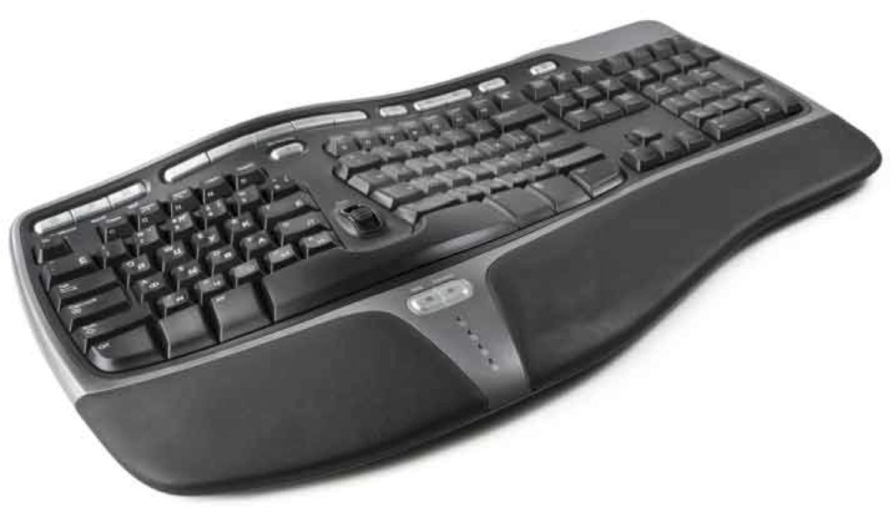
The Keyboard
Keyboard: Most familiar input device
QWERTY keyboard dates back to manual typewriters
Typical keyboard sends signals to computer through cable—usually USB
Keyboards may be wireless
Ergonomic keyboards: Keys are at angles; easy on arms and hands

Slide 5
Pointing Devices
Mouse: Designed to move pointer around screen
Wireless mice: Use Bluetooth or other wireless frequencies
Touchpad: A flat panel, sensitive to light pressure
Trackpoint and trackball:
Used to control pointer
Game controllers, graphics tablets, touch screens: Used for inputting

Slide 6
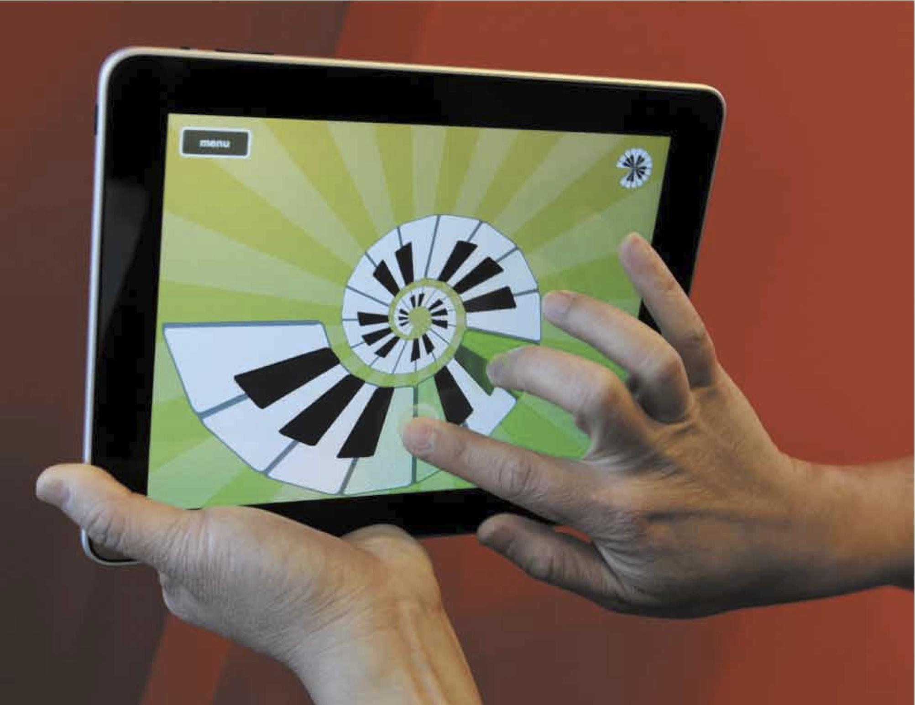
Multi-Touch Input Devices
Use multi-finger or multi-hand gestures to accomplish complex tasks quickly
Touch-sensitive screen, touch tablet, or trackpad can recognize position, pressure, and movement of more than one finger or hand at a time
Best known example is Apple’s iPhone
iPad recognizes one- and two- fingered movements

Slide 7
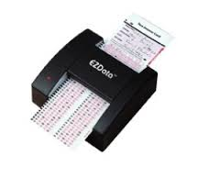
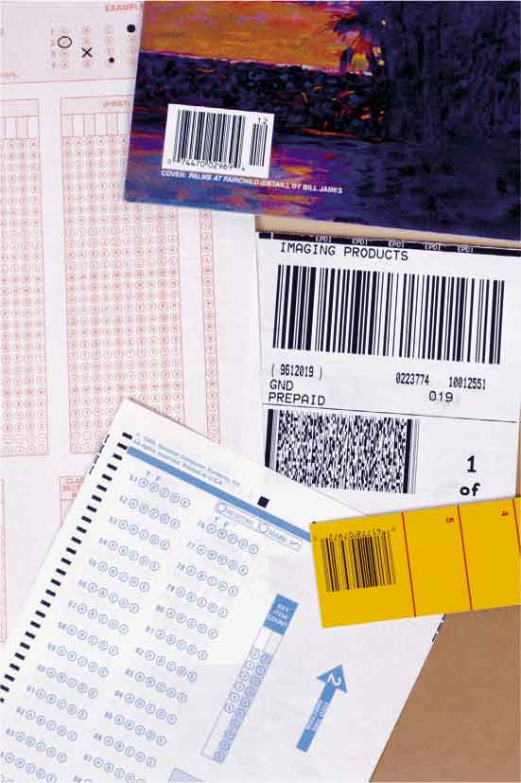
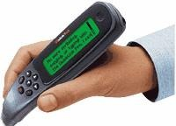
Reading Tools
Devices allow computers to read marks that represent codes:
Optical mark readers
Magnetic ink character readers
Bar code readers
Radio frequency identification (RFID) readers
Scanners and pen scanners
Handwriting recognition devices

Slide 8
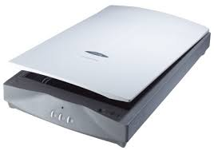
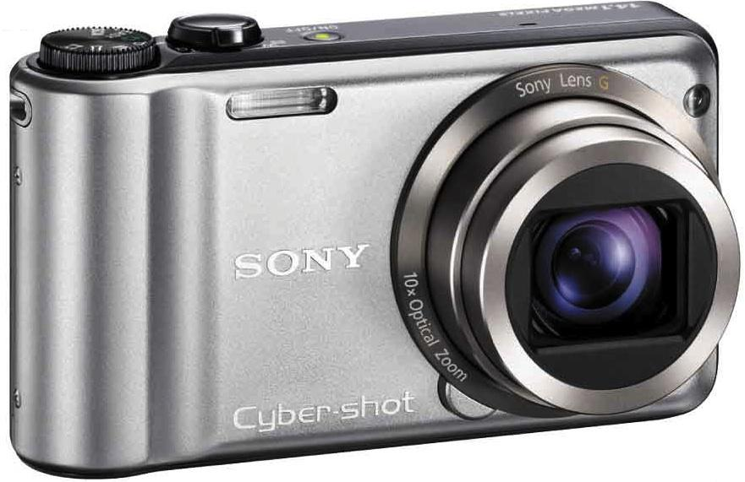
Digitizing Devices and Sensors
Devices for capturing and digitizing information—converting it into digital form:
Scanners
Flatbed scanner
Film scanners
Drum scanners
Digital cameras and digital video cameras

Slide 9
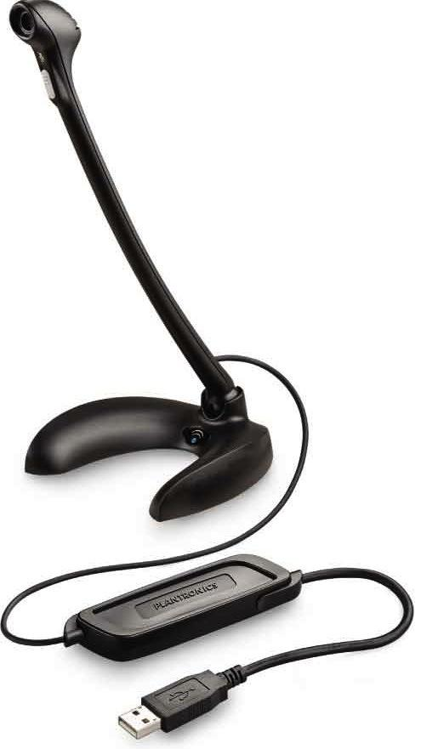
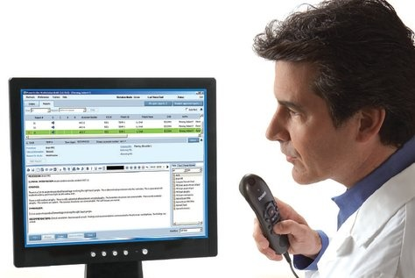
Digitizing Devices and Sensors (cont.)
Voice Input
PCs contain circuitry to convert audio signals from microphones or other sound sources into digital signals.
Speech recognition software can convert voice data into words that can be edited and printed.

Slide 10
Output: From Pulses to People
Output devices convert computer’s internal bit patterns into a form humans can understand.
Output produced through two main devices:
Display screens for immediate visual output
Printers for permanent paper output

Slide 11
Screen Output
Display: Also called a monitor
Display size measured length of diagonal line across screen
Images composed of tiny dots called pixels.
Resolution: Measured in dots per inch (dpi)
Aspect ratio: Relationship between width and height
Monitors use liquid crystal digital (LCD) technology.

Slide 12
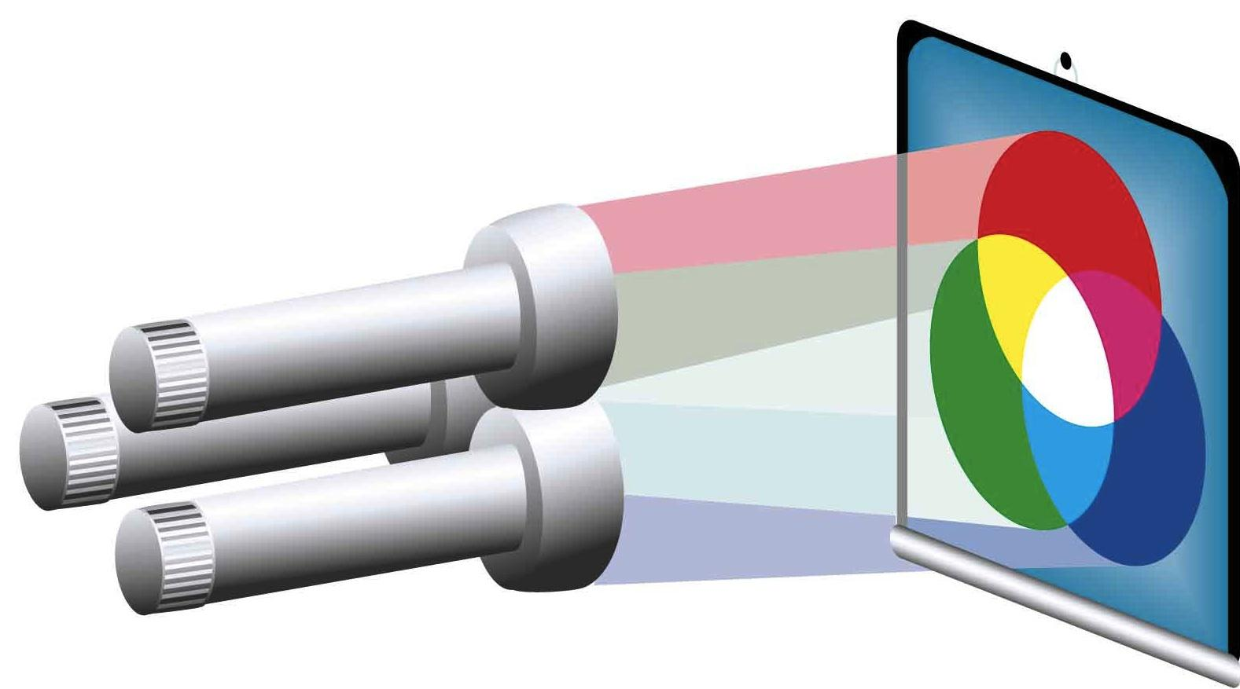
Color Display
Image is made up of rows of colored pixels
Pixels are extremely small and can’t be distinguished
Monitor’s image is refreshed many times per second
Each pixel is made up of mixture of red, green, blue
By varying the brightness of the three colors, a monitor can display millions of unique colors

Slide 13
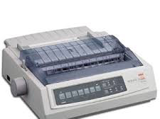
Paper Output
Printers come in two basic groups:
Impact printers: Form images by physically striking paper, ribbon, and print hammer together
Nonimpact printers: Replaced impact printers
Laser printers: High-quality pages, quickly
Inkjet printers: Spray ink directly onto paper
Photo printers: Specialized inkjets print photos

Slide 14
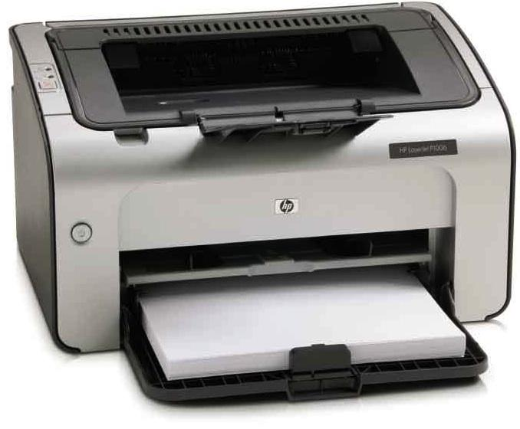
Paper Output (cont.)
Multifunction Printers
All-in-one devices: Take advantage of fact that different tools can use similar technology
Devices can serve as a printer, scanner, color photocopy machine, and fax machine.

Slide 15
Color Printing
Most printers, like monitors, form images from tiny dots.
Most printers mix various amounts of cyan, magenta, yellow, and black pigments to create a color.
Matching on-screen color with printed color is difficult.
Monitors can display more colors than printers.

Slide 16
Controlling Other Machines
Many machines and systems accept orders from computers:
Robot arms
Telephone switchboards
Transportation devices
Automated factory equipment
Spacecraft

Slide 17
Storage Devices: Input Meets Output
Some peripherals perform both input and output functions :
Storage devices (وسائط تخزين): Include tape and disk drives
Referred to as secondary storage (تخزين ثانوي)
Record information so it can be read later

Slide 18
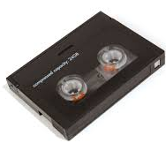
Magnetic Tape
شريط ممغنط
Tape drives: Common storage devices on most mainframe computers
Can store massive amounts of information on magnetic tape in a small space at a relatively low cost
(سعة عالية وتكلفة قليلة)
Tape is sequential-access medium, so retrieving information is time consuming
(بطء في القراءة لأن التخزيين تتابعي.)
Primarily used to back up data (تستعمل للنسخ الاحطياطية)

Slide 19
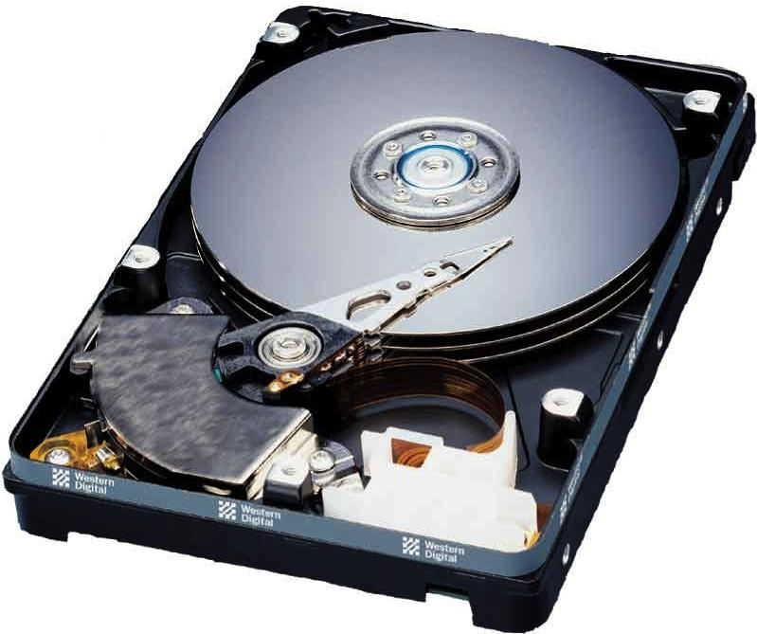
Magnetic Disks
أقراص ممغنطة
Magnetically coated surface stores encoded information
Provide random access capability
Retrieve information rapidly
PCs include hard disks as main storage device
Older diskettes (floppy disks) and Zip disks have all but disappeared
وسائط استرجاع رئيسية، استرجاع المعلومات سريع لان الوصول عشوائي.

Slide 20
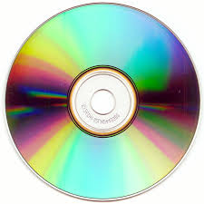
Optical Discs
Optical disc drives: Use laser beams to read and write data
Transparent plastic disc surface protects from physical damage
Access speeds are slower than for magnetic disks
Often used to make backup copies

Slide 21
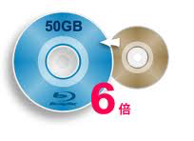
Optical Discs (cont.)
CD-ROM (compact disc—read-only memory) discs
CD-RW drive: Read data from CD-ROMs; record data onto CD-R and CD-RW discs
CD-R (compact disc-recordable)—write-once, read-many
CD-RW (compact disc rewritable) erasable
Rewritable DVD drives: Commonplace in PCs today
Can read and write to CD and DVD media
Gradually being replaced by Blu-ray drives

Slide 22
Disc Capacity
CD-ROM (read-only CD) | CD-RW | DVD-ROM (read-only DVD) | DVD/RW | BD/ROM (read-only Blu-ray) | BD/RW
 |  | 4.7 GB (single-layer disc) | 4.7 GB (single-layer disc) | 27 GB (single-layer disc) | 27 GB (single-layer disc)
700 MB | 700 MB | 9.4 GB (dual-layer disc) | 9.4 GB (dual-layer disc) | 50 GB (dual-layer disc) | 50 GB (dual-layer disc)

Slide 23
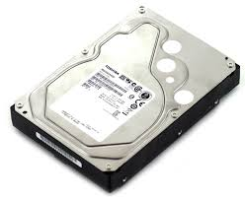
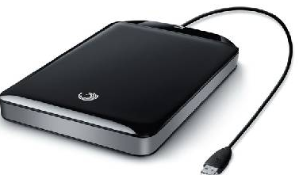
Internal and External Drives
Hard disk drives and optical disk drives can be external or internal.
Internal drives: Reside inside casing of computer
External drives: Can be connected through USB or FireWire ports
Relatively easy to transport between locations
Can be shared between computers

Slide 24
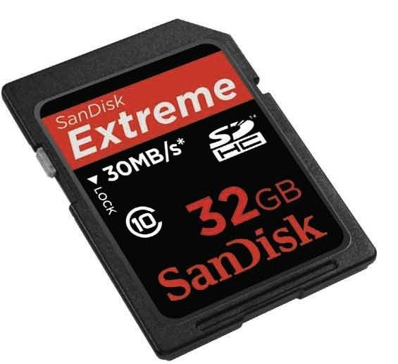
Flash Memory Storage Devices
ذاكرة ومضية
Flash memory: Type of erasable memory (امكانية اعادة الكتابة عليها)
Flash memory cards: Used to store images in digital cameras
USB flash drives: Store and transport data
Still more expensive than spinning drives Hard disk (لا زالت الاكثر تكلفة)

Slide 25
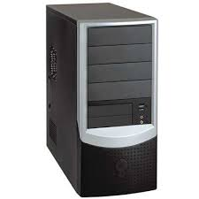
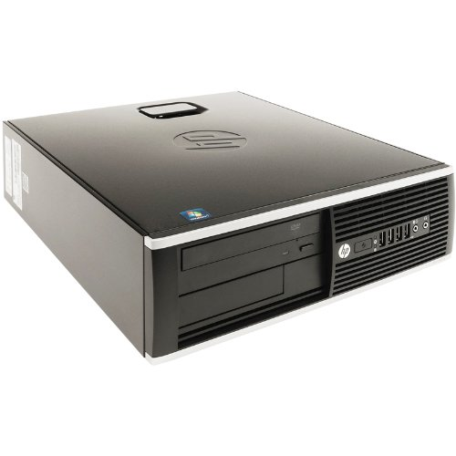
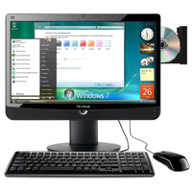
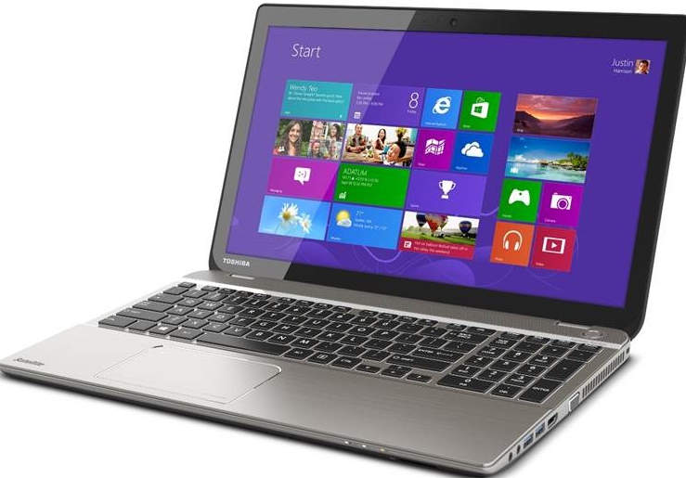
The Computer System: The Sum of Its Parts
Four basic design classes for personal computers:
Tower systems: Tall narrow boxes that generally have more expansion slots and bays
Flat desktop systems: Designed to sit under the monitor like a platform
All-in-one systems: Combine the monitor and system unit into a single housing
Laptop computers: Include all essential components in one compact box

Slide 26
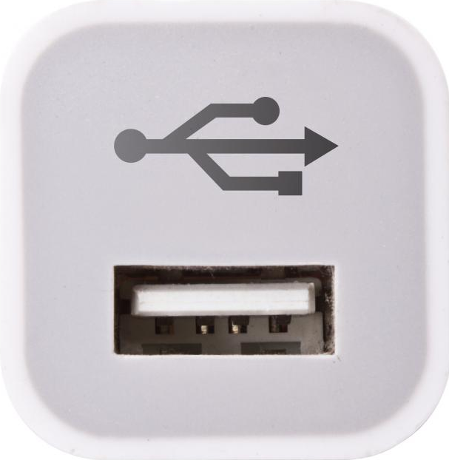
Ports and Slots Revisited
Legacy ports are too slow for today’s needs:
Serial ports send and receive data one bit at a time
Parallel ports send and receive bits in groups
USB (universal serial bus) transmits data faster:
USB 1.0 data transmitted at approximately 11 Mbps
USB 2.0 has transfer rates of up to 480 Mbps
USB 3.0 has data transfer rate of more than 3 Gbps

Slide 27
Ports and Slots Revisited (cont.)
FireWire: A high-speed connection standard developed by Apple
Can move data between devices at:
400 Mbps (original version)
800 Mbps (newer FireWire 800)
FireWire allows multiple devices to be connected to the same port.
Also can supply power to peripherals so they don’t need an external power supply

Slide 28
Wireless Peripherals, Network Peripherals, and the Cloud
Wireless technology
Wireless keyboards, mice, cameras, printers
Computer networks
Peripherals communicate with multiple PCs
Internet “cloud”
Common for computers to use peripherals—especially storage devices—located somewhere in the cloud

