Slide 1
Digital Planet: Tomorrow’s Technology and You
Chapter 8
Networking and Digital Communication
الشبكات والاتصالات الرقمية
Copyright © 2012 Pearson Education, Inc. publishing as Prentice Hall
Notes:
‹#›

Slide 2
Chapter 8 Objectives
Describe the basic types of technology that make telecommunication possible
Describe the nature and function of local area networks and wide area networks
Discuss the uses and implications of several different forms of online communication and collaboration
Explain how wireless network technology is transforming the ways people work and communicate

Slide 3
Chapter 8 Objectives (cont.)
Describe how wireless phone networks are converging with digital data networks and the impact of that convergence
Describe several ways to maximize effectiveness and minimize risks of online communication
Describe how online social networks, wikis, and other new tools for creating online communities compare to traditional forms of community building
Describe current and future trends in telecommunications and networking

Slide 4
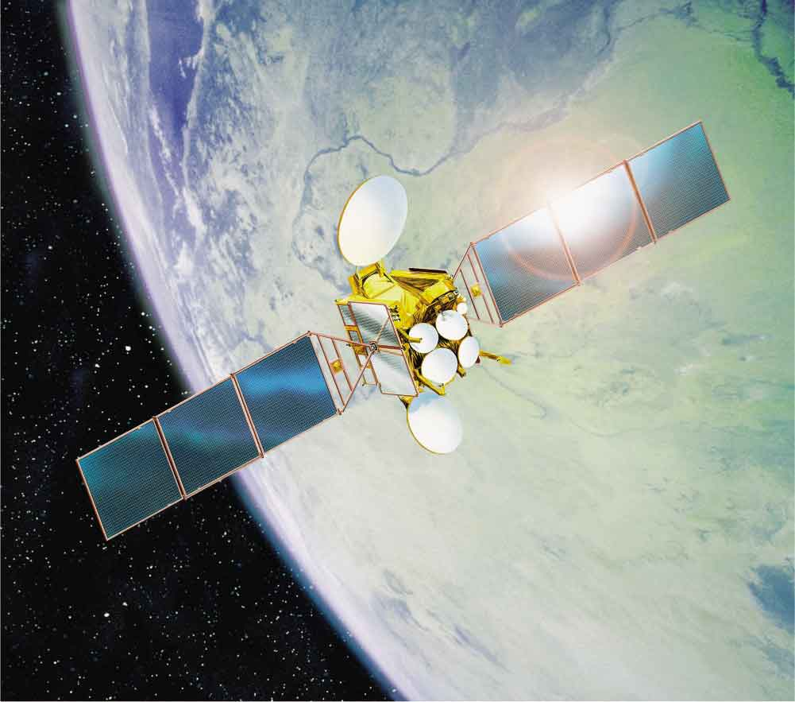
Arthur C. Clarke’s Magical Prophecy
Arthur C. Clarke: predicted the use of geostationary communications satellites
Considered to be the father of satellite communications
توقع السيد ارثر كلارك باستعمال الاقمار الصناعية للاتصلات الارضية.
Notes:
Fig. 8.2

Slide 5
Basic Network Anatomy
A computer network is any system of two or more computers that are linked together.
الشبكة الحاسوبية هي نظام لربط اكثر من حاسوب
Three essential components of every computer system:
Hardware
Software
People

Slide 6
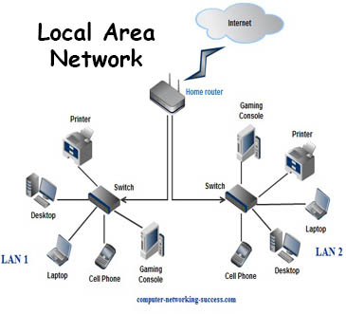
Networks Near and Far
LAN (local area network, شبكة داخلية): computers are physically close to each other
Nodes: connected to hubs or switches, which allow any node on the network to communicate with any other
Ethernet: popular networking architecture developed in the 1970s; now an industry standard
Each node is connected via
wireless network: where a node has a radio transmitter.
Wired network: nodes connected via cables.

Slide 7
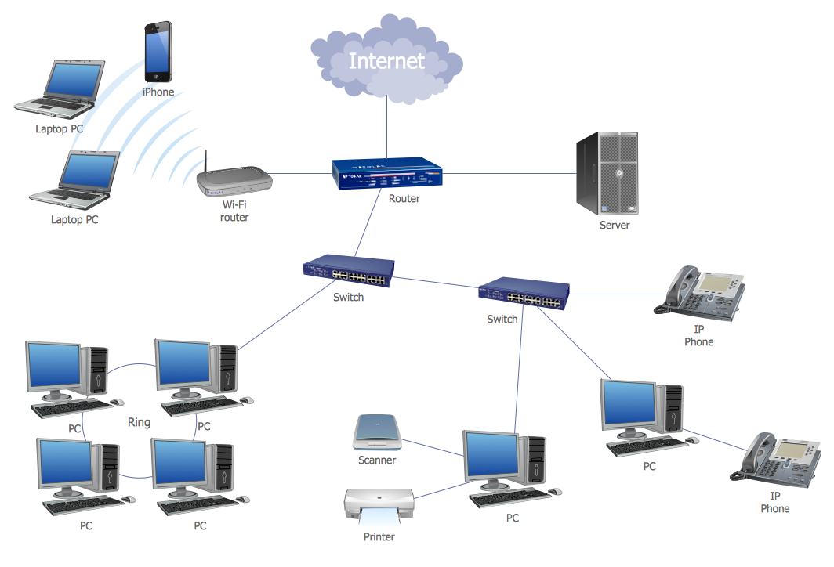

Slide 8
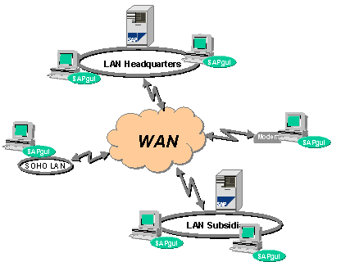
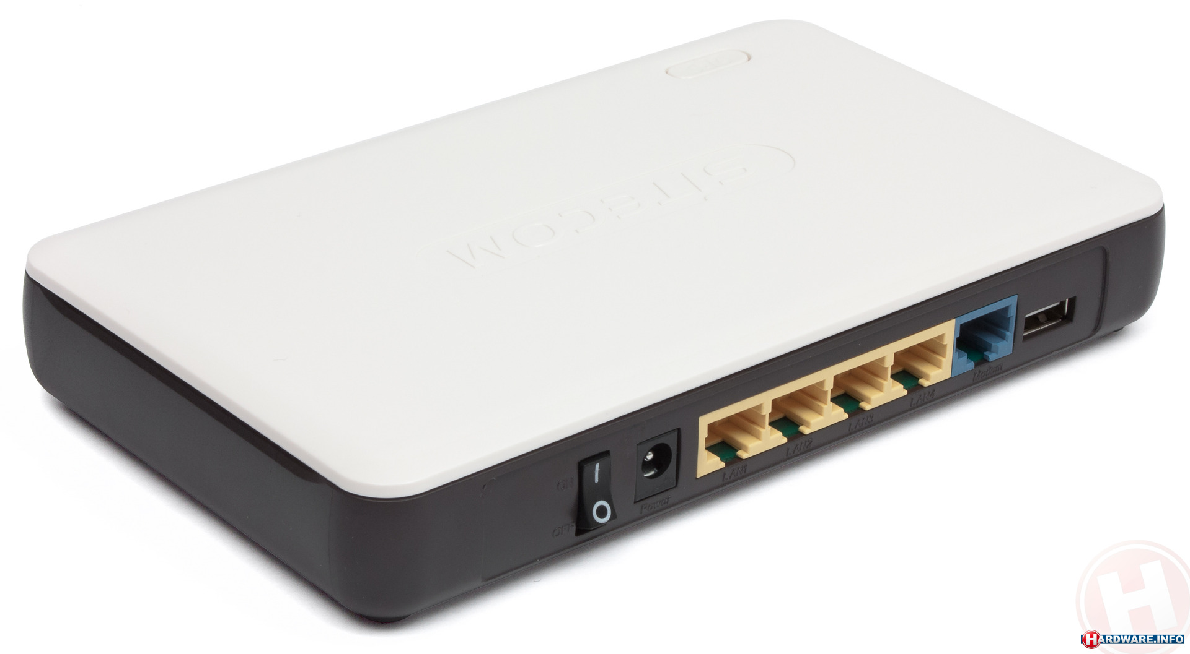
Networks Near and Far (cont.)
WAN (wide area network, شبكات واسعة): extends over a long distance
Each networked LAN site is
a node on the WAN
Routers (موجهات): hardware devices or software programs that route messages between networks
Mesh networks: alternative to networks that uses centralized(مركزية) routers. Good for small systems.

Slide 9
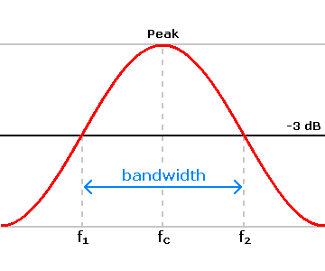
The Importance of Bandwidth
Bandwidth (نطاق التردد): refers to the quantity of data that can be transmitted through a communication medium in a given amount of time.
Typically measured in kilobits or megabits per second

Slide 10
The Importance of Bandwidth (cont.)
Bandwidth can be affected by :
Physical media of the network
Amount of traffic on the network
Type of network connection
Fast Ethernet: carries traffic at 100 megabits per second; provided all devices are fast Ethernet compatible
Gigabit Ethernet: standard is capable of transferring 1 gigabit of data per second

Slide 11
Communication Software
Protocol: set of rules for the exchange of data between devices (طريقة الاتصال)
Computers must follow the same protocols to understand each other.
TCP/IP: most famous protocol for computer networking
TCP/IP controls the exchange of data.

Slide 12
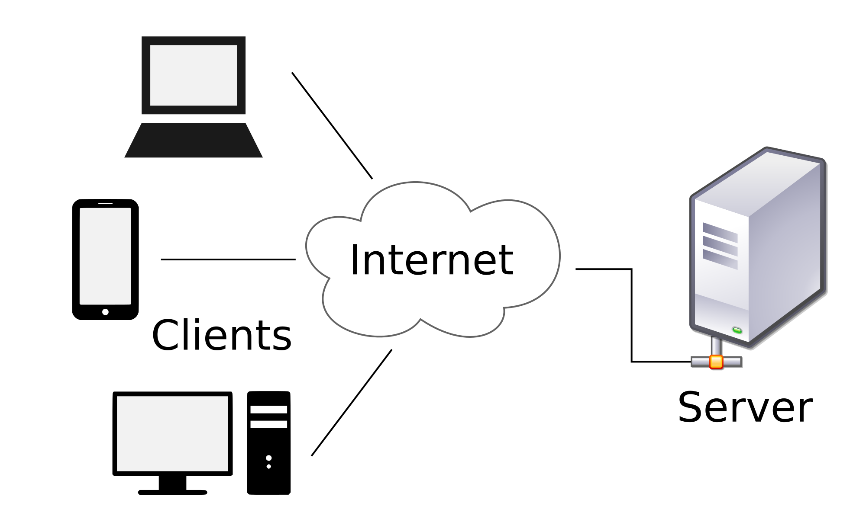
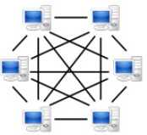
Communication Software (cont.)
Communication software takes many forms:
NOS (network operating system): system handles communications among many workstations
Client/server model: one or more computers act as dedicated servers and all the remaining computers act as clients
Peer-to-peer model: every computer on the network is both client and server

Slide 13
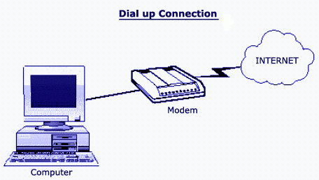
Linking In: Internet Connection Technologies
Direct connection to LAN: faster than other options
Dial-up connection: uses modem and standard phone lines
Modem stands for modulator/demodulator.
Also called narrowband connections
Broadband connection: greater bandwidth than modems

Slide 14
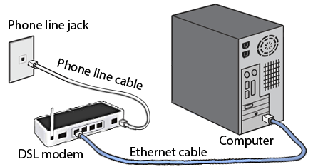
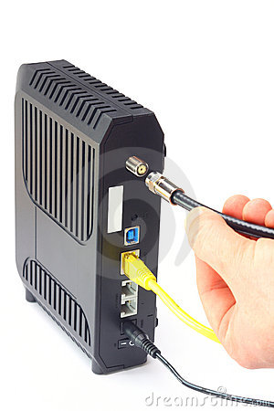
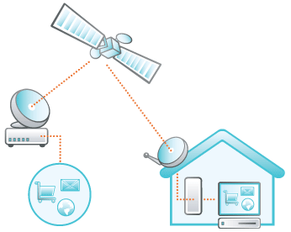
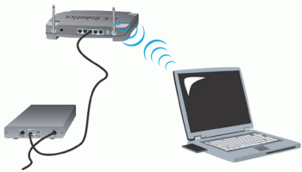
Linking In: Internet Connection Technologies (cont.)
Most common broadband alternatives:
DSL (digital subscriber line): uses telephone lines that carry voice calls
Cable modems: use same network of coaxial cable as television signals
Satellite connections: use dishes that provide television channels
Wireless connections: used by growing numbers

Slide 15
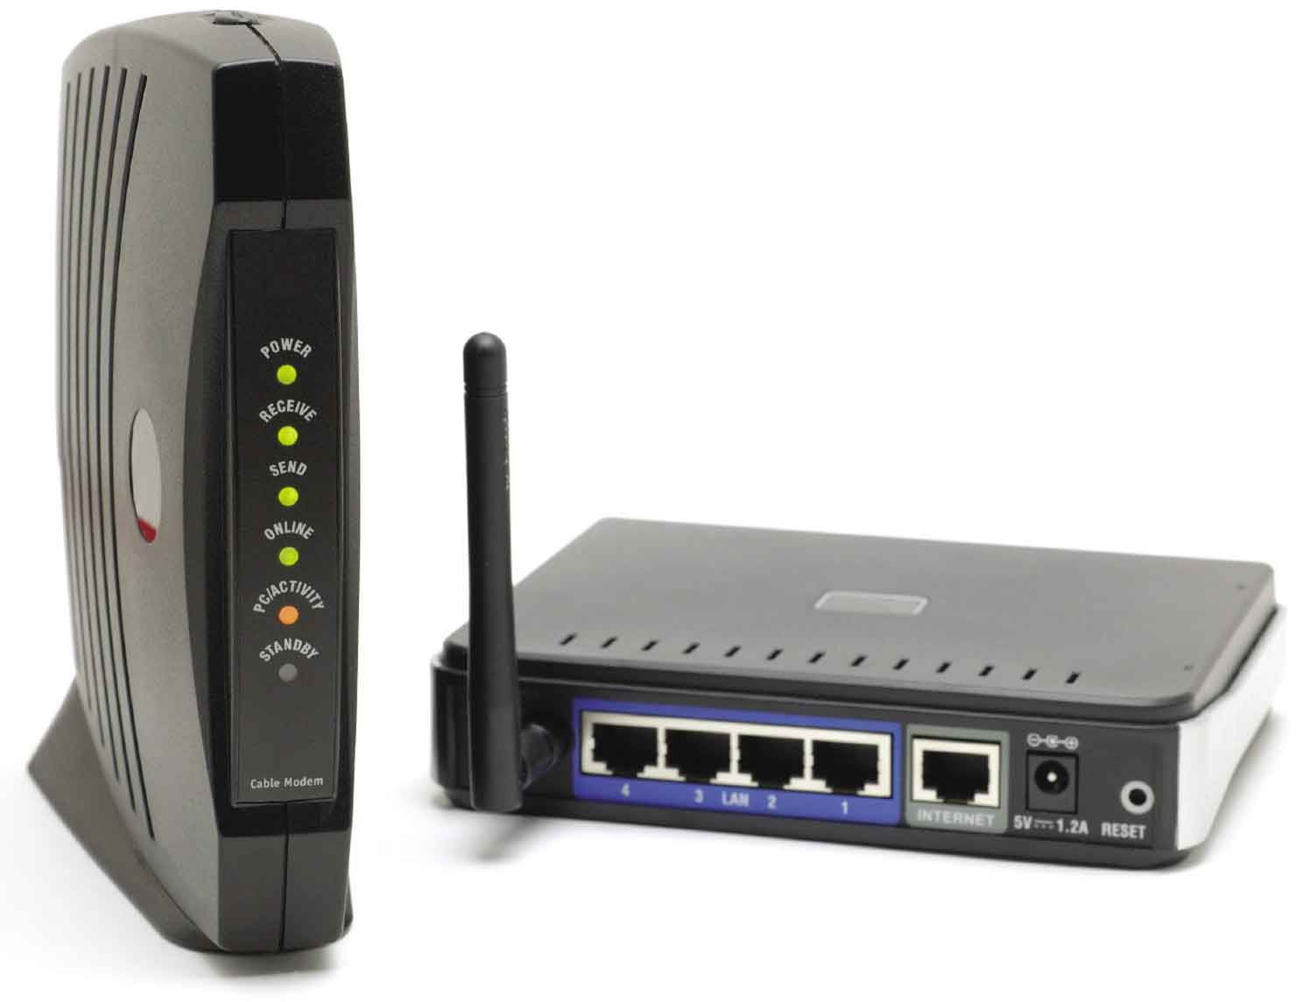
Wi-Fi and WiMax Technology
Wireless access point (WAP): central connection point wireless devices
802.11n: standard IEEE 802.11 specifications for wireless local area networks
Notes:
Figure 8.9

Slide 16
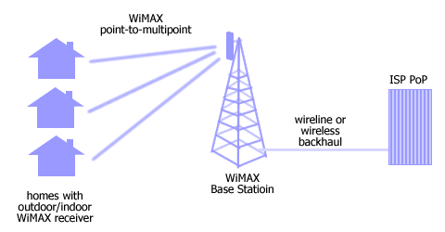
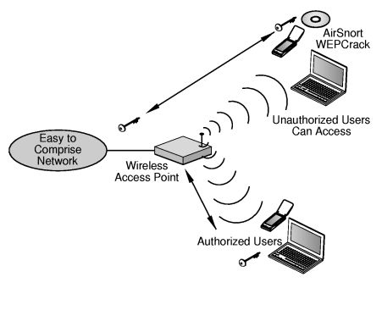
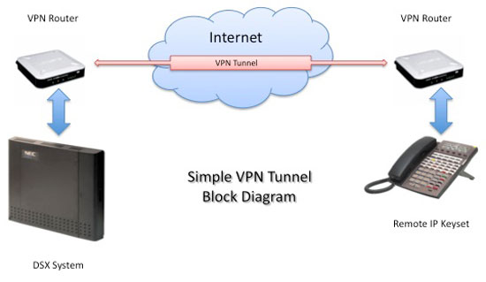
Wi-Fi and WiMax Technology (cont.)
WiMAX: new radio-based wireless standard in which a single tower can provide access to a 25-square-mile area
Security Issues
WEP (wired equivalent privacy): encryption scheme(نظام التشفير) improves the security of wireless networks
VPN (virtual private network): electronic "tunnel” through the Internet that helps to prevent eavesdropping التنصت

Slide 17
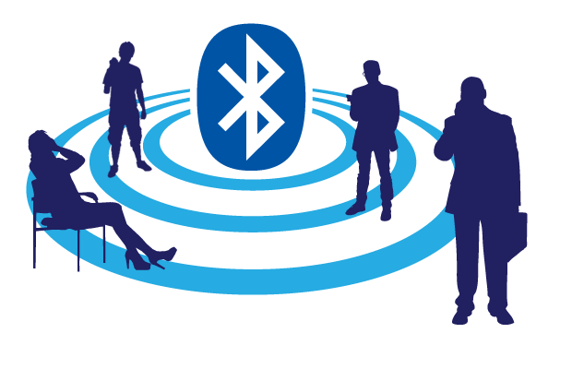
Bluetooth Technology
Bluetooth technology: named for Danish king who overcame his country’s religious differences
Overcomes differences between mobile phones, handheld computers, and PCs, allowing communication between different operating systems
PAN (personal area network): links a variety of electronic devices using Bluetooth technology شبكة باستخدام بلوتوث

Slide 18
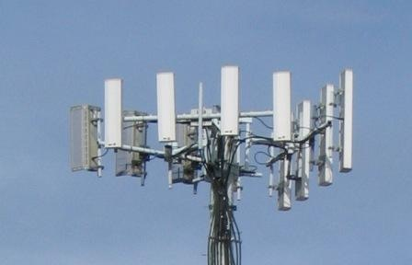
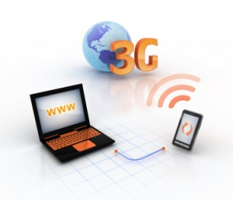
3G and 4G Technology
3G and 4G technology: 3G networks carry multimedia data and voice communications simultaneously(الوقت ذاته)
Lack true broadband speeds
4G networks have gigabit broadband speeds
Tethering : (نقطة الوصول المحمولة) cabling a laptop to a mobile phone so it can send and receive Internet data through the phone’s wireless Internet connection

Slide 19
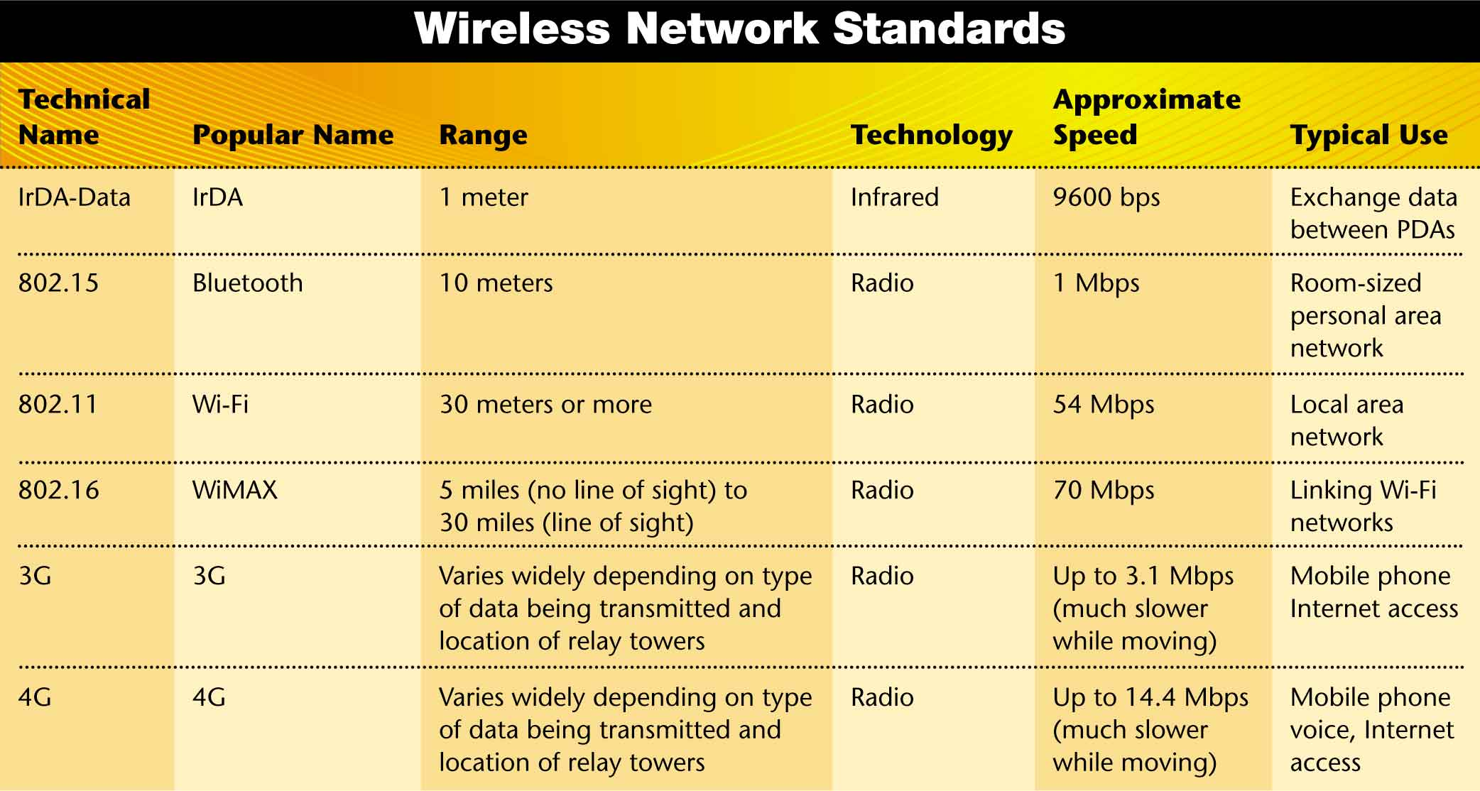
Wireless Network Technology
Notes:
Fig. 8.13

Slide 20
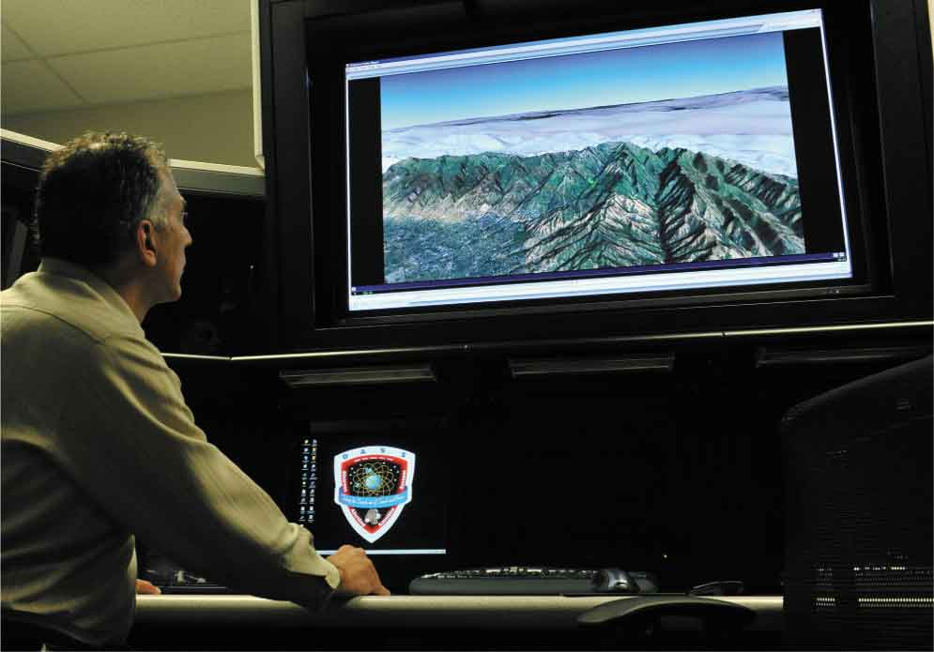
Specialized Networks: From GPS to Digital Money
GPS (Global Positioning System, نظام التموقع العالمي): specialized network of the U.S. Department of Defense
GPS receiver uses signals broadcast by satellites to determine its position.
Notes:
Fig 8.14c

Slide 21
The Network Advantage
Networks enable people to:
Share computer hardware resources
Print servers: accept, prioritize, and process print jobs
Share data and software programs
Site licenses reduce costs for multiple copies of software
Work, play, and communicate together
Groupware enables several users to work on the same document at the same time.

Slide 22
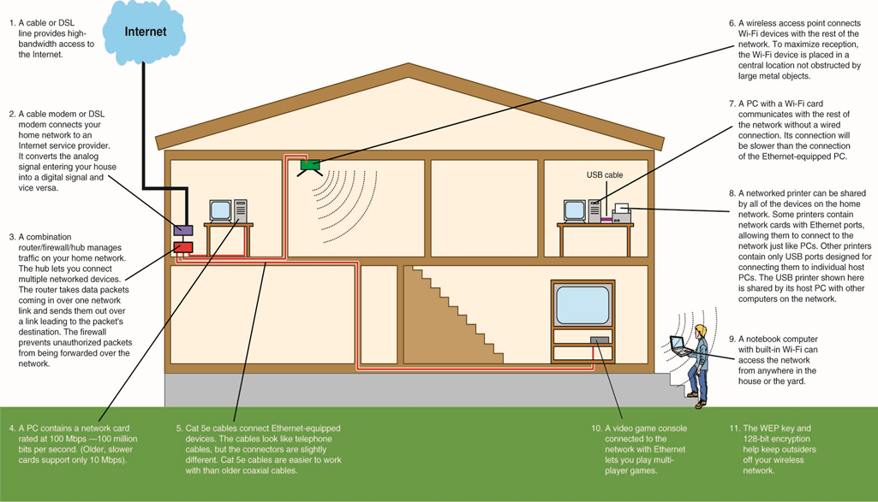
A Home Computer Network
نقطة بث لاسلكي
جهاز مربوط لاسلكيا
طابعة يتم الوصول اليها من خلال الجهاز
كابل اثيرنت
Copyright © 2012 Pearson Education, Inc. publishing as Prentice Hall
Notes:
Figure 8.16

