Slide 1
Digital Planet: Tomorrow’s Technology and You
Chapter 9
The Evolving Internet
الانترنت
Copyright © 2012 Pearson Education, Inc. publishing as Prentice Hall
Notes:
‹#›

Slide 2
Chapter 9 Objectives
Explain how and why the Internet was created
Describe the technology that’s at the heart of the Internet
Describe the technology that makes the Web work
كيف تطورت الانترنت واهم تقنياتها

Slide 3
Objectives (cont.)
Discuss the evolving tools people use to build Web sites
Discuss the trends that are changing the Internet and the way people use it
Discuss important social and political issues raised by the growth of the Internet
التغيرات الاجتماعية واساليب العمل الجديدة المرافقة لتطور الانترنت

Slide 4
ARPANET Pioneers Build a Reliable Network Out of Unreliable Parts
The ARPANET (Advanced Research Projects Agency NETwork) is the predecessor to the Internet.
Developed at the request of the Department of Defense in 1969.
Peer-to-peer networking philosophy and protocols were copied in other networks.
Disbanded in 1990.
تم تطوير آربانت عام 1969, اي قبل الانترنت، من قبل وزارة الدفاع الامريكية، وكانت الاجهزة فيها مشبوكة بطريقة ند لند (peer to peer)، ولكن تم توقيف آربانت عام 1990

Slide 5
Inside the Internet
The Internet: network of networks (شبكة الشبكات)
Links academic, research, government, and commercial institutions
ربط الجامعات والحكومة وبعض المؤسسات التجارية ببعضها
No one entity controls the Internet
لا يوجد احد يتحكم في شبكة الانترنت

Slide 6
Counting Connections
It’s impossible to pin down the exact size of the Internet for several reasons:
The Internet has billions (مليارات المتسخدمين) of new users every year.
The Internet is decentralized. (لا مركزية)
It doesn’t have hard boundaries. (لا حدود)

Slide 7
Internet Protocols
TCP/IP (Transmission Control Protocol/Internet Protocol، برتوكول الانترنت ): specifications are open standard
The language of the Internet
Allows cross-network communication
Internetworking (مصطلح يستعمل عند ربط شبكات من انواع مختلفة): connecting different types of networks and computer systems

Slide 8
Internet Protocols (cont.)
TCP breaks messages into packets (حزم بيانات).
Each packet has all the information needed to travel from network to network. (كل حزمة تحوي العناوين المطلوبة)
Packet switching: flexible and robust
IP (رقم/عنوان انترنت) is the address for the packets.
Each Internet host computer has a unique IP address.
كل جهاز يعطى رقم فريد خاص به يعتبر هو عنوانه، ما دام موصولا بلانترنت.
Each address is comprised of four sets of numbers separated by periods, such as 123.23.168.22.

Slide 9
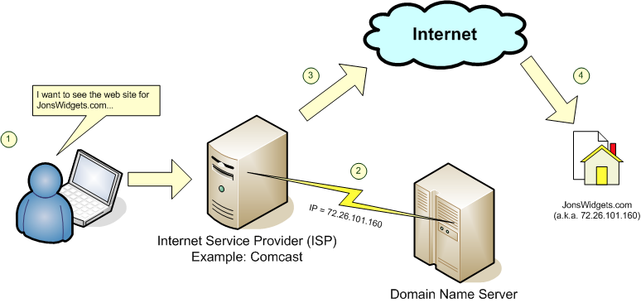
Inside the Internet
DNS (domain name system, نظام أسماء النطاقات): translates IP addresses into a string of names, لتحويل رقم الانترنت الى اسماء
Top-level domains include:
.edu: educational sites
.com: commercial sites
.gov: government sites
.org: nonprofit organization sites

Slide 10
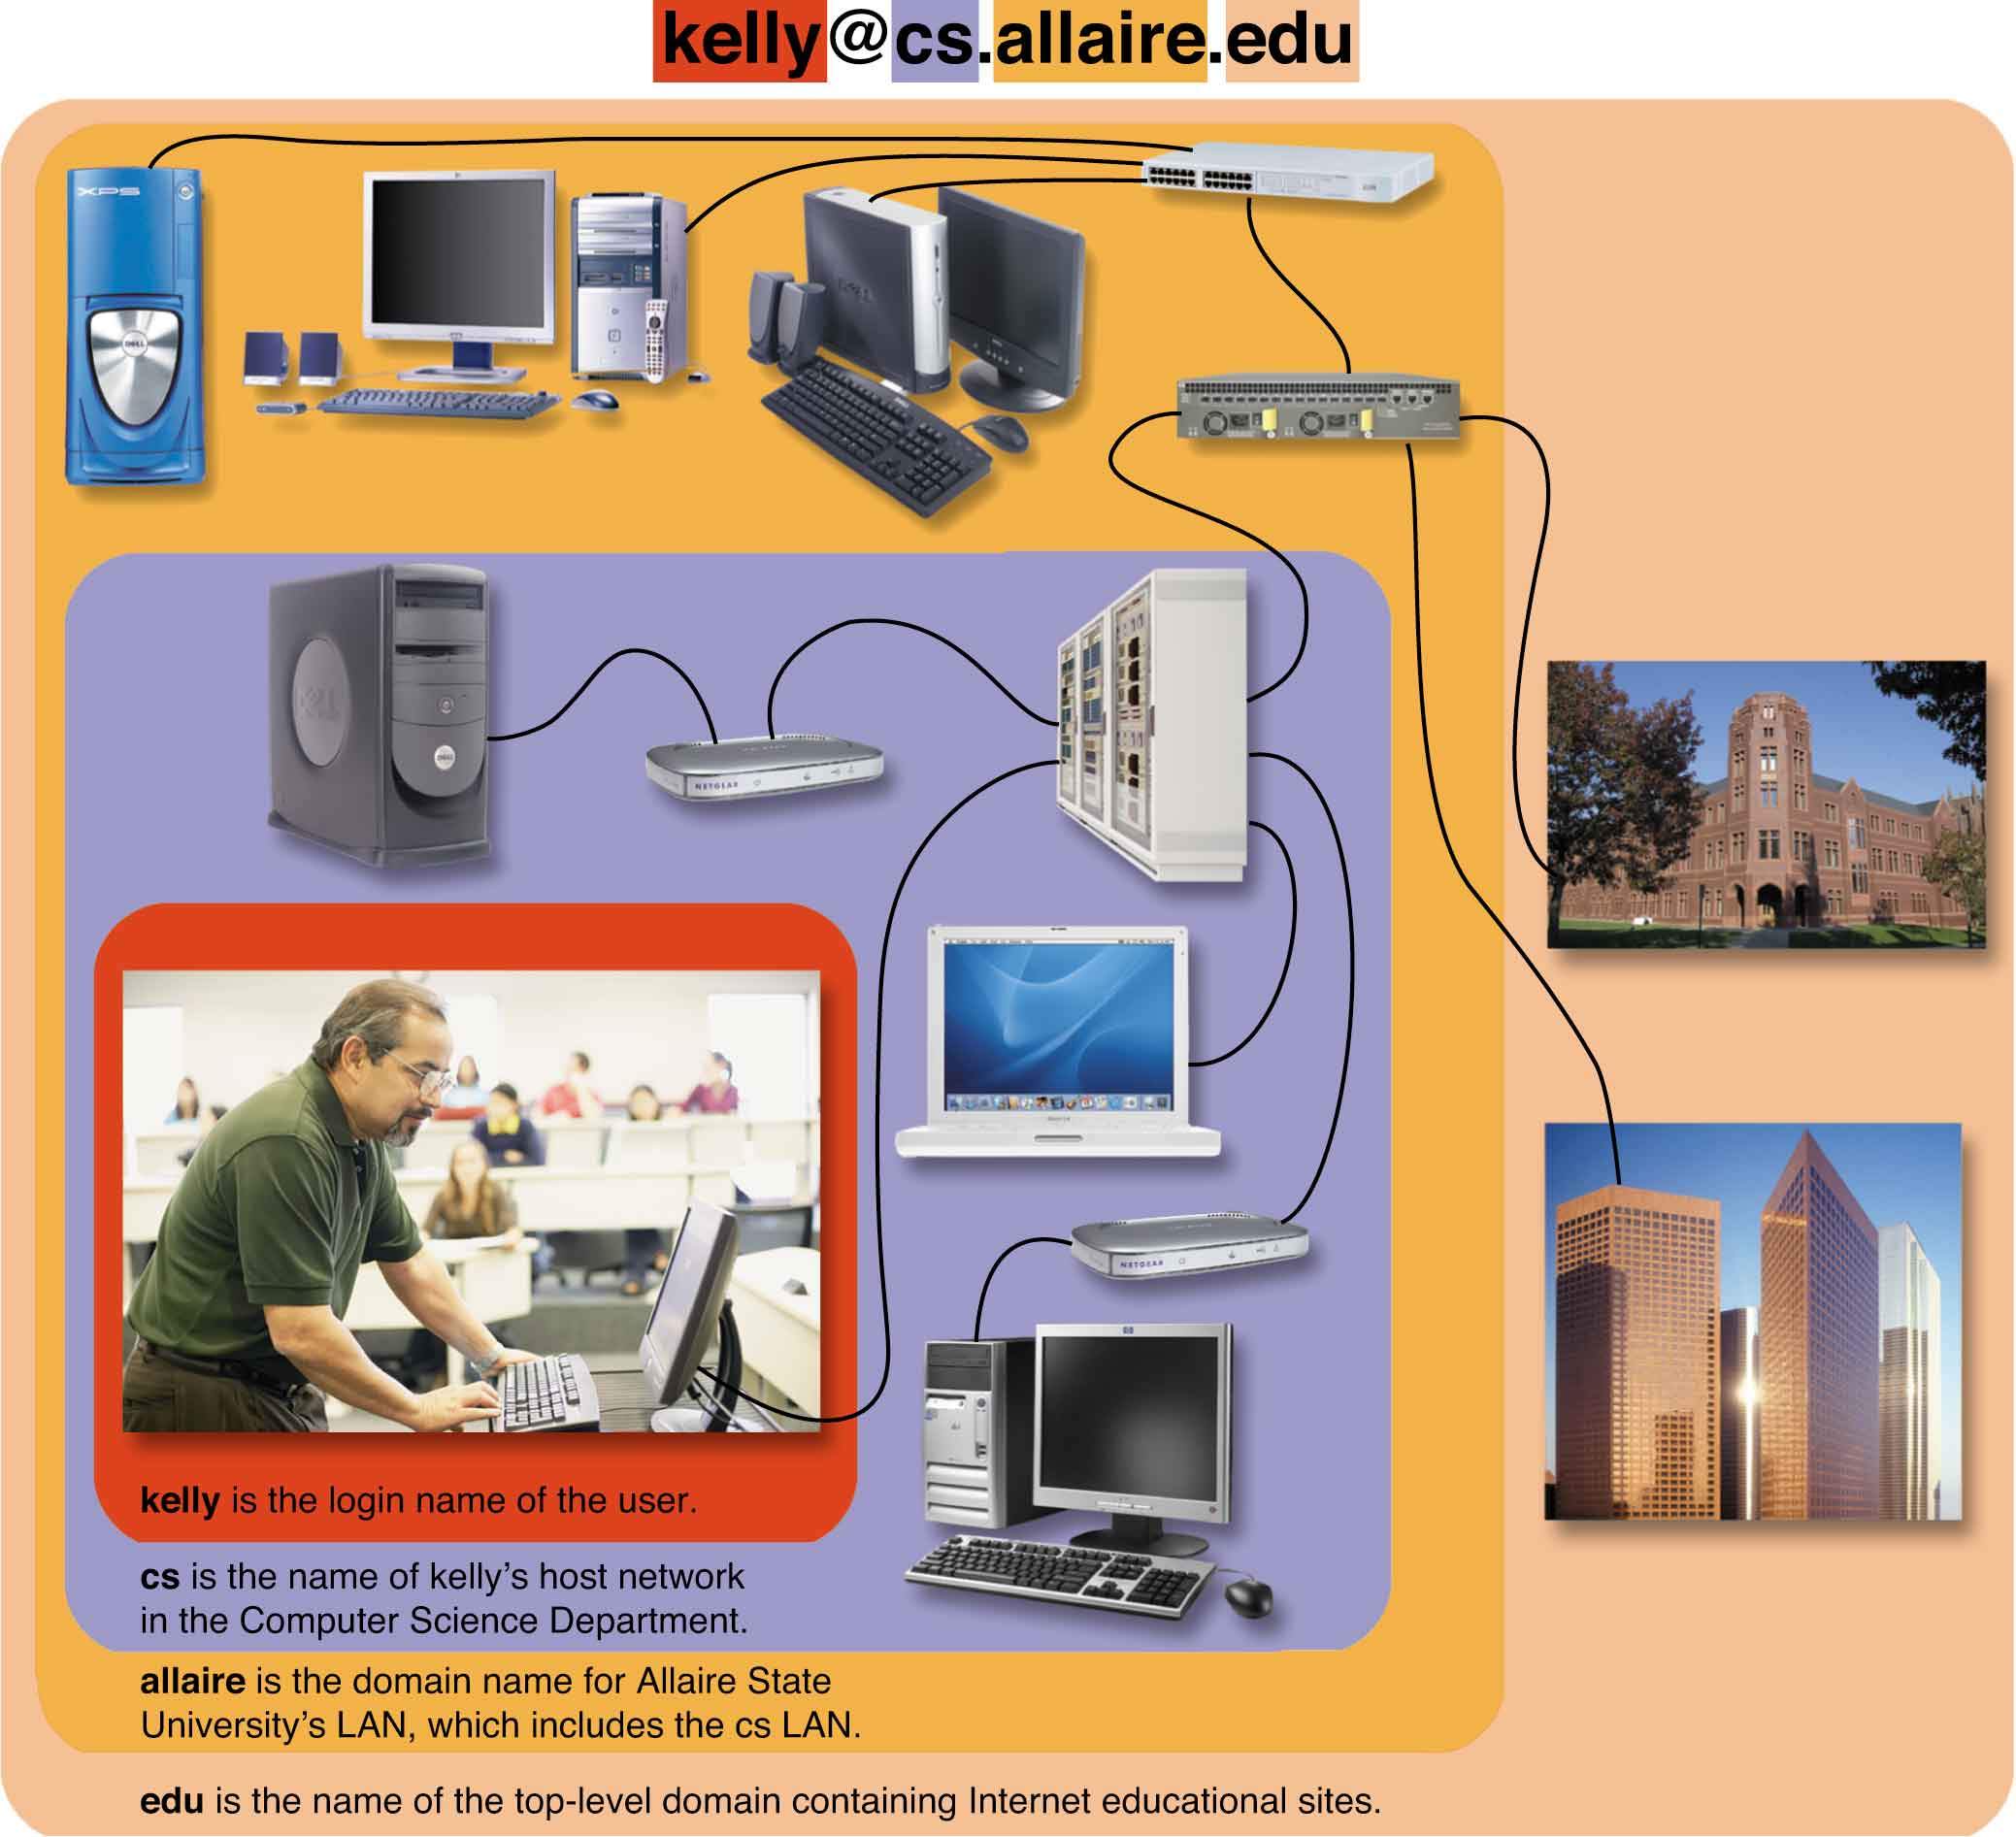
kelly@cs.allaire.edu
kelly: login name
cs: host network
allaire: domain name for Allaire State University’s LAN
edu: top-level domain
Notes:
Fig. 9.7

Slide 11
Internet Access Options
طرق الاتصال بالانترنت
Four types of broadband access:
DSL: standard phone lines
Cable modems: fast Internet connections
Satellite dishes: radio waves and satellite relays
High-speed wireless connections: radio waves
Internet service providers (ISPs): provide connections to the Internet
Online services: offer extra services such as news and chat rooms

Slide 12
Internet Servers
Email servers: act as a local post office for a particular Internet host—a business, an organization, or an ISP.
File servers: distribute programs, media files, and other data across the Internet.
Application servers: store applications and make them available on request.
Web servers: store Web pages and send them to client programs when requested.

Slide 13
Web Protocols and Web Publishing
URL: uniform resource locator
HTML: HyperText Markup Language
Notes:
Fig. 9.10

Slide 14
Web Protocols and Web Publishing (cont.)
HTML: describes format, layout, and structure of a Web page.
Source document: text files that includes codes that describe the format of a hypermedia document
Domain name registry: company that sells server domain names.

Slide 15
From Hypertext to Multimedia
A Web site can contain many media types:
Tables
Frames
Forms
Animations
Search engines
Downloadable audio and video
Streaming audio and video

Slide 16
From Hypertext to Multimedia (cont.)
Most popular free plug-ins include:
Portable Document Format (PDF): documents looks the same on screen as on paper
Shockwave/Flash: allows browsers to present compressed interactive multimedia documents
Windows Media Player: plays streaming audio and video
Quick Time: Apple’s multipurpose multimedia framework

Slide 17
Dynamic Web Sites
Changeable content can provide personalization.
Cookies: small files deposited on visitor’s hard disk
Most browsers don’t tell you when they leave a cookie
Content-management systems (CMS): allow sites to be updated without coding in HTML

Slide 18
Dynamic Web Programming Tools
Scripts: short programs that can add dynamic features
Scripts are typically written in JavaScript
Java: full-featured, cross-platform programming language
Applets are small Java programs.
eXtensible Markup Language (XML): used for defining data formats
AJAX stands for Asynchronous JavaScript and XML.

Slide 19
Dynamic Web Programming Tools (cont.)
Search engines are designed to make it easier to find information on the Web.
Web crawlers or spiders: software robots that systematically explore the Web, retrieve information and index it in a database
Boolean logic: refines queries using keywords
Many sites have their own built-in search engines.
Copyright © 2012 Pearson Education, Inc. publishing as Prentice Hall

Slide 20
Building a Web Site
Make a plan.
Collect and prepare the source documents.
Prepare a logo and banner graphic.
Use software, such as Dreamweaver, to define CSS styles and add tags.
Preview the pages.
Duplicate the unifying elements throughout the site.
Test the site with different Web browsers.
Copyright © 2012 Pearson Education, Inc. publishing as Prentice Hall

Slide 21
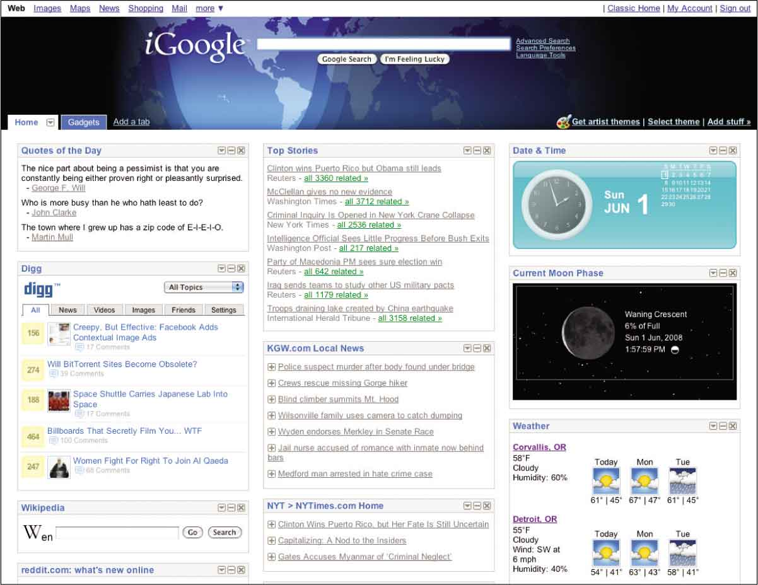
Portals
Web portals: Web entry stations that offer access to a variety of links
Corporate portals: on intranets serve the employees
Notes:
Fig. 9.20

Slide 22
Push Technology and RSS
Pull technology: browsers on client computers pull information form server machines
Push technology: server automatically sends information to the client
Really Simple Syndication (RSS): XML-based family of formats used to publish frequently updated documents

Slide 23
Web 2.0 and You
In Web 2.0 anyone can create an online publication
Blogs
Forums
YouTube
Flickr
Mashup: combination of Web content such as a Web page, song, video, or image

