Slide 1
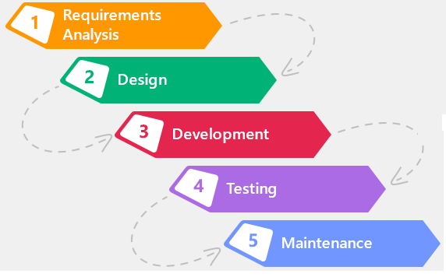
Software Processes
By Samer Zein, PhD

Slide 2
Software Processes: Intro
A software process is a set of related activities that leads to the production of a software product.
There are many different software processes but all must include four activities that are fundamental to software engineering are:
Software Specification
Design& Implementation
Evolution
Validation

Slide 3
Software Processes: intro..2
When we talk about processes, it is not only about the activities and their order.
It is also about:
  Products: outcomes of each activity, example Software Architecture Document
  Roles: programmer, designer, analyst, tester, team leader, etc.
  Pre and Post Conditions: example
    Software requirements must be ready before building software architecture.
    UML models must be designed and reviewed.

Slide 4
Software Process: Intro..2
Software processes are complex and, like all intellectual and creative processes, rely on people making decisions and judgments.
There is no ideal process and most organizations have developed their own.
Processes have evolved to take advantage of the specific characteristics of the systems that are being developed.
  Critical Systems: a very structured development process is required
  A Business System with rapidly changing requirements, a less formal, flexible process is likely to be more effective

Slide 5
Two Categories of Software Processes
All process activities are planned in advance
Progress is measured against this plan
Software Processes
Plan-Driven
Agile
Planning is incremental
Flexible
Cope with change

Slide 6
Software Process Models
Waterfall Model
SW Processes
Models
Incremental Development
Reuse-Oriented
a software process model is a simplified representation of a software process.
These models are not mutually exclusive and are often used together, especially for large systems development.

Slide 7
Waterfall Model
Derived from more general system engineering processes
Plan- driven process
you must plan and schedule all of the process activities
In principle, the result of each phase is one or more documents that are approved before starting work on them
It is best used for critical systems, where requirements are well understood and will not change (eg. Aviation and medical systems)
It can also be used with small systems (mobile apps) with the help of prototypes.

Slide 8
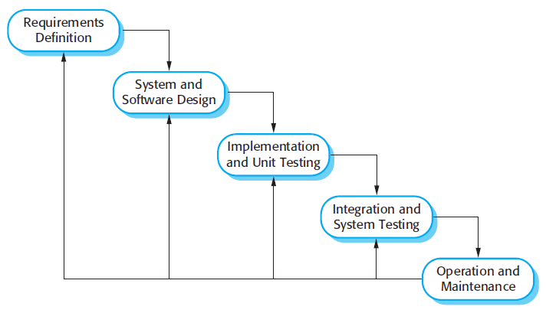
Waterfall Model

Slide 9
Advantages of Waterfall Model
Developers and customers agree on what will be delivered early in the development lifecycle. This makes planning and designing more straightforward.
Progress is more easily measured, as the full scope of the work is known in advance.
Throughout the development effort, it’s possible for various members of the team to be involved or to continue with other work, depending on the active phase of the project
customer presence is not strictly required after the requirements phase.
The software can be designed completely and more carefully, based upon a more complete understanding of all software deliverables
References: http://www.seguetech.com/waterfall-vs-agile-methodology/

Slide 10
Disadvantages of Waterfall Model
One area which almost always falls short is the effectiveness of requirements.
Gathering and documenting requirements in a way that is meaningful to a customer is often the most difficult part of software development.
Another potential drawback of pure Waterfall development is the possibility that the customer will be dissatisfied with their delivered software product
And Testing of whole system that only happens at end of project

Slide 11
Formal System Development
An important variant of the waterfall model is formal system development, where a mathematical model of a system specification is created.
This model is then refined, using mathematical transformations that preserve its consistency, into executable code
Is particularly suited to the development of systems that have stringent safety, reliability, or security requirements.
The formal approach simplifies the production of a safety or security case.

Slide 12
Incremental Development
Incremental development is based on the idea of
  A) developing an initial implementation,
  B) exposing this to user comment and
  C) evolving it through several versions until an adequate system has been developed
fundamental part of agile approaches
Better than waterfall approach for most e-business, e-commerce, and personal systems.
Can be plan-driven, agile, or a mix of both!

Slide 13
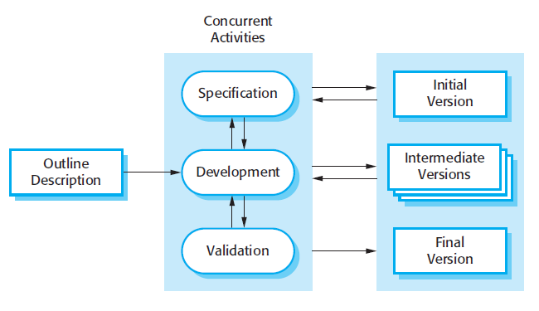
Incremental Development Model

Slide 14
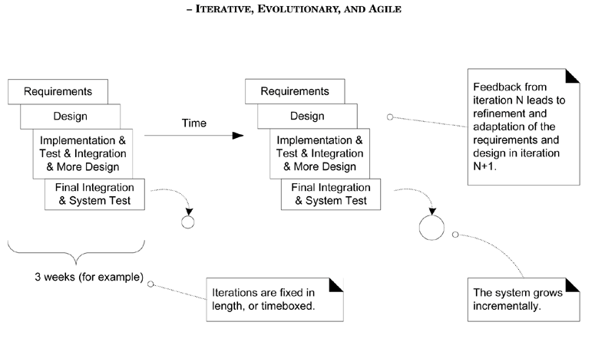
Core Practices - Iterations

Slide 15
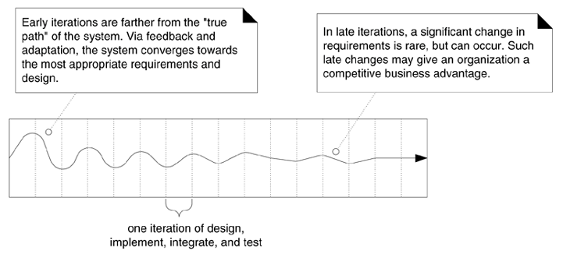

Slide 16
Incremental Development..3
Benefits of incremental development
  The cost of accommodating changing customer requirements is reduced.
  It is easier to get customer feedback on the development work that has been done.
  More rapid delivery and deployment of useful software to the customer is possible
  Better fit for short time-to-market
Problems with incremental development
  The process is not visible. Managers need regular deliverables to measure progress.
  System structure tends to degrade as new increments are added.
  Additional unplanned iterations may be needed.
  Customer may not have the required free time to be involved.
  Team may not be located in same place (distributed teams)

Slide 17
How to do Iterative and Evolutionary Analysis and Design?
Suppose that iteration period = 4 weeks
Week 1 | Week 2 | Week 3 | Week 4

Slide 18
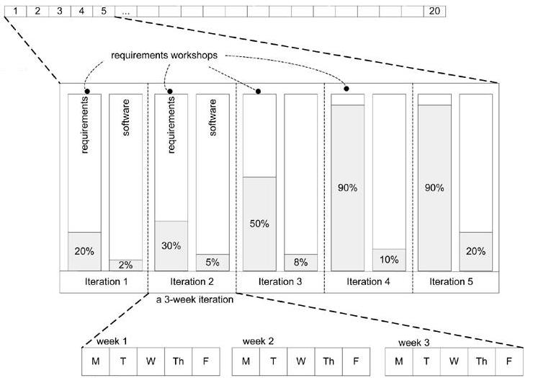

Slide 19
How to plan an iteration?
Step #1 is to decide the length of the iteration; 2 - 6 weeks is the common range
Step #2 is to convene an iteration planning meeting
Step # 3 A list of potential goals (new features or use cases, defects, …) for the iteration is presented, ranked by some priority scheme

Slide 20
Step # 4 Each member of the team is asked for their individual resource budget
Step # 5 For one goal (such as a use case), it is described in some detail. For example, UI tasks, database tasks, domain layer OO development tasks, external systems integration tasks, and so forth.
All the task estimates are summed into a running total

Slide 21
Step #6 repeats until enough work has been chosen: The iteration task total is divided by the resource budget total

Slide 22
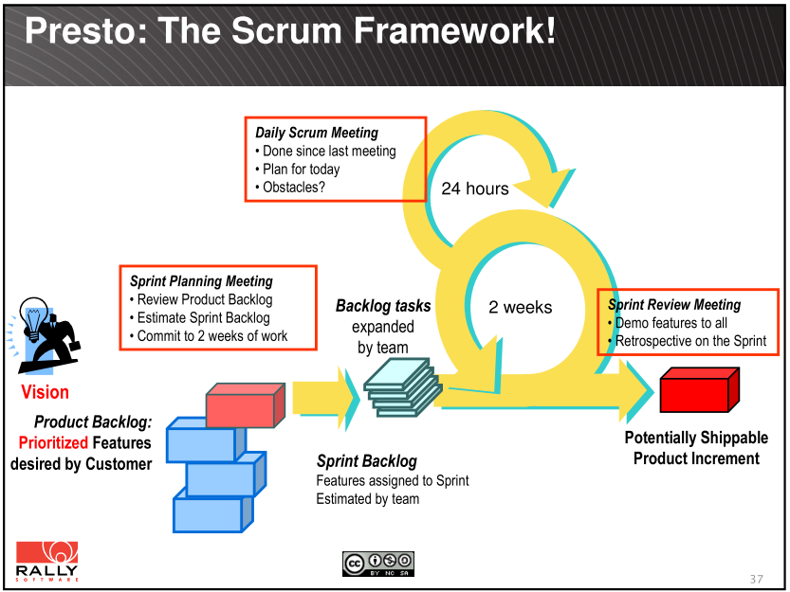

Slide 23
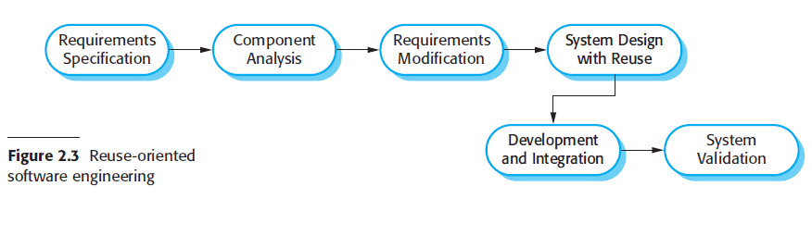
Reuse-Oriented Software Engineering
In the majority of software projects, there is some software reuse.

Slide 24
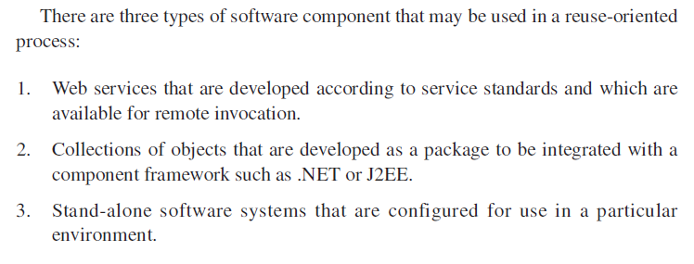
Types of Reuse-Oriented Software Engineering

Slide 25
Prototyping
A prototype is an initial version of a software system that is used to demonstrate:
  concepts, try out design options, and find out more about the problem and its possible solutions
A software prototype can be used in a software development process to help anticipate changes that may be required:
  Requirements engineering
  System design, UI design

Slide 26
Prototyping 2
System prototypes allow users to see how well the system supports their work.
They may get new ideas for requirements, find strength and weakness in the software.
They may then propose new system requirements.
It may also reveal errors and omissions in the requirements.
A function described in a specification may seem useful and well defined.
But, when that function is combined with other functions, users often find that their initial view was incorrect or incomplete.
The system specification may then be modified to reflect their changed understanding of the requirements.

Slide 27
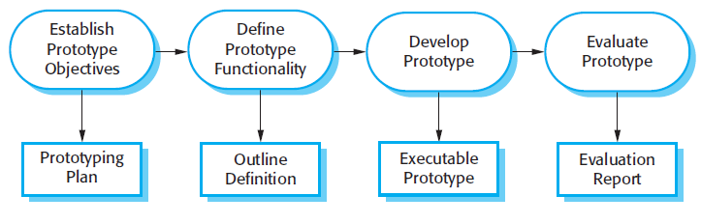
Prototyping 3
A general problem with prototyping is that the prototype may not necessarily be used in the same way as the final system.

Slide 28
Prototyping 3
A system prototype may be used while the system is being designed to carry out design experiments to check the feasibility of a proposed design.
For example, a database design may be prototyped and tested to check that it supports efficient data access for the most common user queries.

Slide 29
Incremental Delivery
Is an approach to software development where some of the developed increments are delivered to the customer and deployed for use in an operational environment.
In an incremental delivery process, customers identify, in outline, the services to be provided by the system.
They identify which of the services are most important and which are least important to them.
A number of delivery increments are then defined, with each increment providing a sub-set of the system functionality.
With the highest-priority services implemented and delivered first.

Slide 30
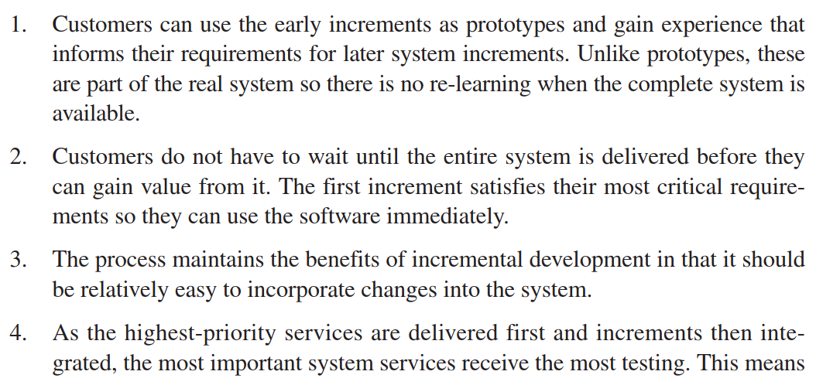
Advantages of Incremental Delivery

Slide 31
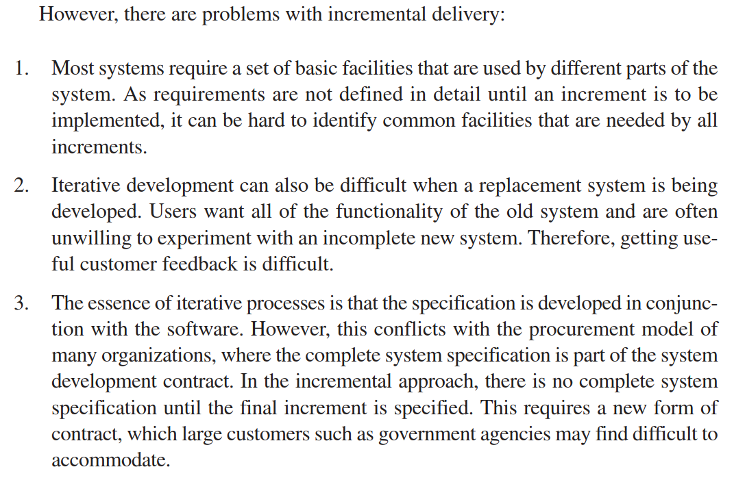

Slide 32
Spiral Model of Bohem
A risk-driven software process framework
Each loop in the spiral represents a phase of the software process.
Thus, the innermost loop might be concerned with system feasibility, the next loop with requirements definition, the next loop with system design, and so on.
includes explicit risk management activities
to reduce these risks.

Slide 33
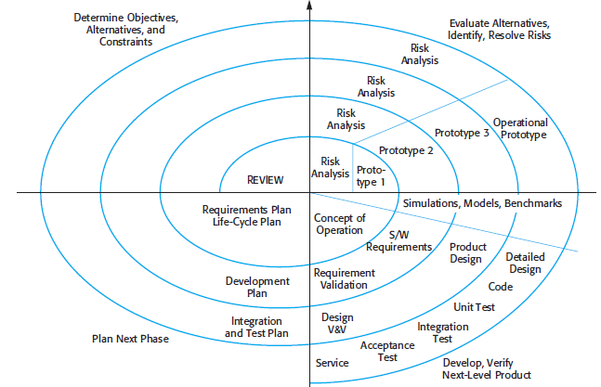
Spiral Model of Bohem

Slide 34
Process Activities: Software Specifications
Software specification or requirements engineering is the process of understanding and defining:
  what services are required from the system
  and identifying the constraints on the system’s operation and development
Requirements are usually presented at two levels of detail.
  End-users and customers need a high-level statement of the requirements;
  system developers need a more detailed system specification.

Slide 35
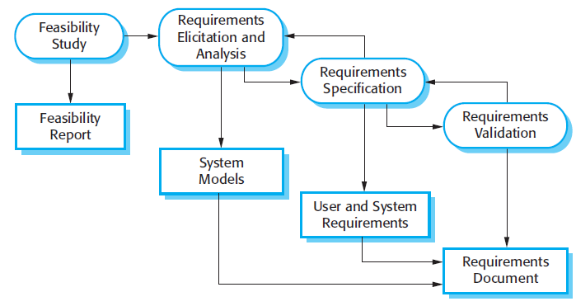
Process Activities: Software Specifications, 2

Slide 36
Process Activities: Software Design & Implementation
A software design is a description of:
  the structure of the software to be implemented,
  the data models and structures used by the system,
  the interfaces between system components
  and, sometimes, the algorithms used.
Creating detailed designs for critical systems.
Generating code from designs and diagrams

Slide 37
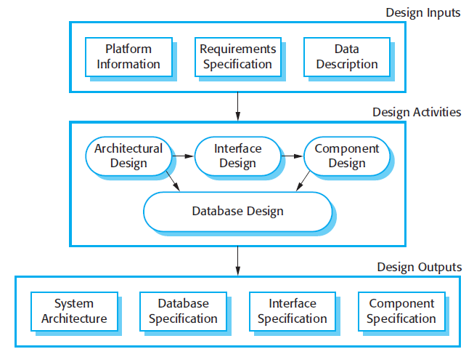

Slide 38
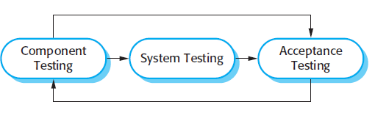
Process Activities: Validation
intended to show that a system both conforms to its specification and that it meets the expectations of the system customer.
Program testing, where the system is executed using simulated test data, is the principal validation technique.
Alpha Testing VS Beta Testing

