Slide 1
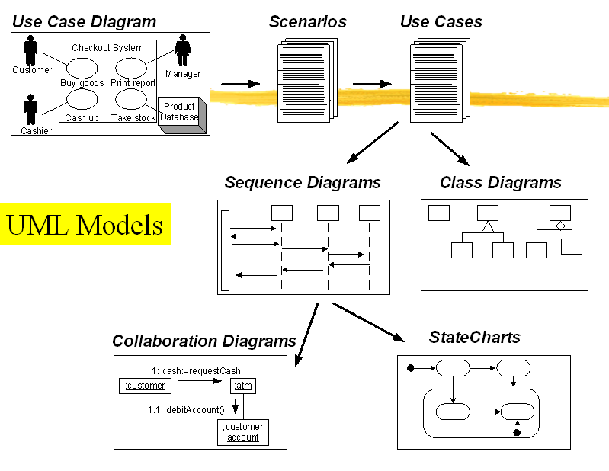
System Modeling
By Samer Zein, PhD

Slide 2
Introduction
System modeling is the process of developing abstract models of a system, with each model presenting a different view or perspective of that system.
System models are used during
Requirements Engineering
System Design
After Implementation

Slide 3
Introduction..2
You can also develop system models to describe:
Existing system: facilitate communication and understanding with customer, derive requirements, etc.
Future System

Slide 4
System Models to View Different Perspectives
An external perspective, where you model the context or environment of the system
An interaction perspective where you model the interactions between a system and its environment or between the components of a system
A structural perspective, where you model the organization of a system or the structure of the data that is processed by the system.
A behavioral perspective, where you model the dynamic behavior of the system and how it responds to events.

Slide 5
Main UML Models
Use Case Diagrams
Activity Diagrams
Class Diagrams
Sequence Diagrams
State Diagrams

Slide 6
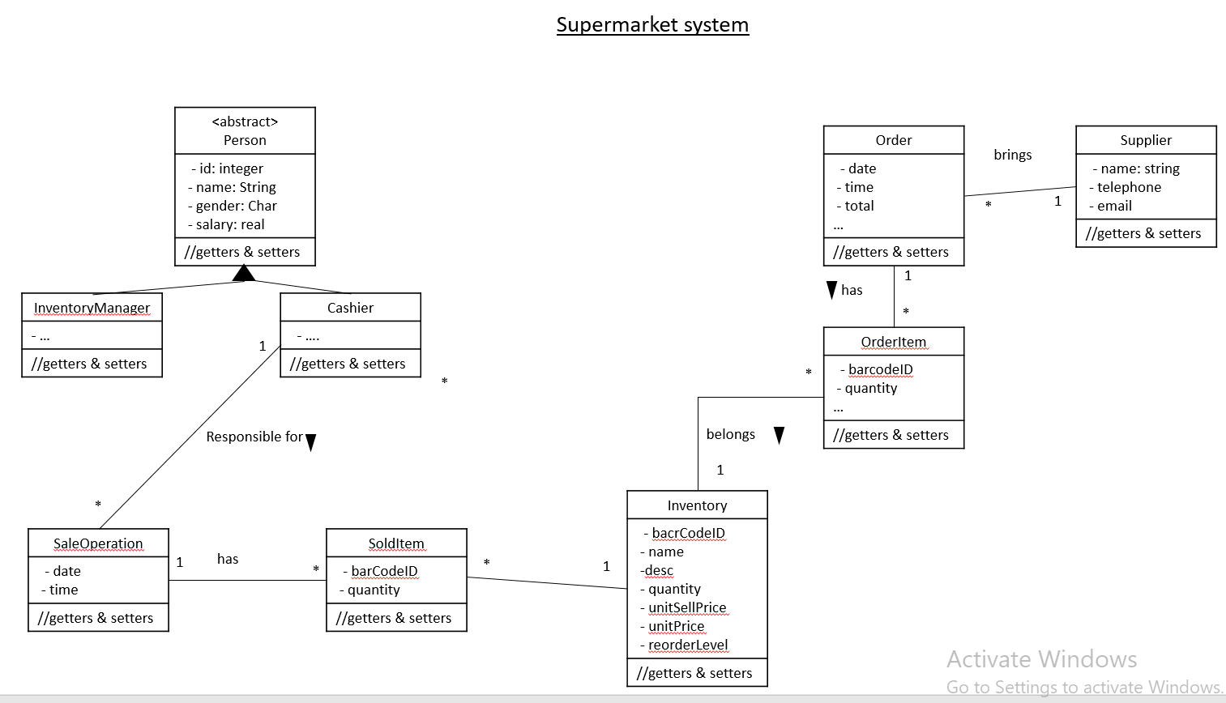

Slide 7
Supermarket system
<abstract> Person
- id: integer - name: String - gender: Char - salary: real
//getters & setters
Order
- date - time - total …
//getters & setters
Supplier
- name: string - telephone - email
//getters & setters
brings
*
1
has
1
InventoryManager
- …
//getters & setters
Cashier
- ….
//getters & setters
*
1
OrderItem
- barcodeID - quantity …
//getters & setters
*
*
Responsible for
belongs
1
*
Inventory
- bacrCodeID - name -desc - quantity - unitSellPrice - unitPrice - reorderLevel
//getters & setters
SaleOperation
- date - time
//getters & setters
has
SoldItem
- barCodeID - quantity
//getters & setters
1
*
*
1

Slide 8
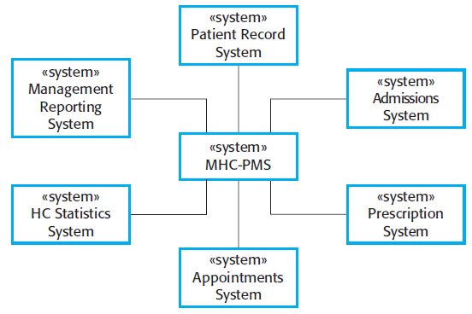
Context Models
Describe the boundary of a system
Used early during requirements engineering

Slide 9
Interaction Models: Use Case Diagrams
Use case modeling, which is mostly used to model interactions between a system and external actors (users or other systems).
High level interaction.

Slide 10
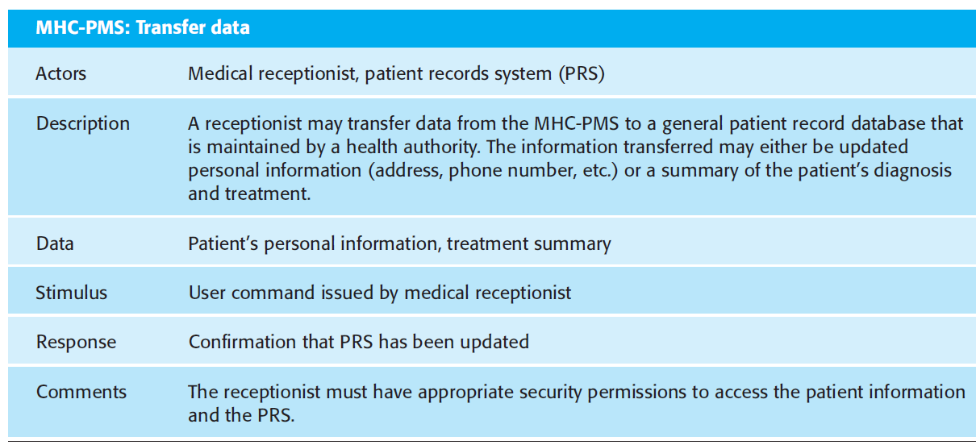
Can Also Use Tabular Presentation to show more details

Slide 11
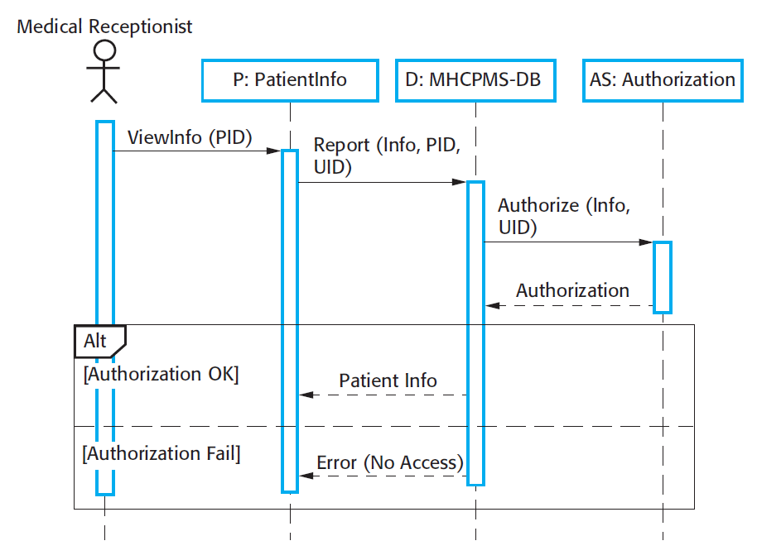
Higher level Sequence Diagram

Slide 12
