Slide 1
Chapter 1:Sample Questions

Slide 4
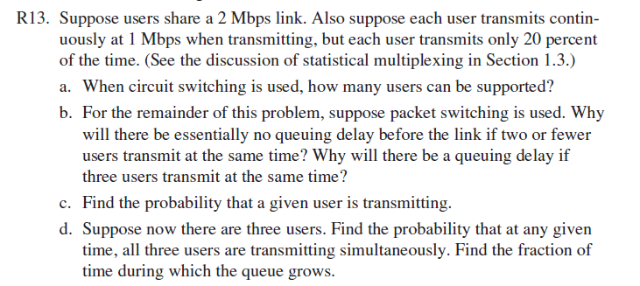
$$\left({3 \atop 3}\right){0.2}^{3{\left(1−0.2\right)}^{3−3}}$$

Slide 7
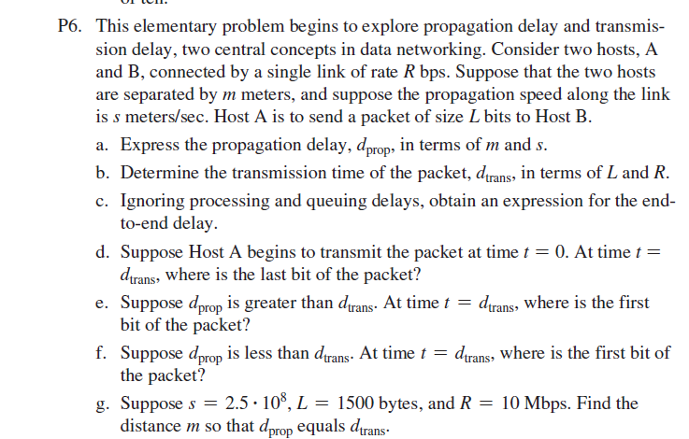

Slide 8
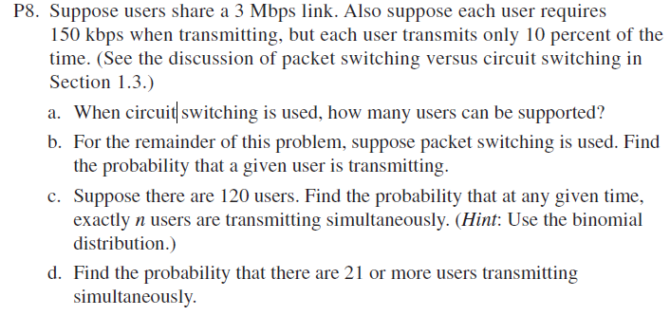

Slide 10
Total delay= IL/R(1-I)+L/R=L/R(1/(1-I)
I=aL/R
X=L/R
Total Delay=x/(1-ax)

Slide 11
1st packet delay=0
2nd packet Delay=L/R
3rd packet delay= 2L/R
Ith packet delay= (i-1)L/R
$$\sum_{i=1}^{N}{\frac{\left(i−1\right)L}{R}=}$$
L/R($\sum_{i=1}^{N}{\left(i\right)−N)=} L/R\left(\frac{N\left(N+1\right)}{2}−N\right)$
L/2R(N(N-1))
Avg=(L/2R)*(N-1)

