Slide 1
Logic and Automated Reasoning

Slide 2
Knowledge-based agents
Inference engine
Domain-independent algorithms
Knowledge base
Domain-specific content
Knowledge base (KB) = set of sentences in a formal language
Declarative approach to building an agent (or other system):
  Tell it what it needs to know
Then it can ask itself what to do - answers should follow from the KB
Distinction between data and program
Fullest realization of this philosophy was in the field of expert systems or knowledge-based systems in the 1970s and 1980s

Slide 3
What is logic?
Logic is a formal system for manipulating facts so that true conclusions may be drawn
  “The tool for distinguishing between the true and the false” – Averroes (12th cen.)
Syntax: rules for constructing valid sentences
  E.g., x + 2 ≥ y is a valid arithmetic sentence, ≥x2y + is not
Semantics: “meaning” of sentences, or relationship between logical sentences and the real world
  Specifically, semantics defines truth of sentences
  E.g., x + 2 ≥ y is true in a world where x = 5 and y = 7

Slide 4
Overview
Propositional logic
Inference rules and theorem proving
First order logic

Slide 5
Propositional logic: Syntax
Atomic sentence:
  A proposition symbol representing a true or false statement
Negation:
  If P is a sentence, ¬P is a sentence
Conjunction:
  If P and Q are sentences, P ∧ Q is a sentence
Disjunction:
  If P and Q are sentences, P ∨ Q is a sentence
Implication:
  If P and Q are sentences, P ⇒ Q is a sentence
Biconditional:
  If P and Q are sentences, P ⇔ Q is a sentence
¬, ∧, ∨, ⇒, ⇔ are called logical connectives

Slide 6
Propositional logic: Semantics
A interpretation I specifies the true/false status of each proposition symbol in the knowledge base
A model is an interpretation in which the formula of interest is True. Given P, Q and R propositions:
  Could be: P is true, Q is true, R is false or {P, Q, R’} or {P, Q}
  With three symbols, there are 8 possible interpretations, and they can be enumerated exhaustively: 000➔111: {P’, Q’, R’} ➔ {P, Q, R}
Rules for evaluating truth with respect to a model:
¬P is true iff P is false
P ∧ Q is true iff P is true and Q is true
P ∨ Q is true iff P is true or Q is true
P ⇒ Q is true iff P is false or Q is true
P ⇔ Q is true iff P ⇒ Q is true and Q ⇒ P is true

Slide 7
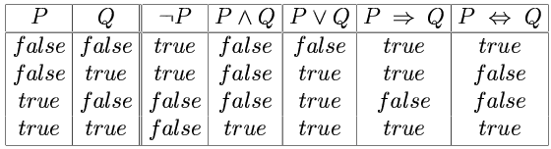
Truth tables
A truth table specifies the truth value of a composite sentence for each possible assignments of truth values to its atoms.
The truth value of a more complex sentence can be evaluated recursively or compositionally
Rain➔ umbrella, can carry umbrella in sun!

Slide 8
Models, Interpretations, Worlds
An interpretation I (world) is an assignment of values (T,F) to ALL variables in a formula α
An interpretation is a model for formula α if α is True in that interpretation:
Given formula α= A V B’: Interpretations: 11; 1,0;01;00
Models are 10,11,00 Nonmodel: 01
Frequently, the interpretation and model are used interchangeably with the context determining the meaning: HERE (in our slides)
E.g. 10,11,00 are the models in which α is TRUE
and 01 is the model in which α is FALSE
Also {A}, {A,B}, {}, are models of α; {B} is not a model.

Slide 9
Models and Interpretations
May specify interpretation by listing positive literals only.
P ⊕ Q: has 4 interpretations and 2 models.
{P}, {Q} are models and interpretations,
{P,Q} is an interpretation but not a model!
However:
Some people use model to mean interpretation: and distinguish between models in which a formula is true and false!
This may be the approach in some of these slides and may be more: but be careful.

Slide 10
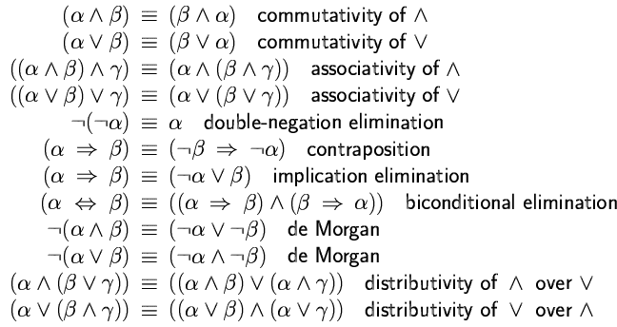
Logical equivalence
Two sentences are logically equivalent iff they are true in same models

Slide 11
Logical equivalence: Clauses
Two sentences are logically equivalent iff they are true in same interpretations:
α→β= α’ v β [same as T ^ α→β V F] T=true, F=false
α1 ^ α2 ^ α3 ^ α4→β= α1’ v α2’ v α3’ v α4’ v β
α1 ^ α2 ^ α3 ^ α4→β1 v β2 v β3 =
α1’ v α2’ v α3’ v α4’ v β1 v β2 v β3
α1 ^ α2 ^ α3 ^ α4→ = α1’ v α2’ v α3’ v α4’
→β1 v β2 v β3 = β1 v β2 v β3

Slide 12
Logical equivalence: Clauses
A literal: an atom or negated atom: α3, α4’, β1
A clause: disjunction of Literals: α3’ v α4’ v β1
□: is the empty clause –Never True-

Slide 13
Validity, satisfiability
A sentence is valid if it is true in all Interpretations,
  e.g., True, 1 , A ∨¬A, A ⇒ A, (A ∧ (A ⇒ B)) ⇒ B
A sentence is satisfiable if it is true in some Interpretation (has a model)
  e.g., A∨B, C
A sentence is unsatisfiable if it is true in no Interpretation (has no models)
  e.g., A∧¬A, 0, False, (A ∨¬A) ⇒
  Valid is also satisfiable,
  Not Valid is either satisfiable or Unsatisfiable:
  S1= A ∨ C, S2= ¬A ∧A

Slide 14
Validity, satisfiability
  If sentence S1 is valid then ¬S1 is
  Unsatisfiable S1=[A ∨¬A]> ¬S1= ¬A ∧A
  If sentence S2 is unstaisfiable then ¬S2 is
  Valid. S2=[¬A ∧A]> ¬S2= A ∨¬A
  If sentence S3 is satisfiable then ¬S3 is
  satisfiable or unsatisfiable: S3= A ∨ C, S3= A ∨¬A,
  If sentence S4 is not valid then ¬S4 is
  Satisfiable or invalid: S4= A ∨ C, S4= ¬A ∧A,

Slide 15
Entailment
Entailment means that a sentence follows from the premises contained in the knowledge base:
KB ╞ α
KB entails sentence α if and only if α is true in all interpretations where KB is true (KB Models)
  E.g., KB : {x = 0} entailsα: {x * y = 0}
  Can α be true when KB is false?
  Of course: x=5, KB is false, x * y = 0 [y=0]➔ α is true!!
KB ╞ α iff (KB ⇒ α) is valid or (¬KB ∨ α) is valid
KB ╞ α iff (KB ∧¬α) is unsatisfiable: has no models
Negate α and prove (KB ∧¬α) unsatisfiable:
Refutational proof, proof by contradiction
Notes:
If a╞ b, a is a stronger assertion than b (a rules out more possible worlds)

Slide 16
Entailment
Entailment Example for KB ╞ α
Let KB = P➔Q and P, Let α=P, show that KB ╞ α
2 variable, 4 interpretations.
P | Q | P➔Q | {P➔Q, P} | Q | {P➔Q, P, Q’}
0 | 0 | 1 | 0 | 0 | 0
0 | 1 | 1 | 0 | 1 | 0
1 | 0 | 0 | 0 | 0 | 0
1 | 1 | 1 | 1 | 1 | 0
Notes:
If a╞ b, a is a stronger assertion than b (a rules out more possible worlds)

Slide 17
Entailment Example
Let KB = R^P➔Q and P, Let α=Q, show thatKB╞ α
3 variable, 8 interpretations. Enumeration:
P | Q | R | R^P | {R^P➔Q} | {R^P➔Q, P} | KB ∧ ¬ α
0 | 0 | 0 | 0 | 1 | 0 | 0
0 | 0 | 1 | 0 | 1 | 0 | 0
0 | 1 | 0 | 0 | 1 | 0 | 0
0 | 1 | 1 | 0 | 1 | 0 | 0
1 | 0* | 0 | 0 | 1 | 1 *** | 1***
1 | 0 | 1 | 1 | 0 | 0 | 0
1 1 | 1 1 | 0 1 | 0 1 | 1 1 | 1 1 | 0 0
Notes:
If a╞ b, a is a stronger assertion than b (a rules out more possible worlds)

Slide 18
Entailment

Slide 19
Entailment

Slide 20
Entailment

Slide 21
Entailment
Check that: (KB ∧¬α) unsatisfiable

Slide 22
Inference
Logical inference: a procedure for generating sentences that follow from a knowledge base KB
An inference procedure is sound if whenever it derives a sentence α, KB╞ α
  A sound inference procedure can derive only true sentences
An inference procedure is complete if whenever
KB╞ α, α can be derived by the procedure
  A complete inference procedure can derive every entailed sentence

Slide 23
Inference: Sound and Complete
Can be sound but not complete:
E.g. Derive nothing from any KB.
Or from A∧B derive only A
Can be complete but not sound.
Or from A∧B derive A and B and C ?
E.g. Derive everything from any KB.
Best if both sound and complete: drives all and only what is derivable: all the truth and nothing but the truth: كل الحق ولا شيء غير الحق

Slide 24
Inference
How can we check whether a sentence α is entailed by KB?
How about we enumerate all possible models of the KB (truth assignments of all its symbols), and check that α is true in every model in which KB is true?
  Is this sound?
  Is this complete?
Problem: if KB contains n symbols, the truth table will be of size 2^{n}
Better idea: use inference rules, or sound procedures to generate new sentences or conclusions given the premises in the KB

Slide 25
Inference rules
Modus Ponens
P-->Q, P
Q
And-elimination
Rule
Fact
premises
conclusion
Goal

Slide 26
Inference rules
And-introduction
Or-introduction

Slide 27
Inference rules
Double negative elimination
Unit resolution

Slide 28
Resolution
or
Example:
  α: “The weather is dry”
  β: “The weather is rainy”
  γ: “I carry an umbrella”

Slide 29
Resolution
Examples:
P v Q, ¬ P v R gives Q v R
¬ P v R, P gives R
¬ P v R, ¬R v P gives P v ¬P OR R v ¬R =1
¬ P, P gives ., or empty clause or  always false =0

Slide 30
Resolution is complete
To prove KB╞ α, assume KB ∧ ¬ α
and derive a contradiction: Refutation proof!
Rewrite KB ∧ ¬ α as a conjunction of clauses,
or disjunctions of literals
  Conjunctive normal form (CNF) (product of sums)
  (¬P ∨ Q ∨ R) ∧(S ∨ P ∨ T ∨¬R) ∧(Q ∨ S)
  Disjuncts are clauses, sets of literals: {¬P,Q,R}, {S,P,T,¬R},{Q,S}
  Special case: the empty set (empty clause){}, 
Keep applying resolution to clauses that contain complementary literals and adding resulting clauses
to the list
  If there are no new clauses to be added, then KB does not entail α
  If two clauses resolve to form an empty clause, we have a contradiction and KB╞ α

Slide 31
Complexity of inference
Propositional inference is co-NP-complete
  Complement of the SAT problem: α ╞ β if and only if the sentence α ∧ ¬ β is unsatisfiable
  Every known inference algorithm has worst-case exponential running time
Efficient inference possible for restricted cases
Notes:
Co-NP: class of problems for which the “no” answer is easy to check, e.g., “Is this formula unsatisfiable?”

Slide 32
Proof, Refutation Proof
P v Q, P→R, Q→ R: can prove R? Yes:
1- P v Q -- {P, Q}
2- ¬ P v R -- {¬P, R}
3- ¬Q v R -- {¬Q, R}
Clause 9 is a proof of R. But refutation is more convenient!
4- ¬R -- {¬R}

Slide 33
Example
If Omar visits Poland (P), then Omar visits Quebec (Q). If it is Monday (M), Omar visits Poland or Québec. Prove that, if it is Monday, then Omar visits Québec.
Query (Goal): M→ Q or ¬ M v Q: =not easy to prove this: so REFUTATION-
Goal negation: M and ¬ Q:: {M}, {¬ Q}

Slide 34
Definite clauses
A definite clause is a disjunction with exactly one positive literal
Equivalent to (P₁ ∧ … ∧ P_{n}) ⇒ Q
Basis of logic programming (Prolog)
Efficient (linear-time) complete inference through forward chaining and backward chaining
conclusion
or head
premise or body

Slide 35
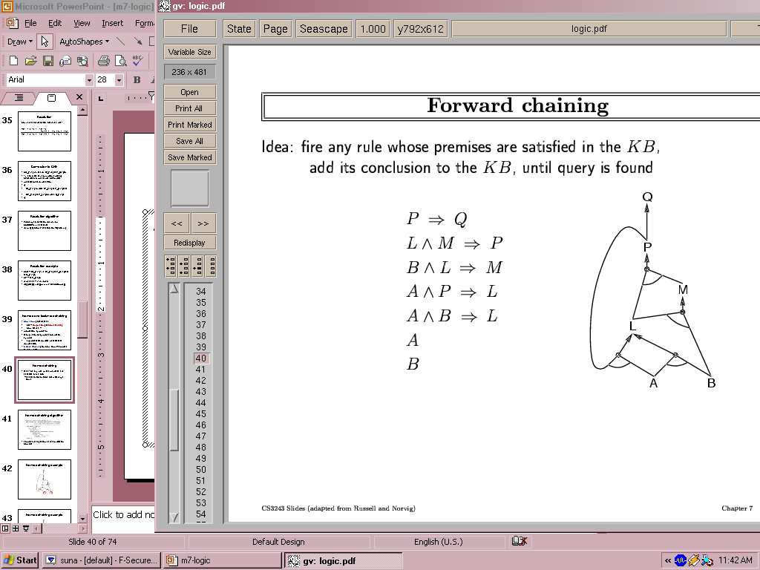
Forward chaining
Idea: find any rule whose premises are satisfied in the KB, add its conclusion to the KB, and keep going until query is found. Let Goal be Q

Slide 36
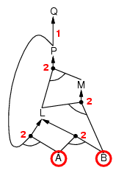
Forward chaining example
AND-OR Graph
  multiple links joined by an arc indicate conjunction – every link must be proved
  multiple links without an arc indicate disjunction – any link can be proved
Empty circles: symbols known to be true but not yet “processed”
Counts: how many premises of each implication are yet unknown
Notes:
Empty circles: symbols known to be true but not yet “processed”
Counts: how many premises of each implication are yet unknown

Slide 37
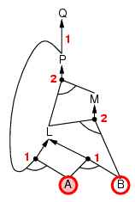
Forward chaining example

Slide 38
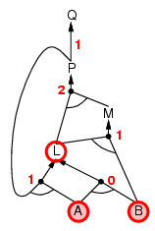
Forward chaining example

Slide 39
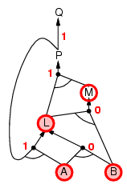
Forward chaining example

Slide 40
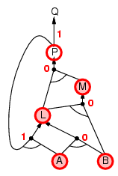
Forward chaining example

Slide 41
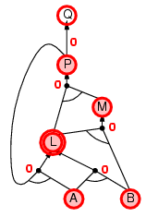
Forward chaining example

Slide 42
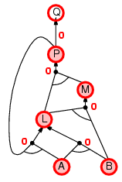
Forward chaining example

Slide 43

Forward chaining example

Slide 44
Backward chaining
Idea: work backwards from the query q:
  to prove q by BC,
    check if q is known already, or
    prove by BC all premises of some rule concluding q

Slide 45
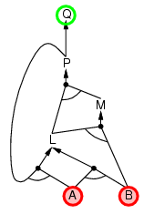
Backward chaining example

Slide 46
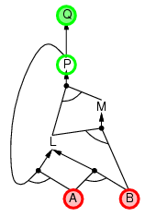
Backward chaining example

Slide 47
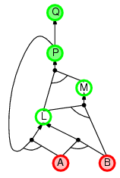
Backward chaining example

Slide 48
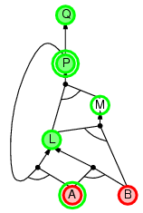
Backward chaining example

Slide 49
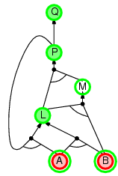
Backward chaining example

Slide 50
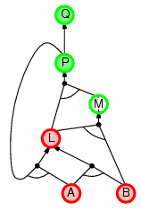
Backward chaining example

Slide 51
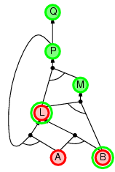
Backward chaining example

Slide 52
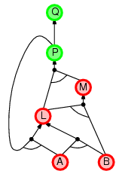
Backward chaining example

Slide 53
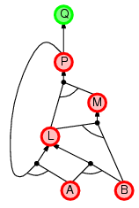
Backward chaining example

Slide 54
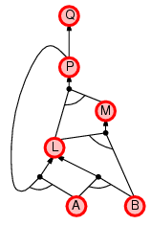
Backward chaining example

Slide 55
Forward vs. backward chaining
Forward chaining is data-driven, automatic processing
  May do lots of work that is irrelevant to the goal
Backward chaining is goal-driven, appropriate for problem-solving
  Complexity can be much less than linear in size of KB

Slide 56
Summary
Logical agents apply inference to a knowledge base to derive new information and make decisions
Basic concepts of logic:
  syntax: formal structure of sentences
  semantics: truth of sentences wrt models
  entailment: necessary truth of one sentence given another
  inference: deriving sentences from other sentences
  soundness: derivations produce only entailed sentences
  completeness: derivations can produce all entailed sentences
Resolution is complete for propositional logic
Forward, backward chaining are linear-time, complete for definite clauses

Slide 57
First-Order Logic

Slide 58
Limitations of propositional logic
Suppose you want to say “All humans are mortal”
  In propositional logic, you would need
  ~10 billion statements
Suppose you want to say “Some people can run a marathon”
  You would need a disjunction of 10 billion statements

Slide 59
First-order logic
Propositional logic assumes the world consists of atomic facts
First-order logic assumes the world contains objects, relations, and functions

Slide 60
Syntax of FOL
Constants: John, Sally, 2, ...
Variables: x, y, a, b,...
Predicates: Person(John), Siblings(John, Sally), IsOdd(2), ...
Functions: MotherOf(John), Sqrt(x), ...
Connectives: ¬, ∧, ∨, ⇒, ⇔
Equality: =
Quantifiers: ∀, ∃
Term: Constant or Variable or Function(Term₁, ... , Term_{n})
Atomic sentence: Predicate(Term₁, ... , Term_{n}) or Term₁ = Term₂
Complex sentence: made from atomic sentences using connectives
and quantifiers
Possible overloading between Functions and Predicates:
FatherOf(Ali,Omar): True or False; FatherOf(Hasan): possibly Issam

Slide 61
Semantics of FOL
Sentences are true with respect to a model and an interpretation
Model contains objects (domain elements) and relations among them
Interpretation specifies referents for
  constant symbols → objects
  predicate symbols → relations
  function symbols → functional relations
An atomic sentence Predicate(Term₁, ... , Term_{n}) is true iff the objects referred to by Term₁, ... , Term_{n} are in the relation referred to by Predicate

Slide 62
Universal quantification
∀x P(x)
Example: “Everyone at BZU is smart”
  ∀x At(x,BZU) ⇒ Smart(x)
  Why not ∀x At(x,BZU) ∧ Smart(x)?
Roughly speaking, equivalent to the conjunction of all possible instantiations of the variable:
  [At(Mariam, BZU) ⇒ Smart(Mariam)] ∧ ...
  [At(Hasan, BZU) ⇒ Smart(Hasan)] ∧ ...
∀x P(x) is true in a model m iff P(x) is true with x being each possible object in the model

Slide 63
Existential quantification
∃x P(x)
Example: “Someone at BZU is smart”
  ∃x At(x,BZU) ∧ Smart(x)
  Why not ∃x At(x, BZU) ⇒ Smart(x)?
Roughly speaking, equivalent to the disjunction of all possible instantiations:
  [At(Mariam, BZU) ∧ Smart(Mariam)] ∨
  [At(Hasan, BZU) ∧ Smart(Hasan)] ∨ …
∃x P(x) is true in a model m iff P(x) is true with x being some possible object in the model

Slide 64
Properties of quantifiers
∀x ∀y is the same as ∀y ∀x
∃x ∃y is the same as ∃y ∃x
∃x ∀y is not the same as ∀y ∃x
  ∃x ∀y Loves(x,y)
  “There is a person who loves everyone”
  ∀y ∃x Loves(x,y)
  “Everyone is loved by at least one person”
Quantifier duality: each quantifier can be expressed using the other with the help of negation
  ∀x Likes(x,IceCream) ¬∃x ¬Likes(x,IceCream)
  ∃x Likes(x,Broccoli) ¬∀x ¬Likes(x,Broccoli)

Slide 65
Equality
Term₁ = Term₂ is true under a given model if and only if Term₁ and Term₂ refer to the same object
E.g., definition of Sibling in terms of Parent:
  ∀x,y Sibling(x,y) ⇔
  [¬(x = y) ∧ ∃m,f ¬ (m = f) ∧ Parent(m,x) ∧ Parent(f,x) ∧ Parent(m,y) ∧ Parent(f,y)]

Slide 66
Using FOL: The Kinship Domain
Brothers are siblings
  ∀x,y Brother(x,y) ⇒ Sibling(x,y)
“Sibling” is symmetric
  ∀x,y Sibling(x,y) ⇔ Sibling(y,x)
One's mother is one's female parent
  ∀m,c (Mother(c) = m) ⇔ (Female(m) ∧ Parent(m,c))

Slide 67
Using FOL: The Set Domain
∀s Set(s) ⇔ (s = {}) ∨ (∃x,s₂ Set(s₂) ∧ s = {x|s₂})
¬∃x,s {x|s} = {}
∀x,s x ∈ s ⇔ s = {x|s}
∀x,s x ∈ s ⇔ [ ∃y,s₂ (s = {y|s₂} ∧ (x = y ∨ x ∈ s₂))]
∀s₁,s₂ s₁ ⊆ s₂ ⇔ (∀x x ∈ s₁ ⇒ x ∈ s₂)
∀s₁,s₂ (s₁ = s₂) ⇔ (s₁ ⊆ s₂ ∧ s₂ ⊆ s₁)
∀x,s₁,s₂ x ∈ (s₁ ∩ s₂) ⇔ (x ∈ s₁ ∧ x ∈ s₂)
∀x,s₁,s₂ x ∈ (s₁ ∪ s₂) ⇔ (x ∈ s₁ ∨ x ∈ s₂)

Slide 68
Translating English to FOL
Every gardener likes the sun.
  ∀x gardener(x) → likes(x,Sun)
You can fool some of the people all of the time.
  ∃x ∀t person(x) ∧time(t) → can-fool(x,t)
You can fool all of the people some of the time.
  ∀x ∃t (person(x) → time(t) ∧can-fool(x,t))
  ∀x (person(x) → ∃t (time(t) ∧can-fool(x,t)))
All purple mushrooms are poisonous.
  ∀x (mushroom(x) ∧ purple(x)) → poisonous(x)
No purple mushroom is poisonous.
  ¬∃x purple(x) ∧ mushroom(x) ∧ poisonous(x)
  ∀x (mushroom(x) ∧ purple(x)) → ¬poisonous(x)
There are exactly two purple mushrooms.
  ∃x ∃y mushroom(x) ∧ purple(x) ∧ mushroom(y) ∧ purple(y) ^ ¬(x=y) ∧ ∀z (mushroom(z) ∧ purple(z)) → ((x=z) ∨ (y=z))
Clinton is not tall.
  ¬tall(Clinton)
Every person who commits a crime must be punished.
  ∀x commitscrime(x) → punished(x)
  What is : ∀x commitscrime(x) ∧ punished(x) XX
Equivalent
Equivalent

Slide 69
Translating English to FOL
  Everybody is loved by all people:
  ∀ z ∀x Loved1By2(x,z)
  Somebody is loved by all people:
  ∃z ∀x Loved1By2(z,x) … ∀x Loved1By2(C1,x)
  Somebody is loved by somebody:
  ∃z ∃x Loved1By2(x,z) … Loved1By2(C1,C2)
  Everybody is loved by somebody:
  ∀z ∃x Loved1By2(z,x) … ∀z Loved1By2(z,M(z)); M(z)=mother/fiancé(z)
  Some people love all animals:
  ∃z ∀x Person(z) ∧ Animal(x) ∧ Loved1By2(x,z)
  Any two real numbers have a number between them:
  ∀ x ∀x ∃z Between(x,y,z) … ∀ x ∀x Between(x,y,f(x,y)); f(x,y) =x+y/2
X is above Y iff X is directly on top of Y or there is a pile of one or more other objects directly on top of one another starting with X and ending with Y.
  ∀x ∀y above(x,y) ↔ (on(x,y) ∨ ∃z (on(x,z) ∧ above(z,y)))

Slide 70
Example: A simple genealogy KB by FOL
Build a small genealogy knowledge base using FOL that
  contains facts of immediate family relations (spouses, parents, etc.)
  contains definitions of more complex relations (ancestors, relatives)
  is able to answer queries about relationships between people
Predicates:
  parent(x, y), child(x, y), father(x, y), daughter(x, y), etc.
  spouse(x, y), husband(x, y), wife(x,y)
  ancestor(x, y), descendant(x, y)
  male(x), female(y)
  relative(x, y)
Facts:
  husband(Joe, Mary), son(Fred, Joe)
  spouse(John, Nancy), male(John), son(Mark, Nancy)
  father(Jack, Nancy), daughter(Linda, Jack)
  daughter(Liz, Linda)
  etc.

Slide 71
Rules for genealogical relations
  (∀x,y) parent(x, y) ↔ child (y, x)
  (∀x,y) father(x, y) ↔ parent(x, y) ∧ male(x) (similarly for mother(x, y))
  (∀x,y) daughter(x, y) ↔ child(x, y) ∧ female(x) (similarly for son(x, y))
  (∀x,y) husband(x, y) ↔ spouse(x, y) ∧ male(x) (similarly for wife(x, y))
  (∀x,y) spouse(x, y) ↔ spouse(y, x) (spouse relation is symmetric)
  (∀x,y) parent(x, y) → ancestor(x, y)
  (∀x,y)(∃z) parent(x, z) ∧ ancestor(z, y) → ancestor(x, y)
  (∀x,y) descendant(x, y) ↔ ancestor(y, x)
  (∀x,y)(∃z) ancestor(z, x) ∧ ancestor(z, y) → relative(x, y)
  (∀x,y) parent(x, y) → mother (y, x) or father (y, x) !!!!!
  (∀x,y) sibling(x, y) → brother (y, x) or sister (y, x) !!!!!
  (∀x,y) uncle(x, y) → خال (y, x) or عم (y, x) !!!!!

Slide 72
Rules for genealogical relations
  (related by common ancestry)
  (∀x,y) spouse(x, y) → relative(x, y) (related by marriage)
  (∀x,y)(∃z) relative(z, x) ∧ relative(z, y) → relative(x, y) (transitive)
  (∀x,y) relative(x, y) ↔ relative(y, x) (symmetric)
Queries
  ancestor(Jack, Fred) /* the answer is yes */
  relative(Liz, Joe) /* the answer is yes */
  relative(Nancy, Matthew)
  /* no answer in general, no if under closed world assumption */
  (∃z) ancestor(z, Fred) ∧ ancestor(z, Liz)

Slide 73
Why “First order”?
FOL permits quantification over variables
Higher order logics permit quantification over functions and predicates:
∀P,x [P(x) ∨ ¬P(x)]
∀x,y (x=y) ⇔ [∀P (P(x)⇔P(y))]

Slide 74
Inference in FOL
All rules of inference for propositional logic apply to first-order logic
We just need to reduce FOL sentences to PL sentences by instantiating variables and removing quantifiers

Slide 75
Reduction of FOL to PL
Suppose the KB contains the following:
  ∀x King(x) ∧ Greedy(x) ⇒ Evil(x)
  King(John), Greedy(John), Brother(Richard,John)
How can we reduce this to PL?
Let’s instantiate the universal sentence in all possible ways:
  King(John) ∧ Greedy(John) ⇒ Evil(John)
  King(Richard) ∧ Greedy(Richard) ⇒ Evil(Richard)
  King(John) Greedy(John) Brother(Richard,John)
The KB is propositionalized
  Proposition symbols are King(John), Greedy(John), Evil(John), King(Richard), etc.

Slide 76
Reduction of FOL to PL
What about existential quantification, e.g.,
  ∃x Crown(x) ∧ OnHead(x,John) ?
Let’s instantiate the sentence with a new constant that doesn’t appear anywhere in the KB:
  Crown(C₁) ∧ OnHead(C₁,John)

Slide 77
Propositionalization
Every FOL KB can be propositionalized so as to preserve entailment
  A ground sentence is entailed by the new KB iff it is entailed by the original KB
Idea: propositionalize KB and query, apply resolution, return result
Problem: with function symbols, there are infinitely many ground terms
  For example, Father(X) yields Father(John), Father(Father(John)), Father(Father(Father(John))), etc.

Slide 78
Propositionalization
Theorem (Herbrand 1930):
  If a sentence α is entailed by an FOL KB, it is entailed by a finite subset of the propositionalized KB
Idea: For n = 0 to Infinity do
  Create a propositional KB by instantiating with depth-n terms
  See if α is entailed by this KB
Problem: works if α is entailed, loops if α is not entailed
Theorem (Turing 1936, Church 1936):
  Entailment for FOL is semidecidable: algorithms exist that say yes to every entailed sentence, but no algorithm exists that also says no to every nonentailed sentence

Slide 79
Inference in FOL
“All men are mortal. Socrates is a man; therefore, Socrates is mortal.”
∀x man(x) → mortal(x)
man(Socrates)
Mortal(Socrates)??
It seems to work if we replace x by Scorates
Can we prove this without full propositionalization as an intermediate step?
Can we do that with the least propositionalization?

Slide 80
Generalized Modus Ponens (GMP)
(p₁ ∧ p₂ ∧ … ∧ p_{n} ⇒q), p₁', p₂', … , p_{n}'
such that SUBST(θ, p_{i})= SUBST(θ, p_{i}') for all i
SUBST(θ,q)
All variables assumed universally quantified
Example:
  ∀x King(x) ∧ Greedy(x) ⇒ Evil(x)
  King(John) Greedy(John) Brother(Richard,John)
  p₁ is King(x), p₂ is Greedy(x), q is Evil(x)
  p₁' is King(John), p₂' is Greedy(y), θ is {x/John,y/John}
  SUBST(θ,q) is Evil(John)

Slide 81
Predicate Logic and CNF
  [Q ⇒ P] ⇒ S;To CNF: [¬Q ∨ P] ⇒ S; ¬[¬Q ∨ P] ∨ S;
  [Q ∧ ¬ P] ∨ S; [Q ∨ S] ∧ [¬ P ∨ S]; {Q,S}; {P , S}
Converting FOL to CNF is harder - we need to worry about variables and quantifiers.
  1. Eliminate all implications ⇒ P ⇒Q= ¬ P ∨ Q
  2. Reduce the scope of all ¬ to single term.
  3. Make all variable names unique (set apart)
  4. Move Quantifiers Left [leftmost]
  5. Eliminate Existential Quantifiers [No ∃]
  6. Eliminate Universal Quantifiers [all are ∀]
  7. Convert to conjunction of disjuncts CNF
  8. Create separate clause for each conjunct CNF.

Slide 82
Eliminate Existential Quantifiers
To eliminate the quantifier, we can replace the variable with a function.
We don’t know what the function is, we just know it exists.
So we invent one!
It is a function of n variables where n is the number of universally quantifies variables preceding the existential quantifier

Slide 83
Skolem functions
∃ y President(y)
We replace y with a new function func:
President(func())
func is called a skolem function.
In general the function must have the same number of arguments as the number of universal quantifiers in the current scope.

Slide 84
Skolemization Example
∀x ∃y Father(y,x)
create a new function named foo and replace y with the function (f1(x) is the function.
x Father(f1(x),x)
z∀x ∀t ∃y Father(y,x,z,t)
z∀x ∀t Father(f2(z,x,t),x,z,t)
z∀x ∃y ∀t Father(y,x,z,t)
z∀x ∀t Father(f3(z,x),x,z,t)
∃y Father(y,x,z,t)
Father(f3(),x,z,t) OR Father(C,x,z,t), C f of 0 var

Slide 85
Conversion to CNF
Everyone who loves all animals is loved by someone:
  ∀x [[∀y [Animal(y) ⇒ Loves(x,y)]] ⇒ [∃y Loves(y,x)]] original
1. Eliminate biconditionals and implications
  ∀x [¬[∀y [ Animal(y) ⇒ Loves(x,y)]] ∨ [∃y Loves(y,x)]
  ∀x [¬[∀y [¬Animal(y) ∨ Loves(x,y)]] ∨ [∃y Loves(y,x)]
2. Move ¬ inwards: ¬∀x p ≡ ∃x ¬p, ¬ ∃x p ≡ ∀x ¬p
  ∀x [∃y ¬(¬Animal(y) ∨ Loves(x,y))] ∨ [∃y Loves(y,x)]
  ∀x [∃y ¬¬Animal(y) ∧ ¬Loves(x,y)] ∨ [∃y Loves(y,x)]
  ∀x [∃y Animal(y) ∧ ¬Loves(x,y)] ∨ [∃y Loves(y,x)]

Slide 86
Conversion to CNF contd.
Standardize variables: each quantifier should use a different one
  ∀x [∃y Animal(y) ∧ ¬Loves(x,y)] ∨ [∃z Loves(z,x)]
4. Skolemize: a more general form of existential instantiation. Each existential variable is replaced by a Skolem function of the enclosing universally quantified variables:F(x)/y, G(x)/z
  ∀x [Animal(F(x)) ∧ ¬Loves(x,F(x))] ∨ Loves(G(x),x)
Drop universal quantifiers: No need, all variables are Universally quantified
  [Animal(F(x)) ∧ ¬Loves(x,F(x))] ∨ Loves(G(x),x)
Distribute ∨ over ∧ :
[Animal(F(x))∨Loves(G(x),x)] ∧ [¬Loves(x,F(x))∨Loves(G(x),x)]

Slide 87
Unification
Now that we have FOL Clauses (CNF) with variables (all universally quantified) we want to apply inference rules
Suppose we have the rule
If x is a working automobile, then x has an engine.
P(x) → Q(x) OR the clause ¬ P(x) ∨ Q(x)
and we have the fact
Tim’s KIA is a working automobile
P(a)
These cannot immediately be resolved because P(x) and P(a) don’t quite match. They must be “unified.”

Slide 88
Modus Ponens in the Predicate Calculus
P(a) → Q(a)
P(a)
---------
Q(a)
But we have
P(x) → Q(x)
So we create a substitution instance of it:
P(a) → Q(a)
using the substitution { a/x }

Slide 89
Substitutions
A substitution is a set of term/variable pairs.
e.g., { a/x, f(a)/y, w/z }
Each element of the set is an elementary substitution.
A particular variable occurs at most once on the the right-hand side of any elementary subst. in a substitution.
{ a/x, b/x } is not an acceptable substitution.
The empty set is an acceptable substitution.
If E is a term or a formula of the predicate calculus, and S is a substitution, then S(E) is the result of applying S to E, i.e., replacing each variable of S that occurs in E by the corresponding term in S.

Slide 90
Unifiers
Given a pair of literals L1 and L2, if S is a substitution such that
S(L1) = S(L2) or S(L1) = ¬S(L2),
then S is a unifier for L1 and L2.
Example:
L1 = ¬P(x, f(a))
L2 = P(b, y)
S = { b/x, f(a)/y }
S(L1) = ¬P(b, f(a)) = ¬S(L2)
Therefore S is a unifier for L1 and L2.

Slide 91
The Occurs Check
A unifier may not contain an elementary substitution of the form f(x)/x and may not cause an indefinite recursion.
In general the term in a term/variable pair may not include that variable.
P(x) and P(f(x)) cannot be unified, since f(x)/x is illegal.
P(y, f(y)) and P(f(x), y) cannot be unified, since
S = { f(x)/y, f(y)/x } leads to an indefinite recursion.
Testing whether a variable appears in its corresponding term is called the “occurs check”.
Some automated reasoning systems do not perform the occurs check in order to save time.

Slide 92
Generality of Unifiers
Some pairs of literals may have more than one possible unifier.
P(x), P(y) is unified by each of { x/y }, { y/x },
{ z/x, z/y }, { a/x, a/y}, { f(a)/x, f(a)/y } etc.
Suppose S1 and S2 are unifiers for P1 and P2.
Then S1(P1) = S1(P2) or S1(P1) = ~S1(P2)
S2(P1) = S2(P2) or S2(P1) = ~S2(P2)
S1 is more general than S2 if there exists S3 such that
S3(S1(P1)) = S2(P1).
S3(S1(P1)) means apply S3 to the result of applying S1 to P1.
{ a/x, a/y } is less general than { y/x }. { y/x } is more general than { a/x, a/y }.

Slide 93
Most General Unifiers
A unifier S1 for L1 and L2 is a most general unifier (MGU) for L1 and L2 provided that for any other unifier S2 of L1 and L2 there exists a substitution S3 such that
S3(S1(L1)) = S2(L1).
S1 = { y/x } is a most general unifier for P(x), P(y).
S2 = { f(a)/x, f(a)/y } is not a MGU for P(x), P(y).
S3 = { f(a)/y }
S3(S1(P(x))) = P(f(a)) = S2(P(x)).

Slide 94
Finding a Most-General Unifier
1. Given literals L1 and L2, place a cursor at the left end of each. Skip any negation sign. If the predicate symbols do not match, return NOT-UNIFIABLE.
2. Let S = { }.
3. Move the cursors right to the next term (argument) in each literal.
If there are no terms left, return S as a MGU else
Let t1 and t2 be the terms.

Slide 95
Finding an MGU (Cont.)
4a. If t1 = t2, go to Step 3.
4b. Otherwise, if either t1 or t2 is a variable (call it v and call the other term t), then attempt to add t/v to S (see below).
4c. Otherwise if t1 and t2 both begin with function symbols, and these symbols are the same, move the cursors to the first argument of these symbols and go to step 4a.
4d. Otherwise, return NOT-UNIFIABLE.

Slide 96
Finding an MGU (Cont.)
When trying to add t/v to S, apply { t/v } to each term in S. If this results in any elementary substitution whose term includes its variable, return NOT-UNIFIABLE.
Otherwise, replace each elementary substitution in S by the result of applying { t/v } and add t/v itself to S.

Slide 97
Example
L1: P(a, f(x, a))
L2: P(a, f(g(y), y))
S: { }
S: { g(y)/x }
S: { g(a)/x, a/y }

Slide 98
Unification
More Examples of Unification:
If we apply the same substitution to both: they become the same.
p q θ
Knows(John,x) Knows(John,Jane) {x/Jane}
Knows(John,x) Knows(y,Mary) {x/Mary, y/John}
Knows(John,x) Knows(y,Mother(y)) {y/John, x/Mother(John)}
Knows(John,x) Knows(x,Mary) {x₁/John, x₂/Mary}
Knows(John,x) Knows(y,z) {y/John, x/z}
P(x, x) P(f(x),x) No. Fails OC
P(x, x) P(f(y),y) {f(y)/x}
P(f(y), f(y)) P(f(y),y) {f(y)/x}o f(y)/y= XXXX
Standardizing apart eliminates overlap of variables
Most general unifier: others special cases: {y/John, x/z} more general than {y/John, x/John, z/John}

Slide 99
Inference with GMP
(p₁ ∧ p₂ ∧ … ∧ p_{n} ⇒q), p₁', p₂', … , p_{n}'
such that SUBST(θ, p_{i})= SUBST(θ, p_{i}') for all i
SUBST(θ,q)
Forward chaining
  Like search: keep proving new things and adding them to the KB until we can prove q
Backward chaining
  Find p₁, …, p_{n} such that knowing them would prove q
  Recursively try to prove p₁, …, p_{n}

Slide 100
Example knowledge base
The law says that it is a crime for an American to sell weapons to hostile nations. The country Nono, an enemy of America, has some missiles, and all of its missiles were sold to it by Colonel West, who is American.
Prove that Col. West is a criminal

Slide 101
Example knowledge base
It is a crime for an American to sell weapons to hostile nations:
  American(x) ∧ Weapon(y) ∧ Sells(x,y,z) ∧ Hostile(z) ⇒ Criminal(x)
Nono has some missiles
∃x Owns(Nono,x) ∧ Missile(x)
  Owns(Nono,M₁) ∧ Missile(M₁) FACTS
All of Nono’s missiles were sold to it by Colonel West
  Missile(x) ∧ Owns(Nono,x) ⇒ Sells(West,x,Nono)
Missiles are weapons:
  Missile(x) ⇒ Weapon(x)
An enemy of America counts as “hostile”:
  Enemy(x,America) ⇒ Hostile(x)
Captain West is American
  American(West) FACTS
The country Nono is an enemy of America
  Enemy(Nono,America)
  Goal: Criminal(West) ?

Slide 102
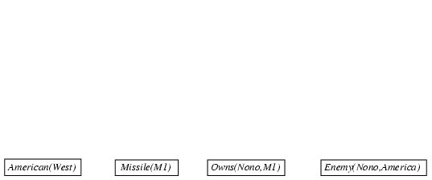
Forward chaining proof
  American(x) ∧ Weapon(y) ∧ Sells(x,y,z) ∧ Hostile(z) ⇒ Criminal(x)
  Owns(Nono,M₁) ∧ Missile(M₁)
  Missile(x) ∧ Owns(Nono,x) ⇒ Sells(West,x,Nono)
  Missile(x) ⇒ Weapon(x) Enemy(x,America) ⇒ Hostile(x)
  American(West) Enemy(Nono,America)

Slide 103
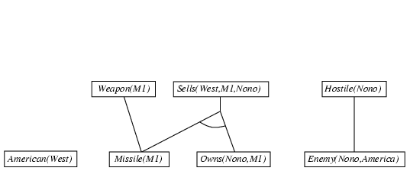
Forward chaining proof
  American(x) ∧ Weapon(y) ∧ Sells(x,y,z) ∧ Hostile(z) ⇒ Criminal(x)
  Owns(Nono,M₁) ∧ Missile(M₁)
  Missile(x) ∧ Owns(Nono,x) ⇒ Sells(West,x,Nono)
  Missile(x) ⇒ Weapon(x) Enemy(x,America) ⇒ Hostile(x)
  American(West) Enemy(Nono,America)

Slide 104
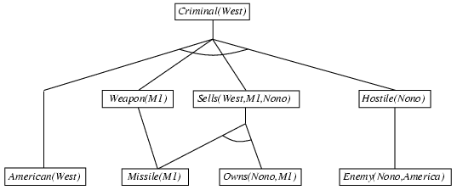
Forward chaining proof
  American(x) ∧ Weapon(y) ∧ Sells(x,y,z) ∧ Hostile(z) ⇒ Criminal(x)
  Owns(Nono,M₁) ∧ Missile(M₁)
  Missile(x) ∧ Owns(Nono,x) ⇒ Sells(West,x,Nono)
  Missile(x) ⇒ Weapon(x) Enemy(x,America) ⇒ Hostile(x)
  American(West) Enemy(Nono,America)

Slide 105

Backward chaining example
  American(x) ∧ Weapon(y) ∧ Sells(x,y,z) ∧ Hostile(z) ⇒ Criminal(x)
  Owns(Nono,M₁) ∧ Missile(M₁)
  Missile(x) ∧ Owns(Nono,x) ⇒ Sells(West,x,Nono)
  Missile(x) ⇒ Weapon(x) Enemy(x,America) ⇒ Hostile(x)
  American(West) Enemy(Nono,America) Criminal(West)

Slide 106
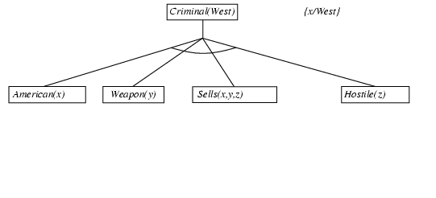
Backward chaining example
  American(x) ∧ Weapon(y) ∧ Sells(x,y,z) ∧ Hostile(z) ⇒ Criminal(x)
  Owns(Nono,M₁) ∧ Missile(M₁)
  Missile(x) ∧ Owns(Nono,x) ⇒ Sells(West,x,Nono)
  Missile(x) ⇒ Weapon(x) Enemy(x,America) ⇒ Hostile(x)
  American(West) Enemy(Nono,America)

Slide 107
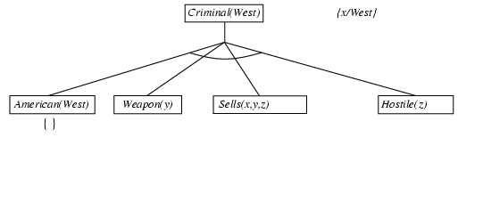
Backward chaining example
  American(x) ∧ Weapon(y) ∧ Sells(x,y,z) ∧ Hostile(z) ⇒ Criminal(x)
  Owns(Nono,M₁) ∧ Missile(M₁)
  Missile(x) ∧ Owns(Nono,x) ⇒ Sells(West,x,Nono)
  Missile(x) ⇒ Weapon(x) Enemy(x,America) ⇒ Hostile(x)
  American(West) Enemy(Nono,America)

Slide 108
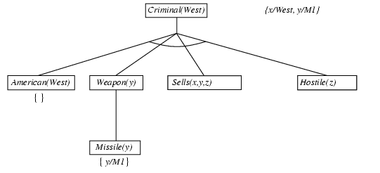
Backward chaining example
  American(x) ∧ Weapon(y) ∧ Sells(x,y,z) ∧ Hostile(z) ⇒ Criminal(x)
  Owns(Nono,M₁) ∧ Missile(M₁)
  Missile(x) ∧ Owns(Nono,x) ⇒ Sells(West,x,Nono)
  Missile(x) ⇒ Weapon(x) Enemy(x,America) ⇒ Hostile(x)
  American(West) Enemy(Nono,America)

Slide 109
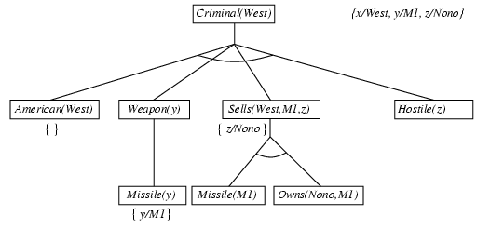
Backward chaining example
  American(x) ∧ Weapon(y) ∧ Sells(x,y,z) ∧ Hostile(z) ⇒ Criminal(x)
  Owns(Nono,M₁) ∧ Missile(M₁)
  Missile(x) ∧ Owns(Nono,x) ⇒ Sells(West,x,Nono)
  Missile(x) ⇒ Weapon(x) Enemy(x,America) ⇒ Hostile(x)
  American(West) Enemy(Nono,America)

Slide 110
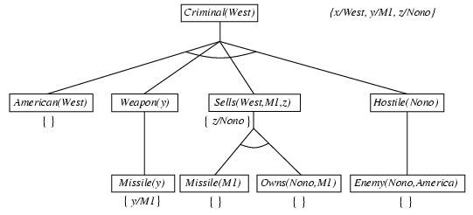
Backward chaining example
  American(x) ∧ Weapon(y) ∧ Sells(x,y,z) ∧ Hostile(z) ⇒ Criminal(x)
  Owns(Nono,M₁) ∧ Missile(M₁)
  Missile(x) ∧ Owns(Nono,x) ⇒ Sells(West,x,Nono)
  Missile(x) ⇒ Weapon(x) Enemy(x,America) ⇒ Hostile(x)
  American(West) Enemy(Nono,America)

Slide 111
Resolution: FOL version
p₁ ∨ ··· ∨ p_{k}, q₁ ∨ ··· ∨ q_{n}
such that UNIFY(p_{i}, ¬q_{j}) = θ
SUBST(θ, p₁ ∨ ··· ∨ p_{i-1} ∨ p_{i+1} ∨ ··· ∨ p_{k} ∨ q₁ ∨ ··· ∨ q_{j-1} ∨ q_{j+1} ∨ ··· ∨ q_{n})
For example,
¬Rich(x) ∨ Unhappy(x)
Rich(Ken)
Unhappy(Ken)
with θ = {x/Ken}
Refutation Proof: Apply resolution steps to CNF(KB ∧ ¬α);
complete for FOL

Slide 112
Example: Resolution
1- ¬ Smart(x) ∨ ¬ LikesHockey(x) ∨ NorthSchool(x)
2- ¬ Canadian(y) ∨ LikesHockey(y)
3- ¬ Skates(z) ∨ LikesHockey(z)
4- Smart(Joe)
5- Skates(Joe)
Goal is to find out if NorthSchool(Joe) is true NorthSchool(Joe) ?
3+5= LikesHockey(Joe)….(6)
4+1= ¬ LikesHockey(Joe) ∨ NorthSchool(Joe) ….(7)
6+7= NorthSchool(Joe) Goal
Next Refutational Proof

Slide 113
Example:Resolution Refutation
1- ¬ Smart(x) ∨ ¬ LikesHockey(x) ∨ NorthSchool(x)
2- ¬ Canadian(y) ∨ LikesHockey(y)
3- ¬ Skates(z) ∨ LikesHockey(z)
4- Smart(Joe)
5- Skates(Joe)
0- ¬ NorthSchool (Joe) (Goal: NorthSchool (Joe))
---------------------------------------------------------------------------------
0+1= ¬ Smart(Joe) ∨ ¬ LikesHockey(Joe) ….(6)
3+5= LikesHockey(Joe)….(7)
4+7= ¬ Skates(Joe)….(8)
0+8=

Slide 114
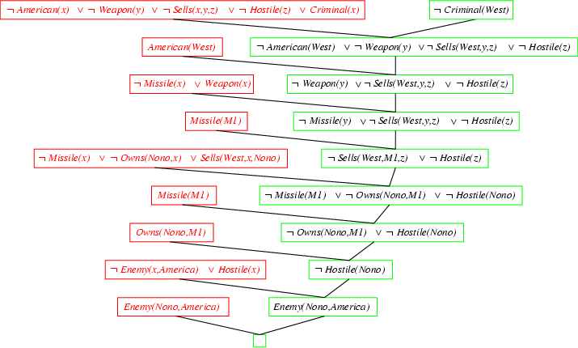
Resolution proof: definite clauses

Slide 115
Logic programming: Prolog
  FOL:
    King(x) ∧ Greedy(x) ⇒ Evil(x)
    Greedy(y)
    King(John)
Prolog:
  evil(X) :- king(X), greedy(X).
  greedy(Y).
  king(john).
Closed-world assumption:
  Every constant refers to a unique object
  Atomic sentences not in the database are assumed to be false
Inference by backward chaining, clauses are tried in the order in which they are listed in the program, and literals (predicates) are tried from left to right

Slide 116
Prolog example
parent(abraham,ishmael).
parent(abraham,isaac).
parent(isaac,esau).
parent(isaac,jacob).
grandparent(X,Y) :- parent(X,Z), parent(Z,Y).
descendant(X,Y) :- parent(Y,X).
descendant(X,Y) :- parent(Z,X), descendant(Z,Y).
? parent(david,solomon).
? parent(abraham,X).
? grandparent(X,Y).
? descendant(X,abraham).

Slide 117
Prolog example
parent(abraham,ishmael).
parent(abraham,isaac).
parent(isaac,esau).
parent(isaac,jacob).
What if we wrote the definition of descendant like this:
descendant(X,Y) :- descendant(Z,Y), parent(Z,X).
descendant(X,Y) :- parent(Y,X).
? descendant(W,abraham).
Backward chaining would go into an infinite loop!
  Prolog inference is not complete, so the ordering of the clauses and the literals is really important

Slide 118
Applications of Automated Reasoning
Diagnosis of Digital Circuits
Software/hardware verification
Rule Based Systems (customer Support)
Mathematics: proving theorems
Deductive databases: rules instead of facts: can save lots of space: database constraints (salaries of managers >supervised_employee)
Ways to treat negation! Can’t prove something

Slide 119
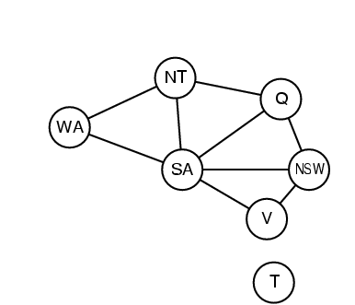
Graph coloring
colorable(Wa,Nt,Sa,Q,Nsw,V) :-
diff(Wa,Nt), diff(Wa,Sa), diff(Nt,Q), diff(Nt,Sa), diff(Q,Nsw), diff(Q,Sa), diff(Nsw,V), diff(Nsw,Sa), diff(V,Sa).
diff(red,blue). diff(red,green). diff(green,red).
diff(green,blue). diff(blue,red). diff(blue,green).

Slide 120
Prolog lists
Appending two lists to produce a third:
append([],Y,Y).
append([X|L],Y,[X|Z]) :- append(L,Y,Z).
query: append(A,B,[1,2])
answers: A=[] B=[1,2]
A=[1] B=[2]
A=[1,2] B=[]

