Slide 1
Chapter 6: Synchronization Tools

Slide 2
Outline
Background
The Critical-Section Problem
Peterson’s Solution
Hardware Support for Synchronization
Mutex Locks
Semaphores
Monitors
Liveness
Evaluation

Slide 3
Objectives
Describe the critical-section problem and illustrate a race condition
Illustrate hardware solutions to the critical-section problem using memory barriers, compare-and-swap operations, and atomic variables
Demonstrate how mutex locks, semaphores, monitors, and condition variables can be used to solve the critical section problem
Evaluate tools that solve the critical-section problem in low-, Moderate-, and high-contention scenarios

Slide 4
Background
Processes can execute concurrently
  May be interrupted at any time, partially completing execution
Concurrent access to shared data may result in data inconsistency
Maintaining data consistency requires mechanisms to ensure the orderly execution of cooperating processes
We illustrated in chapter 4 the problem when we considered the Bounded Buffer problem with use of a counter that is updated concurrently by the producer and consumer,. Which lead to race condition.

Slide 5
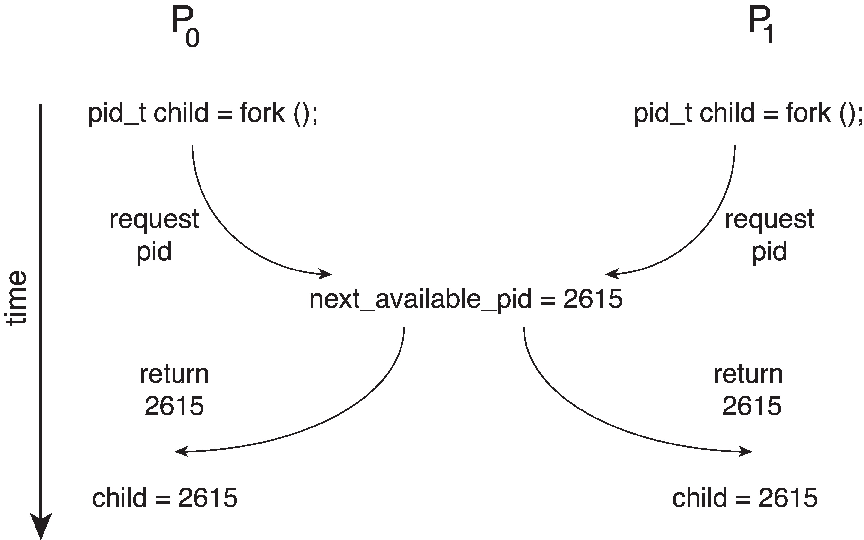
Race Condition
Processes P₀ and P₁ are creating child processes using the fork() system call
Race condition on kernel variable next_available_pid which represents the next available process identifier (pid)
Unless there is a mechanism to prevent P₀ and P₁ from accessing the variable next_available_pid the same pid could be assigned to two different processes!

Slide 6
Critical Section Problem
Consider system of n processes {p₀, p₁, … p_{n-1}}
Each process has critical section segment of code
  Process may be changing common variables, updating table, writing file, etc.
  When one process in critical section, no other may be in its critical section
Critical section problem is to design protocol to solve this
Each process must ask permission to enter critical section in entry section, may follow critical section with exit section, then remainder section

Slide 7
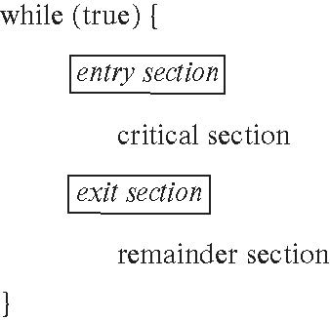
Critical Section
General structure of process P_{i}

Slide 8
Critical-Section Problem (Cont.)
Requirements for solution to critical-section problem
Mutual Exclusion - If process P_{i} is executing in its critical section, then no other processes can be executing in their critical sections
Progress - If no process is executing in its critical section and there exist some processes that wish to enter their critical section, then the selection of the process that will enter the critical section next cannot be postponed indefinitely
Bounded Waiting - A bound must exist on the number of times that other processes are allowed to enter their critical sections after a process has made a request to enter its critical section and before that request is granted
  Assume that each process executes at a nonzero speed
  No assumption concerning relative speed of the n processes

Slide 9
Interrupt-based Solution
Entry section: disable interrupts
Exit section: enable interrupts
Will this solve the problem?
  What if the critical section is code that runs for an hour?
  Can some processes starve – never enter their critical section.
  What if there are two CPUs?

Slide 10
Software Solution 1
Two process solution
Assume that the load and store machine-language instructions are atomic; that is, cannot be interrupted
The two processes share one variable:
  int turn;
The variable turn indicates whose turn it is to enter the critical section
initially, the value of turn is set to i

Slide 11
Algorithm for Process P_{i}
while (true){
while (turn = = j);
/* critical section */
turn = j;
/* remainder section */
}

Slide 12
Correctness of the Software Solution
Mutual exclusion is preserved
P_{i} enters critical section only if:
turn = i
and turn cannot be both 0 and 1 at the same time
What about the Progress requirement?
What about the Bounded-waiting requirement?

Slide 13
Peterson’s Solution
Two process solution
Assume that the load and store machine-language instructions are atomic; that is, cannot be interrupted
The two processes share two variables:
  int turn;
  boolean flag[2]
The variable turn indicates whose turn it is to enter the critical section
The flag array is used to indicate if a process is ready to enter the critical section.
  flag[i] = true implies that process P_{i} is ready!

Slide 14
Algorithm for Process P_{i}
while (true){
flag[i] = true;
turn = j;
while (flag[j] && turn = = j)
;
/* critical section */
flag[i] = false;
/* remainder section */
}

Slide 15
Correctness of Peterson’s Solution
Provable that the three CS requirement are met:
1. Mutual exclusion is preserved
P_{i} enters CS only if:
either flag[j] = false or turn = i
2. Progress requirement is satisfied
3. Bounded-waiting requirement is met

Slide 16
Peterson’s Solution and Modern Architecture
Although useful for demonstrating an algorithm, Peterson’s Solution is not guaranteed to work on modern architectures.
  To improve performance, processors and/or compilers may reorder operations that have no dependencies
Understanding why it will not work is useful for better understanding race conditions.
For single-threaded this is ok as the result will always be the same.
For multithreaded the reordering may produce inconsistent or unexpected results!

Slide 17
Modern Architecture Example
Two threads share the data:
boolean flag = false;
int x = 0;
Thread 1 performs
while (!flag)
;
print x
Thread 2 performs
x = 100;
flag = true
What is the expected output?
100

Slide 18
Modern Architecture Example (Cont.)
However, since the variables flag and x are independent of each other, the instructions:
flag = true;
x = 100;
for Thread 2 may be reordered
If this occurs, the output may be 0!

Slide 19
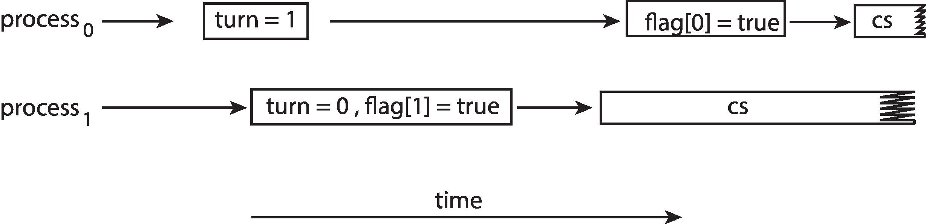
Peterson’s Solution Revisited
The effects of instruction reordering in Peterson’s Solution
This allows both processes to be in their critical section at the same time!
To ensure that Peterson’s solution will work correctly on modern computer architecture we must use Memory Barrier.

Slide 20
Memory Barrier
Memory model are the memory guarantees a computer architecture makes to application programs.
Memory models may be either:
  Strongly ordered – where a memory modification of one processor is immediately visible to all other processors.
  Weakly ordered – where a memory modification of one processor may not be immediately visible to all other processors.
A memory barrier is an instruction that forces any change in memory to be propagated (made visible) to all other processors.

Slide 21
Memory Barrier Instructions
When a memory barrier instruction is performed, the system ensures that all loads and stores are completed before any subsequent load or store operations are performed.
Therefore, even if instructions were reordered, the memory barrier ensures that the store operations are completed in memory and visible to other processors before future load or store operations are performed.

Slide 22
Memory Barrier Example
Returning to the example of slides 6.17 - 6.18
We could add a memory barrier to the following instructions to ensure Thread 1 outputs 100:
Thread 1 now performs
while (!flag)
memory_barrier();
print x
Thread 2 now performs
x = 100;
memory_barrier();
flag = true
For Thread 1 we are guaranteed that that the value of flag is loaded before the value of x.
For Thread 2 we ensure that the assignment to x occurs before the assignment flag.

Slide 23
Synchronization Hardware
Many systems provide hardware support for implementing the critical section code.
Uniprocessors – could disable interrupts
  Currently running code would execute without preemption
  Generally too inefficient on multiprocessor systems
    Operating systems using this not broadly scalable
We will look at three forms of hardware support:
1. Hardware instructions
2. Atomic variables

Slide 24
Hardware Instructions
Special hardware instructions that allow us to either test-and-modify the content of a word, or to swap the contents of two words atomically (uninterruptedly.)
  Test-and-Set instruction
  Compare-and-Swap instruction

Slide 25
The test_and_set Instruction
Definition
boolean test_and_set (boolean *target)
{
boolean rv = *target;
*target = true;
return rv:
}
Properties
  Executed atomically
  Returns the original value of passed parameter
  Set the new value of passed parameter to true

Slide 26
Solution Using test_and_set()
Shared boolean variable lock, initialized to false
Solution:
do {
while (test_and_set(&lock))
; /* do nothing */
/* critical section */
lock = false;
/* remainder section */
} while (true);
Does it solve the critical-section problem?

Slide 27
The compare_and_swap Instruction
Definition
int compare_and_swap(int *value, int expected, int new_value)
{
int temp = *value;
if (*value == expected)
*value = new_value;
return temp;
}
Properties
  Executed atomically
  Returns the original value of passed parameter value
  Set the variable value the value of the passed parameter new_value but only if *value == expected is true. That is, the swap takes place only under this condition.

Slide 28
Solution using compare_and_swap
Shared integer lock initialized to 0;
Solution:
while (true){
while (compare_and_swap(&lock, 0, 1) != 0)
; /* do nothing */
/* critical section */
lock = 0;
/* remainder section */
}
Does it solve the critical-section problem?

Slide 29
Bounded-waiting with compare-and-swap
while (true) {
waiting[i] = true;
key = 1;
while (waiting[i] && key == 1)
key = compare_and_swap(&lock,0,1);
waiting[i] = false;
/* critical section */
j = (i + 1) % n;
while ((j != i) && !waiting[j])
j = (j + 1) % n;
if (j == i)
lock = 0;
else
waiting[j] = false;
/* remainder section */
}

Slide 30
Atomic Variables
Typically, instructions such as compare-and-swap are used as building blocks for other synchronization tools.
One tool is an atomic variable that provides atomic (uninterruptible) updates on basic data types such as integers and booleans.
For example:
  Let sequence be an atomic variable
  Let increment() be operation on the atomic variable sequence
  The Command:
  increment(&sequence);
  ensures sequence is incremented without interruption:

Slide 31
Atomic Variables
The increment() function can be implemented as follows:
void increment(atomic_int *v)
{
int temp;
do {
temp = *v;
}
while (temp != (compare_and_swap(v,temp,temp+1));
}

Slide 32
Mutex Locks
Previous solutions are complicated and generally inaccessible to application programmers
OS designers build software tools to solve critical section problem
Simplest is mutex lock
  Boolean variable indicating if lock is available or not
Protect a critical section by
  First acquire() a lock
  Then release() the lock
Calls to acquire() and release() must be atomic
  Usually implemented via hardware atomic instructions such as compare-and-swap.
But this solution requires busy waiting
  This lock therefore called a spinlock

Slide 33
Solution to CS Problem Using Mutex Locks
while (true) {
acquire lock
critical section
release lock
remainder section
}

Slide 34
Semaphore
Synchronization tool that provides more sophisticated ways (than Mutex locks) for processes to synchronize their activities.
Semaphore S – integer variable
Can only be accessed via two indivisible (atomic) operations
  wait() and signal()
    Originally called P() and V()
Definition of the wait() operation
  wait(S) {
  while (S <= 0)
  ; // busy wait
  S--;
  }
Definition of the signal() operation
  signal(S) {
  S++;
  }

Slide 35
Semaphore (Cont.)
Counting semaphore – integer value can range over an unrestricted domain
Binary semaphore – integer value can range only between 0 and 1
  Same as a mutex lock
Can implement a counting semaphore S as a binary semaphore
With semaphores we can solve various synchronization problems

Slide 36
Semaphore Usage Example
Solution to the CS Problem
  Create a semaphore “mutex” initialized to 1
    wait(mutex);
    CS
    signal(mutex);
Consider P₁ and P₂ that with two statements S₁ and S₂ and the requirement that S₁ to happen before S₂
  Create a semaphore “synch” initialized to 0
    P1:
    S₁;
    signal(synch);
    P2:
    wait(synch);
    S₂;

Slide 37
Semaphore Implementation
Must guarantee that no two processes can execute the wait() and signal() on the same semaphore at the same time
Thus, the implementation becomes the critical section problem where the wait and signal code are placed in the critical section
Could now have busy waiting in critical section implementation
  But implementation code is short
  Little busy waiting if critical section rarely occupied
Note that applications may spend lots of time in critical sections and therefore this is not a good solution

Slide 38
Semaphore Implementation with no Busy waiting
With each semaphore there is an associated waiting queue
Each entry in a waiting queue has two data items:
  Value (of type integer)
  Pointer to next record in the list
Two operations:
  block – place the process invoking the operation on the appropriate waiting queue
  wakeup – remove one of processes in the waiting queue and place it in the ready queue

Slide 39
Implementation with no Busy waiting (Cont.)
Waiting queue
typedef struct {
int value;
struct process *list;
} semaphore;

Slide 40
Implementation with no Busy waiting (Cont.)
wait(semaphore *S) {
S->value--;
if (S->value < 0) {
add this process to S->list;
block();
}
}
signal(semaphore *S) {
S->value++;
if (S->value <= 0) {
remove a process P from S->list;
wakeup(P);
}
}

Slide 41
Problems with Semaphores
Incorrect use of semaphore operations:
  signal(mutex) …. wait(mutex)
  wait(mutex) … wait(mutex)
  Omitting of wait (mutex) and/or signal (mutex)
These – and others – are examples of what can occur when semaphores and other synchronization tools are used incorrectly.

Slide 42
Monitors
A high-level abstraction that provides a convenient and effective mechanism for process synchronization
Abstract data type, internal variables only accessible by code within the procedure
Only one process may be active within the monitor at a time
Pseudocode syntax of a monitor:
    monitor monitor-name
    {
    // shared variable declarations
    procedure P1 (…) { …. }
    procedure P2 (…) { …. }
    procedure Pn (…) {……}
    initialization code (…) { … }
    }

Slide 43
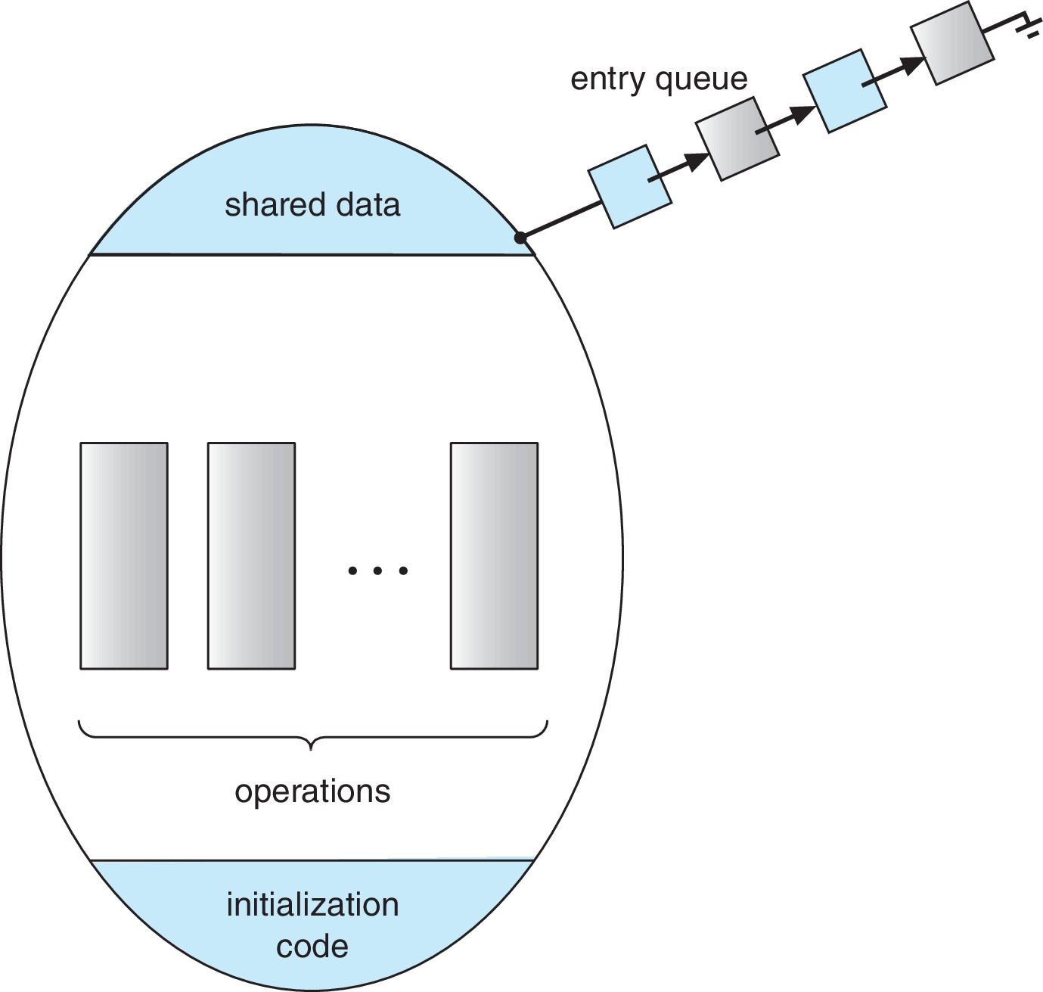
Schematic view of a Monitor

Slide 44
Monitor Implementation Using Semaphores
Variables
semaphore mutex
mutex = 1
Each procedure P is replaced by
wait(mutex);
…
body of P;
…
signal(mutex);
Mutual exclusion within a monitor is ensured

Slide 45
Condition Variables
condition x, y;
Two operations are allowed on a condition variable:
  x.wait() – a process that invokes the operation is suspended until x.signal()
  x.signal() – resumes one of processes (if any) that invoked x.wait()
    If no x.wait() on the variable, then it has no effect on the variable

Slide 46
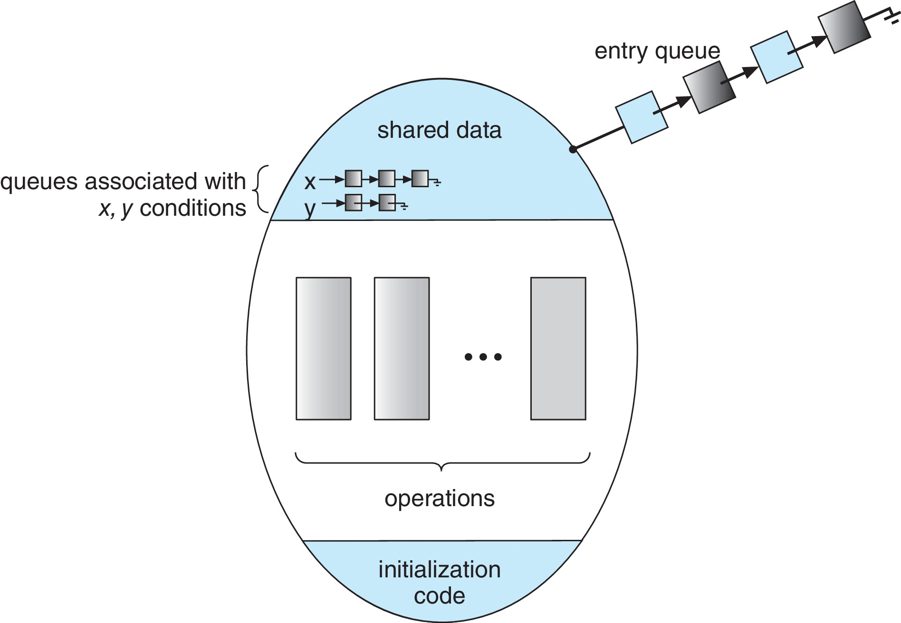
Monitor with Condition Variables

Slide 47
Usage of Condition Variable Example
Consider P₁ and P₂ that that need to execute two statements S₁ and S₂ and the requirement that S₁ to happen before S₂
  Create a monitor with two procedures F₁ and F₂ that are invoked by P₁ and P₂ respectively
  One condition variable “x” initialized to 0
  One Boolean variable “done”
  F1:
    S₁;
    done = true;
    x.signal();
  F2:
    if done = false
    x.wait()
    S₂;

Slide 48
Monitor Implementation Using Semaphores
Variables
semaphore mutex; // (initially = 1)
semaphore next; // (initially = 0)
int next_count = 0; // number of processes waiting
inside the monitor
Each function P will be replaced by
wait(mutex);
…
body of P;
…
if (next_count > 0)
signal(next)
else
signal(mutex);
Mutual exclusion within a monitor is ensured

Slide 49
Implementation – Condition Variables
For each condition variable x, we have:
semaphore x_sem; // (initially = 0)
int x_count = 0;
The operation x.wait() can be implemented as:
x_count++;
if (next_count > 0)
signal(next);
else
signal(mutex);
wait(x_sem);
x_count--;

Slide 50
Implementation (Cont.)
The operation x.signal() can be implemented as:
if (x_count > 0) {
next_count++;
signal(x_sem);
wait(next);
next_count--;
}

Slide 51
Resuming Processes within a Monitor
If several processes queued on condition variable x, and x.signal() is executed, which process should be resumed?
FCFS frequently not adequate
Use the conditional-wait construct of the form
x.wait(c)
where:
  c is an integer (called the priority number)
  The process with lowest number (highest priority) is scheduled next

Slide 52
Single Resource allocation
Allocate a single resource among competing processes using priority numbers that specifies the maximum time a process plans to use the resource
R.acquire(t);
...
access the resurce;
...
R.release;
Where R is an instance of type ResourceAllocator

Slide 53
Single Resource allocation
Allocate a single resource among competing processes using priority numbers that specifies the maximum time a process plans to use the resource
The process with the shortest time is allocated the resource first
Let R is an instance of type ResourceAllocator (next slide)
Access to ResourceAllocator is done via:
R.acquire(t);
...
access the resurce;
...
R.release;
Where t is the maximum time a process plans to use the resource

Slide 54
A Monitor to Allocate Single Resource
monitor ResourceAllocator
{
boolean busy;
condition x;
void acquire(int time) {
if (busy)
x.wait(time);
busy = true;
}
void release() {
busy = false;
x.signal();
}
initialization code() {
busy = false;
}
}

Slide 55
Single Resource Monitor (Cont.)
Usage:
acquire
...
release
Incorrect use of monitor operations
  release() … acquire()
  acquire() … acquire())
  Omitting of acquire() and/or release()

Slide 56
Liveness
Processes may have to wait indefinitely while trying to acquire a synchronization tool such as a mutex lock or semaphore.
Waiting indefinitely violates the progress and bounded-waiting criteria discussed at the beginning of this chapter.
Liveness refers to a set of properties that a system must satisfy to ensure processes make progress.
Indefinite waiting is an example of a liveness failure.

Slide 57
Liveness
Deadlock – two or more processes are waiting indefinitely for an event that can be caused by only one of the waiting processes
Let S and Q be two semaphores initialized to 1
P₀ P₁
wait(S); wait(Q);
wait(Q); wait(S);
... ...
signal(S); signal(Q);
signal(Q); signal(S);
Consider if P₀ executes wait(S) and P₁ wait(Q). When P₀ executes wait(Q), it must wait until P₁ executes signal(Q)
However, P₁ is waiting until P₀ execute signal(S).
Since these signal() operations will never be executed, P₀ and P₁ are deadlocked.

Slide 58
Liveness
Other forms of deadlock:
Starvation – indefinite blocking
  A process may never be removed from the semaphore queue in which it is suspended
Priority Inversion – Scheduling problem when lower-priority process holds a lock needed by higher-priority process
  Solved via priority-inheritance protocol

Slide 59
End of Chapter 6

