Slide 1
Applied Cryptography ENCS4320
Lecture 1:
Course Overview & What is Cryptography
Historical Ciphers (& How to Break Them)
Perfect Secrecy
Computational Security
Readings: Katz and Lindell Chapter 1-2 + Appendix A.3 (background)
Summer 2022

Slide 2
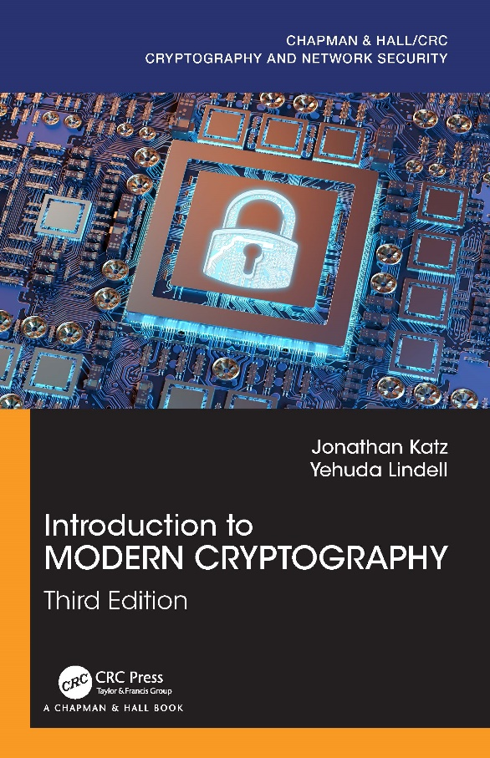
Course Resources
Instructor: Ahmad Alsadeh
Office Hours: TBD
Textbook:
Introduction to Modern Cryptography (3rd edition)
Jonathan Katz and Yehuda Lindell

Slide 3
Grades
Course Participation: 5%
Homework: 20%
Quizzes: 10%
Midterm Exam: 25%
Final Exam: 40%
Collaboration is permitted on homework assignments, but you completely understand your solutions and you must write the solutions entirely in your own words.
No collaboration on quizzes/exams

Slide 4
Expected Background
Basic Probability Theory
Algorithms and Complexity
Most security proofs involve reductions
General Mathematical Maturity
Quantifiers/Predicate Logic
Understand what is (is not) a proper definition
Know how to write a proof

Slide 5
Course Goals
Understand the mathematics underlying cryptographic algorithms and protocols
Understand the power (and limitations) of common cryptographic tools
Understand the formal approach to security in modern cryptography

Slide 6
Topic 1: Course Overview & What is Cryptography

Slide 7
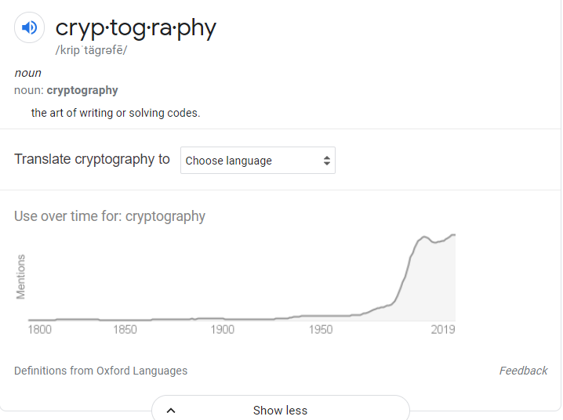
What is Cryptography?
“the art of writing or solving codes” – Concise Oxford English Dictionary

Slide 8
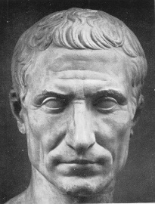
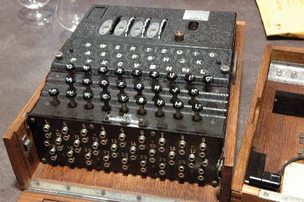
What is Cryptography?
“the art of writing or solving codes” – Concise Oxford English Dictionary
“The study of mathematical techniques for securing digital information, systems and distributed computation against adversarial attacks.”
-- Intro to Modern Cryptography
Late 20th century
Art
Science

Slide 9
What is Cryptography?
Precise Mathematical Security Definitions
Specific Algorithmic Assumptions
Formal Security Reductions/Proofs
Experience
Intuition
Creativity

Slide 10
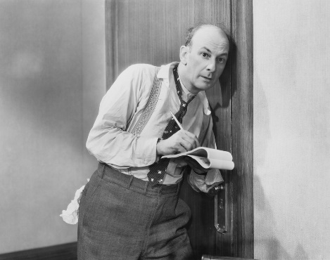
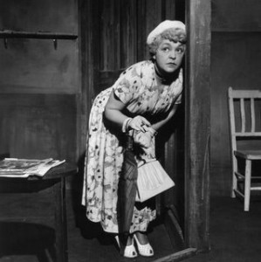
What Does It Mean to “Secure Information”
Confidentiality (Security/Privacy)
Only intended recipient can see the communication

Slide 11
What Does It Mean to “Secure Information”
Confidentiality (Security/Privacy)
Only intended recipient can see the communication
Integrity (Authenticity)
The message was actually sent by the alleged sender
I love you Alice… - Bob
We need to break up -Bob
Alice
Bob

Slide 12
Two Attacker Models
Passive Attacker (Eve)
Attacker can eavesdrop
Protection Requires?
Confidentiality
Active Attacker (Mallory)
Has full control over communication channel
Protection Requires?
Confidentiality & Integrity

Slide 13
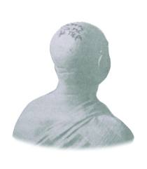
Steganography vs Cryptography
Steganography
Goal: Hide existence of a message
Invisible Ink, Tattoo Underneath Hair, …
Assumption: Method is secret
Notes:
Herodotus, an entertaining but less than reliable Greek historian, reports a more ingenious method. Histaeus, ruler of Miletus, wanted to send a message to his friend Aristagorus, urging revolt against the Persians. Histaeus shaved the head of his most trusted slave, then tattooed a message on the slave's scalp. After the hair grew back, the slave was sent to Aristagorus with the message safely hidden.
Later in Herodotus' histories, the Spartans received word that Xerxes was preparing to invade Greece. Their informant, Demeratus, was a Greek in exile in Persia. Fearing discovery, Demeratus wrote his message on the wood backing of a wax tablet. He then hid the message underneath a fresh layer of wax. The apparently blank tablet sailed easily past sentries on the road.
A more subtle method, nearly as old, is to use invisible ink. Described as early as the first century AD, invisible inks were commonly used for serious communications until WWII. The simplest are organic compounds, such as lemon juice, milk, or urine, all of which turn dark when held over a flame. In 1641, Bishop John Wilkins suggested onion juice, alum, ammonia salts, and for glow-in-the dark writing the "distilled Juice of Glowworms." Modern invisible inks fluoresce under ultraviolet light and are used as anti-counterfeit devices. For example, "VOID" is printed on checks and other official documents in an ink that appears under the strong ultraviolet light used for photocopies.
A modern area that is related to both is information hiding or covert channels. Embed messages in places not intended for storing information. They can use cryptographic approaches to ensure secrecy, and do not rely only on secrecy of method.

Slide 14
Steganography vs Cryptography
Steganography
Goal: Hide existence of a message
Invisible Ink, Tattoo Underneath Hair, …
Assumption: Method is secret
Cryptography
Goal: Hide the meaning of a message
Depends only on secrecy of a (short) key
Kerckhoff’s Principle: Cipher method should
not be required to be secret.
Notes:
Herodotus, an entertaining but less than reliable Greek historian, reports a more ingenious method. Histaeus, ruler of Miletus, wanted to send a message to his friend Aristagorus, urging revolt against the Persians. Histaeus shaved the head of his most trusted slave, then tattooed a message on the slave's scalp. After the hair grew back, the slave was sent to Aristagorus with the message safely hidden.
Later in Herodotus' histories, the Spartans received word that Xerxes was preparing to invade Greece. Their informant, Demeratus, was a Greek in exile in Persia. Fearing discovery, Demeratus wrote his message on the wood backing of a wax tablet. He then hid the message underneath a fresh layer of wax. The apparently blank tablet sailed easily past sentries on the road.
A more subtle method, nearly as old, is to use invisible ink. Described as early as the first century AD, invisible inks were commonly used for serious communications until WWII. The simplest are organic compounds, such as lemon juice, milk, or urine, all of which turn dark when held over a flame. In 1641, Bishop John Wilkins suggested onion juice, alum, ammonia salts, and for glow-in-the dark writing the "distilled Juice of Glowworms." Modern invisible inks fluoresce under ultraviolet light and are used as anti-counterfeit devices. For example, "VOID" is printed on checks and other official documents in an ink that appears under the strong ultraviolet light used for photocopies.
A modern area that is related to both is information hiding or covert channels. Embed messages in places not intended for storing information. They can use cryptographic approaches to ensure secrecy, and do not rely only on secrecy of method.

Slide 15
Symmetric Key Encryption
What cryptography has historically been all about (Pre 1970)
Two parties (sender and receiver) share secret key
Sender uses key to encrypt (“scramble”) the message before transmission
Receiver uses the key to decrypt (“unscramble”) and recover the original message

Slide 16
Encryption: Basic Terminology
Plaintext
The original message m
Plaintext Space (Message Space)
The set $ℳ$ of all possible plaintext messages
Example 1: $ℳ=\left\{{}^{′}attack^{′},^{′}retreat^{′},{}_{}^{′}hold current position′\right\}$
Example 2: $ℳ=\left\{0,1\right\}n$ --- all n-bit messages
Ciphertext $c∈𝒞$
An encrypted (“scrambled”) message $c∈𝒞$ (ciphertext space)
Key/Keyspace $k∈𝒦$

Slide 17
Private Key Encryption Syntax
Typically picks $k∈𝒦$
uniformly at random
Message Space: $ℳ$
Key Space: $𝒦$
Three Algorithms $Π=\left(Gen,Enc,Dec\right)$
$\operatorname{Gen}{(R)}$ (Key-generation algorithm)
Input: Random Bits R
Output: Secret key $k∈𝒦$
$\operatorname{Enck}{(m)}$ (Encryption algorithm)
Input: Secret key $k∈𝒦$ and message $m∈ℳ$
Output: ciphertext c
$\operatorname{Deck}{(c)}$ (Decryption algorithm)
Input: Secret key $k∈𝒦$ and a ciphertex$c$
Output: a plaintext message $m∈ℳ$
Invariant: Dec_{k}(Enc_{k}(m))=m
Trusted Parties (e.g., Alice and Bob) must run Gen in advance to obtain secret k.
Assumption: Adversary does not get to see output of Gen

Slide 18
Example: Shift Cipher
Key Space: $𝒦$={0,1,…,25}
Message Space: $ℳ$={a,b,c,…,z}*
Right Shift Operation
RS₁(a) = b
RS₁(b) = c
...
RS₁(z) = ?
RS_{i+1}(a)=RS_{i}(b)

Slide 19
Shift Cipher
Key Space: $𝒦$={0,1,…,25}
Message Space: $ℳ$={a,b,c,…,z}*
Right Shift Operation
RS₁(a) = b
RS₁(b) = c
...
RS₁(z) = a
RS_{i+1}(a)=RS_{i}(b)
$\operatorname{Enck}{(m_{1}∘…{∘m}_{n})}={RS}_{k}\left(m_{1}\right)∘…{∘RS}_{k}\left(m_{n}\right)$
Each letter in plaintext message $m=m_{1}∘…{∘m}_{n}$ is right shifted k times RS_{k}
Question: what is ciphertext space $𝒞$?

Slide 20
Example: Shift Cipher (Multiple Characters)
Key Space: $𝒦$={0,1,…,25}
Message Space: $ℳ$={a,b,c,…,z}*
$$\operatorname{Enck}{(m_{1}∘…{∘m}_{n})}={RS}_{k}\left(m_{1}\right)∘…{∘RS}_{k}\left(m_{n}\right)$$
$$\operatorname{Deck}{(c_{1}∘…{∘c}_{n})}={LS}_{k}\left(c_{1}\right)∘…{∘LS}_{k}\left(c_{n}\right)$$
Note:
$$\operatorname{Deck}\left(\operatorname{Enck}\left(m_{1}∘…{∘m}_{n}\right)\right)=m_{1}∘…{∘m}_{n}$$
since
$${LS}_{k}\left({RS}_{k}\left(m_{i}\right)\right)=m_{i}$$

Slide 21
Topic 2: Historical Ciphers (& How to Break Them)

Slide 22
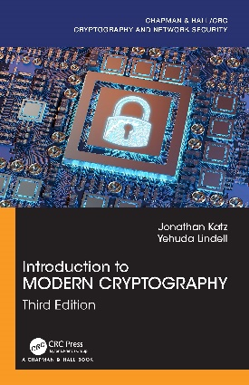
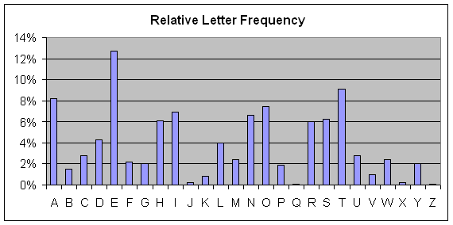
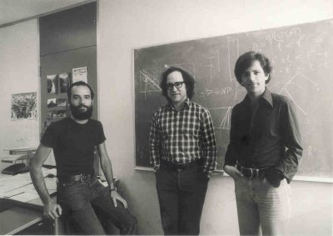
Cryptography History
2500+ years
Ongoing battle
Codemakers and codebreakers
Formalization of Modern Crypto (1976+)
Caesar Shift Cipher (50 BC)
Shannon Entropy/Perfect Secrecy
(~1950)
1970s
Cipher Machines (1900s)
Frequency Analysis
Public Key Crypto/RSA

Slide 23
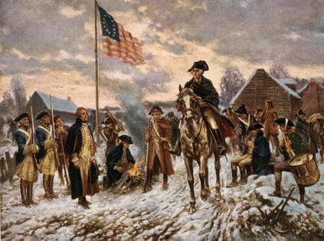
Who Uses Cryptography
Traditionally: Militias
Modern Times: Everyone!
Caesar Shift Cipher (50 BC)
Revolutionary War
Modern Crypto

Slide 24
Caesar Cipher
Three shall be the number of thy shifting and the number of thy shifting shall be three. Four shalt thou not shift, neither shift thou two, excepting that thou then proceed to three. Five is right out…..
Caesar adopted the shift cipher with secret key k=3

Slide 25
Caesar Cipher (Example)
BEGINTHEATTACKNOW
→
EHJLQWKHDWWDFNQRZ
Caesar adopted the shift cipher with secret key k=3

Slide 26
Caesar Cipher (Example)
BEGINTHEATTACKNOW
→
EHJLQWKHDWWDFNQRZ
Immediate Issue: anyone who knows method can decrypt
(since k=3 is fixed)

Slide 27
Shift Cipher: Brute Force Attack
Ciphertext: “lwxrw ztn sd ndj iwxcz xh gxvwi?”
k=1 → m = “mxysx auo te oek jxyda yi hywxj?”
k=2 → m=“nyzty bvp uf pfl kyzeb zj izxyk?”
k=3 → m=“ozauz cwq vg qgm lzafc ak jayzl?”
k=4 → m = “pabva dxr wh rhn mabgd bl kbzam?”
k=5 → m=“qbcwb eys xi sio nbche cm lcabn?”
k=6 → m=“rcdxc fzt yj tjp ocdif dn mdbco?”

Slide 28
Shift Cipher: Brute Force Attack
Ciphertext: “lwxrw ztn sd ndj iwxcz xh gxvwi?”
…
k=7 → m=“sdeyd gau zk ukq pdejg eo necdp?”
k=8 → m=“tefze hbv al vlr qefkh fp ofdeq?”
k=9 → m = “ufgaf icw bm wms rfgli gq pgefr?”
k=10 → m=“vghbg jdx cn xnt sghmj hr qhfgs?”
k=11→ m= “which key do you think is right?”
k=12→ m= “xijdi lfz ep zpv uijol jt sjhiu?”

Slide 29
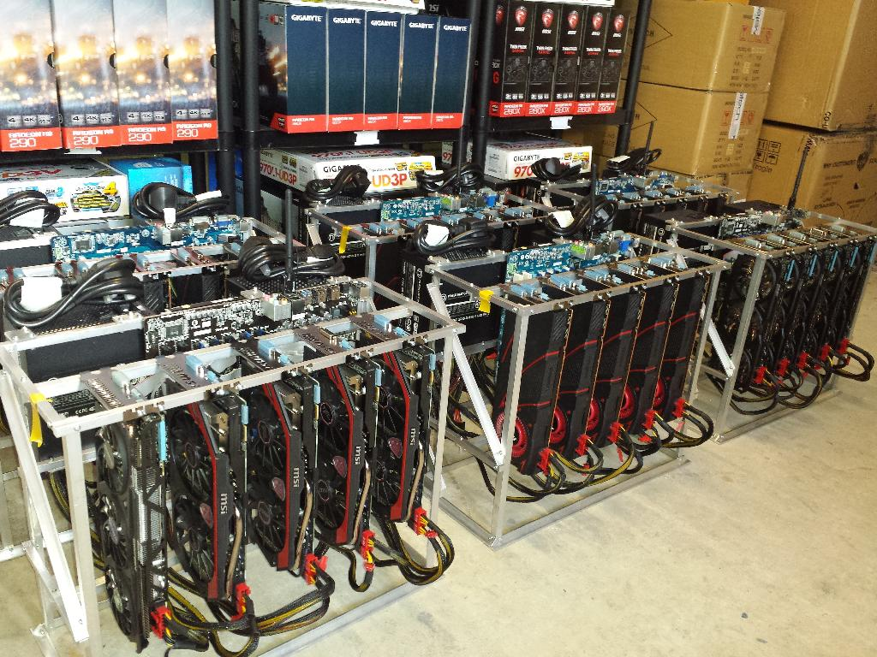
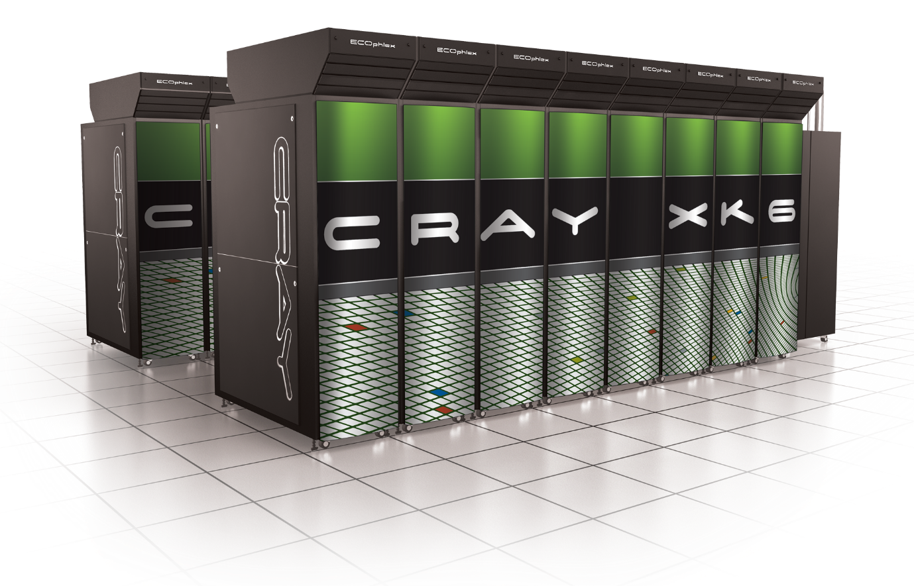
Sufficient Key Space Principle
“Any secure encryption scheme must have a key space that is sufficiently large to make an exhaustive search attack infeasible.”
Notes:
Attackers can user supercomputer, GPUs, Application Specific Integrated Circtuits etc… to speed up brute-force attacks. Key space should have size at least 2^70….probably larger to provide long term security against well funded attackers…

Slide 30
Sufficient Key Space Principle
“Any secure encryption scheme must have a key space that is sufficiently large to make an exhaustive search attack infeasible.”
Question 1: How big is big enough? Complicated question….
Question 2: If the key space is large is the encryption scheme necessarily secure?

Slide 31
Substitution Cipher
Secret key K is permutation of the alphabet
Example:
A B C D E F G H I J K L M N O P Q R S T U V W X Y Z
X E U A D N B K V M R O C Q F S Y H W G L Z I J P T
Encryption: apply permutation K to each letter in message
TELLHIMABOUTME → GDOOKVCXEFLGCD
Decryption: reverse the permutation

Slide 32
Substitution Cipher
Secret key K is a permutation of the alphabet
Example:
A B C D E F G H I J K L M N O P Q R S T U V W X Y Z
X E U A D N B K V M R O C Q F S Y H W G L Z I J P T
Question: What is the size of the keyspace $𝒦$?
$$\left|𝒦\right|=26! ≈2^{88}$$

Slide 33
Frequency Analysis
Observation 1: If e is mapped to d then every appearance of e in the plaintext results in the appearance of a d in the ciphertext
Observation 2: Some letters occur much more frequently in English.
Observation 3: Texts consisting of a few sentences tend to have a distribution close to average.
Step 1: Find letter in ciphertext that occurs with
frequency > 11%. This letter is probably e…

Slide 34
Vigenère Cipher
Generalizes Shift Cipher
K=k₁,…,k_{t}
Enc_{K}(m)
Shift first letter right k₁ times
Shift second letter right k₂ times
…
Shift t^{th} letter right k_{t} times
Shift t+1st letter right k₁ times
…
Question: Size of key-space?
Answer: 26^{t} (brute force may not be useful)

Slide 35
Vigenère Cipher
Still vulnerable to frequency analysis
Good guess: Select K=k₁,…,k_{t} to maximize number of e’s in resulting ciphertext
See Katz and Lindell 1.3 for even more sophisticated heuristics.
Attack works when the initial message m is sufficiently long
Vigenère is “perfectly secret” if the message m is at most t letters long.

Slide 36
Conclusions
Designing secure ciphers is hard
Vigenère remained “unbroken” for a long time
Complex schemes are not secure
All historical ciphers have fallen

Slide 37
Topic 3: Perfect Secrecy + One-Time-Pads

Slide 38
Principles of Modern Cryptography
Need formal definitions of “security”
If you don’t understand what you want to achieve, how can you possibly know when (or if) you have achieved it?
Attempt 1: Impossible/infeasible for attacker to recover secret key K
$\operatorname{Enck}{(m)}=m$
Attempt 2: Impossible for attacker to recover entire plaintext from ciphertext?
Ok to decrypt 90% of message?
Attempt 3: Impossible for attacker to figure out any particular character of the plaintext from the ciphertext?
[Too Weak] Does employee make more than $100,000 per year?
[Too Strong] Lucky guess? Prior Information? (e.g., letters always begin “Dear ….”)

Slide 39
Principles of Modern Cryptography
Need formal definitions of “security”
If you don’t understand what you want to achieve, how can you possibly know when (or if) you have achieved it?
Final Attempt: Regardless of information an attacker already has, a ciphertext should leak no additional information about the underlying plaintext.
This is the “right” approach
Still need to formalize mathematically
Security definition includes goal and threat-model

Slide 40
Principles of Modern Cryptography
Proofs of Security are critical
Iron-clad guarantee that attacker will not succeed (relative to definition/assumptions)
Experience: intuition is often misleading in cryptography
An “intuitively secure” scheme may actually be badly broken.
Before deploying in the real world
Consider definition/assumptions in security definition
Does the threat model capture the attackers true abilities?

Slide 41
Perfect Secrecy Intuition
Regardless of information an attacker already has, a ciphertext should leak no additional information about the underlying plaintext.
We will formalize this intuition
And show how to achieve it

Slide 42
Private Key Encryption Syntax
Typically picks $k∈𝒦$
uniformly at random
Message Space: $ℳ$
Key Space: $𝒦$
Three Algorithms $Π=\left(Gen,Enc,Dec\right)$
$\operatorname{Gen}{(R)}$ (Key-generation algorithm)
Input: Random Bits R
Output: Secret key $k∈𝒦$.
$\operatorname{Enck}{(m)}$ (Encryption algorithm)
Input: Secret key $k∈𝒦$ and message $m∈ℳ$
Output: ciphertext c
$\operatorname{Deck}{(c)}$ (Decryption algorithm)
Input: Secret key $k∈𝒦$ and a ciphertex$c$
Output: a plaintext message $m∈ℳ$
Invariant: Dec_{k}(Enc_{k}(m))=m
Trusted Parties (e.g., Alice and Bob) must run Gen in advance to obtain secret k.
Assumption: Adversary does not get to see output of Gen

Slide 43
An Example
Enemy knows that Caesar likes to fight in the rain and it is raining today
$$Pr\left[m=wait\right]=0.3$$
$$Pr\left[m=attack\right]=0.7$$
Suppose that Caesar sends c=Enc_{K}(m) to generals and that the attacker intercepts the ciphertext c and calculates
$$Pr\left[m=wait |\text{c}\text{=}\text{EncK}\text{(}\text{m}\text{)}\right]=0.2$$
$$Pr\left[m=attack |\text{c}\text{=}\text{EncK}\text{(}\text{m}\text{)}\right]=0.8$$
Did the attacker learn anything useful?

Slide 44
Perfect Secrecy
Definition 1: An encryption scheme $Π=\left(Gen,Enc,Dec\right)$with message space $ℳ$ is perfectly secret if for every probability distribution $𝒟$ over $ℳ,$every message $m∈ℳ$ and every ciphertext $c∈𝒞$ for which $Pr\left[C=c\right]>0$:
$$Pr\left[M=m\left|C=c\right.\right]=Pr\left[M=m\right].$$
(where $M←𝒟$, $K=Gen(R)$ and $C=EncK\left(M\right)$)
Definition 2: For every $m,m′∈ℳ$ and $c∈𝒞$
$$Pr\left[EncK\left(m\right)=c\right]=Pr\left[EncK\left(m^{′}\right)=c\right].$$
(where the probabilities are taken over the randomness of Gen and Enc)
Lemma 2.4: The above definitions are equivalent.
Notes:
Proof: Suppose first that (Gen,Enc,Dec) does not satisfy definition 2. Then there exists $m,m′∈ℳ$ and $c∈𝒞$ such that
$$Pr\left[EncK\left(m\right)=c\right]≠Pr\left[EncK\left(m^{′}\right)=c\right] (1).$$
Now suppose for contradiction that Definition 1 holds and define the distribution $𝒟$ such that Pr[M=m]=1/2=Pr[M=m’] when $M←𝒟$. By definition 1 we have $Pr\left[M=m\left|C=c\right.\right]=Pr\left[M=m\left|EncK\left(m\right)=c\right.\right]=\text{Pr}\text{[}\text{M}\text{=}\text{m}\text{]}=\frac{1}{2}=Pr\left[M=m′\left|EncK\left(m′\right)=c\right.\right].$ Notice that by Bayes Theorem we have
$$\frac{1}{2}=Pr\left[M=m\left|EncK\left(m\right)=c\right.\right]=\frac{Pr\left[C=c\left|M=m\right.\right]\text{Pr}\text{[}\text{M}\text{=}\text{m}\text{]}}{\text{Pr}\text{[}\text{C}\text{=}\text{c}\text{]}}=\frac{Pr\left[C=c\left|M=m\right.\right]}{2\text{Pr}\text{[}\text{C}\text{=}\text{c}\text{]}}(2)$$
And similarly
$$\frac{1}{2}=Pr\left[M=m′\left|EncK\left(m′\right)=c\right.\right]=\frac{Pr\left[C=c\left|M=m′\right.\right]}{2\text{Pr}\text{[}\text{C}\text{=}\text{c}\text{]}} (3)$$
It follows that
$$Pr\left[C=c\left|M=m′\right.\right]=Pr\left[C=c\left|M=m\right.\right] (4)$$
We now observe that
$$Pr\left[C=c\left|M=m\right.\right]=Pr\left[EncK\left(m\right)=c\left|M=m\right.\right]=Pr\left[EncK\left(m\right)=c\right] (5)$$
Where the first inequality follows by definition of C and the second follows because we condition on the event that M=m.
From (4) + (5) we reach the conclusion that
$$Pr\left[EncK\left(m\right)=c\right]=Pr\left[EncK\left(m^{′}\right)=c\right]$$
In contradiction of our assumption (1). See textbook for other direction of proof.

Slide 45
Perfect Secrecy
Definition 1: An encryption scheme $Π=\left(Gen,Enc,Dec\right)$with message space $ℳ$ is perfectly secret if for every probability distribution $𝒟$ over $ℳ,$every message $m∈ℳ$ and every ciphertext $c∈𝒞$ for which $Pr\left[C=c\right]>0$:
$$Pr\left[M=m\left|C=c\right.\right]=Pr\left[M=m\right].$$
(where $M←𝒟$, $K=Gen(R)$ and $C=EncK\left(M\right)$)
Definition 2: For every $m,m′∈ℳ$ and $c∈𝒞$
$$Pr\left[EncK\left(m\right)=c\right]=Pr\left[EncK\left(m^{′}\right)=c\right].$$
(where the probabilities are taken over the randomness of Gen and Enc)
Lemma 2.4: The above definitions are equivalent.
Definition 1 is more compelling as a security definition (attacker gains no information).
Easier to prove an encryption scheme satisfied definition 2.
Notes:
Proof: Suppose first that (Gen,Enc,Dec) does not satisfy definition 2. Then there exists $m,m′∈ℳ$ and $c∈𝒞$ such that
$$Pr\left[EncK\left(m\right)=c\right]≠Pr\left[EncK\left(m^{′}\right)=c\right] (1).$$
Now suppose for contradiction that Definition 1 holds and define the distribution $𝒟$ such that Pr[M=m]=1/2=Pr[M=m’] when $M←𝒟$. By definition 1 we have $Pr\left[M=m\left|C=c\right.\right]=Pr\left[M=m\left|EncK\left(m\right)=c\right.\right]=\text{Pr}\text{[}\text{M}\text{=}\text{m}\text{]}=\frac{1}{2}=Pr\left[M=m′\left|EncK\left(m′\right)=c\right.\right].$ Notice that by Bayes Theorem we have
$$\frac{1}{2}=Pr\left[M=m\left|EncK\left(m\right)=c\right.\right]=\frac{Pr\left[C=c\left|M=m\right.\right]\text{Pr}\text{[}\text{M}\text{=}\text{m}\text{]}}{\text{Pr}\text{[}\text{C}\text{=}\text{c}\text{]}}=\frac{Pr\left[C=c\left|M=m\right.\right]}{2\text{Pr}\text{[}\text{C}\text{=}\text{c}\text{]}}(2)$$
And similarly
$$\frac{1}{2}=Pr\left[M=m′\left|EncK\left(m′\right)=c\right.\right]=\frac{Pr\left[C=c\left|M=m′\right.\right]}{2\text{Pr}\text{[}\text{C}\text{=}\text{c}\text{]}} (3)$$
It follows that
$$Pr\left[C=c\left|M=m′\right.\right]=Pr\left[C=c\left|M=m\right.\right] (4)$$
We now observe that
$$Pr\left[C=c\left|M=m\right.\right]=Pr\left[EncK\left(m\right)=c\left|M=m\right.\right]=Pr\left[EncK\left(m\right)=c\right] (5)$$
Where the first inequality follows by definition of C and the second follows because we condition on the event that M=m.
From (4) + (5) we reach the conclusion that
$$Pr\left[EncK\left(m\right)=c\right]=Pr\left[EncK\left(m^{′}\right)=c\right]$$
In contradiction of our assumption (1). See textbook for other direction of proof.

Slide 46
Proof (Def 1 ➔ Def 2):
Suppose first that (Gen,Enc,Dec) does not satisfy definition 2. Then there exists $m,m′∈ℳ$ and $c∈𝒞$ such that
$$Pr\left[EncK\left(m\right)=c\right]≠Pr\left[EncK\left(m^{′}\right)=c\right] (1).$$
We will now prove that definition 1 does not hold. Define $𝒟$ such that
$$\text{Pr}\text{[}\text{M}\text{=}\text{m}\text{]=}\text{Pr}\text{[}\text{M}\text{=}\text{m}\text{′}\text{]}\text{=}\frac{1}{2}$$
Assume for the sake of contradiction that Definition 1 were satisfied then we would have
$$Pr\left[M=m\left|C=c\right.\right]=Pr\left[M=m\right]=\frac{1}{2}, and$$
$$Pr\left[M=m′\left|C=c\right.\right]=Pr\left[M=m′\right]=\frac{1}{2}$$
which implies
$$Pr\left[M=m\left|C=c\right.\right]=Pr\left[M=m′\left|C=c\right.\right] (∗)$$

Slide 47
Proof (Def 1 ➔ Def 2):
Suppose first that (Gen,Enc,Dec) does not satisfy definition 2. Then there exists $m,m′∈ℳ$ and $c∈𝒞$ such that
$$Pr\left[EncK\left(m\right)=c\right]≠Pr\left[EncK\left(m^{′}\right)=c\right] (1).$$
Define $𝒟$ such that $\text{Pr}\text{[}\text{M}\text{=}\text{m}\text{]=}\text{Pr}\text{[}\text{M}\text{=}\text{m}\text{′}\text{]}\text{=}\frac{1}{2}$
Bayes Rule (1)
$$Pr\left[M=m\left|EncK\left(M\right)=c\right.\right]=\frac{Pr\left[C=c\left|M=m\right.\right]\text{Pr}\text{[}\text{M}\text{=}\text{m}\text{]}}{\text{Pr}\text{[}\text{C}\text{=}\text{c}\text{]}}$$
$$=\frac{1}{2}\frac{Pr\left[EncK\left(m\right)=c\right]}{\text{Pr}\text{[}\text{C}\text{=}\text{c}\text{]}} (2)$$

Slide 48
Proof (Def 1 ➔ Def 2):
Suppose first that (Gen,Enc,Dec) does not satisfy definition 2. Then there exists $m,m′∈ℳ$ and $c∈𝒞$ such that
$$Pr\left[EncK\left(m\right)=c\right]≠Pr\left[EncK\left(m^{′}\right)=c\right] (1).$$
Define $𝒟$ such that $\text{Pr}\text{[}\text{M}\text{=}\text{m}\text{]=}\text{Pr}\text{[}\text{M}\text{=}\text{m}\text{′}\text{]}\text{=}\frac{1}{2}$
Bayes Rule (2)
$$Pr\left[M=m′\left|EncK\left(M\right)=c\right.\right]=\frac{Pr\left[C=c\left|M=m′\right.\right]\text{Pr}\text{[}\text{M}\text{=}\text{m}\text{′}\text{]}}{\text{Pr}\text{[}\text{C}\text{=}\text{c}\text{]}}$$
$$=\frac{1}{2}\frac{Pr\left[EncK\left(m′\right)=c\right]}{\text{Pr}\text{[}\text{C}\text{=}\text{c}\text{]}} (3)$$

Slide 49
Proof (Def 1 ➔ Def 2):
Suppose first that (Gen,Enc,Dec) does not satisfy definition 2. Then there exists $m,m′∈ℳ$ and $c∈𝒞$ such that
$$Pr\left[EncK\left(m\right)=c\right]≠Pr\left[EncK\left(m^{′}\right)=c\right] (1).$$
Define $𝒟$ such that $\text{Pr}\text{[}\text{M}\text{=}\text{m}\text{]=}\text{Pr}\text{[}\text{M}\text{=}\text{m}\text{′}\text{]}\text{=}\frac{1}{2}$
Combining equations (2) and (3), Bayes Rule implies that
$$Pr\left[M=m′\left|EncK\left(M\right)=c\right.\right]=\frac{1}{2}\frac{Pr\left[EncK\left(m′\right)=c\right]}{\text{Pr}\text{[}\text{C}\text{=}\text{c}\text{]}}$$
$$≠\frac{1}{2}\frac{Pr\left[EncK\left(m\right)=c\right]}{\text{Pr}\text{[}\text{C}\text{=}\text{c}\text{]}}=Pr\left[M=m\left|EncK\left(M\right)=c\right.\right] (∗∗)$$

Slide 50
Proof (Def 1 ➔ Def 2):
Thus, Bayes Rule implies that
$$Pr\left[M=m′\left|EncK\left(M\right)=c\right.\right]=\frac{1}{2}\frac{Pr\left[EncK\left(m′\right)=c\right]}{\text{Pr}\text{[}\text{C}\text{=}\text{c}\text{]}}$$
$$≠\frac{1}{2}\frac{Pr\left[EncK\left(m\right)=c\right]}{\text{Pr}\text{[}\text{C}\text{=}\text{c}\text{]}}=Pr\left[M=m\left|EncK\left(M\right)=c\right.\right] (∗∗)$$
We previously showed that definition 2 implies
$$Pr\left[M=m\left|C=c\right.\right]=Pr\left[M=m′\left|C=c\right.\right] (∗)$$
Contradiction!
(Still need to prove Def 2 ➔ Def 1 --- See textbook for details)
Notes:
Proof 2 ➔ 1
Assume that $Pr\left[EncK\left(m\right)=c\right]=Pr\left[EncK\left(m^{′}\right)=c\right]$ for all messages m,m’ and ciphertexts c.
Fix any distribution D over messages and any ciphertext c with Pr[C=c]>0 and message m.
If Pr[M=m] = 0 (when M is sampled from D) then trivially Pr[M=m | C= c] = 0 = Pr[M=m].
Otherwise we observe that $Pr\left[C=c\left|M=m\right.\right]=Pr\left[EncK\left(M\right)=c\left|M=m\right.\right]=Pr\left[EncK\left(m\right)=c\right]$
Notice that $pc=Pr\left[C=c\left|M=m\right.\right]=Pr\left[EncK\left(m\right)=c\right]=Pr\left[EncK\left(m′\right)=c\right]$ for any other message m’ (definition 1)
Applying Bayes’ Theorem
$$Pr\left[M=m\left|C=c\right.\right]=\frac{Pr\left[C=c\left|M=m\right.\right] Pr[M=m]}{Pr[C=c]}=\frac{Pr\left[C=c\left|M=m\right.\right] Pr[M=m]}{\sum_{m′}{Pr[M=m^{′}]Pr[C=c|M=m′]}}=\frac{pc Pr[M=m]}{\sum_{m′}{Pr[M=m^{′}]pc}}=\frac{ Pr[M=m]}{\sum_{m′}{Pr[M=m^{′}] }}=\frac{ Pr[M=m]}{1}=Pr[M=m]$$

Slide 51
Proof (Def 2 ➔ Def 1):
Assume that Definition 2 holds then for all messages m,m’ and ciphertexts we have
$$Pr\left[EncK\left(m\right)=c\right]=Pr\left[EncK\left(m^{′}\right)=c\right]$$
Now to show that Definition 1 holds we fix any distribution D and any message m and ciphertext c for which $\operatorname{Pr}\left[C=c\right]>0$
(when $C=EncK\left(M\right)$for a randomly sampled message M from D)
We need to prove that $Pr\left[M=m\left|C=c\right.\right]=\operatorname{Pr}\left[M=m\right]$
Observation 1: If $\operatorname{Pr}\left[M=m\right]=0$ then $Pr\left[M=m\left|C=c\right.\right]=0=\operatorname{Pr}\left[M=m\right]$

Slide 52
Proof (Def 2 ➔ Def 1):
We need to prove that $Pr\left[M=m\left|C=c\right.\right]=\operatorname{Pr}\left[M=m\right]$
Observation 1: If $\operatorname{Pr}\left[M=m\right]=0$ then $Pr\left[M=m\left|C=c\right.\right]=0=\operatorname{Pr}\left[M=m\right]$
Otherwise, define $pc≔Pr\left[C=c\left|M=m\right.\right]$ and notice that
$$Pr\left[C=c\left|M=m\right.\right]=Pr\left[EncK\left(M\right)=c\left|M=m\right.\right]=Pr\left[EncK\left(m\right)=c\right] (1)$$
For any other message m’ we have
$$Pr\left[EncK\left(m′\right)=c\right]=Pr\left[EncK\left(m\right)=c\right]=Pr\left[C=c\left|M=m\right.\right]=pc$$
Def 1
Eq 1
Definition

Slide 53
Proof (Def 2 ➔ Def 1):
$$Pr\left[M=m\left|C=c\right.\right]=\frac{Pr\left[C=c\left|M=m\right.\right] Pr[M=m]}{Pr[C=c]} (Bayes Theorem)$$
$$=\frac{Pr\left[C=c\left|M=m\right.\right]Pr[M=m]}{\sum_{m′}{Pr[M=m^{′}]Pr[C=c|M=m′]}}$$
$$=\frac{pc Pr[M=m]}{\sum_{m′}{Pr[M=m^{′}]pc}}=\frac{ Pr[M=m]}{\sum_{m′}{Pr[M=m^{′}] }}$$
$$=\frac{ Pr[M=m]}{1}=Pr\left[M=m\right]$$
This is what we wanted to prove
QED

Slide 54
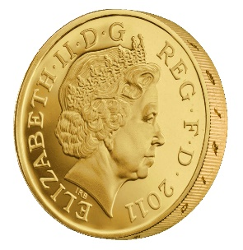
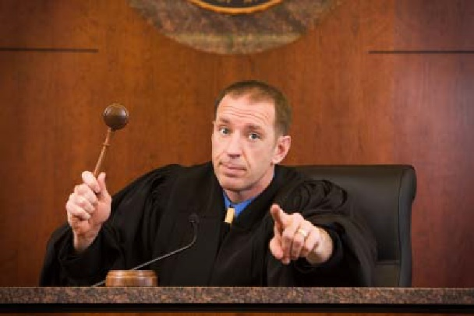
Another Equivalent Definition (Game)
m₀, m₁
Random bit b
K ← Gen(.)
c = Enc_{K}(m_{b})
c
b’
$$∀\begin{matrix} & \\ & \\ & \end{matrix} Pr\left[\begin{matrix} & \\ & \end{matrix} Guesses b^{′}=b\right]=\frac{1}{2}$$
Notes:
Suppose we have m,m’,c’ s.t. Pr[EncK(m)= c’] > Pr[EncK(m’)=c’] then adversary can select m0= m, m1=m’. If the ciphertext challenge c=c’ then the adversary outputs guess b’ = 1. Otherwise, the adversary outputs random guess b’.

Slide 55
Another Equivalent Definition (Game)
$Formally, let Π= \left(Gen,Enc,Dec\right) denote the encryption scheme,$and let A denote an eavesdropping attacker. $Call the game the adversarial indistinguishability experiment and$
$$define a random variable{ PrivK}_{A,Π }^{eav} as follows$$
$${ PrivK}_{A,Π }^{eav}=\left\{\begin{matrix}1 & if b=b^{′}(attacker is correct) \\ 0 & otherwise(attacker is not correct)\end{matrix}\right.$$
$$Π has indistinguishable encryptions in the presence of$$
$an eavesdropper if for all eavesdropping adversaries A we have$
$$Pr\left[{PrivK}_{A,Π }^{eav}=1\right]=\frac{1}{2}$$
m₀, m₁
Random bit b
K = Gen(.)
c = Enc_{K}(m_{b})
c
b’
$$∀\begin{matrix} & \\ & \\ & \end{matrix} Pr\left[\begin{matrix} & \\ & \end{matrix} Guesses b^{′}=b\right]=\frac{1}{2}$$
Notes:
Suppose we have m,m’,c’ s.t. Pr[EncK(m)= c’] > Pr[EncK(m’)=c’] then adversary can select m0= m, m1=m’. If the ciphertext challenge c=c’ then the adversary outputs guess b’ = 1. Otherwise, the adversary outputs random guess b’.

Slide 56
Another Equivalent Definition (Game)
m₀, m₁
Random bit b
K ← Gen(.)
c = Enc_{K}(m_{b})
c
b’
Suppose we have m,m’,c’ s.t. Pr[Enc_{K}(m)= c’] > Pr[Enc_{K}(m’)=c’] then the adversary can win the game w.p > ½. How?
What else do we need to establish to prove that the definitions are equivalent?
Notes:
Suppose we have m,m’,c’ s.t. Pr[EncK(m)= c’] > Pr[EncK(m’)=c’] then adversary can select m0= m, m1=m’. If the ciphertext challenge c=c’ then the adversary outputs guess b’ = 1. Otherwise, the adversary outputs random guess b’. Let Wins
Denote the event that the attacker wins the game.
Pr[Wins|c!=c’] = 1/2
Pr[Wins|c=c’] = Pr[b=1|c=c’] = Pr[b=1 and c=c’]/Pr[c=c’] = (1/2)Pr[Enck(m1)=c’]/Pr[c=c’]
Pr[Wins|c=c’] *Pr[c=c’] = (1/2) Pr[Enck(m1)]
Pr[Wins] = Pr[Wins|c!=c’]*Pr[c!=c’] + Pr[c=c’]*Pr[Wins|c=c’] = (½)*Pr[c!=c’]+(½) Pr[Enck(m1)] = (½) (1-½ * Pr[Enck(m0)=c’]-½ Pr[Enck(m1)=c’]) ’]+(½) Pr[Enck(m1)] = ½ – ¼ Pr[Enck(m0)=c’] + ¼ Pr[Enck(m1)=c’] > ½
The above derivation only establishes one direction of the proof.
Suppose now that for all m,m’, c’ we have Pr[Enc_{K}(m)= c’] = Pr[Enc_{K}(m’)=c’] . Now we need to argue that the adversary cannot win the game with probability > ½. How to argue? Let m0,m1 denote the messages played in round 1, and let c be the challenge cipher text sent in round 2. Note that Pr[Enc_{K}(m₀)= c’] = Pr[Enc_{K}(m₁)=c’] (by definition) so we have
Pr[b=1 | c] = Pr[b and c]/Pr[c] = (1/2) Pr[Enc_{K}(m₁)=c]/ Pr[c] = (1/2) Pr[Enc_{K}(m₀)=c]/ Pr[c] = Pr[b=0|c]
Note that Pr[b=1 | c] +Pr[b=0|c] =1. Thus, Pr[b=0|c] = ½ and Pr[b=1|c] = ½ so whatever bit b’ the attacker guesses after seeing c he will win with probability ½.
QED.

Slide 57
One Time Pad [Vernam 1917]
$${Enc}_{K}\left(m\right)=K⨁m$$
$${Dec}_{K}\left(c\right)=K⨁c$$
$Example=1011⨁$0011 = ???
Theorem: The one-time pad encryption scheme is perfectly secret
The following calculation holds for any c, m
Pr[Enc_{K}(m)=c] = Pr[$K⨁$m =c] = Pr[K=c$⨁$m] = $1/{\left|𝒦\right|}$.
Thus, for any m, m’, c we have
Pr[Enc_{K}(m)=c]=$1/{\left|𝒦\right|}$ =Pr[Enc_{K}(m’)=c].
Notes:
The following calculation holds for any c, m’ Pr[C=c|M=m’] = Pr[Enc_{K}(m’)=c] = Pr[$K⨁$m’ =c] = Pr[K=c$⨁$m’] = $1/{\left|𝒦\right|}$

Slide 58
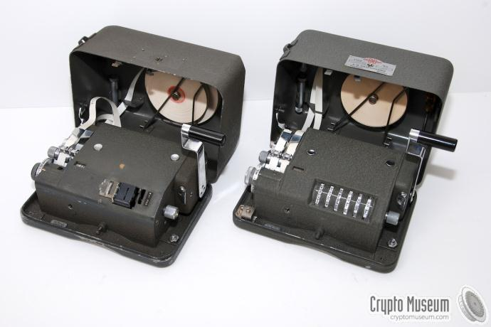
One Time Pad [Vernam 1917]
$${Enc}_{K}\left(m\right)=K⨁m$$
$${Dec}_{K}\left(c\right)=K⨁c$$
$Example=1011⨁$0011 = ???
Notes:
Examples

Slide 59
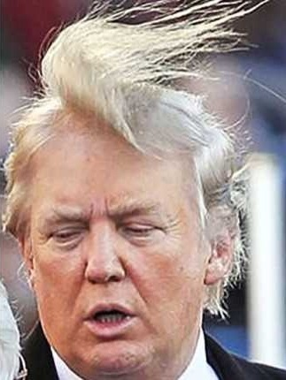
One Time Pad

Slide 60
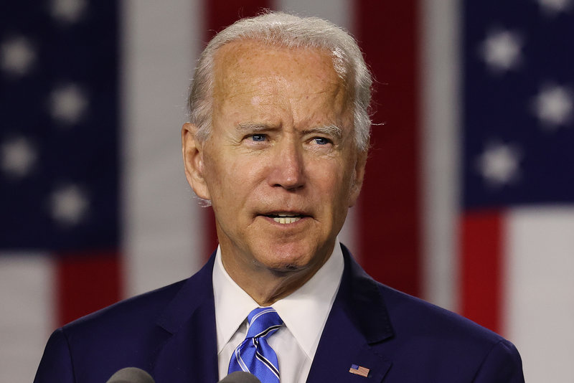
One Time Pad

Slide 61
Perfect Secrecy Limitations
Theorem: If (Gen,Enc,Dec) is a perfectly secret encryption scheme then
$$\left|𝒦\right|≥\left|ℳ\right|$$
Notes:
Proof: Suppose for contradiction that $\left|𝒦\right|<\left|ℳ\right|$. Given a ciphertext c let $ℳ\left(c\right)=\left\{m\left|m={Dec}_{k}\left(c\right)\right. for some key k ∈𝒦\right\}$. Trivially $\left|ℳ\left(c\right)\right|≤\left|𝒦\right|<\left|ℳ\right|$. This implies that there is some message$m∈ℳ\backslash ℳ\left(c\right)$ so that
$$Pr\left[M=m\left|C=c\right.\right]=0≠Pr\left[M=m\right].$$

Slide 62
One Time Pad Limitations
The key is as long as the message
How to exchange long messages?
Need to exchange/secure lots of one-time pads!
OTPs can only be used once
As the name suggests
VENONA project (US + UK)
Decrypt ciphertexts sent by Soviet Union which were mistakenly encrypted with portions of the same one-time pad over several decades
$$c⨁c^{′}=\left(m⨁k\right)⨁\left(m^{′}⨁k\right)=m⨁m′$$
Notes:
Other Limitations?
Integrity

Slide 63
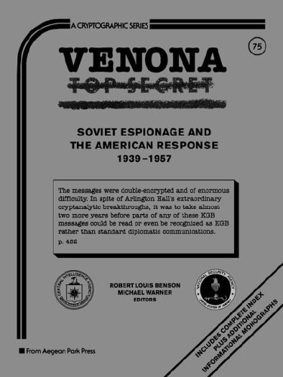
VENONA project

Slide 64
Shannon’s Theorem
Theorem: Let (Gen,Enc,Dec) be an encryption scheme with $\left|𝒦\right|=\left|ℳ\right|=\left|𝒞\right|.$Then the scheme is perfectly secret if and only if:
Every key k $∈$ $𝒦$ is chosen with (equal) probability $1/{\left|𝒦\right|}$ by the algorithm Gen, and
For every $m∈ℳ$ and every $c∈𝒞$ there exists a unique key k $∈$ $𝒦$such that Enc_{k}(m)=c$.$

Slide 65
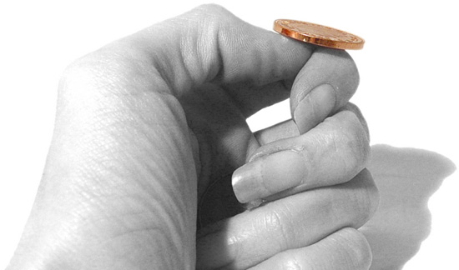
An Important Remark on Randomness
In our analysis we have made (and will
continue to make) a key assumption:
We have access to true “randomness”
to generate a secret key K
Example: K = one time pad
Independent Random Bits
Unbiased Coin flips
Radioactive decay?

Slide 66
In Practice
Hard to flip thousands/millions of coins
Mouse-movements/keys
Uniform bits?
Independent bits?
Use Randomness Extractors
As long as input has high entropy, we can extract (almost) uniform/independent bits
Hot research topic in theory

Slide 67
In Practice
Hard to flip thousands/millions of coins
Mouse-movements/keys
Customized Randomness Chip?

Slide 68
Caveat: Don’t do this!
Rand() in C stdlib.h is no good for cryptographic applications
Source of many real
world flaws

Slide 69
Perfect Secrecy
What capabilities do we assume the attacker has?
Eavesdropping (Passive Adversary)
That’s it!
Implicit Assumption: No ability to tamper with messages!
Remark on One-Time Pads: If attacker has the ability to tamper with the ciphertext then s/he can easily flip the last bit of the message. How?
Answer: Flip the last bit of the intercepted ciphertext $c=K⨁m$ to obtain
$c^{′}=c⨁00…01$
$${Dec}_{K}\left(c′\right)=K⨁c^{′}=\left(K⨁c\right)⨁00…01=m⨁00…01$$

Slide 70
Topic 4: Computational Security

Slide 71
What if we want to send a longer message?
K₁,K₂,K₃
K₁,K₂,K₃
$${Enc}_{K_{1}}\left("Dear Alice, I wrote this poem for you"\right)$$
$${Enc}_{K_{2}}\left("Roses are red, …."\right)$$
$${Enc}_{K_{3}}\left("I am out of space, but the rest was awesome"\right)$$
Notes:
Alice doesn’t respond to Bob since they are out of one-time-pads so they stop talking. Can we save their relationship?

Slide 72
What if we want to send many messages?
K₁,K₂,K₃
K₁,K₂,K₃
$${Enc}_{K_{1}}\left("Whats up, Alice?"\right)$$
$${Enc}_{K_{2}}\left("Not too much, you?"\right)$$
$${Enc}_{K_{3}}\left("Just chilling out"\right)$$
Notes:
Alice doesn’t respond to Bob since they are out of one-time-pads so they stop talking. Can we save their relationship?

Slide 73
Can we save their relationship?
K₁,K₂,K₃
K₁,K₂,K₃
$${Enc}_{K_{1}}\left("Whats up, Alice?"\right)$$
$${Enc}_{K_{2}}\left("Not too much, you?"\right)$$
$${Enc}_{K_{3}}\left("Just chilling out"\right)$$
Notes:
Alice doesn’t respond to Bob since they are out of one-time-pads so they stop talking. Can we save their relationship?

Slide 74
Perfect Secrecy vs Computational Security
Perfect Secrecy is Information Theoretic
Guarantee is independent of attacker resources
Computational Security
Security against computationally bounded attacker
An attacker with infinite resources might break security
Attacker might succeed with very small probability
Example: Lucky guess reveals secret key
Very Small Probability: $2^{−100},$ $2^{−1000}$, …

Slide 75
Current Goal
Define computational security in presence of eavesdropper who intercepts a single (long) message
If you don’t understand what you want to achieve, how can you possibly know when (or if) you have achieved it?
Show how to build a symmetric encryption scheme with computational security in the presence of an eavesdropper.
Define computational security against an active attacker who might modify the message
Define computational security for multiple messages in presence of an eavesdropper

Slide 76
Concrete Security
“A scheme is (t,ε)-secure if every adversary running for time at most t succeeds in breaking the scheme with probability at most ε”
Example: t = 2⁶⁰ CPU cycles
9 years on a 4GHz processor
< 1 minute on fastest supercomputer (in parallel)
Full formal definition needs to specify “break”
Important Metric in Practice
Caveat 1: difficult to provide/prove such precise statements
Caveat 2: hardware improves over time

Slide 77
Asymptotic Approach to Security
A scheme is secure if every probabilistic polynomial time (ppt) adversary “succeeds” with negligible probability.
Two Key Concepts
Polynomial time algorithm
Negligible Function
Definition: A function $f: ℕ⟶ℝ_{≥0}$ is negligible if for every positive polynomial p there is an integer N>0 such that for all n > N we have
$$f(n)<\frac{1}{p(n) }$$

Slide 78
Asymptotic Approach to Security
Definition: A function $f: ℕ⟶ℝ_{≥0}$ is negligible if for every positive polynomial $p\left(.\right)>0$ there is an integer N>0 such that for all n > N we have
$$f(n)<\frac{1}{p(n) }$$
Intuition: If we choose the security parameter n to be sufficiently large then we can make the adversaries success probability very small (negligibly small).

Slide 79
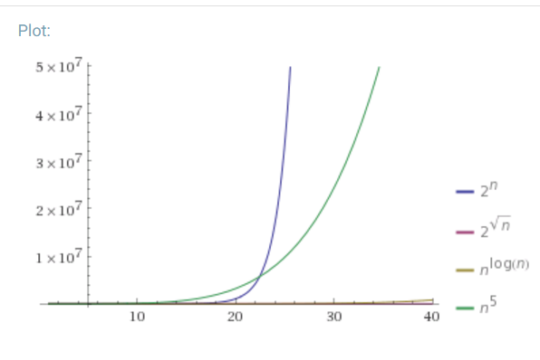
Asymptotic Approach to Security
Definition: A function $f: ℕ⟶ℝ_{≥0}$ is negligible if for every positive polynomial p there is an integer N>0 such that for all n > N we have
$$f(n)<\frac{1}{p(n) }$$
Which functions below are negligible?
${f\left(n\right)=2}^{−n}$
$f\left(n\right)=n^{−5}$
$f\left(n\right)={2^{−1000}1000n}^{1000}$
${f\left(n\right)=2^{100}2}^{−\sqrt{n}}$
${f\left(n\right)=2}^{−\log{n}}$
${f\left(n\right)=n}^{−\log{n}}$

Slide 80
Asymptotic Approach to Security
Definition: A function $f: ℕ⟶ℝ_{≥0}$ is negligible if for every positive polynomial p there is an integer N>0 such that for all n > N we have
$$f(n)<\frac{1}{p(n) }$$
Which functions below are negligible?
${f\left(n\right)=2}^{−n}$
$f\left(n\right)=n^{−5}$
$f\left(n\right)={2^{−1000}1000n}^{1000}$
${f\left(n\right)=2^{100}2}^{−\sqrt{n}}$
${f\left(n\right)=2}^{−\log{n}}$
${f\left(n\right)=n}^{−\log{n}}$

Slide 81
Asymptotic Approach to Security
Definition: An (randomized) algorithm A runs in polynomial time if there exists a polynomial p(.) such that for every n-bit input x, A(x) terminates in at most p(n) steps in expectation.
Intuition: If an algorithm A does not run in polynomial time then, for sufficiently large n, it will quickly become impractical for any attacker to run the algorithm A.

Slide 82
Asymptotic Approach to Security
A scheme is secure if every probabilistic polynomial time (ppt) adversary “succeeds” with negligible probability.
General Attack 1: Test all possible secret keys $k′∈𝒦$
Doesn’t run in polynomial time, since $\left|𝒦\right|=2^{n}$
General Attack 2: Select random key $k^{′}∈𝒦,$check if it is correct (otherwise output $⊥$for “fail”).
Only successful with negligible probability $2^{−n}$

Slide 83
Advantages of Asymptotic Approach
Closure
If subroutine B runs in polynomial time and algorithm A makes poly(n) queries to the subroutine B then A also runs in polynomial time.
If f and g are negligible functions then h(n) = f(n)+g(n) is a negligible function
If p(.) is a positive polynomial, and f(.) is a negligible function then the function g(n)=f(n)p(n) is also negligible.
Church-Turing Thesis: “reasonable” model of computations are all polynomially equivalent.
Implication: No need to worry about different models of computation (circuits, random access machines, etc…)
Disadvantage: Limited guidance on how big to make security parameter n in practice.

Slide 84
Note: Asymptotic vs Concrete Security
Theory of Cryptography: Often follows Asymptotic Approach
Course Textbook (Katz-Lindell) follows the asymptotic approach
Applied Cryptography: Concrete Security Analysis is more useful
This Course: We will consider both approaches

Slide 85
Private Key Encryption Syntax (Revisited)
Message Space: $ℳ$
Key Space: $𝒦$
Three Algorithms
$\operatorname{Gen}{(1^{n};R)}$ (Key-generation algorithm)
Input: 1^{n} (security parameter in unary) + Random Bits R,
Output: Secret key $k∈𝒦$
$\operatorname{Enck}{(m;R)}$ (Encryption algorithm)
Input: Secret key $k∈𝒦$ and message $m∈ℳ$ + Random Bits R,
Output: ciphertext c
$\operatorname{Deck}{(c)}$ (Decryption algorithm)
Input: Secret key $k∈𝒦$ and a ciphertex$c$
Output: a plaintext message $m∈ℳ$ or $⊥(i.e$“Fail”)
Invariant: Dec_{k}(Enc_{k}(m))=m
Requirement: all three algorithms run in probabilistic polynomial time
Trusted Parties (e.g., Alice and Bob) must run Gen in advance to obtain secret k.
Typically picks $k∈𝒦$
uniformly at random
Quick Comment on Notation:
$K=\operatorname{Gen}{(1^{n};R)}$ vs.
$K←\operatorname{Gen}{(1^{n})}$

Slide 86
Private Key Encryption Syntax (Revisited)
Message Space: $ℳ$
Key Space: $𝒦$
Three Algorithms
$\operatorname{Gen}{(1^{n};R)}$ (Key-generation algorithm)
Input: 1^{n} (security parameter in unary) + Random Bits R,
Output: Secret key $k∈𝒦$
$\operatorname{Enck}{(m;R)}$ (Encryption algorithm)
Input: Secret key $k∈𝒦$ and message $m∈ℳ$ + Random Bits R,
Output: ciphertext c
$\operatorname{Deck}{(c)}$ (Decryption algorithm)
Input: Secret key $k∈𝒦$ and a ciphertex$c$
Output: a plaintext message $m∈ℳ$ or $⊥(i.e$“Fail”)
Invariant: Dec_{k}(Enc_{k}(m))=m
Requirement: all three algorithms run in probabilistic polynomial time
Trusted Parties (e.g., Alice and Bob) must run Gen in advance to obtain secret k.
Typically picks $k∈𝒦$
uniformly at random
Quick Comment on Notation:
$K=\operatorname{Gen}{(1^{n};R)}$ vs.
$K←\operatorname{Gen}{(1^{n})}$

Slide 87
Adversarial Indistinguishability Experiment
m₀, m₁
Random bit b
K ← Gen(1^{n})
c ← Enc_{K}(m_{b})
c
b’
$$∀\begin{matrix} & \\ & ∃μ \\ & \end{matrix} Pr\left[\begin{matrix} & \\ & \end{matrix} Guesses b^{′}=b\right]≤\frac{1}{2}+μ_{}(n)$$
$$ppt attacker$$
$$negligible function$$
$$negligible function$$

Slide 88
Adversarial Indistinguishability Experiment
$$Formally, let Π= \left(Gen,Enc,Dec\right) denote the encryption scheme,$$
$$call the game the adversarial indistinguishability experiment and$$
$$define a random variable{ PrivK}_{A,Π }^{eav}\left(\text{1}\text{n}\right) as follows$$
$${ PrivK}_{A,Π }^{eav}\left(\text{1}\text{n}\right)=\left\{\begin{matrix}1 & if b=b′ \\ 0 & otherwise\end{matrix}\right.$$
$$Π has indistinguishable encryptions in the presence of$$
$$an eavesdropper if for all PPT adversary A, there exists a$$
negligible function $μ(.)$ such that
Pr[${PrivK}_{A,Π }^{eav}=1$] $≤\frac{1}{2}+μ(n)$
m₀, m₁
Random bit b
K = Gen(1^{n})
c = Enc_{K}(m_{b})
c
b’
$$∀\begin{matrix} & \\ & \\ & \end{matrix} Pr\left[\begin{matrix} & \\ & \end{matrix} Guesses b^{′}=b\right]≤\frac{1}{2}+μ(n)$$
$$ppt attacker$$
$$negligible function$$

Slide 89
EAV-Secure
m₀, m₁
Random bit b
K ← Gen(1^{n})
c ← Enc_{K}(m_{b})
c
b’
$$∀\begin{matrix} & \\ & ∃μ \\ & \end{matrix} Pr\left[\begin{matrix} & \\ & \end{matrix} Guesses b^{′}=b\right]≤\frac{1}{2}+μ_{}(n)$$
$$ppt attacker$$
$$negligible function$$
$$negligible function$$

Slide 90
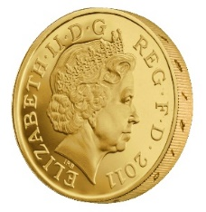
$\left(t\left(n\right),ε\left(n\right)\right)$-EAV-Secure (Concrete Version)
m₀, m₁
Random bit b
K ← Gen(1^{n})
c = Enc_{K}(m_{b})
c
b’
$$∀\begin{matrix} & \\ & \\ & \end{matrix} Pr\left[\begin{matrix} & \\ & \end{matrix} Guesses b^{′}=b\right]≤\frac{1}{2}+ε(n)$$
$$running in time at most t(n)$$
$$specific function$$
(same for all attackers)
Notes:
Suppose we have m,m’,c’ s.t. Pr[EncK(m)= c’] > Pr[EncK(m’)=c’] then adversary can select m0= m, m1=m’. If the ciphertext challenge c=c’ then the adversary outputs guess b’ = 1. Otherwise, the adversary outputs random guess b’.

Slide 91
Aside: Message and Ciphertext Length
In the previous game we typically require that |m₀|=|m₁|. Why?
It is impossible to support arbitrary length messages while hiding all information about plaintext length
Limitation: When could message length be sensitive?
Numeric data (5 figure vs 6 figure salary)
Database Searches: number of records returned can reveal information about the query
Compressed Data: Short compressed string indicates that original plaintext has a lot of redundancy (e.g., CRIME attack on session cookies in HTTPS)

Slide 92
Implications of Indistinguishability
i^{th} bit of message
Theorem 3.10: Let (Gen, Enc, Dec) be a fixed-length private key encryption scheme for message of length $ℓ$ that satisfies indistinguishability (prior definition) then for all PPT attackers A and any $i≤ℓ$ we have
$$Pr\left[A\left(1^{n},{Enc}_{K}\left(m\right)\right)=m^{i}\right]≤\frac{1}{2}+negl(n)$$
Where the randomness is taken over $K←Gen\left(1^{n}\right)$, uniform $m∈{\left\{0,1\right\}}^{ℓ}$ and the randomness of $Enc$ and A.
Remark: A bit weaker than saying eavesdropping attacker obtains ``no additional” information about message m.

Slide 93
Semantic Security
Definition 3.12: Let $Π=\left(\text{Gen}\text{, }\text{Enc}\text{, }\text{Dec}\right)$be a fixed-length private key encryption scheme for message of length $ℓ$. We say that the scheme is semantically secure if for all PPT attackers A there exists a PPT algorithm A’ such that for any PPT algorithm Sample all any polynomial time computable functions f and h we have
$$\left|Pr\left[A\left(1^{n},{Enc}_{K}\left(m\right),h(m)\right)=f(m)\right]−Pr\left[A′\left(1^{n},\left|m\right|,h(m)\right)=f(m)\right]\right|≤negl(n)$$
Where the randomness is taken over $K←Gen\left(1^{n}\right)$, $m←Samp\left(1^{n}\right)$ and the randomness of $Enc$, A and A’.

Slide 94
Semantic Security
A’ doesn’t even get to see an encryption of m! Just the length of m!
h(m) background knowledge the attacker might have about m.
Example:
f(m) = 1 if m > 100,000;
f(m) = 0 otherwise .
Definition 3.12: Let $Π=\left(\text{Gen}\text{, }\text{Enc}\text{, }\text{Dec}\right)$be a fixed-length private key encryption scheme for message of length $ℓ$. We say that the scheme is semantically secure if for all PPT attackers A there exists a PPT algorithm A’ such that for any PPT algorithm Sample all any polynomial time computable functions f and h we have
$$\left|Pr\left[A\left(1^{n},{Enc}_{K}\left(m\right),h(m)\right)=f(m)\right]−Pr\left[A′\left(1^{n},\left|m\right|,h(m)\right)=f(m)\right]\right|≤negl(n)$$
Where the randomness is taken over $K←Gen\left(1^{n}\right)$, $m←Samp\left(1^{n}\right)$ and the randomness of $Enc$, A and A’.

Slide 95
Semantic Security
Definition 3.12: Let $Π=\left(\text{Gen}\text{, }\text{Enc}\text{, }\text{Dec}\right)$be a fixed-length private key encryption scheme for message of length $ℓ$. We say that the scheme is semantically secure if for all PPT attackers A there exists a PPT algorithm A’ such that for any PPT algorithm Sample all any polynomial time computable functions f and h we have
$$\left|Pr\left[A\left(1^{n},{Enc}_{K}\left(m\right),h(m)\right)=f(m)\right]−Pr\left[A′\left(1^{n},\left|m\right|,h(m)\right)=f(m)\right]\right|≤negl(n)$$
Where the randomness is taken over $K←Gen\left(1^{n}\right)$, $m←Samp\left(1^{n}\right)$ and the randomness of $Enc$, A and A’.
Theorem 3.13. (Equivalent Definitions) $Π$ is Semantically secure if and only if $Π$ has indistinguishable encryptions in the presence of an eavesdropper.

Slide 96
Another Interpretation of Semantic Security
World 2: Perfect Secrecy (Attacker doesn’t even see ciphertext).
For all attackers A’ (even unbounded) with background knowledge h(m) we have
$$Pr\left[A′\left(1^{n},\left|m\right|,h(m)\right)=f(m)\right]=Pr\left[f(m)\left| h\left(m\right),\right.\left|m\right|\right]$$
World 1: Attacker is PPT and sees ciphertext
Best World 1 attacker does no better than World 2 attacker
$\left|Pr\left[A\left(1^{n},{Enc}_{K}\left(m\right),h(m)\right)=f(m)\right]−Pr\left[A′\left(1^{n},\left|m\right|,h(m)\right)=f(m)\right]\right|≤negl(n)$
What is probability over?

