Slide 1
Applied Cryptography ENCS4320
Week 3:
Building CPA-Secure Encryption Schemes
Pseudorandom Functions/Permutations
Block Ciphers + Modes of Operation
CCA-Security (definition)
Message Authentication Codes [time permitting]
Readings: Katz and Lindell Chapter 3.5-3.7

Slide 2
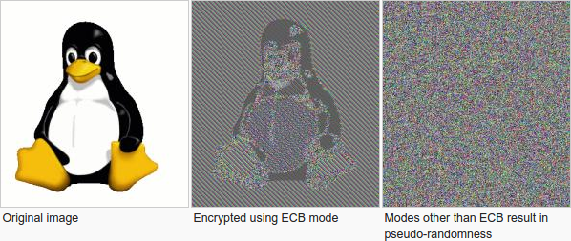
Modes of Encryption, The Penguin and CCA security

Slide 3
Pseudorandom Permutation
A keyed function $F:{\left\{0,1\right\}}^{n}×{\left\{0,1\right\}}^{n}→{\left\{0,1\right\}}^{n}$, which is invertible and “looks random” without the secret key k.
Similar to a PRF, but
Computing F_{k}(x) and $F_{k}^{−1}\left(x\right)$ is efficient (polynomial-time)
Definition 3.28: A keyed function $F:{\left\{0,1\right\}}^{n}×{\left\{0,1\right\}}^{n}→{\left\{0,1\right\}}^{n}$ is a strong pseudorandom permutation if for all PPT distinguishers D there is a negligible function $μ$ s.t.
$$\left|Pr\left[D^{F_{k}\left(.\right),F_{k}^{−1}\left(.\right)}\left(1^{n}\right)\right]−Pr\left[D^{f\left(.\right),f^{−1}\left(.\right)}\left(1^{n}\right)\right]\right|≤μ\left(n\right)$$

Slide 4
Pseudorandom Permutation
Definition 3.28: A keyed function $F:{\left\{0,1\right\}}^{n}×{\left\{0,1\right\}}^{n}→{\left\{0,1\right\}}^{n}$ is a strong pseudorandom permutation if for all PPT distinguishers D there is a negligible function $μ$ s.t.
$$\left|Pr\left[D^{F_{k}\left(.\right),F_{k}^{−1}\left(.\right)}\left(1^{n}\right)\right]−Pr\left[D^{f\left(.\right),f^{−1}\left(.\right)}\left(1^{n}\right)\right]\right|≤μ\left(n\right)$$
Notes:
the first probability is taken over the uniform choice of ${k∈\left\{0,1\right\}}^{n}$ as well as the randomness of D.
the second probability is taken over uniform choice of f $∈$Perm_{n}as well as the randomness of D.
D is never given the secret k
However, D is given oracle access to (keyed) permutation and inverse
Strong pseudorandom permutation: attacker doesn’t get oracle access to inverse
Can build strong pseudorandom permutation given pseudorandom function

Slide 5
Electronic Code Book (ECB) Mode
Uses strong PRP F_{k}(x) and $F_{k}^{−1}\left(x\right)$
Enc_{k}
Input: m₁,…,m$ℓ$
Output: $\left\langle \text{F}\text{k}\text{(}\text{m}\text{1}\text{)},…,\text{F}\text{k}\text{(}\text{m}ℓ \text{)}\right\rangle$
How to decrypt?
Is this secure?
Hint: Encryption is deterministic.
Implication: Not CPA-Secure
But, it gets even worse

Slide 6
ECB Mode (A Failed Approach)

Slide 7
The Penguin Principle
If you can still see the penguin after “encrypting” the image something is very very wrong with the encryption scheme.

Slide 8
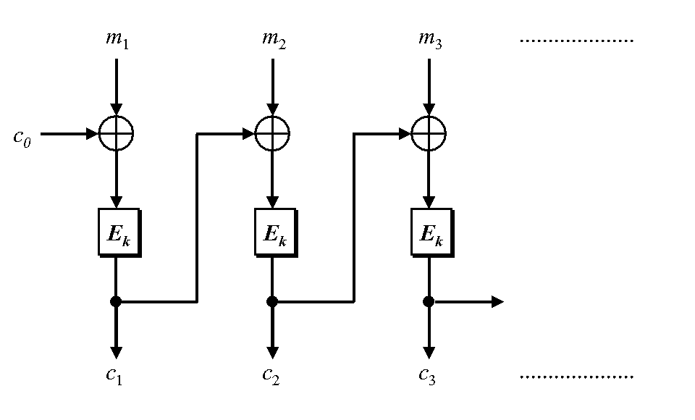
Cipher Block Chaining
CBC-Mode (below) is CPA-secure if E_{k} is a PRP
Reduces bandwidth!
Message: 3n bits
Ciphertext: 4n bits
IV
IV
How to decrypt? (Hint: Can be done in parallel)

Slide 9
Recap
PRFs/PRPs
CPA-Secure Encryption + Security Reduction
$${Enc}_{k}\left(m\right)=\left\langle r,F_{k}\left(r\right)⨁m\right\rangle$$
ECB Mode + Penguin Principle
CBC Mode (CPA Secure)
Chained CBC-Mode

Slide 10
Chained CBC-Mode
m₄
m₅
m₆
IV
c₃
IV
c₄
c₅
c₆
First glance: seems similar to CBC-Mode and reduces bandwidth
Vulnerable to CPA-Attack! (Set $m4=IV⨁c3⨁m_{1}^{′}$ and c₄=c₁ iff m₁=m₁’)
Moral: Be careful when tweaking encryption scheme!

Slide 11
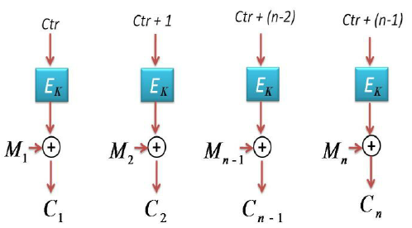
Counter Mode
Input: m₁,…,m_{n}
Output: c = (ctr, c₁,c₂,…,c_{n}) where ctr is chosen uniformly at random
Theorem: If E_{k} is PRF (or PRP) then counter mode is CPA-Secure
Advantages: Parallelizable encryption/decryption

Slide 12
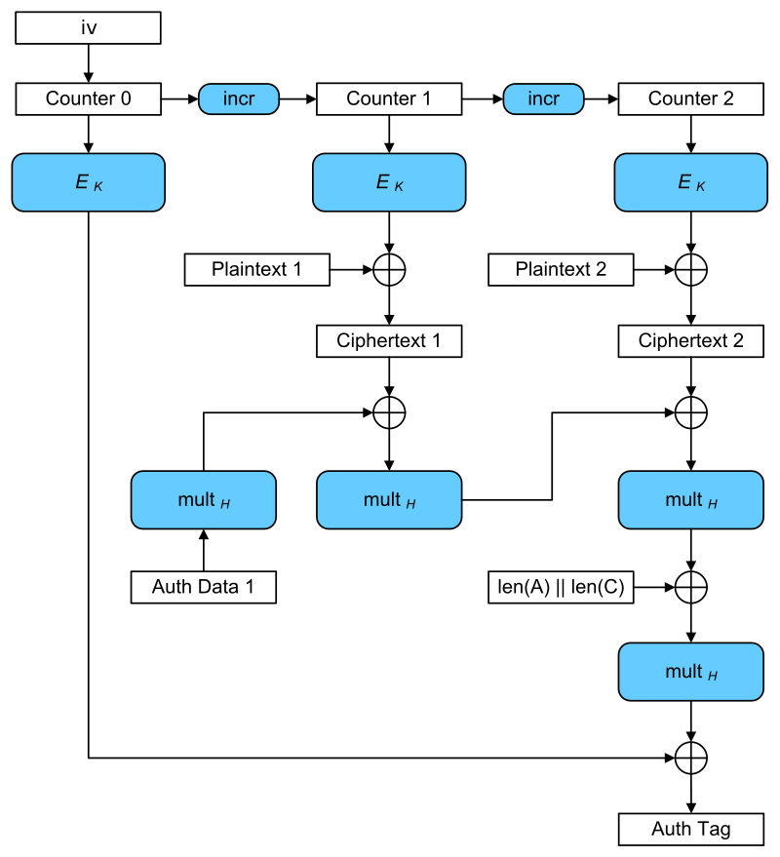
Galois Counter Mode (GCM)
Input: plaintexts 1 & 2
AES-GCM is CCA-secure (> CPA-security)
Bonus: Authentication Encryption with Associated Data
Ensure integrity of ciphertext
Attacker cannot even generate new/valid ciphertext!
Ensures attacker cannot tamper with associated packet data
Source IP
Destination IP
Why can’t these values be encrypted?
Encryption is largely parallelizable!
Outputs: iv, ciphertexts 1 & 2, authentication tag

Slide 13
CCA-Security

Slide 14
Chosen Ciphertext Attacks
Sometimes an attacker has ability to obtain (partial) decryptions of ciphertexts of its choice.
CPA-Security does not model this ability.
Examples:
An attacker may learn that a ciphertext corresponds to an ill-formed plaintext based on the reaction (e.g., server replies with “invalid message”).
Monitor enemy behavior after receiving an encrypted message.
Authentication Protocol: Send Enc_{k}(r) to recipient who authenticates by responding with r.

Slide 15
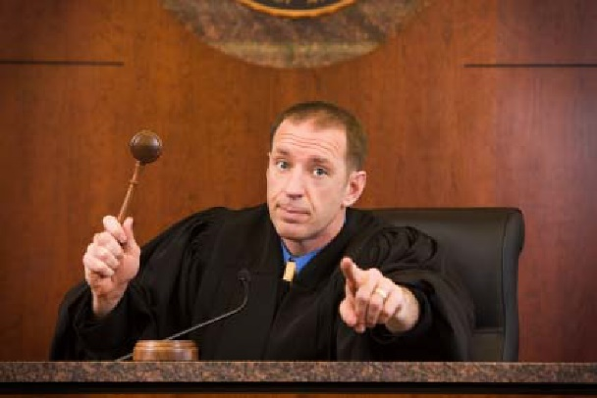
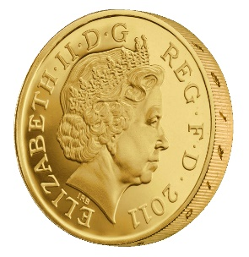
CCA-Security (Ind-CCA2)
We could set m₀ = m₋₁ or m₁ = m₋₂ etc…
m₋₁
c₋₁ = Enc_{K}(m₋₁)
c₋₂
…
m₋₂ = Dec_{K}(c₋₂)
m₀,m₁
However, we could still flip 1 bit of c and ask challenger to decrypt
c = Enc_{K}(m_{b})
m₂
c₂ = Enc_{K}(m₂)
Random bit b
K = Gen(.)
c₃
m₃ = Dec_{K}(c₃)
c₄ =c
…
“No Way!”
b’

Slide 16
CCA-Security $\left({PrivK}_{A,Π}^{cca}\left(n\right)\right)$
Challenger generates a secret key k and a bit b
Adversary (A) is given oracle access to Enc_{k} and Dec_{k}
Adversary outputs m₀,m₁
Challenger sends the adversary c=Enc_{k}(m_{b}).
Adversary maintains oracle access to Enc_{k} and Dec_{k} ,however the adversary is not allowed to query Dec_{k}(c).
Eventually, Adversary outputs b’.
$${PrivK}_{A,Π}^{cca}\left(n\right)=1 if b=b^{′};otherwise 0.$$
CCA-Security: For all PPT A exists a negligible function negl(n) s.t.
$$Pr\left[{PrivK}_{A,Π}^{cca}\left(n\right)=1\right]≤\frac{1}{2}+negl(n)$$

Slide 17
CCA-Security
Definition 3.33: An encryption scheme $Π$ is CCA-secure if for all PPT A there is a negligible function negl(n) such that
$$Pr\left[{PrivK}_{A,Π}^{cca}\left(n\right)=1\right]≤\frac{1}{2}+negl(n)$$

Slide 18
CPA-Security doesn’t imply CCA-Security
$$\text{Enc}\text{k}\text{(}\text{m}\text{)}=\left\langle r,F_{k}\left(r\right)⨁m\right\rangle$$
Attacker: Selects m₀ = 0^{n} and m₁ = 1^{n}
Attacker Receives: $c=\left\langle r, s\right\rangle$ ${\text{where} s=F}_{k}\left(r\right)⨁m_{b}$
Attacker Queries: Dec_{k}(c’) for
$$c′=\left\langle r,s⨁{10}^{n−1}\right\rangle$$
Attacker Receives: $m=\left\{\begin{matrix}{10}^{n−1} & if b=0 \\ {01}^{n−1} & if b=1\end{matrix}\right.$
Example Shows: CPA-Security doesn’t imply CCA Security (Why?)

Slide 19
Attacks in the Wild
Padding Oracle Attack
Length of plaintext message must be multiple of block length (e.g., 16 bytes)
Popular fix PKCS #5 padding
1 bytes of padding (0x01)
2 bytes of padding (0x0202)
3 bytes of padding (0x030303)
4 bytes of padding (0x04040404)
Invalid: (0x020303)
“Bad Padding Error”
Adversary submits ciphertext(s) and waits to if this error is produced
Attacker can repeatedly modify ciphertext to reveal original plaintext piece by piece!

Slide 20
Example
M=“hello…please keep this message secret”+0x030303
$$C=\left\langle r,s=F_{k}\left(r\right)⨁M\right\rangle$$
$C^{′}=\left\langle r,F_{k}\left(r\right)⨁M⨁\text{0}\text{x}\text{0000}….\text{30}\text{303}⨁\text{0}\text{x}\text{00000}…\text{0}\text{2}\text{0}2\right\rangle$
Ask to decrypt C’
If we added 3 bytes of padding?
→ C’ can be decrypted (Looks like the message M’ = M + 0x0301 with 1 byte padding).
If we added $>$ 3 (or < 3) bytes of padding?
→We will get a decryption error (bad padding)!
Once we know we have three bits of padding we can set
$$C^{′′}=\left\langle r,s=F_{k}\left(r\right)⨁\left(M⨁\text{0}\text{x}\text{0000}….\text{0}\text{30303}\right)⨁\text{0}\text{x}\text{0}…gg0\text{4}\text{0}\text{4}\text{0}\text{4}\right\rangle$$
If C’’ decrypts then we can infer the byte t s.t. $M=x∥t∥(0x030303)$ since $t⨁gg=0x04$.

Slide 21
Example
M=“hello…please keep this message secret”+0x030303
$$C=\left\langle r,s=F_{k}\left(r\right)⨁M\right\rangle$$
Once we know we have three bits of padding we can set
$$C^{′′}=\left\langle r,s=F_{k}\left(r\right)⨁\left(M⨁\text{0}\text{x}\text{0000}….\text{0}\text{30303}\right)⨁\text{0}\text{x}\text{0}…gg0\text{4}\text{0}\text{4}\text{0}\text{4}\right\rangle$$
If C’’ decrypts then we can infer the byte t s.t. $M=x∥t∥(0x030303)$ since $t⨁gg=0x04$.
Question: How do we infer the next byte t’?
Answer: Set $C′′′=C′′⨁\text{0}\text{x}\text{0}…gg050\text{5}\text{0}\text{5}\text{0}\text{5}$
if decryption is successful then $t′⨁gg=0x05$

Slide 22
CCA-Security
CCA-Security is strictly stronger than CPA-Security
Note: If a scheme has indistinguishable encryptions under one chosen-ciphertext attack then it has indistinguishable multiple encryptions under chosen-ciphertext attacks.
None of the encryption schemes we have considered so far are CCA-Secure ☹
Achieving CCA-Security?
Useful to guarantee integrity of the ciphertext
Idea: If attacker cannot generate valid new ciphertext c’ (distinct from ciphertext obtained via eavesdropping) then ability to query decryption oracle is useless!
CCA-Security requires non-malleability.
Intuition: if attacker tampers with ciphertext c then c’ is either invalid or m’ is unrelated to m
Let $c={Enc}_{K}\left(\text{m}\text{b}\right).$Suppose attacker could generate a new valid ciphertext $c′≠c$ such that $m′$ is related to $\text{m}\text{b}$the but not message $m_{1−b}$
How can the attacker win the CCA-Security game?
Ask for decryption of c’ and check if $m′$ is related to $m_{1}$ or $m_{0}$

Slide 23
Message Authentication Codes (Part 1)

Slide 24
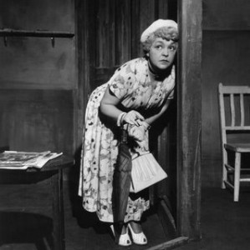
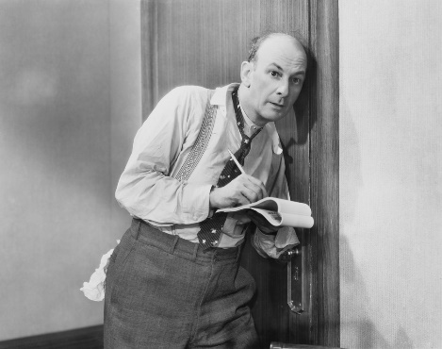
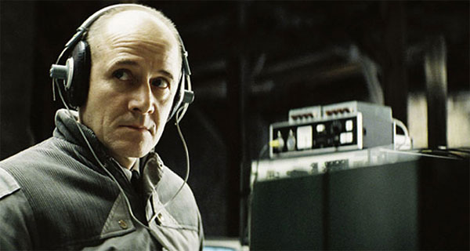
What Does It Mean to “Secure Information”
Confidentiality (Security/Privacy)
Only intended recipient can see the communication

Slide 25
What Does It Mean to “Secure Information”
Confidentiality (Security/Privacy)
Only intended recipient can see the communication
Integrity (Authenticity)
The message was actually sent by the alleged sender
I love you Alice… - Bob
We need to break up -Bob
Alice
Bob

Slide 26
Message Authentication Codes
CPA-Secure Encryption: Focus on Secrecy
But does not promise integrity
Message Authentication Codes: Focus on Integrity
But does not promise secrecy
CCA-Secure Encryption: Requires Integrity and Secrecy

Slide 27
What Does It Mean to “Secure Information”
Integrity (Authenticity)
The message was actually sent by the alleged sender
And the received message matches the original
Pay robot devil $50
Pay robot devil $5,000
Alice
Bob
Notes:
Example: HTTP is stateless. Cookies can be stored on the client, but can the server trust the client not to modify the cookie?

Slide 28
Error Correcting Codes?
Tool to detect/correct a small number of random errors in transmission
Examples: Parity Check, Reed-Solomon Codes, LDPC, Hamming Codes …
Provides no protection against a malicious adversary who can introduce an arbitrary number of errors
Still useful when implementing crypto in the real world (Why?)
Notes:
Low-density parity-check code

Slide 29
Modifying Ciphertexts
$$\text{Enc}\text{k}\text{(}\text{m}\text{)}=c=\left\langle r,F_{k}\left(r\right)⨁m\right\rangle$$
$$c^{′}=\left\langle r,F_{k}\left(r\right)⨁m⨁y\right\rangle =\text{Enc}\text{k}\text{(}m⨁y\text{)}$$
$$\text{Dec}\text{k} {(c}^{′})=F_{k}\left(r\right)⨁F_{k}\left(r\right)⨁m⨁y=m⨁y$$
If attacker knows original message he can forge c’ to decrypt to any message he wants.
Even if attacker doesn’t know message he may find it advantageous to flip certain bits (e.g., decimal places)

Slide 30
Message Authentication Code Syntax
Definition 4.1: A message authentication code (MAC) consists of three algorithms
$\operatorname{Gen}{(1^{n};R)}$ (Key-generation algorithm)
Input: security parameter 1^{n} (unary) and random bits R
Output: Secret key $k∈𝒦$
$\operatorname{Mack}{(m;R)}$ (Tag Generation algorithm)
Input: Secret key $k∈𝒦$ and message $m∈ℳ$ and random bits R
Output: a tag t
$\operatorname{Vrfyk}{(m,t)}$ (Verification algorithm)
Input: Secret key $k∈𝒦,$ a message m and a tag t
Output: a bit b (b=1 means “valid” and b=0 means “invalid”)
Invariant?

Slide 31
Message Authentication Code Syntax
Definition 4.1: A message authentication code (MAC) consists of three algorithms
$\operatorname{Gen}{(1^{n};R)}$ (Key-generation algorithm)
Input: security parameter 1^{n} (unary) and random bits R
Output: Secret key $k∈𝒦$
$\operatorname{Mack}{(m;R)}$ (Tag Generation algorithm)
Input: Secret key $k∈𝒦$ and message $m∈ℳ$ and random bits R
Output: a tag t
$\operatorname{Vrfyk}{(m,t)}$ (Verification algorithm)
Input: Secret key $k∈𝒦,$ a message m and a tag t
Output: a bit b (b=1 means “valid” and b=0 means “invalid”)
Invariant?

Slide 32
Message Authentication Code Syntax
Definition 4.1: A message authentication code (MAC) consists of three algorithms $Π=\left(Gen, Mac, Vrfy\right)$
$\operatorname{Gen}{(1^{n};R)}$ (Key-generation algorithm)
Input: security parameter 1^{n} (unary) and random bits R
Output: Secret key $k∈𝒦$
$\operatorname{Mack}{(m;R)}$ (Tag Generation algorithm)
Input: Secret key $k∈𝒦$ and message $m∈ℳ$ and random bits R
Output: a tag t
$\operatorname{Vrfyk}{(m,t)}$ (Verification algorithm)
Input: Secret key $k∈𝒦,$ a message m and a tag t
Output: a bit b (b=1 means “valid” and b=0 means “invalid”)
$$\operatorname{Vrfyk}{(m,\operatorname{Mack}{(m;R)})}=1$$
Security Goal (Informal): Attacker should not be able to forge a valid tag t’ for new message m’ that s/he wants to send.

Slide 33
MAC Authentication Game (${Macforge}_{A,Π}(n)$)
m₁
t₁ = Mac_{K}(m₁)
m₂
…
t₂ = Mac_{K} (m₂)
m_{q}
t_{q} = Mac_{K}(m_{q})
$\left(m,t\right)$ s.t $m∉\left\{m1,…,m_{q}\right\}$
$${Macforge}_{A,Π}(n)=Vrfyk{(m,t)}$$
K = Gen(.)
$$∀PPT A ∃μ (negligible) s.t$$
$$Pr\left[{Macforge}_{A,Π}\left(n\right)=1\right]≤μ(n)$$

Slide 34
Discussion
Is the definition too strong?
Attacker wins if he can forge any message
Does not necessarily attacker can forge a “meaningful message”
“Meaningful Message” is context dependent
Conservative Approach: Prove Security against more powerful attacker
Conservative security definition can be applied broadly
Replay Attacks?
t=Mac_{K}(“Pay Bob $1,000 from Alice’s bank account”)
Alice cannot modify message to say $10,000, but…
She may try to replay it 10 times

Slide 35
Replay Attacks
MACs alone do not protect against replay attacks (they are stateless)
Common Defenses:
Include Sequence Numbers in Messages (requires synchronized state)
Can be tricky over a lossy channel
Timestamp Messages
Double check timestamp before taking action

Slide 36
Strong MACs
Previous game ensures attacker cannot generate a valid tag for a new message.
However, attacker may be able to generate a second valid tag t’ for a message m after observing (m,t)
Strong MAC: attacker cannot generate second valid tag, even for a known message

Slide 37
Strong MAC Authentication (${Macsforge}_{A,Π}(n)$)
m₁
t₁ = Mac_{K}(m₁)
m₂
…
t₂ = Mac_{K} (m₂)
m_{q}
t_{q} = Mac_{K}(m_{q})
$\left(m,t\right)$ s.t $\left(m,t\right)∉\left\{(m1,t1),…,(mq,tq)\right\}$
$${Macsforge}_{A,Π}(n)=Vrfyk{(m,t)}$$
K = Gen(.)
$$∀PPT A ∃μ (negligible) s.t$$
$$Pr\left[{Macsforge}_{A,Π}\left(n\right)=1\right]≤μ(n)$$

Slide 38
Deterministic MACs
Canonical Verification Algorithm
$$\operatorname{Vrfyk}{(m,t)}=\left\{\begin{aligned}\begin{matrix}1 & if t=Mack(m)\end{matrix} \\ \begin{matrix}0 & otherwise\end{matrix}\end{aligned}\right.{}$$
“All real-world MACs use canonical verification” – page 115

Slide 39
Strong MAC vs Regular MAC
Proposition 4.4: Let $Π=\left(Gen, Mac, Vrfy\right)$ be a secure MAC that uses canonical verification. Then $Π$ is a strong MAC.
“All real-world MACs use canonical verification” – page 115
Should attacker have access to Vrfy_{K}(.) oracle in games?
(e.g., CPA vs CCA security for encryption)
Irrelevant if the MAC uses canonical verification!

Slide 40
Timing Attacks (Side Channel)
Naïve Canonical Verification Algorithm
Input: m,t’
t=Mac_{K}(m)
for i=1 to tag-length
if t[i] != t’[i] then
return 0
return 1
Example
t= 1 0 1 0 1 1 1 0
t’= 1 0 1 0 1 1 1 1
Returns 0 after 8 steps

Slide 41
Timing Attacks (Side Channel)
Naïve Canonical Verification Algorithm
Input: m,t’
t=Mac_{K}(m)
for i=1 to tag-length
if t[i] != t’[i] then
return 0
return 1
Example
t= 1 0 1 0 1 1 1 0
t’= 0 0 1 0 1 1 1 0
Returns 0 after 1 step

Slide 42
Timing Attack
MACs used to verify code updates for Xbox 360
Implementation allowed different rejection times (side-channel)
Attacks exploited vulnerability to load pirated games onto hardware
Moral: Ensure verification is time-independent

Slide 43
Improved Canonical Verification Algorithm
Input: m,t’
B=1
t=Mac_{K}(m)
for i=1 to tag-length
if t[i] != t’[i] then
B=0
else (dummy op)
return B
Example
t= 1 0 1 0 1 1 1 0
t’= 0 0 1 0 1 0 1 0
Returns 0 after 8 steps

Slide 44
Side-Channel Attacks
Cryptographic Definition
Attacker only observes outputs of oracles (Enc, Dec, Mac) and nothing else
When attacker gains additional information like timing (not captured by model) we call it a side channel attack.
Other Examples
Differential Power Analysis
Cache Timing Attack
Power Monitoring
Acoustic Cryptanalysis
…many others

Slide 45
Recap
Data Integrity
Message Authentication Codes
Side-Channel Attacks
Build Secure MACs
Construct CCA-Secure Encryption Scheme
Current Goal:
Build a Secure MAC
Key tool in Construction of CCA-Secure Encryption Schemes

Slide 46
General vs Fixed Length MAC
$$ℳ={\left\{0,1\right\}}^{∗}$$
versus
$$ℳ={\left\{0,1\right\}}^{ℓ(n)}$$

Slide 47
Strong MAC Construction (Fixed Length)
Simply uses a secure PRF F
$$\operatorname{Mack}{(m)}=FK(m)$$
Question: How to verify the a MAC?
Canonical Verification Algorithm…
$$\operatorname{Vrfyk}{(m,t)}=\left\{\begin{aligned}\begin{matrix}1 & if t=FK(m) \end{matrix} \\ \begin{matrix}0 & otherwise\end{matrix}\end{aligned}\right.$$

Slide 48
Strong MAC Authentication (${Macsforge}_{A,Π}(n)$)
m₁
t₁ = Mac_{K}(m₁)
m₂
…
t₂ = Mac_{K} (m₂)
m_{q}
t_{q} = Mac_{K}(m_{q})
$\left(m,t\right)$ s.t $\left(m,t\right)∉\left\{(m1,t1),…,(mq,tq)\right\}$
$${Macsforge}_{A,Π}(n)=Vrfyk{(m,t)}$$
K = Gen(.)
$$∀PPT A ∃μ (negligible) s.t$$
$$Pr\left[{Macsforge}_{A,Π}\left(n\right)=1\right]≤μ(n)$$

Slide 49
Concrete Version: $\left(t\left(n\right),q\left(n\right),ε(n)\right)$-secure MAC
m₁
t₁ = Mac_{K}(m₁)
m₂
…
t₂ = Mac_{K} (m₂)
m_{q}
t_{q} = Mac_{K}(m_{q})
$\left(m,t\right)$ s.t $\left(m,t\right)∉\left\{(m1,t1),…,(mq,tq)\right\}$
$${Macsforge}_{A,Π}(n)=Vrfyk{(m,t)}$$
K = Gen(.)
$$∀ A with \left(time(A)≤t\left(n\right),queries(A)≤q\left(n\right)\right)$$
$$Pr\left[{Macsforge}_{A,Π}\left(n\right)=1\right]≤ε(n)$$

Slide 50
Strong MAC Construction (Fixed Length)
$$\operatorname{Mack}{(m)}=FK(m)$$
$$\operatorname{Vrfyk}{(m,t)}=\left\{\begin{aligned}\begin{matrix}1 & if t=FK(m) \end{matrix} \\ \begin{matrix}0 & otherwise\end{matrix}\end{aligned}\right.$$
Theorem 4.6: If F is a PRF then this is a secure (fixed-length) MAC for messages of length n.
Proof: Start with attacker who breaks MAC security and build an attacker who breaks PRF security (contradiction!)
Sufficient to start with attacker who breaks regular MAC security (why?)

Slide 51
Breaking MAC Security (${Macforge}_{A,Π}(n)$)
m₁
$$t_{1}=F_{K}\left(m_{1}\right)$$
m₂
…
$$t_{2}=F_{K}\left(m_{2}\right)$$
m_{q}
$$t_{q}=F_{K}\left(m_{q}\right)$$
$\left(m,t\right)$ s.t $m∉\left\{m_{1},…,m_{q}\right\}$
$${Macforge}_{A,Π}(n)=Vrfyk{(m,t)}$$
K = Gen(.)
$$∃PPT A and g(.) (positive/non negligible) s.t$$
$$Pr\left[{Macforge}_{A,Π}\left(n\right)=1\right]>g(n)$$

Slide 52
A Similar Game (${Macforge}_{A,\tilde{Π}}(n)$)
Why? Because f(m) is distributed uniformly
in {0,1}^{n} so Pr[f(m)=t]=2^{-n}
m₁
t₁ = f(m₁)
m₂
…
t₂ = f (m₂)
m_{q}
t_{q} = f(m_{q})
$\left(m,t\right)$ s.t $m∉\left\{m_{1},…,m_{q}\right\}$
$${Macforge}_{A,\tilde{Π}}(n)=Vrfyk{(m,t)}$$
Truly Random Function
f $∈$Func_{n}
Claim: $∀A \left(not just PPT\right)$
$$Pr\left[{Macforge}_{A,\tilde{Π}}\left(n\right)=1\right]≤2^{−n}$$

Slide 53
PRF Distinguisher D
Given oracle O (either F_{K} or truly random f)
Run PPT Macforge adversary A
When adversary queries with message m, respond with O(m)
Output 1 if attacker wins (otherwise 0)
If O = f then
$$Pr\left[DO\left(1n\right)=1\right]=Pr\left[{Macforge}_{A,\tilde{Π}}\left(n\right)=1\right]≤2^{−n}$$
If O=F_{K} then
$$Pr\left[DO\left(1n\right)=1\right]=Pr\left[{Macforge}_{A,Π}\left(n\right)=1\right]>g(n)$$

Slide 54
PRF Distinguisher D
If O = f then
$$Pr\left[DO\left(1n\right)=1\right]=Pr\left[{Macforge}_{A,\tilde{Π}}\left(n\right)=1\right]≤2^{−n}$$
If O=F_{K} then
$$Pr\left[DO\left(1n\right)=1\right]=Pr\left[{Macforge}_{A,Π}\left(n\right)=1\right]>g(n)$$
Advantage:
$$\left|Pr\left[D^{F_{K}}\left(1n\right)=1\right]−Pr\left[Df\left(1n\right)=1\right]\right|>g\left(n\right)−2^{−n}$$
Note that $g\left(n\right)−2^{−n}$ is non-negligible and D runs in PPT if A does.

Slide 55
Strong MAC Construction (Fixed Length)
$$\operatorname{Mack}{(m)}=FK(m)$$
$$\operatorname{Vrfyk}{(m,t)}=\left\{\begin{aligned}\begin{matrix}1 & if t=FK(m) \end{matrix} \\ \begin{matrix}0 & otherwise\end{matrix}\end{aligned}\right.$$
Theorem 4.6: If F is a PRF then this is a secure (fixed-length) MAC for messages of length n.

Slide 56
Strong MAC Construction (Fixed Length)
$$\operatorname{Mack}{(m)}=FK(m)$$
$$\operatorname{Vrfyk}{(m,t)}=\left\{\begin{aligned}\begin{matrix}1 & if t=FK(m) \end{matrix} \\ \begin{matrix}0 & otherwise\end{matrix}\end{aligned}\right.$$
Theorem (Concrete): If F is a $\left(t\left(n\right),q\left(n\right),ε(n)\right)$-secure PRF then the above construction is a $\left(t\left(n\right)−O\left(n\right),q\left(n\right),ε\left(n\right)+2^{−n}\right)$-secure MAC for $ℳ={\left\{0,1\right\}}^{n}$ (messages of length n).
Example: F is a $\left(2^{n},2^{n/2},2^{−n}\right)$-secure PRF-→ the above MAC construction is
$\left(2^{n}−O\left(n\right),2^{n/2},2^{−n+1}\right)$-secure

Slide 57
Strong MAC Construction (Fixed Length)
$$\operatorname{Mack}{(m)}=FK(m)$$
$$\operatorname{Vrfyk}{(m,t)}=\left\{\begin{aligned}\begin{matrix}1 & if t=FK(m) \end{matrix} \\ \begin{matrix}0 & otherwise\end{matrix}\end{aligned}\right.$$
Theorem (Concrete): If F is a $\left(t\left(n\right),q\left(n\right),ε(n)\right)$-secure PRF then the above construction is a $\left(t\left(n\right)−O\left(n\right),q\left(n\right),ε\left(n\right)+2^{−n}\right)$-secure MAC for $ℳ={\left\{0,1\right\}}^{n}$ (messages of length n).
Limitation: What if we want to authenticate a longer message? $ℳ={\left\{0,1\right\}}^{∗}$

Slide 58
MACs for Arbitrary Length Messages
Building Block $Π$’=(Mac’,Vrfy’), a secure MAC for length n messages
First: A few failed attempts
Let m = m₁,…,m_{d} where each m_{i} is n bits and let $t_{i}={Mac}_{K}^{′}\left(m_{i}\right)$
$$\text{Mac}\text{K}\text{(}\text{m}\text{)}=\left\langle t_{1},…,t_{d}\right\rangle$$
What is wrong?
Block-reordering attack
$$\text{Mac}\text{K}\text{(}\text{m}\text{d}\text{,}\text{…}\text{,}m_{1}\text{)}=\left\langle t_{d},…,t_{1}\right\rangle$$
$m_{1}=$“I love you”
$m_{2}=$“I will never say that”
$m_{3}=$“you are stupid”

Slide 59
MACs for Arbitrary Length Messages
Building Block $Π$’=(Mac’,Vrfy’), a secure MAC for length n messages
Attempt 2
Let m = m₁,…,m_{d} where each m_{i} is n bits and let $t_{i}={Mac}_{K}^{′}\left(i{∥m}_{i}\right)$
$$\text{Mac}\text{K}\text{(}\text{m}\text{)}=\left\langle t_{1},…,t_{d}\right\rangle$$
Addresses block-reordering attack.
Any other concerns?
Truncation attack!
$$\text{Mac}\text{K}\text{(}\text{m}\text{1}\text{,}\text{…}\text{,}m_{d−1}\text{)}=\left\langle t_{1},…,t_{d−1}\right\rangle$$
Suppose $m_{1},…,m_{d−1},m_{d}=$
“I don’t like you. I LOVE you!”

Slide 60
MACs for Arbitrary Length Messages
Building Block $Π$’=(Mac’,Vrfy’), a secure MAC for length n messages
Attempt 3
Let m = m₁,…,m_{d} where each m_{i} is n bits and m has length $ℓ=nd$
Let $t_{i}={Mac}_{K}^{′}\left(i{∥ℓ∥m}_{i}\right)$
$$\text{Mac}\text{K}\text{(}\text{m}\text{)}=\left\langle t_{1},…,t_{d}\right\rangle$$
Addresses truncation.
Any other concerns?
Mix and Match Attack!

Slide 61
MACs for Arbitrary Length Messages
Let m = m₁,…,m_{d} where each m_{i} is n bits and m has length $ℓ=nd$
Let m’ = m’₁,…,m’_{d} where each m’_{i} is n bits and m has length $ℓ=nd$
Let $t_{i}={Mac}_{K}^{′}\left(i{∥ℓ∥m}_{i}\right)$ and ${t′}_{i}={Mac}_{K}^{′}\left(i{∥ℓ∥m}_{i}′\right)$
$$\text{Mac}\text{K}\text{(}\text{m}\text{)}=\left\langle t_{1},…,t_{d}\right\rangle$$
$$\text{Mac}\text{K}\text{(}\text{m}\text{′}\text{)}=\left\langle {t′}_{1},…,{t′}_{d}\right\rangle$$
Mix and Match Attack!
$$\text{Mac}\text{K}\text{(}\text{m}\text{1}\text{,}\text{m}\text{′}\text{2}\text{,}\text{m}\text{3}\text{,...}\text{)}=\left\langle t_{1},{t′}_{2},t_{3},…\right\rangle$$

Slide 62
$m_{1}=$“What will I say to Eve?”
$m_{2}=$“You are evil and vile.”
$m_{3}=$“Please leave me alone!”
$m_{4}=$“Your sworn enemy - BOB”
$$t=\left\langle t_{1},t_{2},,t_{3},t_{4}\right\rangle$$
$m_{1}′=$“Dear Alice”
$m_{2}′=$“You are wonderful.”
$m_{3}′=$“I can’t wait to see you!”
$m_{4}′=$“XOXOXOXOXO - BOB”
$$t^{′}=\left\langle t_{1}′,t_{2}′,,t_{3}′,t_{4}′\right\rangle$$
$m_{1}′=$“Dear Alice”
$m_{2}=$“You are evil and vile.”
$m_{3}=$“Please leave me alone!”
$m_{4}=$“Your sworn enemy - BOB”
$$t^{′′}=\left\langle t_{1}′,t_{2},,t_{3},t_{4}\right\rangle$$

Slide 63
MACs for Arbitrary Length Messages
A non-failed approach ☺
Building Block $Π$’=(Mac’,Vrfy’), a secure MAC for length n messages
Let m = m₁,…,m_{d} where each m_{i} is n/4 bits and m has length $ℓ<2^{n/4}$
Mac_{K}(m)=
Select random $\frac{n}{4}$ bit nonce $r$
Let $t_{i}={Mac}_{K}^{′}\left(r∥ℓ∥i{∥m}_{i}\right)$ for i=1,…,d
(Note: encode i and $ℓ$ as $\frac{n}{4}$ bit strings)
Output $\left\langle r,t_{1},…,t_{d}\right\rangle$

Slide 64
MACs for Arbitrary Length Messages
Mac_{K}(m)=
Select random n/4 bit string r
Let $t_{i}={Mac}_{K}^{′}\left(r∥ℓ∥i{∥m}_{i}\right)$ for i=1,…,d
(Note: encode i and $ℓ$ as n/4 bit strings)
Output $\left\langle r,t_{1},…,t_{d}\right\rangle$
Theorem 4.8: If $Π′$ is a secure MAC for messages of fixed length n, above construction$Π=(Mac,Vrfy)$ is secure MAC for arbitrary length messages.

