Slide 1
Applied Cryptography
Week 4:
Message Authentication Codes
CBC-MAC
Authenticated Encryption + CCA Security
Readings: Katz and Lindell Chapter 4.1-4.4

Slide 2
Recap
Chosen Plaintext Attacks/Chosen Ciphertext Attacks
  CPA vs CCA-security
Blockciphers and Modes of Operation
Message Authentication Codes
  Confidentiality vs Integrity
  Canonical Verification and Timing Side Channel
Current Goal:
Build a Secure MAC
  Key tool in Construction of CCA-Secure Encryption Schemes

Slide 3
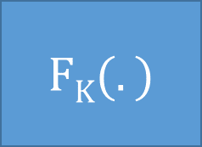
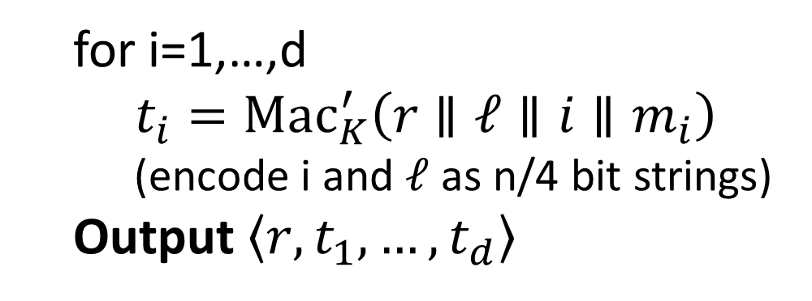


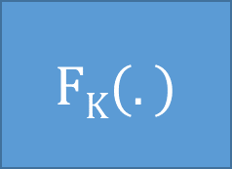








CBC-MAC
Caveat: Tricky Padding Issues arise if |m| is not a multiple of the block-length. See textbook.
We will see a simpler MAC construction using hash functions soon.
$$m_{1}$$
$$m_{2}$$
$$m_{3}$$
$${\left|m\right|}_{}$$
$$⨁$$
$$⨁$$
$$⨁$$
$$FK(.)$$
$$FK(.)$$
$$FK(.)$$
$$FK(.)$$
$$τ={Mac}_{K}\left(m\right)$$
Advantages over Previous Solution
Both MACs are secure
Works for unbounded length messages
Canonical Verification
Short Authentication tag
Parallelizable
  for i=1,…,d
  $t_{i}={Mac}_{K}^{′}\left(r∥ℓ∥i{∥m}_{i}\right)$
    (encode i and $ℓ$ as n/4 bit strings)
  Output $\left\langle r,t_{1},…,t_{d}\right\rangle$

Slide 4
Coming Soon
CBC-MAC and Authenticated Encryption
Read Katz and Lindell 4.4-4.5

Slide 5
Week 4
Topics 2&3: Authenticated Encryption + CCA-Security

Slide 6
Recap
Message Authentication Codes
Secrecy vs Confidentiality
Today’s Goals:
Authenticated Encryption
Build Authenticated Encryption Scheme with CCA-Security

Slide 7

Authenticated Encryption
Encryption: Hides a message from the attacker
Message Authentication Codes: Prevents attacker from tampering with message

Slide 8
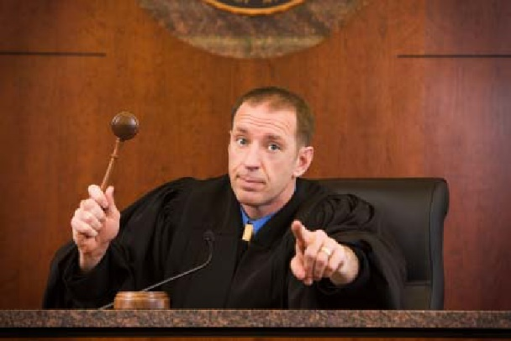

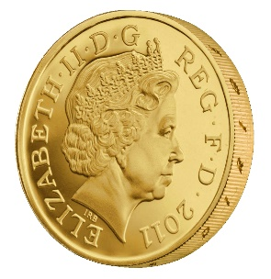
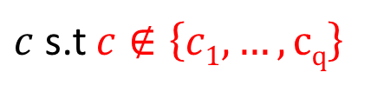

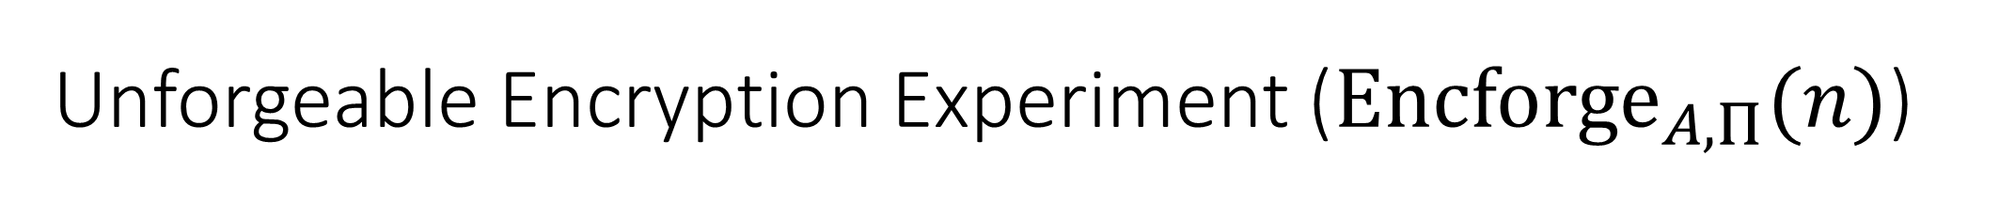
Unforgeable Encryption Experiment (${Encforge}_{A,Π}(n)$)
m₁
c₁ = Enc_{K}(m₁)
m₂
c₂ = Enc_{K} (m₂)
…
m_{q}
c_{q} = Enc_{K}(m_{q})
$c$ s.t $c∉\left\{c1,…,cq\right\}$
$${Encforge}_{A,Π}\left(n\right)=1 if Deck\left(c\right)≠⊥$$
K = Gen(.)
$$∀PPT A ∃μ (negligible) s.t$$
$$Pr\left[{Encforge}_{A,Π}\left(n\right)=1\right]≤μ(n)$$

Slide 9
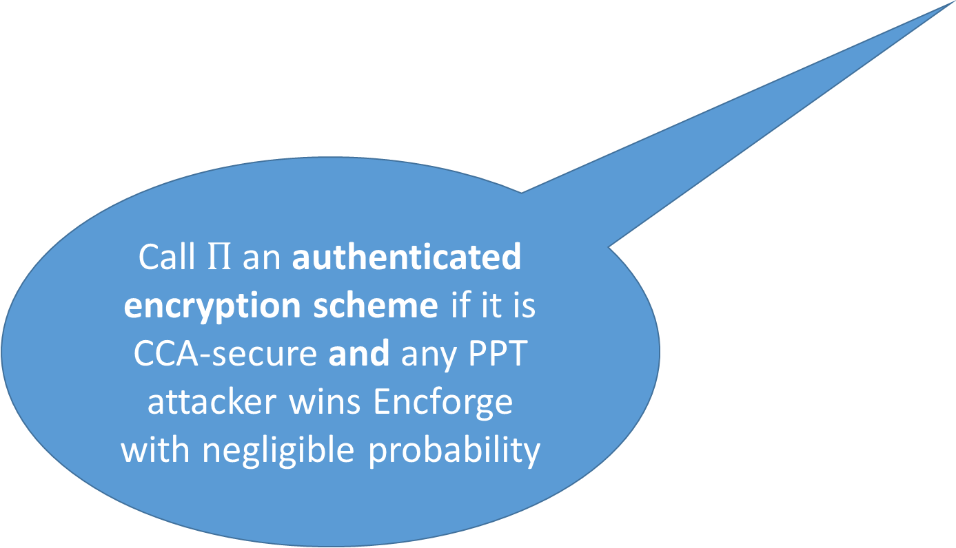
Unforgeable Encryption Experiment (${Encforge}_{A,Π}(n)$)
m₁
c₁ = Enc_{K}(m₁)
m₂
Call $Π$ an authenticated encryption scheme if it is CCA-secure and any PPT attacker wins Encforge with negligible probability
…
c₂ = Enc_{K} (m₂)
Game is very similar to MAC-Forge game
m_{q}
c_{q} = Enc_{K}(m_{q})
$c$ s.t $c∉\left\{c1,…,cq\right\}$
$${Encforge}_{A,Π}\left(n\right)=1 if Deck\left(c\right)≠⊥$$
K = Gen(.)
$$∀PPT A ∃μ (negligible) s.t$$
$$Pr\left[{Encforge}_{A,Π}\left(n\right)=1\right]≤μ(n)$$

Slide 10
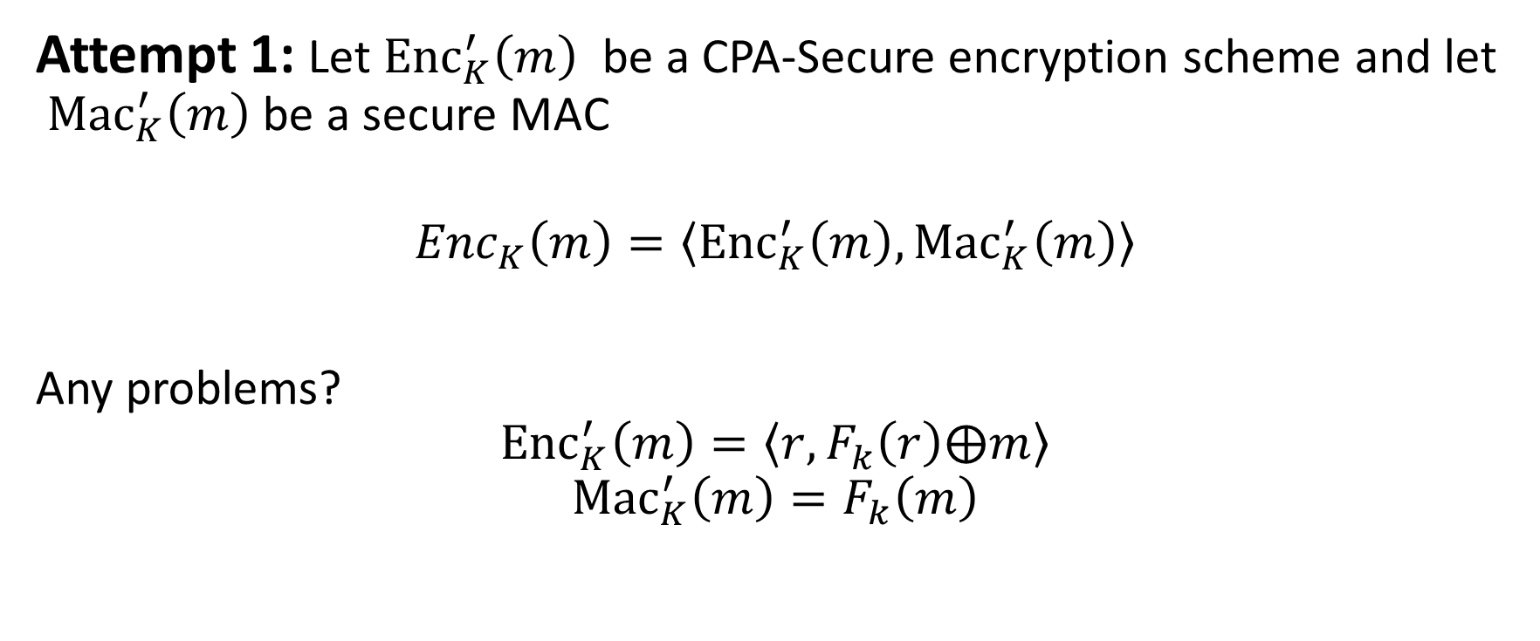
Building Authenticated Encryption
Attempt 1: Let ${Enc}_{K}^{′}\left(m\right)$ be a CPA-Secure encryption scheme and let ${Mac}_{K}^{′}\left(m\right)$ be a secure MAC
$${Enc}_{K}\left(m\right)=\left\langle {Enc}_{K}^{′}\left(m\right),{Mac}_{K}^{′}\left(m\right)\right\rangle$$
Any problems?
$${Enc}_{K}^{′}\left(m\right)=\left\langle r,F_{k}\left(r\right)⨁m\right\rangle$$
$${Mac}_{K}^{′}\left(m\right)=F_{k}\left(m\right)$$

Slide 11
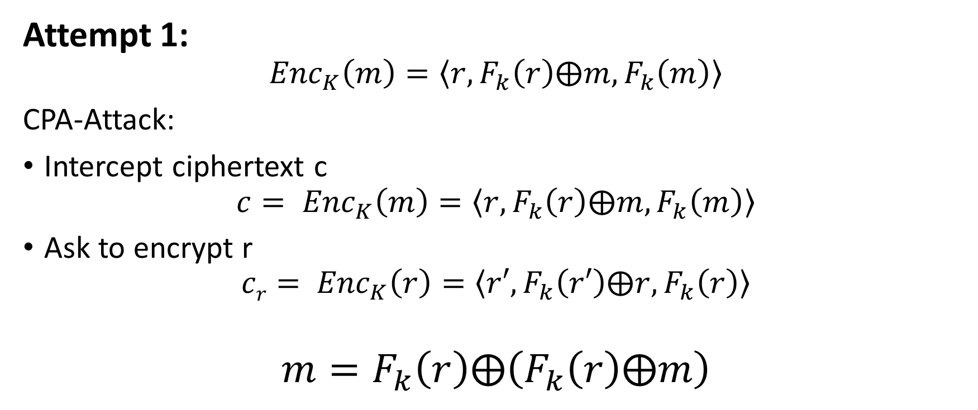
Building Authenticated Encryption
Attempt 1:
$${Enc}_{K}\left(m\right)=\left\langle r,F_{k}\left(r\right)⨁m,F_{k}\left(m\right)\right\rangle$$
CPA-Attack:
Intercept ciphertext c
$$c= {Enc}_{K}\left(m\right)=\left\langle r,F_{k}\left(r\right)⨁m,F_{k}\left(m\right)\right\rangle$$
Ask to encrypt r
$$cr= {Enc}_{K}\left(r\right)=\left\langle r′,F_{k}\left(r′\right)⨁r,F_{k}\left(r\right)\right\rangle$$
$$m=F_{k}\left(r\right)⨁\left(F_{k}\left(r\right)⨁m\right)$$

Slide 12

Building Authenticated Encryption
Attempt 1: Let ${Enc}_{K}^{′}\left(m\right)$ be a CPA-Secure encryption scheme and let ${Mac}_{K}^{′}\left(m\right)$ be a secure MAC
$${Enc}_{K}\left(m\right)=\left\langle {Enc}_{K}^{′}\left(m\right),{Mac}_{K}^{′}\left(m\right)\right\rangle$$
Attack exploited fact that same secret key used for MAC’/Enc’

Slide 13
Independent Key Principle
“different instances of cryptographic primitives should always use independent keys”

Slide 14
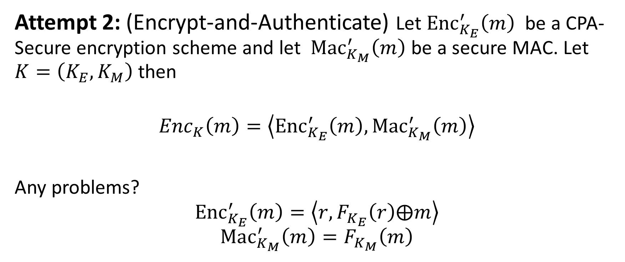
Building Authenticated Encryption
Attempt 2: (Encrypt-and-Authenticate) Let ${Enc}_{K_{E}}^{′}\left(m\right)$ be a CPA-Secure encryption scheme and let ${Mac}_{K_{M}}^{′}\left(m\right)$ be a secure MAC. Let $K=\left(K_{E},K_{M}\right)$ then
$${Enc}_{K}\left(m\right)=\left\langle {Enc}_{K_{E}}^{′}\left(m\right),{Mac}_{K_{M}}^{′}\left(m\right)\right\rangle$$
Any problems?
$${Enc}_{K_{E}}^{′}\left(m\right)=\left\langle r,F_{K_{E}}\left(r\right)⨁m\right\rangle$$
$${Mac}_{K_{M}}^{′}\left(m\right)=F_{K_{M}}\left(m\right)$$

Slide 15
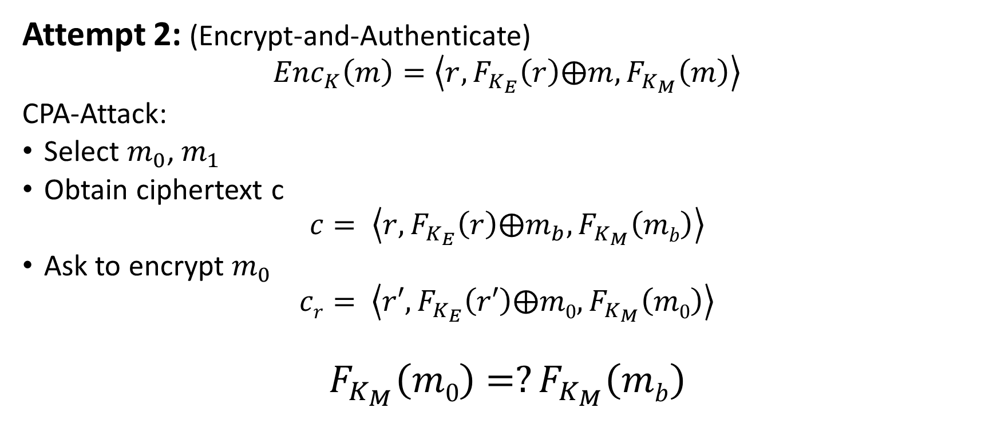
Building Authenticated Encryption
Attempt 2: (Encrypt-and-Authenticate)
$${Enc}_{K}\left(m\right)=\left\langle r,F_{K_{E}}\left(r\right)⨁m,F_{K_{M}}\left(m\right)\right\rangle$$
CPA-Attack:
Select $m_{0}$, $m_{1}$
Obtain ciphertext c
$$c= \left\langle r,F_{K_{E}}\left(r\right)⨁m_{b},F_{K_{M}}\left(mb\right)\right\rangle$$
Ask to encrypt $m_{0}$
$$cr= \left\langle r′,F_{K_{E}}\left(r′\right)⨁m0,F_{K_{M}}\left(m0\right)\right\rangle$$
$$F_{K_{M}}\left(m0\right)=?F_{K_{M}}\left(mb\right)$$

Slide 16
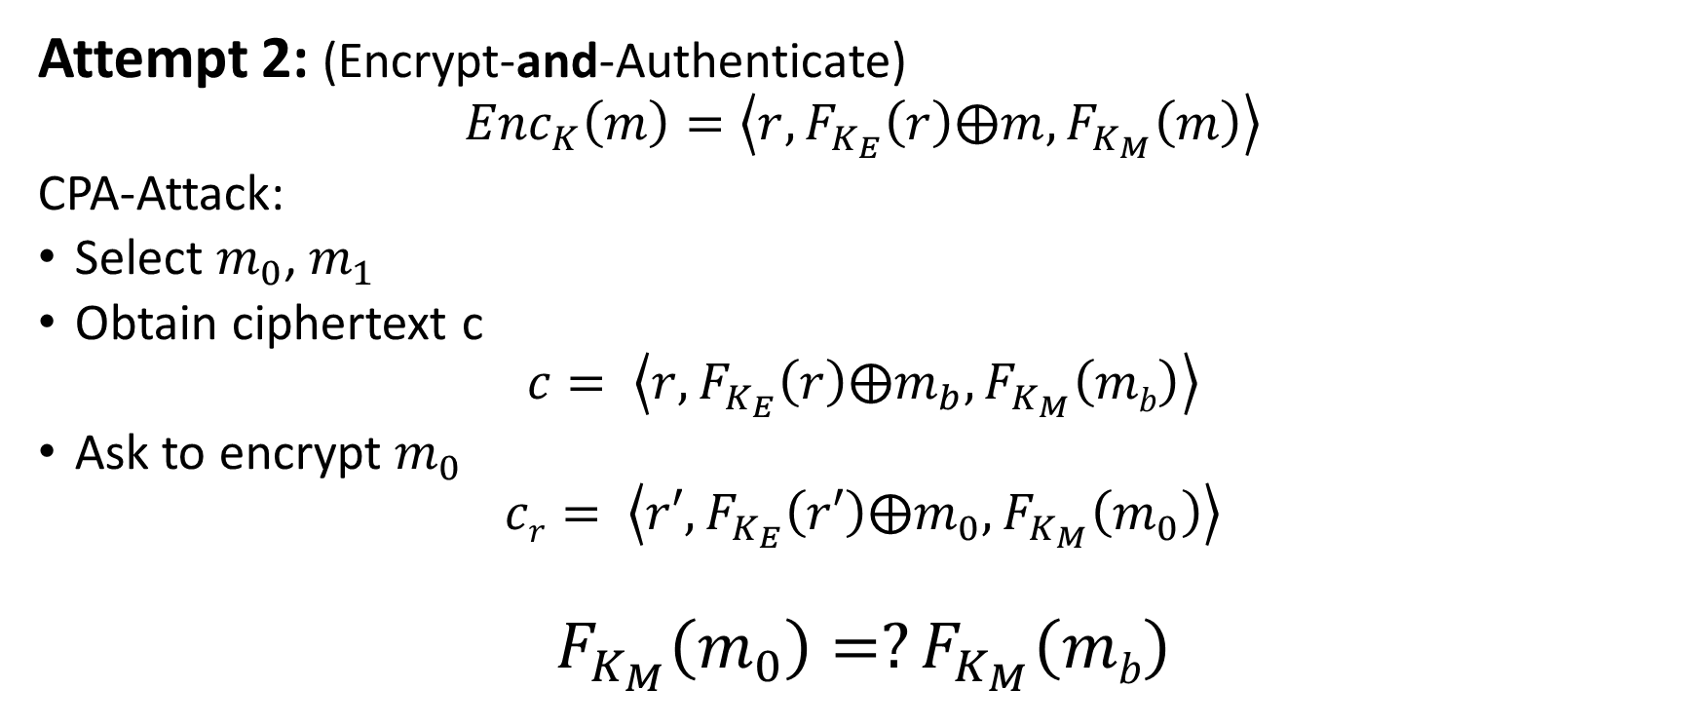
Building Authenticated Encryption
Attempt 2: (Encrypt-and-Authenticate)
$${Enc}_{K}\left(m\right)=\left\langle r,F_{K_{E}}\left(r\right)⨁m,F_{K_{M}}\left(m\right)\right\rangle$$
CPA-Attack:
Select $m_{0}$, $m_{1}$
Obtain ciphertext c
$$c= \left\langle r,F_{K_{E}}\left(r\right)⨁m_{b},F_{K_{M}}\left(mb\right)\right\rangle$$
Ask to encrypt $m_{0}$
$$cr= \left\langle r′,F_{K_{E}}\left(r′\right)⨁m_{0},F_{K_{M}}\left(m_{0}\right)\right\rangle$$
$$F_{K_{M}}\left(m_{0}\right)=?F_{K_{M}}\left(mb\right)$$
Encrypt and Authenticate Paradigm does not work in general

Slide 17

Building Authenticated Encryption
Attempt 2: (Encrypt-and-Authenticate) Let ${Enc}_{K_{E}}^{′}\left(m\right)$ be a CPA-Secure encryption scheme and let ${Mac}_{K_{M}}^{′}\left(m\right)$ be a secure MAC. Let $K=\left(K_{E},K_{M}\right)$ then
$${Enc}_{K}\left(m\right)=\left\langle {Enc}_{K_{E}}^{′}\left(m\right),{Mac}_{K_{M}}^{′}\left(m\right)\right\rangle$$
Problem: MAC security definition doesn’t promise to hide m!
This is what SSL does ☹

Slide 18
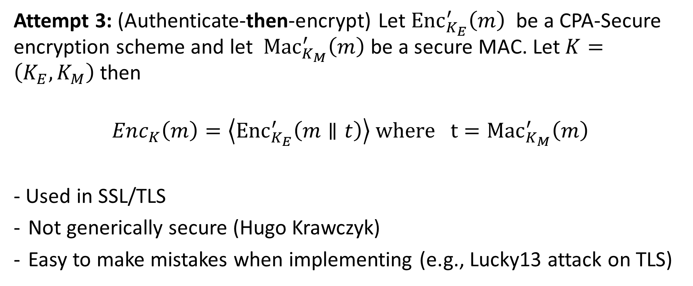
Building Authenticated Encryption
Attempt 3: (Authenticate-then-encrypt) Let ${Enc}_{K_{E}}^{′}\left(m\right)$ be a CPA-Secure encryption scheme and let ${Mac}_{K_{M}}^{′}\left(m\right)$ be a secure MAC. Let $K=\left(K_{E},K_{M}\right)$ then
$${Enc}_{K}\left(m\right)=\left\langle {Enc}_{K_{E}}^{′}\left(m∥t\right)\right\rangle where{ t=Mac}_{K_{M}}^{′}\left(m\right)$$
- Used in SSL/TLS
Not generically secure (Hugo Krawczyk)
Easy to make mistakes when implementing (e.g., Lucky13 attack on TLS)
The Order of Encryption and Authentication for Protecting Communications (or: How Secure Is SSL?)

Slide 19
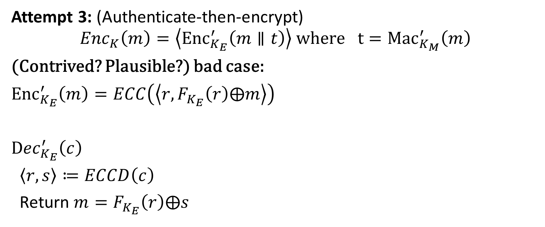
Authenticate-then-Encrypt: A Bad Case
Attempt 3: (Authenticate-then-encrypt)
$${Enc}_{K}\left(m\right)=\left\langle {Enc}_{K_{E}}^{′}\left(m∥t\right)\right\rangle where{ t=Mac}_{K_{M}}^{′}\left(m\right)$$
(Contrived? Plausible?) bad case:
${Enc}_{K_{E}}^{′}\left(m\right)=ECC\left(\left\langle r,F_{K_{E}}\left(r\right)⨁m\right\rangle \right)$
${Dec}_{K_{E}}^{′}\left(c\right)$
$\left\langle r,s\right\rangle ≔ECCD\left(c\right)$
Return $m=F_{K_{E}}\left(r\right)⨁s$
Error Correcting Code

Slide 20
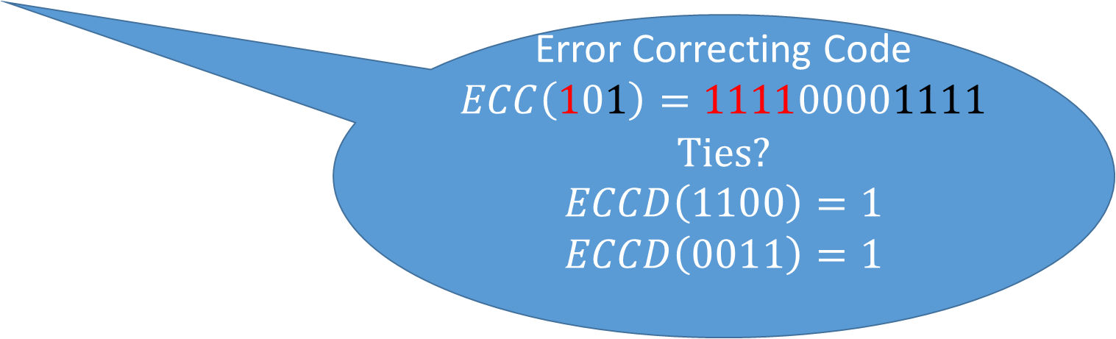
Authenticate-then-Encrypt: A Bad Case
Attempt 3: (Authenticate-then-encrypt)
$${Enc}_{K}\left(m\right)=\left\langle {Enc}_{K_{E}}^{′}\left(m∥t\right)\right\rangle where{ t=Mac}_{K_{M}}^{′}\left(m\right)$$
(Contrived? Plausible?) bad case:
${Enc}_{K_{E}}^{′}\left(m\right)=ECC\left(\left\langle r,F_{K_{E}}\left(r\right)⨁m\right\rangle \right)$
${Dec}_{K_{E}}^{′}\left(c\right)$
$\left\langle r,s\right\rangle ≔ECCD\left(c\right)$
Return $m=F_{K_{E}}\left(r\right)⨁s$
Error Correcting Code
$$ECC\left(101\right)=111100001111$$
Ties?
$$ECCD\left(1100\right)=1$$
$$ECCD\left(0011\right)=1$$

Slide 21



Authenticate-then-Encrypt: A Bad Case
Error Correcting Code
$$ECC\left(101\right)=111100001111$$
$$ECCD\left(1100\right)=1$$
$$ECCD\left(0011\right)=1$$
Can learn tag and message bit by bit by repeatedly querying decryption oracle!
Attempt 3: (Authenticate-then-encrypt)
$${Enc}_{K}\left(m\right)=\left\langle {Enc}_{K_{E}}^{′}\left(m∥t\right)\right\rangle where{ t=Mac}_{K_{M}}^{′}\left(m\right)$$
(Contrived? Plausible?) bad case:
${Enc}_{K_{E}}^{′}\left(m\right)=ECC\left(\left\langle r,F_{K_{E}}\left(r\right)⨁m\right\rangle \right)$
${Dec}_{K_{E}}^{′}\left(c\right)$
$\left\langle r,s\right\rangle ≔ECCD\left(c\right)$
Return $m=F_{K_{E}}\left(r\right)⨁s$
Attacker obtains $c=ECC\left(\left\langle r,s=F_{K_{E}}\left(r\right)⨁\left(m∥t\right)\right\rangle \right)$
Attacker asks for decryption of $c^{′}=ECC\left(\left\langle r,s\right\rangle \right)⨁\left(0…0∥0011 \right)$
  What happens if last bit of $s$ was a zero?
  Answer: decryption error since $t^{′}=t⨁\left(0…0∥1 \right)$!
  $ECCD\left(c′\right)=\left\langle r,s^{′}=s⨁\left(0…0∥1 \right)\right\rangle$
What happens if last bit of $s$ is a one?
  Answer: Valid! $ECCD\left(c\right)=ECCD\left(c′\right)$

Slide 22

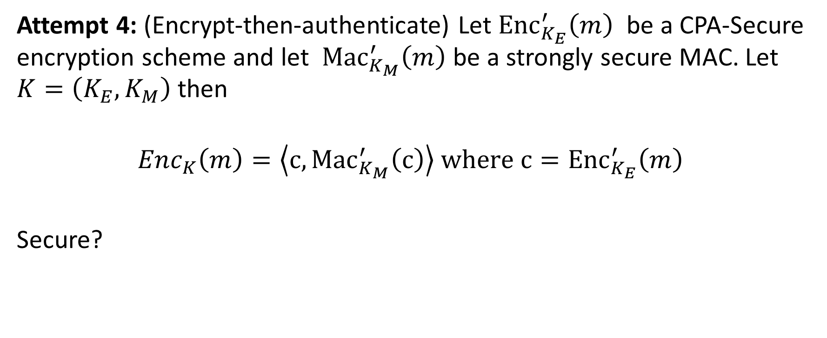
Building Authenticated Encryption
Attempt 4: (Encrypt-then-authenticate) Let ${Enc}_{K_{E}}^{′}\left(m\right)$ be a CPA-Secure encryption scheme and let ${Mac}_{K_{M}}^{′}\left(m\right)$ be a strongly secure MAC. Let $K=\left(K_{E},K_{M}\right)$ then
$${Enc}_{K}\left(m\right)=\left\langle c,{Mac}_{K_{M}}^{′}\left(c\right)\right\rangle where{ c=Enc}_{K_{E}}^{′}\left(m\right)$$
Secure?

Slide 23
Recap
MACs for Unbounded Length Messages
  Reordering/Truncation/Block Swapping Attacks
  Nonce Based Construction
  CBC MAC
Authenticated Encryption = CCA-Secure + Unforgeable Encryptions
  Independent Key Principle
  Encrypt and Authenticate
    Not generically secure
  Authenticate then Encrypt
    Not generically secure
  Encrypt then Authenticate
    Always secure given CPA-Secure encryption + strongly secure MAC

Slide 24
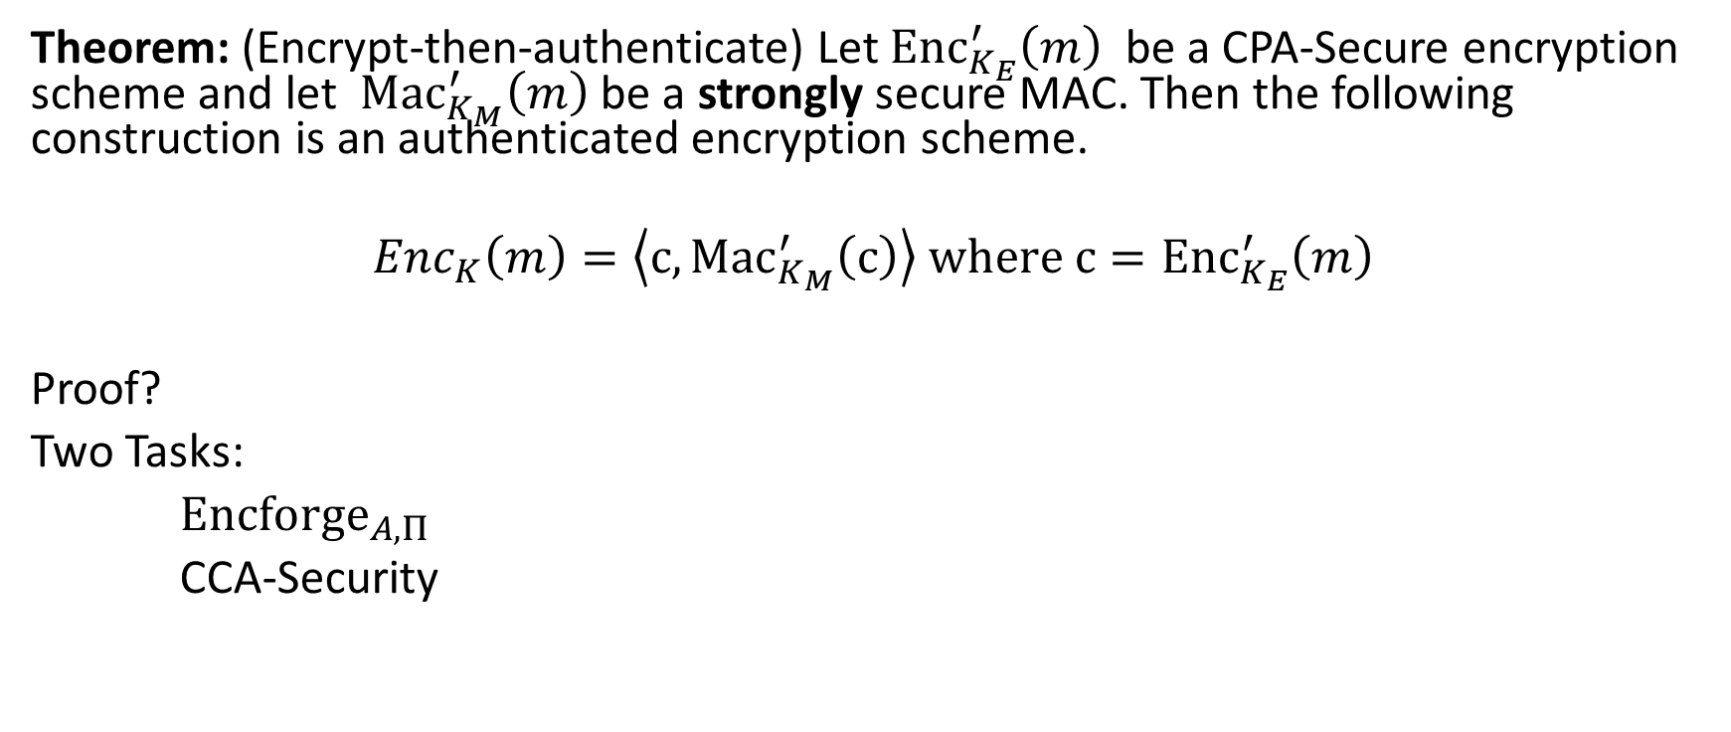
Building Authenticated Encryption
Theorem: (Encrypt-then-authenticate) Let ${Enc}_{K_{E}}^{′}\left(m\right)$ be a CPA-Secure encryption scheme and let ${Mac}_{K_{M}}^{′}\left(m\right)$ be a strongly secure MAC. Then the following construction is an authenticated encryption scheme.
$${Enc}_{K}\left(m\right)=\left\langle c,{Mac}_{K_{M}}^{′}\left(c\right)\right\rangle where{ c=Enc}_{K_{E}}^{′}\left(m\right)$$
Proof?
Two Tasks:
${Encforge}_{A,Π}$
CCA-Security

Slide 25
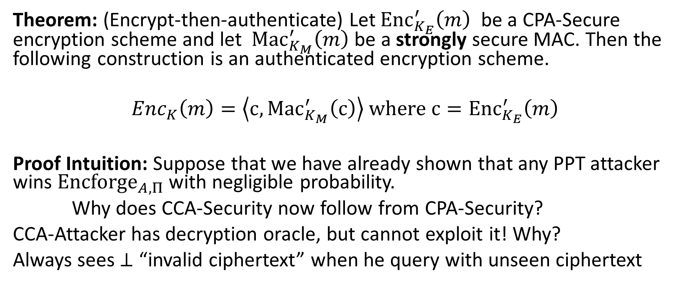
Building Authenticated Encryption
Theorem: (Encrypt-then-authenticate) Let ${Enc}_{K_{E}}^{′}\left(m\right)$ be a CPA-Secure encryption scheme and let ${Mac}_{K_{M}}^{′}\left(m\right)$ be a strongly secure MAC. Then the following construction is an authenticated encryption scheme.
$${Enc}_{K}\left(m\right)=\left\langle c,{Mac}_{K_{M}}^{′}\left(c\right)\right\rangle where{ c=Enc}_{K_{E}}^{′}\left(m\right)$$
Proof Intuition: Suppose that we have already shown that any PPT attacker wins ${Encforge}_{A,Π}$ with negligible probability.
Why does CCA-Security now follow from CPA-Security?
CCA-Attacker has decryption oracle, but cannot exploit it! Why?
Always sees $⊥$ “invalid ciphertext” when he query with unseen ciphertext

Slide 26
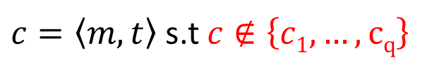


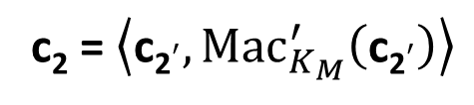

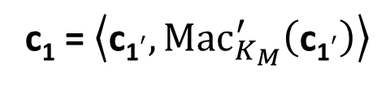

Encryption Forgery Attacker (${Encforge}_{A,Π}(n)$)
m₁
c₁ = $\left\langle {\text{c}\text{1}}^{′},{Mac}_{K_{M}}^{′}\left({\text{c}\text{1}}^{′}\right)\right\rangle$
m₂
c₂ = $\left\langle {\text{c}\text{2}}^{′},{Mac}_{K_{M}}^{′}\left({\text{c}\text{2}}^{′}\right)\right\rangle$
…
m_{q}
c_{q} = $\left\langle {\text{c}\text{q}}^{′},{Mac}_{K_{M}}^{′}\left({\text{c}\text{q}}^{′}\right)\right\rangle$
$c=\left\langle m,t\right\rangle$ s.t $c∉\left\{c1,…,cq\right\}$
$${Encforge}_{A,Π}\left(n\right)=1 iff Deck\left(c\right)≠⊥$$
K = Gen(.)
$$iff{ Verify}_{K_{M}}^{′}\left(m,t\right)=1$$
$$\left\langle m,t\right\rangle ∉\left\{\left\langle {\text{c}\text{1}}^{′},{\text{t}\text{1}}^{′}\right\rangle ,…,\left\langle {\text{c}\text{q}}^{′},{\text{t}\text{q}}^{′}\right\rangle \right\}$$
MAC forgery for the key $K_{M}$

Slide 27
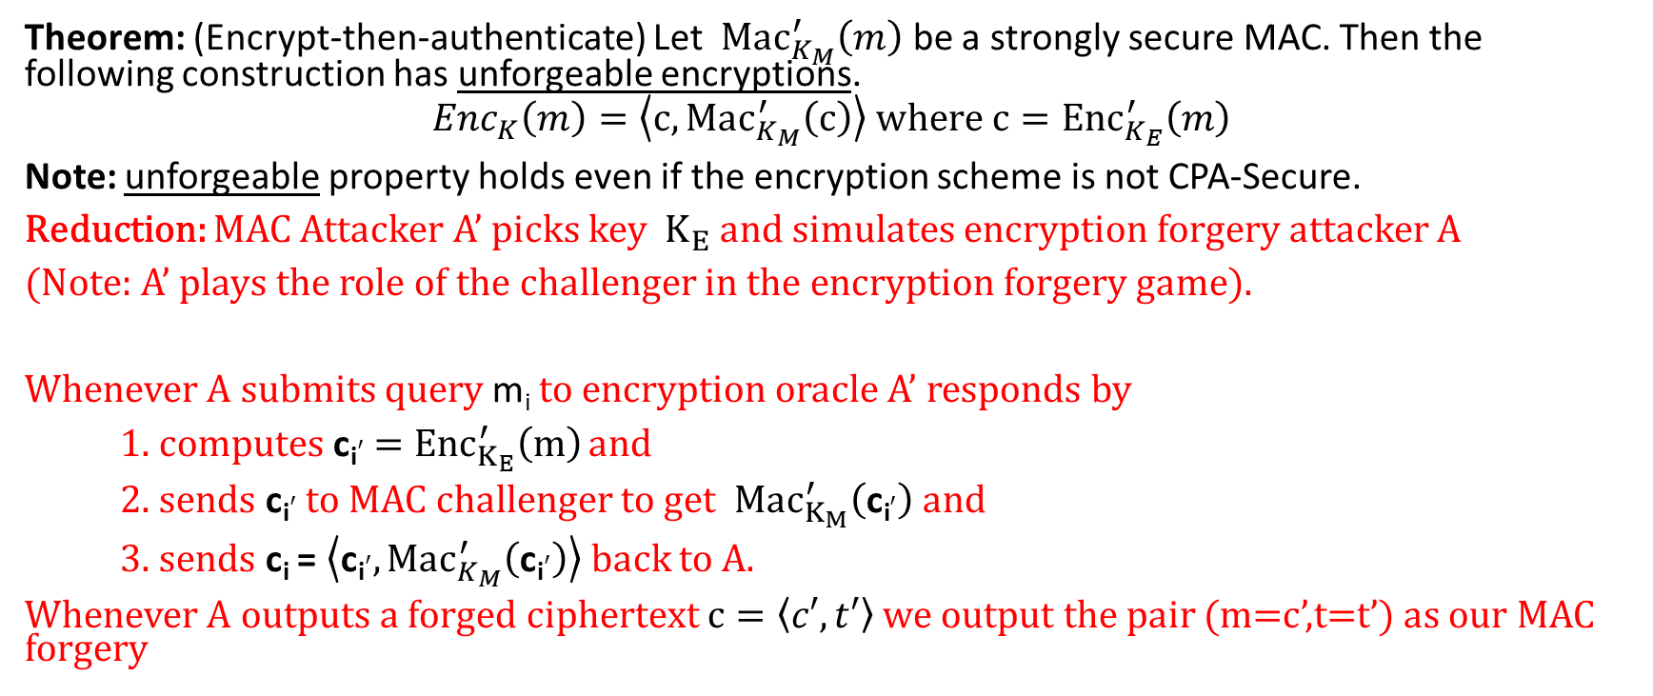
Unforgeable Encryptions
Theorem: (Encrypt-then-authenticate) Let ${Mac}_{K_{M}}^{′}\left(m\right)$ be a strongly secure MAC. Then the following construction has unforgeable encryptions.
$${Enc}_{K}\left(m\right)=\left\langle c,{Mac}_{K_{M}}^{′}\left(c\right)\right\rangle where{ c=Enc}_{K_{E}}^{′}\left(m\right)$$
Note: unforgeable property holds even if the encryption scheme is not CPA-Secure.
Reduction: MAC Attacker A’ picks key $K_{E}$ and simulates encryption forgery attacker A
(Note: A’ plays the role of the challenger in the encryption forgery game).
Whenever A submits query m_{i} to encryption oracle A’ responds by
1. computes ${\text{c}\text{i}}^{′}{ =Enc}_{K_{E}}^{′}\left(m\right)$ and
2. sends ${\text{c}\text{i}}^{′}$ to MAC challenger to get ${Mac}_{K_{M}}^{′}\left({\text{c}\text{i}}^{′}\right)$ and
3. sends c_{i} = $\left\langle {\text{c}\text{i}}^{′},{Mac}_{K_{M}}^{′}\left({\text{c}\text{i}}^{′}\right)\right\rangle$ back to A.
Whenever A outputs a forged ciphertext $c=\left\langle c′,t′\right\rangle$ we output the pair (m=c’,t=t’) as our MAC forgery

Slide 28
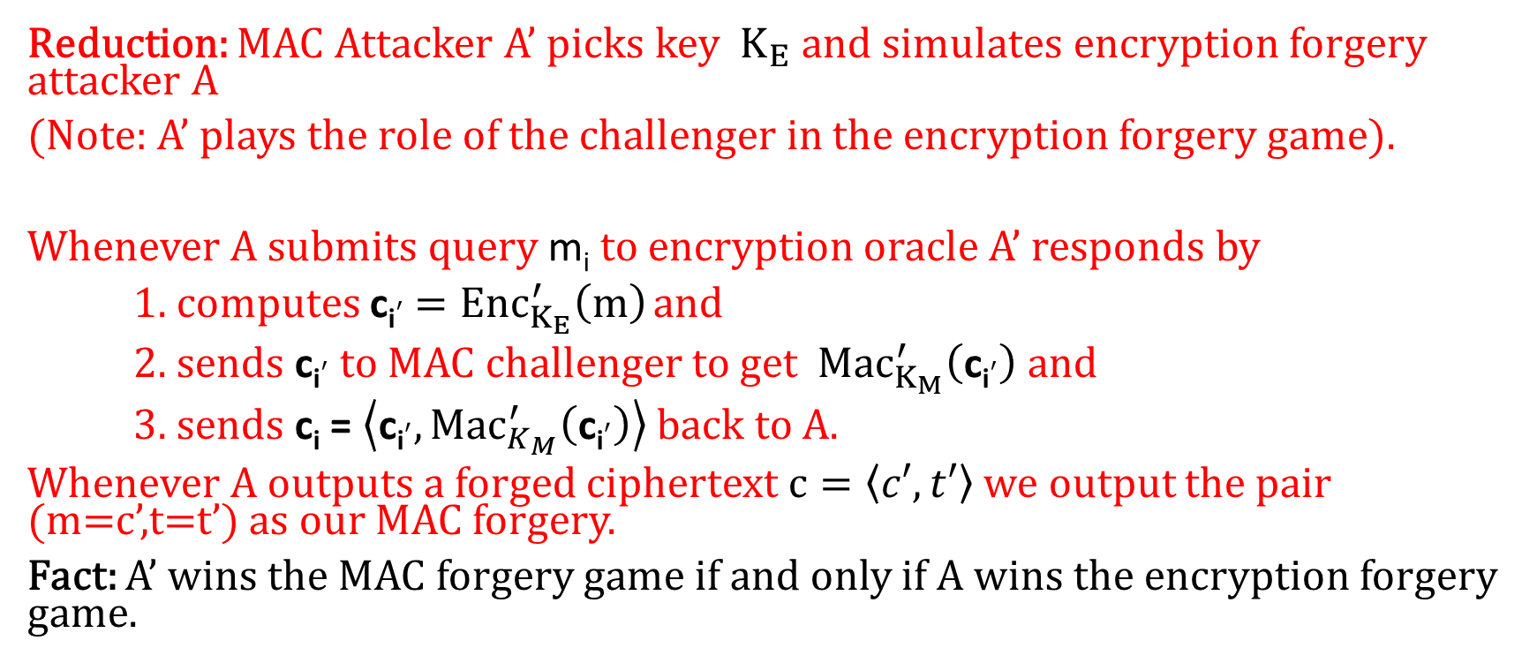
Unforgeable Encryptions
Reduction: MAC Attacker A’ picks key $K_{E}$ and simulates encryption forgery attacker A
(Note: A’ plays the role of the challenger in the encryption forgery game).
Whenever A submits query m_{i} to encryption oracle A’ responds by
1. computes ${\text{c}\text{i}}^{′}{ =Enc}_{K_{E}}^{′}\left(m\right)$ and
2. sends ${\text{c}\text{i}}^{′}$ to MAC challenger to get ${Mac}_{K_{M}}^{′}\left({\text{c}\text{i}}^{′}\right)$ and
3. sends c_{i} = $\left\langle {\text{c}\text{i}}^{′},{Mac}_{K_{M}}^{′}\left({\text{c}\text{i}}^{′}\right)\right\rangle$ back to A.
Whenever A outputs a forged ciphertext $c=\left\langle c′,t′\right\rangle$ we output the pair (m=c’,t=t’) as our MAC forgery.
Fact: A’ wins the MAC forgery game if and only if A wins the encryption forgery game.

Slide 29
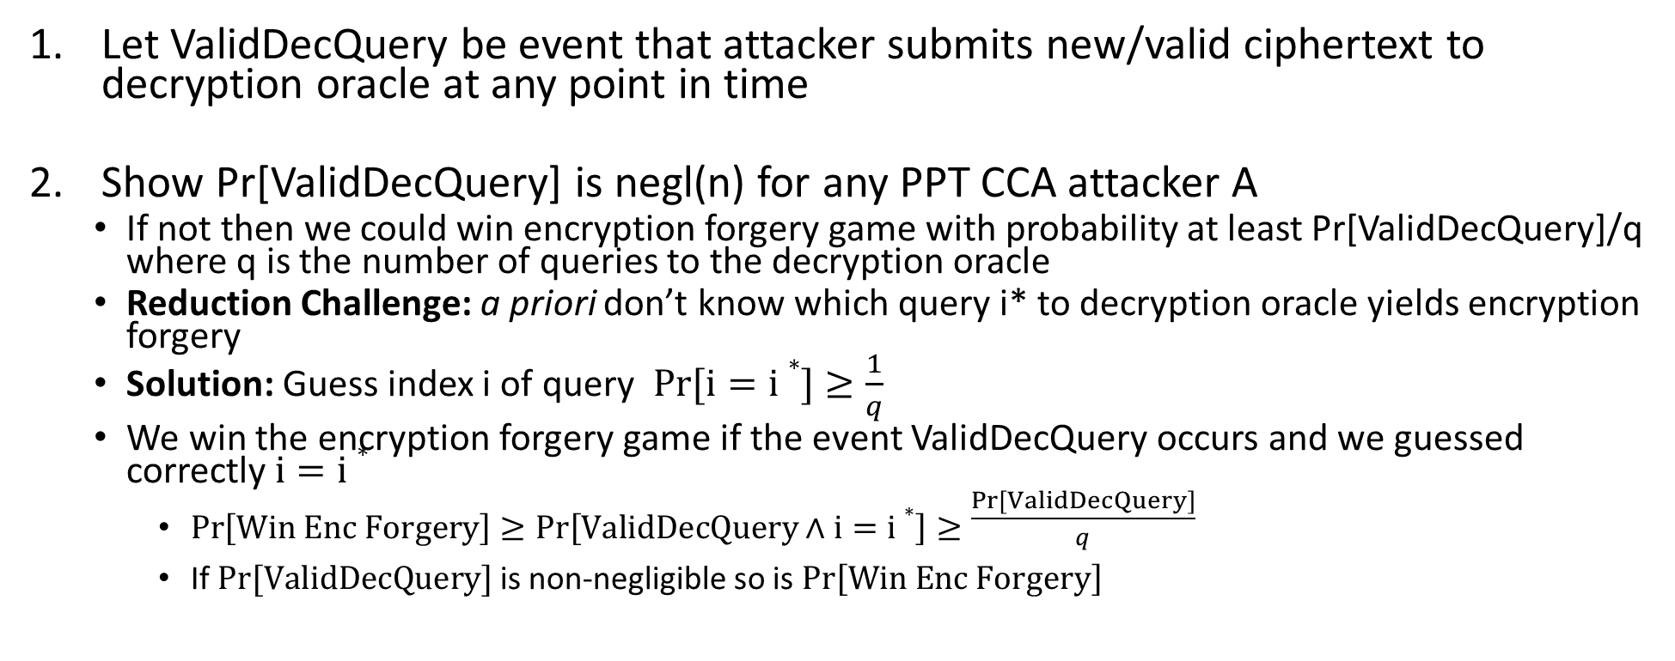
Proof Sketch (CCA-Security)
Let ValidDecQuery be event that attacker submits new/valid ciphertext to decryption oracle at any point in time
Show Pr[ValidDecQuery] is negl(n) for any PPT CCA attacker A
  If not then we could win encryption forgery game with probability at least Pr[ValidDecQuery]/q where q is the number of queries to the decryption oracle
  Reduction Challenge: a priori don’t know which query i* to decryption oracle yields encryption forgery
  Solution: Guess index i of query $Pr[i=i∗]≥\frac{1}{q}$
  We win the encryption forgery game if the event ValidDecQuery occurs and we guessed correctly $i=i∗$
    $Pr\left[Win Enc Forgery\right]≥Pr\left[ValidDecQuery∧i=i∗\right]≥\frac{Pr\left[ValidDecQuery\right]}{q}$
    If $Pr[ValidDecQuery]$ is non-negligible so is$Pr\left[Win Enc Forgery\right]$

Slide 30
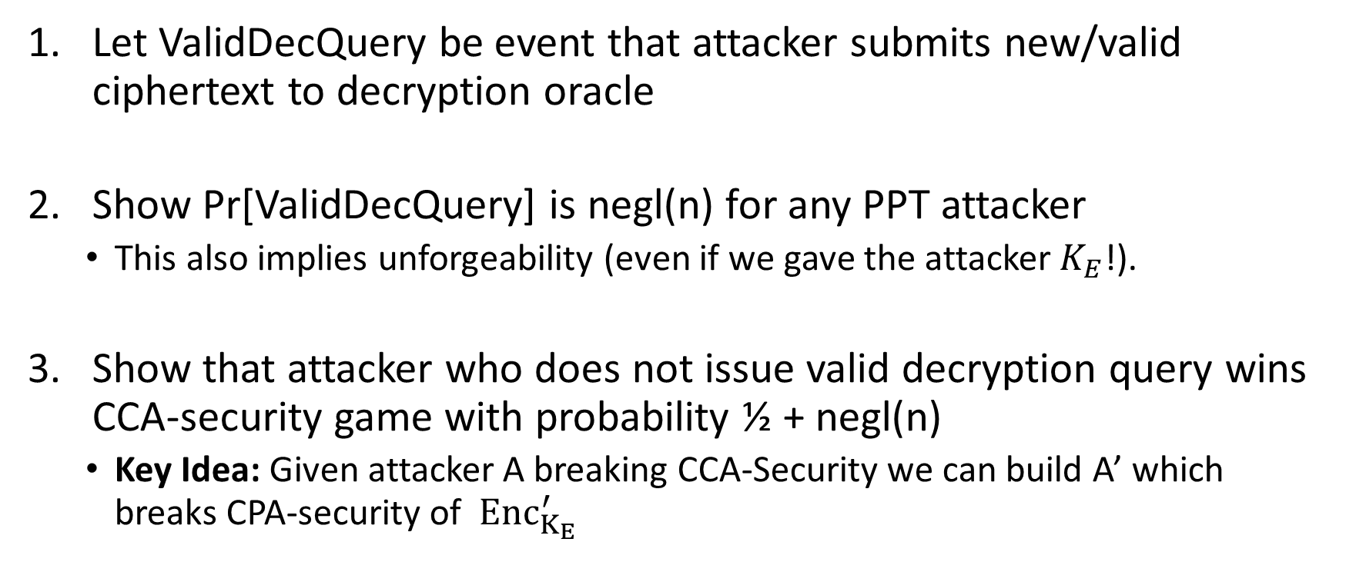
Proof Sketch
Let ValidDecQuery be event that attacker submits new/valid ciphertext to decryption oracle
Show Pr[ValidDecQuery] is negl(n) for any PPT attacker
  This also implies unforgeability (even if we gave the attacker $K_{E}$!).
Show that attacker who does not issue valid decryption query wins CCA-security game with probability ½ + negl(n)
  Key Idea: Given attacker A breaking CCA-Security we can build A’ which breaks CPA-security of ${ Enc}_{K_{E}}^{′}$

Slide 31
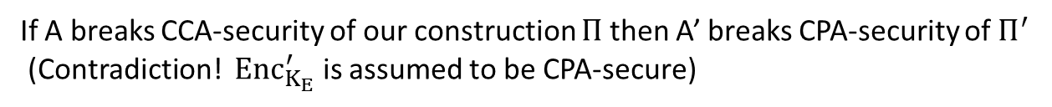
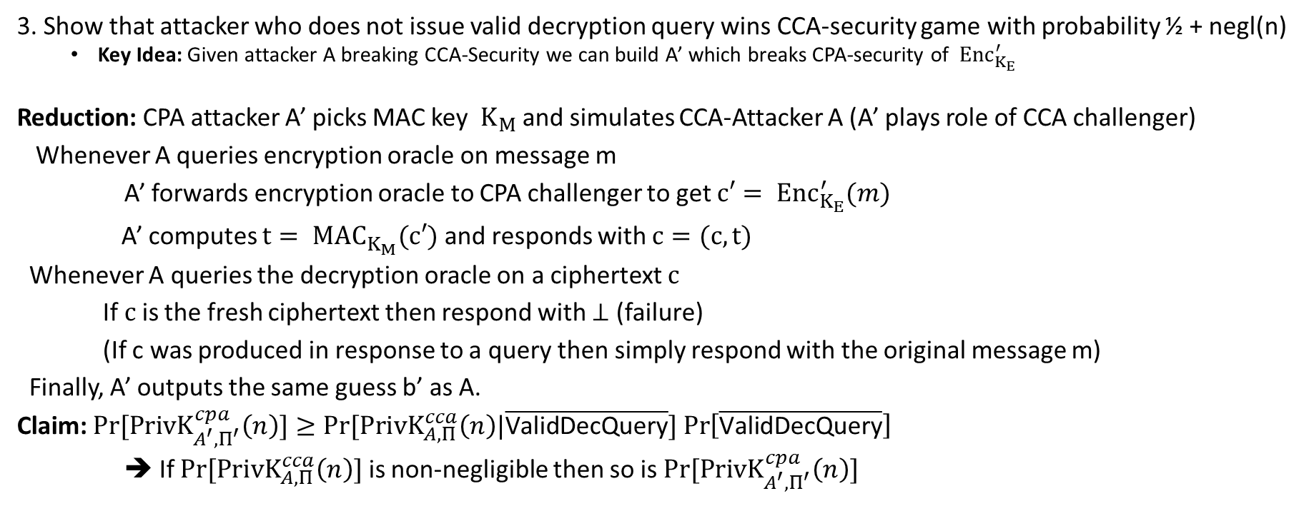
Proof Sketch
3. Show that attacker who does not issue valid decryption query wins CCA-security game with probability ½ + negl(n)
  Key Idea: Given attacker A breaking CCA-Security we can build A’ which breaks CPA-security of ${ Enc}_{K_{E}}^{′}$
Reduction: CPA attacker A’ picks MAC key $K_{M}$ and simulates CCA-Attacker A (A’ plays role of CCA challenger)
Whenever A queries encryption oracle on message m
A’ forwards encryption oracle to CPA challenger to get ${c′= Enc}_{K_{E}}^{′}(m)$
A’ computes ${t= MAC}_{K_{M}}^{}(c′)$ and responds with $c=(c,t)$
Whenever A queries the decryption oracle on a ciphertext $c$
If $c$ is the fresh ciphertext then respond with $⊥$ (failure)
(If c was produced in response to a query then simply respond with the original message m)
Finally, A’ outputs the same guess b’ as A.
Claim: $Pr[{PrivK}_{A^{′},Π^{′}}^{cpa}\left(n\right)]≥Pr⁡[{PrivK}_{A,Π}^{cca}\left(n\right)|\overline{\text{ValidDecQuery}}]$ $\operatorname{Pr}\left[\overline{\text{ValidDecQuery}}\right]$
➔ If $Pr⁡[{PrivK}_{A,Π}^{cca}\left(n\right)]$ is non-negligible then so is $Pr[{PrivK}_{A^{′},Π^{′}}^{cpa}\left(n\right)]$
If A breaks CCA-security of our construction $Π$ then A’ breaks CPA-security of $Π^{′}$
(Contradiction! ${ Enc}_{K_{E}}^{′}$ is assumed to be CPA-secure)

Slide 32
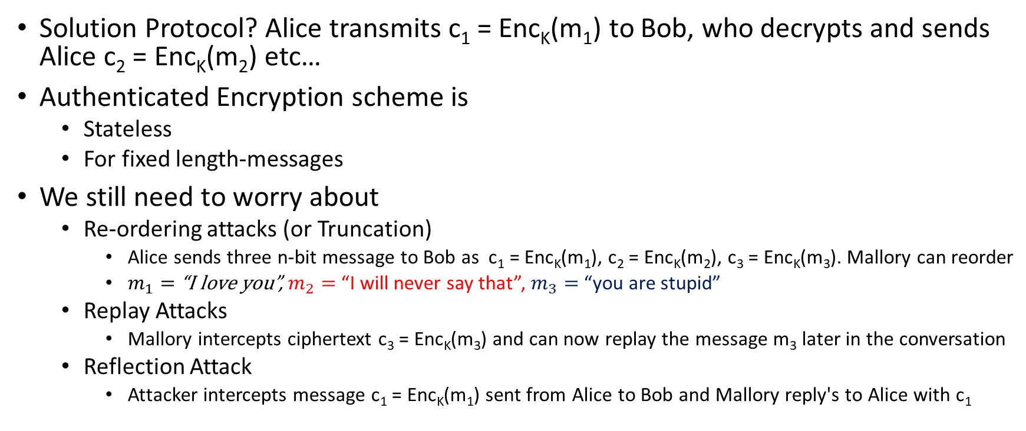
Secure Communication Session
Solution Protocol? Alice transmits c₁ = Enc_{K}(m₁) to Bob, who decrypts and sends Alice c₂ = Enc_{K}(m₂) etc…
Authenticated Encryption scheme is
  Stateless
  For fixed length-messages
We still need to worry about
  Re-ordering attacks (or Truncation)
    Alice sends three n-bit message to Bob as c₁ = Enc_{K}(m₁), c₂ = Enc_{K}(m₂), c₃ = Enc_{K}(m₃). Mallory can reorder
    $m_{1}=$“I love you”, $m_{2}=$“I will never say that”, $m_{3}=$“you are stupid”
  Replay Attacks
    Mallory intercepts ciphertext c₃ = Enc_{K}(m₃) and can now replay the message m₃ later in the conversation
  Reflection Attack
    Attacker intercepts message c₁ = Enc_{K}(m₁) sent from Alice to Bob and Mallory reply's to Alice with c₁
Notes:
$m_{1}=$“I love you”
$m_{2}=$“I will never say that”
$m_{3}=$“you are stupid”

Slide 33
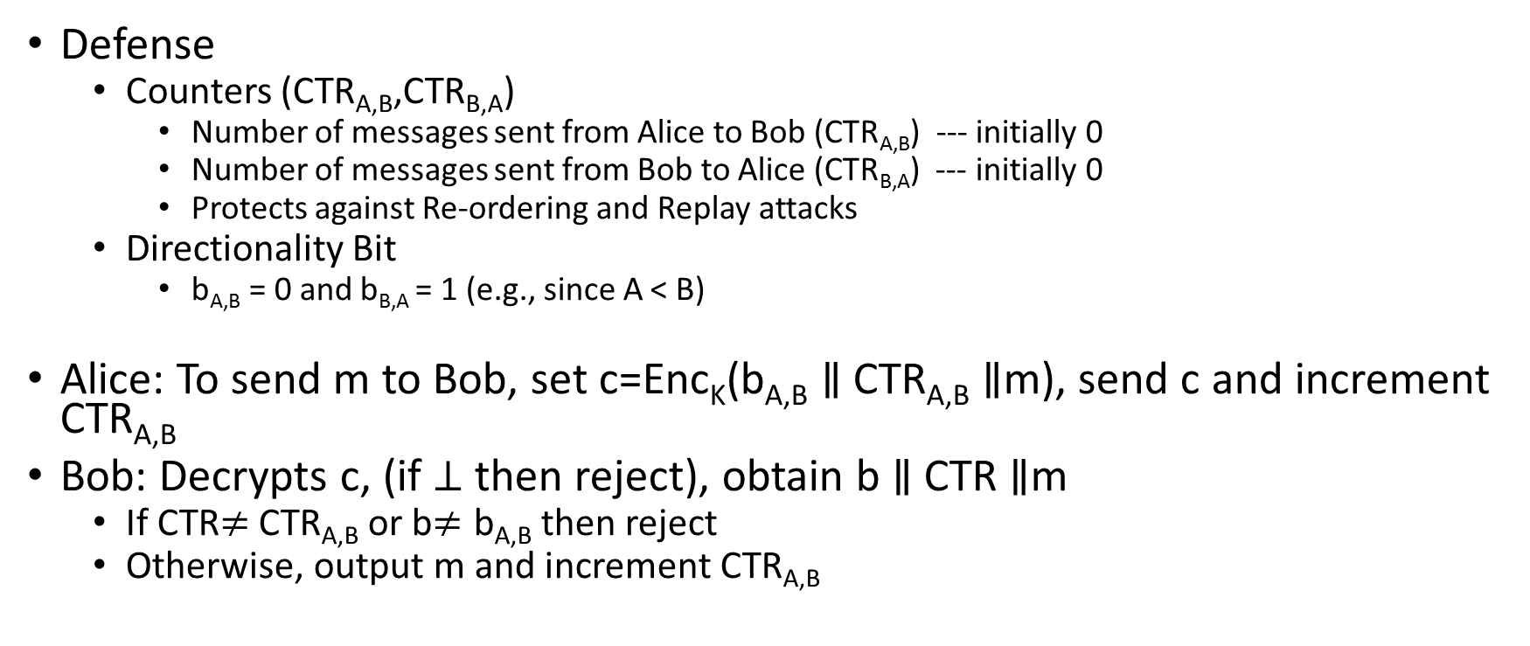
Secure Communication Session
Defense
  Counters (CTR_{A,B},CTR_{B,A})
    Number of messages sent from Alice to Bob (CTR_{A,B}) --- initially 0
    Number of messages sent from Bob to Alice (CTR_{B,A}) --- initially 0
    Protects against Re-ordering and Replay attacks
  Directionality Bit
    b_{A,B} = 0 and b_{B,A} = 1 (e.g., since A < B)
Alice: To send m to Bob, set c=Enc_{K}(b_{A,B} $∥$ CTR_{A,B} $∥$m), send c and increment CTR_{A,B}
Bob: Decrypts c, (if $⊥$ then reject), obtain b $∥$ CTR $∥$m
  If CTR$≠$CTR_{A,B} or b$≠\text{b}\text{A}\text{,}\text{B}$ then reject
  Otherwise, output m and increment CTR_{A,B}

Slide 34
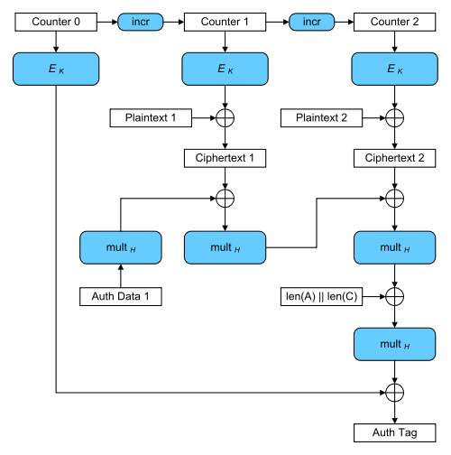
Galois Counter Mode (GCM)
AES-GCM is an Authenticated Encryption Scheme
  Encrypt then Authenticate
  Only uses one symmetric key, but still secure ☺
  Bonus: Authentication Encryption with Associated Data
  Associated Data incorporated into MAC
  Ensures attacker cannot tamper with associated packet data
    Source IP
    Destination IP
    Why can’t these values be encrypted?
Encryption is largely parallelizable!
    Direction of Message is Authenticated
    No truncation/reordering attacks possible amongst the blocks of this message

Slide 35
Authenticated Security vs CCA-Security
Authenticated Encryption → CCA-Security (by definition)
CCA-Security does not necessarily imply Authenticate Encryption
  But most natural CCA-Secure constructions are also Authenticated Encryption Schemes
  Some constructions are CCA-Secure, but do not provide Authenticated Encryptions, but they are less efficient.
Conceptual Distinction
  CCA-Security the goal is secrecy (hide message from active adversary)
  Authenticated Encryption: the goal is integrity + secrecy

Slide 36
Week 4: Topic 4:
Cryptographic Hash Functions

Slide 37

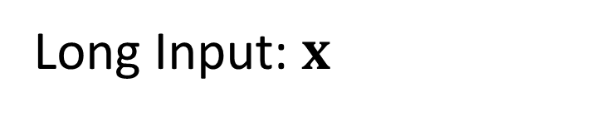
Hash Functions
H(x)=y
Long Input: $x$
Short Output: y s.t.
$$\left|y\right|≪\left|x \right|$$

Slide 38
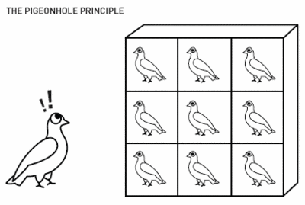
Pigeonhole Principle
“You cannot fit 10 pigeons into 9 pigeonholes”

Slide 39
Hash Collisions
By Pigeonhole Principle there must exist x and y s.t.
H(x) = H(y)

Slide 40
Classical Hash Function Applications
Hash Tables
  O(1) lookup*
“Good hash function” should yield “few collisions”
* Certain terms and conditions apply

Slide 41
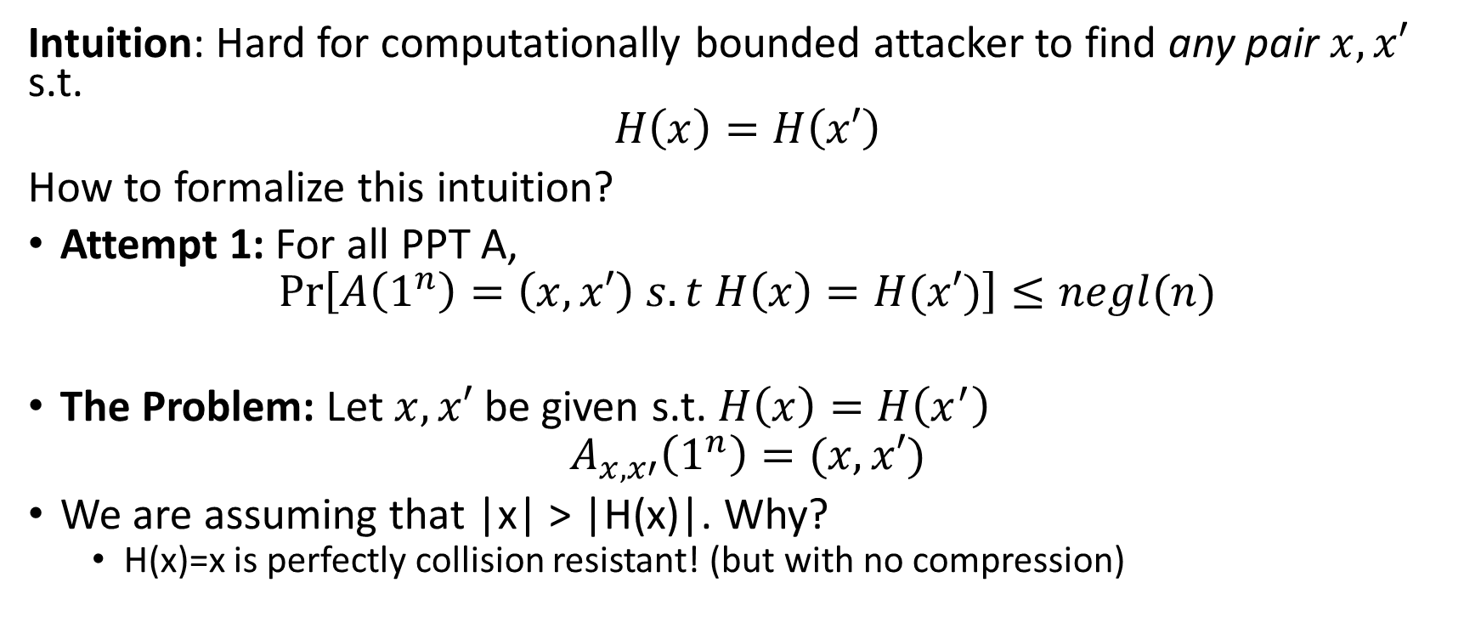
Collision-Resistant Hash Function
Intuition: Hard for computationally bounded attacker to find any pair $x, x′$ s.t.
$$H\left(x\right)=H\left(x′\right)$$
How to formalize this intuition?
Attempt 1: For all PPT A,
$$Pr\left[A\left(1^{n}\right)=\left(x,x′\right) s.t H\left(x\right)=H(x′)\right]≤negl(n)$$
The Problem: Let $x,x′$ be given s.t. $H\left(x\right)=H\left(x^{′}\right)$
$$A_{x,x′}\left(1^{n}\right)=(x,x′)$$
We are assuming that |x| > |H(x)|. Why?
  H(x)=x is perfectly collision resistant! (but with no compression)

Slide 42
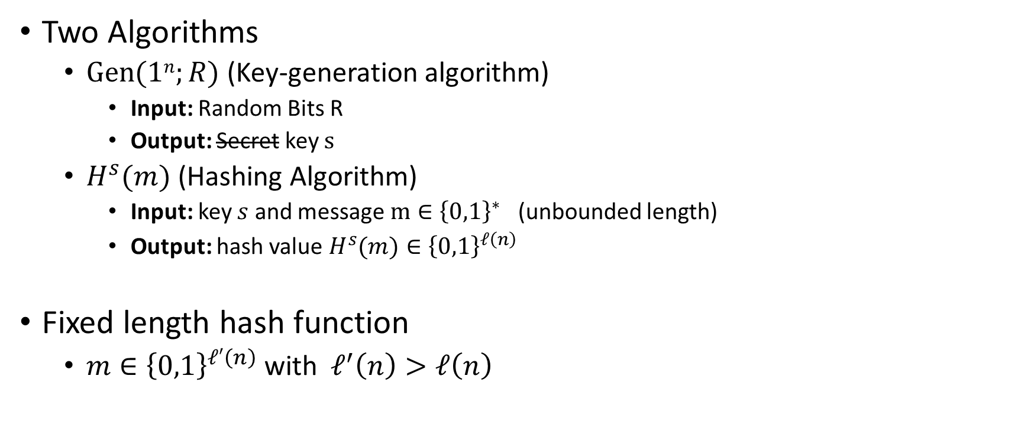
Keyed Hash Function Syntax
Two Algorithms
  $\operatorname{Gen}{(1n;R)}$ (Key-generation algorithm)
    Input: Random Bits R
    Output: Secret key $s$
  $H^{s}{(m)}$ (Hashing Algorithm)
    Input: key $s$ and message $m∈{\left\{0,1\right\}}^{∗}$ (unbounded length)
    Output: hash value${ H}^{s}{(m)}∈{\left\{0,1\right\}}^{ℓ\left(n\right)}$
Fixed length hash function
  $m∈{\left\{0,1\right\}}^{ℓ′\left(n\right)}$ with$ℓ^{′}\left(n\right)>ℓ\left(n\right)$

Slide 43
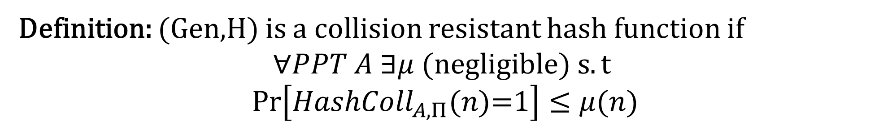


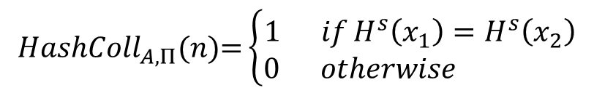
Collision Experiment (${HashColl}_{A,Π}(n)$)
s
x₁,x₂
$${HashColl}_{A,Π}(n)\text{=}\left\{\begin{aligned}1 ifH^{s}\left(x_{1}\right)=H^{s}\left(x_{2}\right) \\ 0 otherwise \end{aligned}\right.$$
$$s=Gen{(1n;R)}$$
Definition: (Gen,H) is a collision resistant hash function if
$$∀PPT A ∃μ (negligible) s.t$$
$$Pr\left[{HashColl}_{A,Π}(n)\text{=}1\right]≤μ(n)$$

Slide 44
Collision Experiment (${HashColl}_{A,Π}(n)$)
For simplicity we will sometimes just say that H (or H^{s}) is a collision resistant hash function
s
Key is not key secret (just random)
x₁,x₂
$${HashColl}_{A,Π}(n)\text{=}\left\{\begin{aligned}1 ifH^{s}\left(x_{1}\right)=H^{s}\left(x_{2}\right) \\ 0 otherwise \end{aligned}\right.$$
$$s=Gen{(1n;R)}$$
Definition: (Gen,H) is a collision resistant hash function if
$$∀PPT A ∃μ (negligible) s.t$$
$$Pr\left[{HashColl}_{A,Π}(n)\text{=}1\right]≤μ(n)$$

Slide 45
Theory vs Practice
Most cryptographic hash functions used in practice are un-keyed
  Examples: MD5, SHA1, SHA2, SHA3
Tricky to formally define collision resistance for keyless hash function
  There is a PPT algorithm to find collisions
  We just usually can’t find this algorithm ☺

