Slide 1
Distance Between Words for spellchecking
Distance between strings

Slide 2
Errors are close to correct words
Need a measure of distance between strings (words/phrases):
Jackard coefficient/similarity (done)
Edit distance: effort to convert one into another
Soundex: phonetic closeness (sound: تشابه النطق)
More likely to mistake with adjacent keyboard characters, or without language switch: Really ٌثشممغ really in Arabic keyboard!
Confusion letters:{ء ئ ؤ أ آ إ}, {ى ي}, {ة ه} less distance within
Final distance: A weighted sum!

Slide 3
How similar are two strings?
Spell correction
The user typed “graffe”
Which is closest?
graf
graft
grail
giraffe
Computational Biology
Align two sequences of nucleotides
Resulting alignment:
AGGCTATCACCTGACCTCCAGGCCGATGCCC
TAGCTATCACGACCGCGGTCGATTTGCCCGAC
-AGGCTATCACCTGACCTCCAGGCCGA--TGCCC---
TAG-CTATCAC--GACCGC--GGTCGATTTGCCCGAC
Also for Machine Translation, Information Extraction, Speech Recognition

Slide 4
Edit Distance
The minimum edit distance between two strings
Is the minimum number of editing operations
Insertion
Deletion
Substitution
Needed to transform one into the other

Slide 5
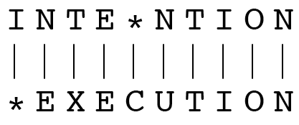
Minimum Edit Distance
Two strings and their alignment:

Slide 6
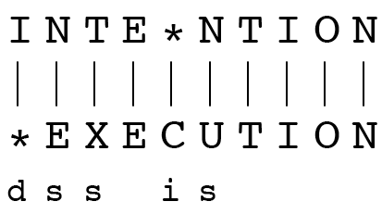
Minimum Edit Distance
If each operation has cost of 1
Distance between these is 5
If substitutions cost 2 (Levenshtein)
Distance between them is 8

Slide 7
Alignment in Computational Biology
Given a sequence of bases
An alignment:
Given two sequences, align each letter to a letter or gap
AGGCTATCACCTGACCTCCAGGCCGATGCCC
TAGCTATCACGACCGCGGTCGATTTGCCCGAC
-AGGCTATCACCTGACCTCCAGGCCGA--TGCCC---
TAG-CTATCAC--GACCGC--GGTCGATTTGCCCGAC

Slide 8
Other uses of Edit Distance in NLP
Evaluating Machine Translation and speech recognition
R Spokesman confirms senior government adviser was shot
H Spokesman said the senior adviser was shot dead
S I D I
Named Entity Extraction and Entity Coreference
IBM Inc. announced today
IBM profits
Stanford President John Hennessy announced yesterday
for Stanford University President John Hennessy

Slide 9
How to find the Min Edit Distance?
Searching for a path (sequence of edits) from the start string to the final string:
Initial state: the word we’re transforming
Operators: insert, delete, substitute [Levenshtein] exchange[Demerau]
Goal state: the word we’re trying to get to
Path cost: what we want to minimize: the number of edits

Slide 10
Minimum Edit as Search
But the space of all edit sequences is huge!
We can’t afford to navigate naïvely
Lots of distinct paths wind up at the same state.
We don’t have to keep track of all of them
Just the shortest path to each of those revisted states.

Slide 11
Defining Min Edit Distance
For two strings
X of length n
Y of length m
We define D(i,j)
the edit distance between X[1..i] and Y[1..j]
i.e., the first i characters of X and the first j characters of Y
The edit distance between X and Y is thus D(n,m)

Slide 12
Minimum Edit Distance
Definition of Minimum Edit Distance

Slide 13
Minimum Edit Distance
Computing Minimum Edit Distance

Slide 14
Dynamic Programming for Minimum Edit Distance
Dynamic programming: A tabular computation of D(n,m)
Solving problems by combining solutions to subproblems.
Bottom-up
We compute D(i,j) for small i,j
And compute larger D(i,j) based on previously computed smaller values
i.e., compute D(i,j) for all i (0 < i < n) and j (0 < j < m)

Slide 15
Defining Min Edit Distance (Levenshtein)
Initialization
D(i,0) = i
D(0,j) = j
Recurrence Relation:
For each i = 1…M
For each j = 1…N
D(i-1,j) + 1
D(i,j)= min D(i,j-1) + 1
D(i-1,j-1) + 2; if X(i) ≠ Y(j)
0; if X(i) = Y(j)
Termination:
D(N,M) is distance

Slide 16
The Edit Distance Table
N | 9
O | 8
I | 7
T | 6
N | 5
E | 4
T | 3
N | 2
I | 1
# | 0 | 1 | 2 | 3 | 4 | 5 | 6 | 7 | 8 | 9
 | # | E | X | E | C | U | T | I | O | N

Slide 17
The Edit Distance Table
N | 9
O | 8
I | 7
T | 6
N | 5
E | 4
T | 3
N | 2
I | 1
# | 0 | 1 | 2 | 3 | 4 | 5 | 6 | 7 | 8 | 9
 | # | E | X | E | C | U | T | I | O | N

Slide 18
Edit Distance
N | 9
O | 8
I | 7
T | 6
N | 5
E | 4
T | 3
N | 2
I | 1
# | 0 | 1 | 2 | 3 | 4 | 5 | 6 | 7 | 8 | 9
 | # | E | X | E | C | U | T | I | O | N

Slide 19
The Edit Distance Table
N | 9 | 8 | 9 | 10 | 11 | 12 | 11 | 10 | 9 | 8
O | 8 | 7 | 8 | 9 | 10 | 11 | 10 | 9 | 8 | 9
I | 7 | 6 | 7 | 8 | 9 | 10 | 9 | 8 | 9 | 10
T | 6 | 5 | 6 | 7 | 8 | 9 | 8 | 9 | 10 | 11
N | 5 | 4 | 5 | 6 | 7 | 8 | 9 | 10 | 11 | 10
E | 4 | 3 | 4 | 5 | 6 | 7 | 8 | 9 | 10 | 9
T | 3 | 4 | 5 | 6 | 7 | 8 | 7 | 8 | 9 | 8
N | 2 | 3 | 4 | 5 | 6 | 7 | 8 | 7 | 8 | 7
I | 1 | 2 | 3 | 4 | 5 | 6 | 7 | 6 | 7 | 8
# | 0 | 1 | 2 | 3 | 4 | 5 | 6 | 7 | 8 | 9
 | # | E | X | E | C | U | T | I | O | N

Slide 20
Minimum Edit Distance
Weighted Minimum Edit Distance

Slide 21
Levenshtein vs Demerau
Levenshtein: three ops: add, delete, substitute.
Demerau: Add, delete, substitute, exchange:
Resaerch → research 1 Demerau, 2 or more Levenshtein

Slide 22
Weighted Edit Distance
Why would we add weights to the computation?
Spell Correction: some letters are more likely to be mistyped than others
Biology: certain kinds of deletions or insertions are more likely than others

Slide 23
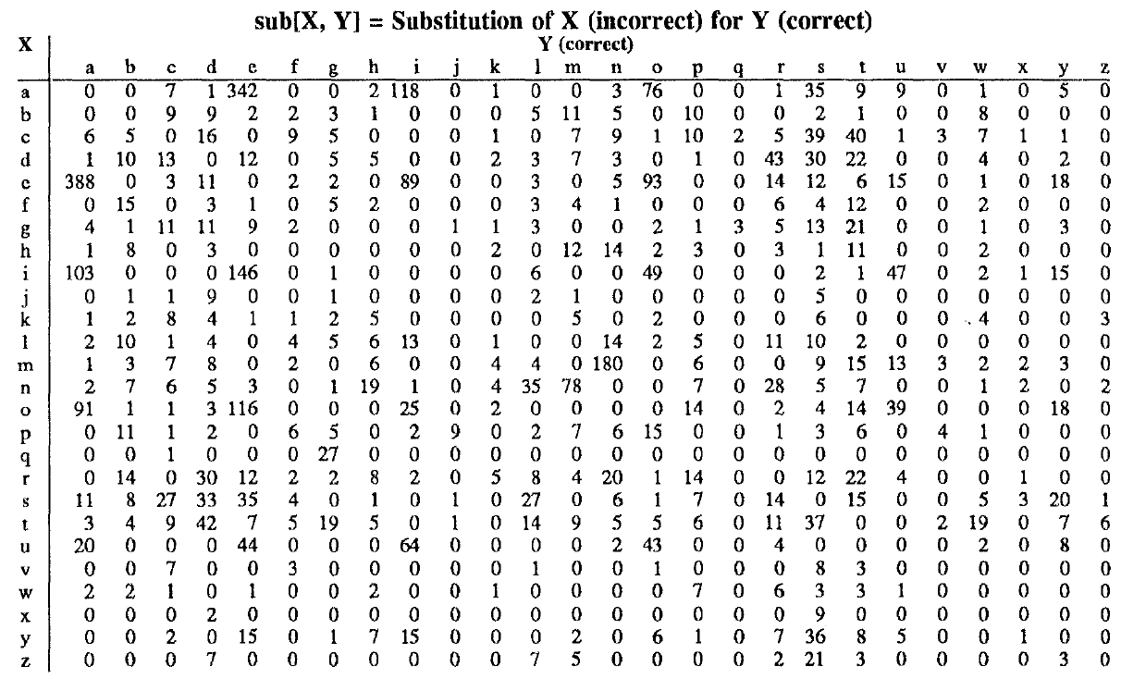
Confusion matrix for spelling errors

Slide 24
Weighted Min Edit Distance
Initialization:
D(0,0) = 0
D(i,0) = D(i-1,0) + del[x(i)]; 1 < i ≤ N
D(0,j) = D(0,j-1) + ins[y(j)]; 1 < j ≤ M
Recurrence Relation:
D(i-1,j) + del[x(i)]
D(i,j)= min D(i,j-1) + ins[y(j)]
D(i-1,j-1) + sub[x(i),y(j)]
Termination:
D(N,M) is distance

Slide 25
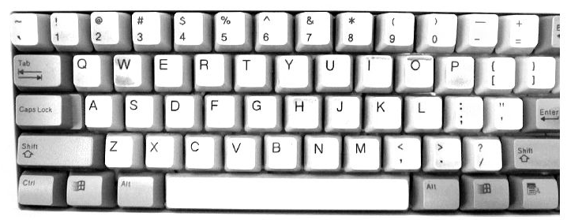
Keyboarding Errors: more for mobiles

Slide 26
Where did the name, dynamic programming, come from?
…The 1950s were not good years for mathematical research. [the] Secretary of Defense …had a pathological fear and hatred of the word, research…
I decided therefore to use the word, “programming”.
I wanted to get across the idea that this was dynamic, this was multistage… I thought, let’s … take a word that has an absolutely precise meaning, namely dynamic… it’s impossible to use the word, dynamic, in a pejorative sense. Try thinking of some combination that will possibly give it a pejorative meaning. It’s impossible.
Thus, I thought dynamic programming was a good name. It was something not even a Congressman could object to.”
Richard Bellman, “Eye of the Hurricane: an autobiography” 1984.

Slide 27
Soundex Algorithm
Idea
–Vowels are viewed as interchangeable in transcribing names
Consonants with similar sounds (e.g., D and T) are put in equivalence classes
related names often have the same soundex codes
Algorithm
–Turn every term to be indexed into a four-character reduced form,
build an inverted index from these reduced forms to the original terms called the soundex index
Do the same with the query terms
Search the soundex index
Richard Bellman, “Eye of the Hurricane: an autobiography” 1984.

Slide 28
Soundex Algorithm: Four-Character Code
The first character is a letter of the alphbet and the other three are digits between 0 and 9
•Algorithm
–Retain the first letter of the term
–Change all occurrences of the following letters to ‘0’
A, E, I, O U, H, W, and Y
–Change letters to digits as follows
B, F, P, V →1
Richard Bellman, “Eye of the Hurricane: an autobiography” 1984.

Slide 29
Soundex Algorithm: Four-Character Code
•D, T → 3
•L →4
•M, N → 5
•R → 6
–Repeatedly remove one out of each pair of consecutive identical digits
–Remove all 0’s from the resulting string, pad the resulting string with trailing zeros and return the first four positions: a letter followed by three digits
•Example: Hermann →H655, Herman →H655, matched!
Richard Bellman, “Eye of the Hurricane: an autobiography” 1984.

Slide 30
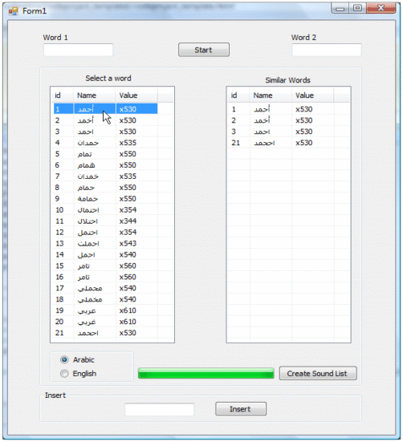
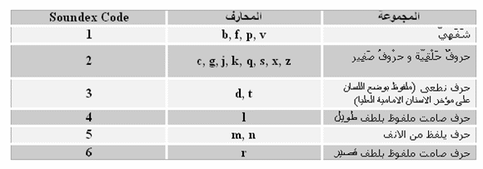
Arabic Soundex : Four-Character Code
Hold the first letter.
Replace the characters ا, أ, إ, آ, ح, ع, غ, ش,و,ي) ) with the value 0.
Replace the characters ف, ب) ) with the value 1.
Replace the characters خ, ج, ز, س, ص, ظ, ق, ك) ) with the value 2.
Replace the characters ت, ث,د,ذ,ض,ط) ) with the value 3.
Replace the character ل) ) with the value 4.
Replace the characters (م, ن ) with the value 5.
Replace the character (ر )with the value 6.
https://www.codeproject.com/Articles/26880/Arabic-Soundex

Slide 31
Errors are close to correct words
Distance between error and correct words: a combination of:
Jackard coefficient/similarity (distance)
Edit distance (Levenshtein, Demerau): not all equal
Soundex: phonetic closeness (sound: تشابه النطق): less distance here
More likely to mistake with adjacent keyboard characters, or without language switch: Really ٌثشممغ really in Arabic keyboard!
Confusion letters:{ء ئ ؤ أ آ إ}, {ى ي}, {ة ه} less distance within
Final distance: A weighted sum!

Slide 32
Minimum Edit Distance
https://www.youtube.com/watch?v=Xxx0b7djCrs

