Slide 1
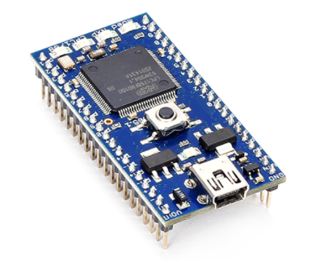
Introduction to MBED microcontroller

Slide 2
Arduino VS. mbed VS. Raspberry Pi Size

Slide 3
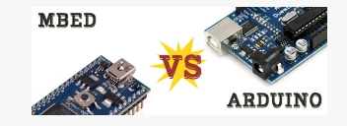
 | MBED | Arduino
Microcontroller Family | ARM | AVR
Clock | 96 MHz | 16 MHz
Flash | 512K | 32K
RAM | 32K | 2K
Price | ~100 $ | 10-20 $
 | Ethernet

Slide 4
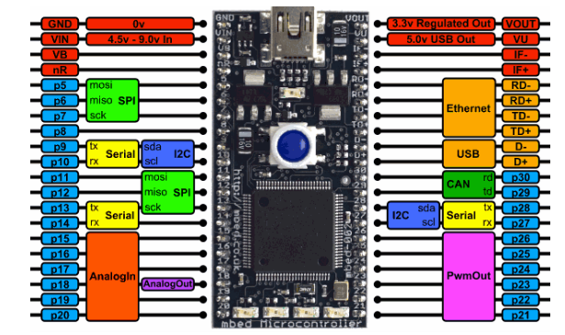
MBED pins 40 pins

Slide 5
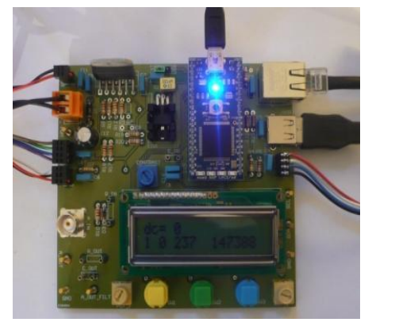

Slide 6
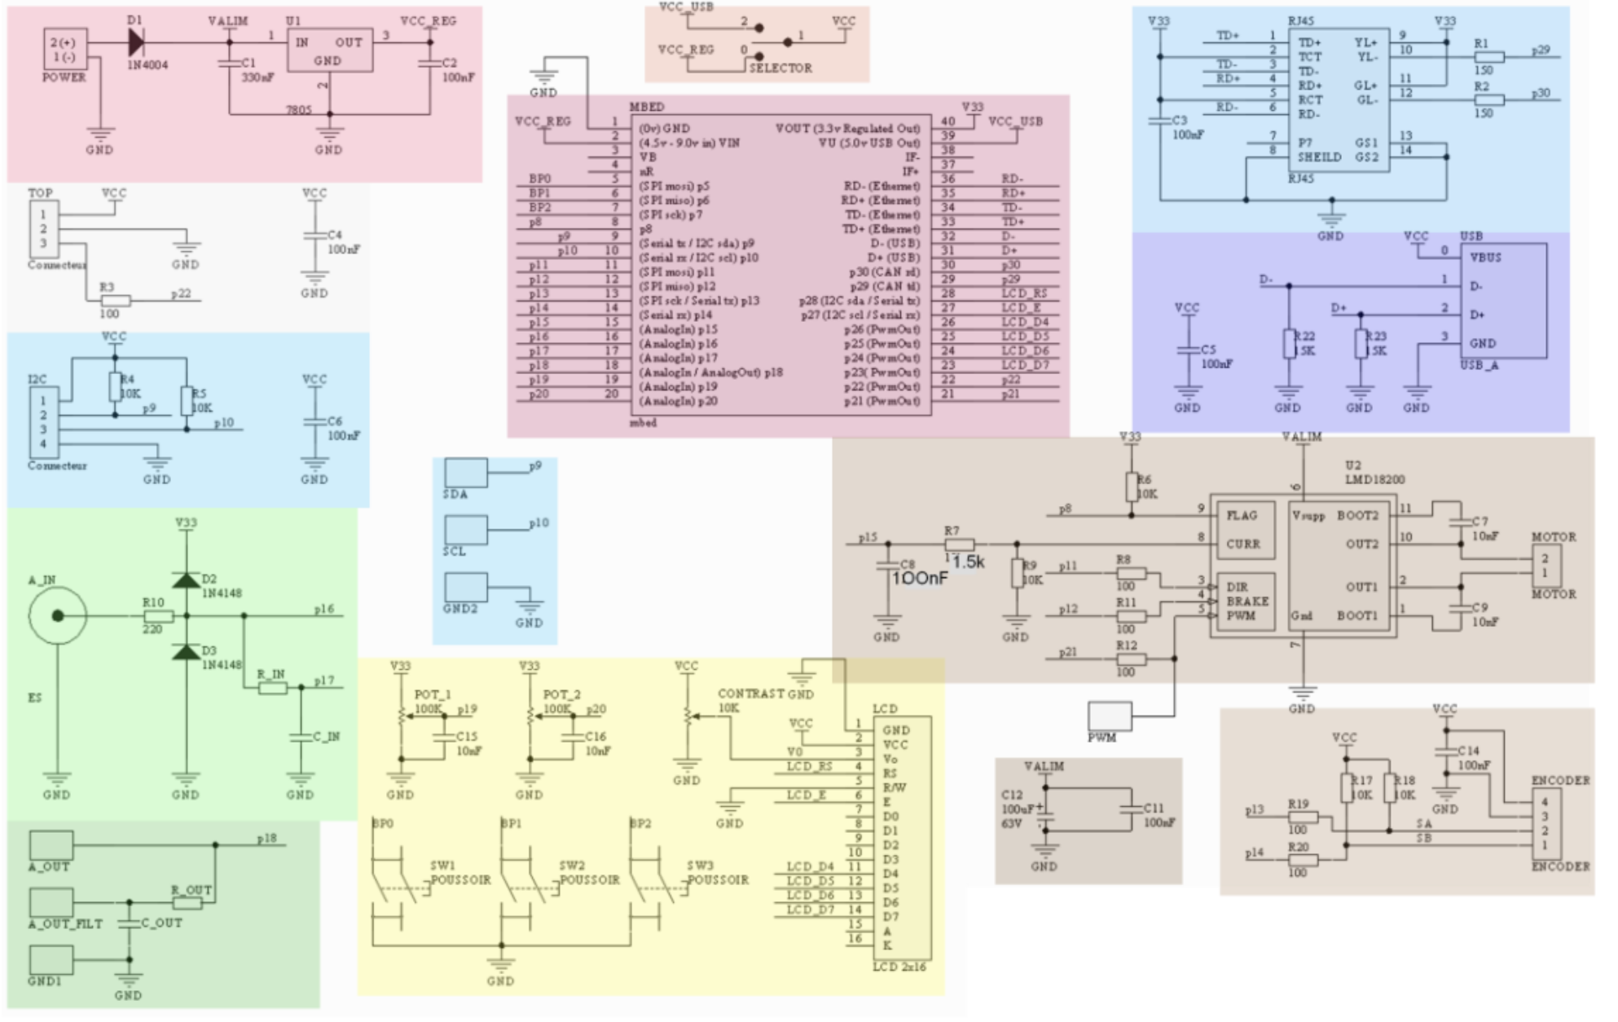

Slide 7
Code structure
LED1 = P1_18, LED2 = P1_20, LED3 = P1_21, LED4 = P1_23

Slide 8
Digital Inputs/Outputs
Combinational
F1 = A’B + AB’
F2 = ABC + A’c

Slide 9
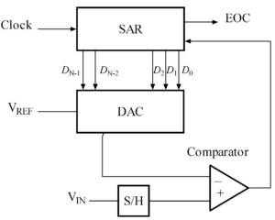
ADC, DAC and Timers
Successive-approximation ADC

Slide 10
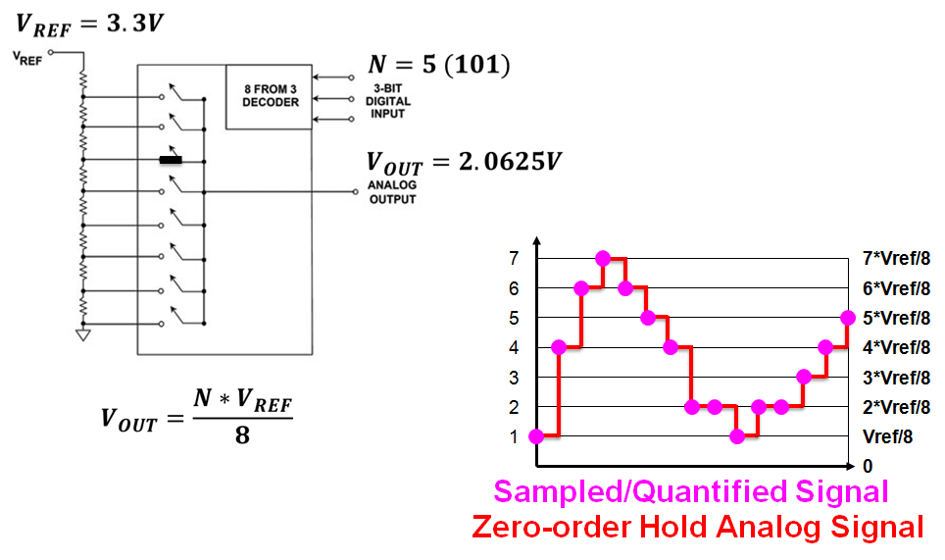

Slide 11
Timers and Interrutps
Using Timer Object
Using Timeout interface
Using Ticker interface
External interrupts

