Slide 1
Electrical Engineering Department
Network Analysis II
ENEE 335
3 Credit Hours
Second Semester 2014
Instructor : Dr. Atheer Barghouthi
Date : 24.02.2014

Slide 2
Intended Learning Outcomes (ILO’s)
To be able to apply the linear network analysis methods in the Laplace domain, (mesh analysis, node analysis, and network theorems and circuits transformation).
To be able to apply the circuit synthesis methods in the implementation of LTI systems (transfer functions).
To understand two ports elements representation.
To be able to solve circuits with two ports elements
To be able to determine and analyze the frequency response of the systems
To be able to analyze different types of analog filters (active and passive).
To be able to design and implement different types of analog filters
To understand the graph representation of electric networks
To apply the graph theory concepts in solving electric networks
To be able to use CAD tools (ORCAD , MATLAB) in simulating and synthesizing electric networks
To acquire interaction and communication skills

Slide 3
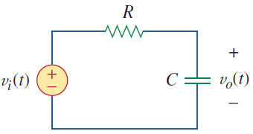
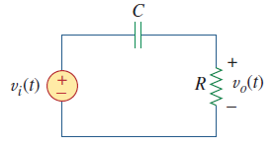
Filters Design
Passive filters
Low pass filters:
Gain = 1
Cut off frequency =1/RC
High pass filters:
Gain = 1
Cut off frequency =1/RC

Slide 4
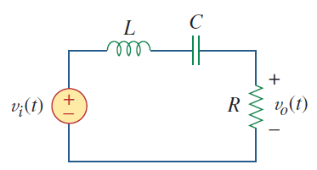
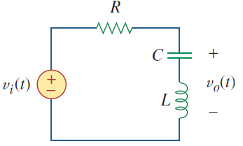
Filters Design
Passive Bandpass filters:
Second order filters RLC, K =1
Passive Bandstop filters: Second order filters RLC, K=1

Slide 5
Filters Design
Why active filters?
Filter design
Filter Design begins with the specifications, which is translated into the order of the filter and the corresponding transfer function
The filter is implemented depending on its order using first and second order building blocks(2nd order complex poles are used to get steeper slopes, less components, and lower cost)
The building blocks components can be scaled to reach components that can be implemented. Additionally, they can be frequency scaled to shift cut off frequencies.

Slide 6
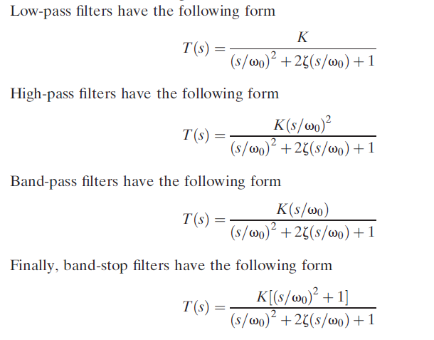
Filters Design
Transfer functions general form of second order filters

Slide 7
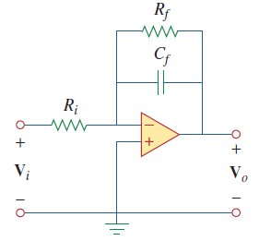
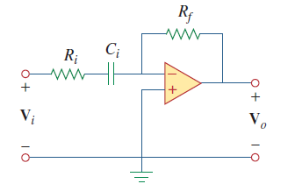
Filters Design
First order active filters building blocks
Low pass filters:
Gain = -Rf/Ri
Cut off frequency =1/RfCf
High pass filters:
Gain = -Rf/Ri
Cut off frequency =1/RfCi

Slide 8
Filters Design
Second order active filters building blocks
Low pass filters and high pass filters: gain, cut off frequency and zeta
Band pass and band stop filters: bandwidth, Q

Slide 9
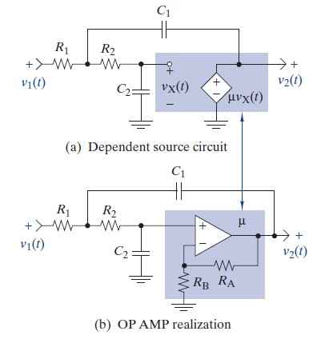
Filters Design
Second order active filters building blocks
Low pass filters:
1) Equal element method:

Slide 10
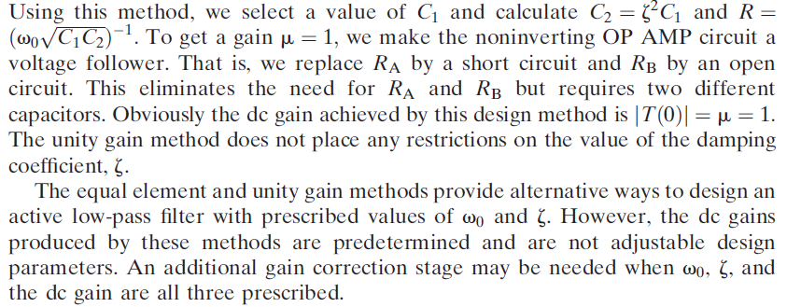
Filters Design
Second order active filters building blocks
2) Unity gain method:

Slide 11
Filters Design
Second order active filters building blocks
Example:
Low pass:

Slide 12
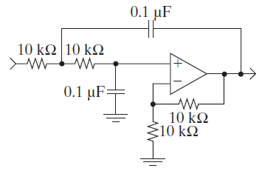
Filters Design
Second order active filters building blocks

Slide 13
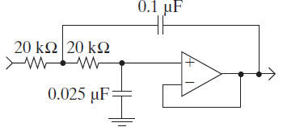
Filters Design
Second order active filters building blocks
Ex2:

Slide 14
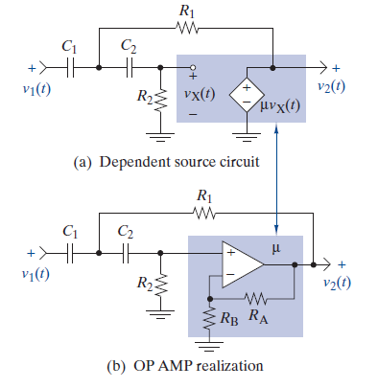
Filters Design
Second order active filters building blocks
High pass filters:
High pass filters can be achieved from low pass filters with the following transformation:

Slide 15
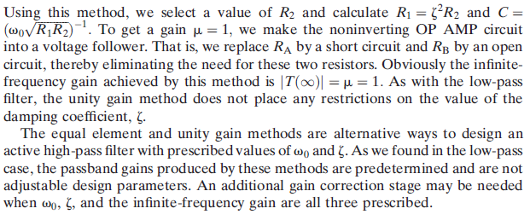
Filters Design
Second order active filters building blocks
High pass filters:

Slide 16
Filters Design
Second order active filters building blocks
High pass filters example:

Slide 17
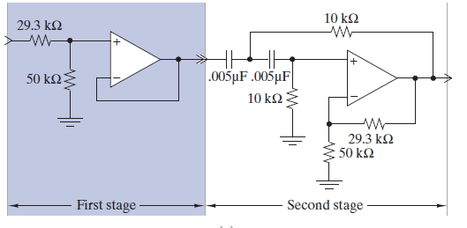
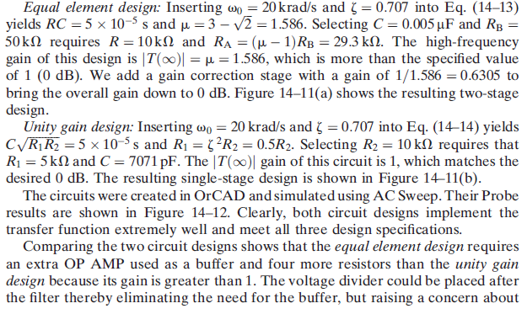
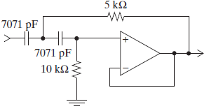
Filters Design
Second order active filters building blocks
High pass filters example:

Slide 18
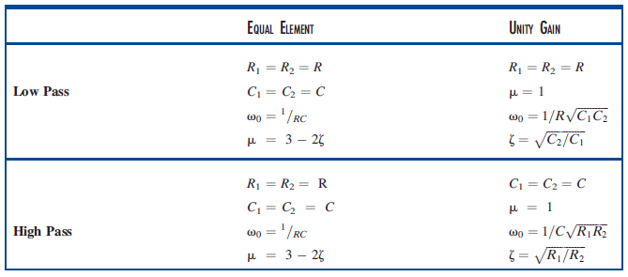
Filters Design
Second order active filters building blocks
High pass filters example 2:

Slide 19
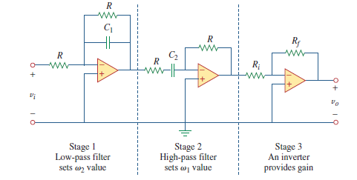
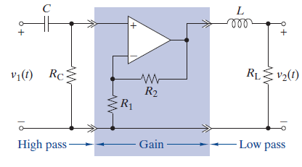
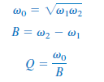
Filters Design
Active Bandpass filters: Two approaches to design band pass filters
1. Cascade of a low pass and high pass filter (used for low Q filters or wideband)

Slide 20
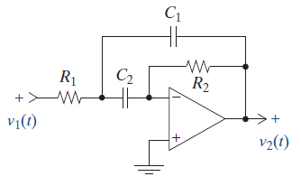
Filters Design
Active Bandpass filters:
2. Direct design (used for narrow band filters or high Q)

Slide 21
Filters Design
Bandpass active filters:

Slide 22
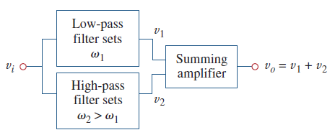
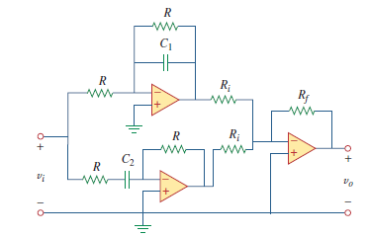
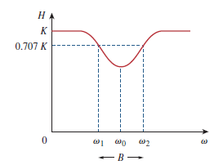
Filters Design
Bandstop active filters:
1. Parallel combination of a low pass and high pass filter

Slide 23
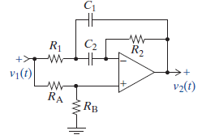
Filters Design
Bandstop active filters:
2. Direct design (used for narrow band filters or high Q)
For the circuit to perform as band stop

Slide 24
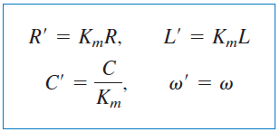
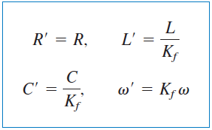
Filters Design
Scaling: magnitude scaling and frequency scaling
Magnitude scaling is what we used to achieve a realizable design from a prototype.
2. Frequency scaling is used to change the cut off frequency of the filter .

Slide 25
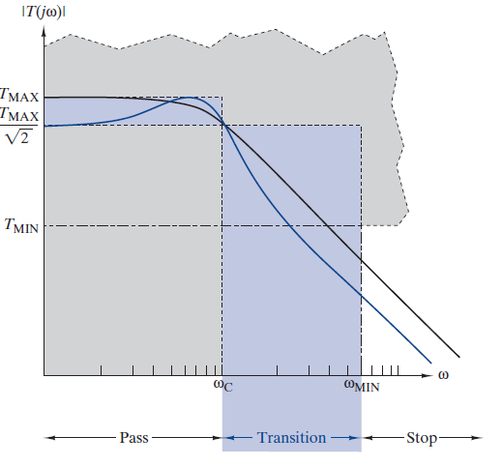
Filters Design
Filter design from specifications:
Determine which type of the filter to design
(First order cascade, Butterworth...)
2. Determine which type of the filter to design
(low pass, high pass, band pass, band stop)
3. The specifications are, the cut off frequency(
frequencies), the gain, and a frequency
Wmin at which the gain should be lower the
Tmin
4. Determine by a formula the order of the
filter (number of stages)
5. Find the transfer function of each stage, from
table
6. Frequency scale the transfer functions to fit with the cut off frequency specified
7. Build and connect the transfer functions to finish the design.

Slide 26
Filters Design
Filter design from specifications:
Many types of filters are available, we will learn only (First order
cascade, Butterworth...) the others Chebychev, Bessel... are not
considereed here
Different filter typesgenerate different filter orders for a certain specifications, additionally, the quality of their magnitude and phase responses differ.
The core design is low pass filter, because it can be converted to the other three by simple tricks, it will be considered in details for the first order cascade and Butterworth

Slide 27
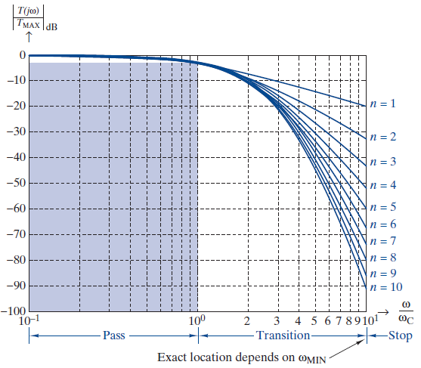
Filters Design
Filter design from specifications:
1. First order cascade low pass

Slide 28
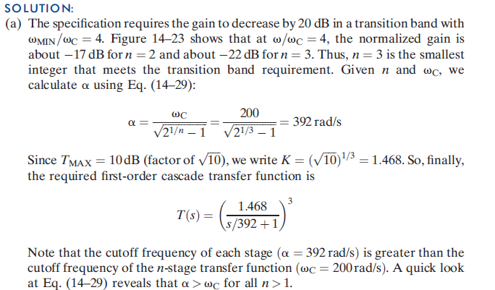
Filters Design
Filter design from specifications:
1. First order cascade low pass example

Slide 29
Filters Design
Filter design from specifications:
2. Butterworth low pass

