Slide 1
Electrical Engineering Department
Network Analysis II
ENEE 335
3 Credit Hours
Second Semester 2014
Instructor : Dr. Atheer Barghouthi
Date : 24.02.2014

Slide 2
Intended Learning Outcomes (ILO’s)
To be able to apply the linear network analysis methods in the Laplace domain, (mesh analysis, node analysis, and network theorems and circuits transformation).
To be able to apply the circuit synthesis methods in the implementation of LTI systems (transfer functions).
To understand two ports elements representation.
To be able to solve circuits with two ports elements
To be able to determine and analyze the frequency response of the systems
To be able to analyze different types of analog filters (active and passive).
To be able to design and implement different types of analog filters
To understand the graph representation of electric networks
To apply the graph theory concepts in solving electric networks
To be able to use CAD tools (ORCAD , MATLAB) in simulating and synthesizing electric networks
To acquire interaction and communication skills

Slide 3
Laplace transform
Laplace transform motivation
As we have learned, we can change the circuit from time domain to phasor(frequency domain) to make the circuit easier to analyse using sinusoidal signals. The draw back of this approach was that we were only able to analyse for the steady state. The transient analysis could not be obtained using phasor domain analysis. Additionally int time domain solving differential equations of higher orders is not an easy task to do. Transforming the circuit into laplace domain enables us to have a general solution of the circuit to any signal and for both the transient and steady state solution. In the laplace domain the equations generated are algebraic which is easier to deal with than differential equations´when the solution is obtained in the laplace domain it is inverted back to the time domain to find the final solution. Additionally, in laplace domain we are not limited to transients due to dc inputs only, but also more complicated input signals can be dealt with. Each component has current or voltage rating that should not be exceeded. Steady state can tell us that the component is operating within the limits, at the time the limit might be exceeded in transient. That is why transients are necessary to be analyzed. Additionally transients show the speed at which the circuit reaches the steady state which is important in many applications. One additional advantage, the laplace domain provide the total solution in one step and not two (forced and natural responses)

Slide 4
Laplace transform
Laplace transform review
This is a unilateral laplace transform which we will consider. Bilateral laplace where the lower integration limit is minus infinity is of no interest for our systems as we care only about causal systems.
The inverse laplace transform is of complex nature, as a result we will not use it to calculate inverses but we will use look up tables.

Slide 5
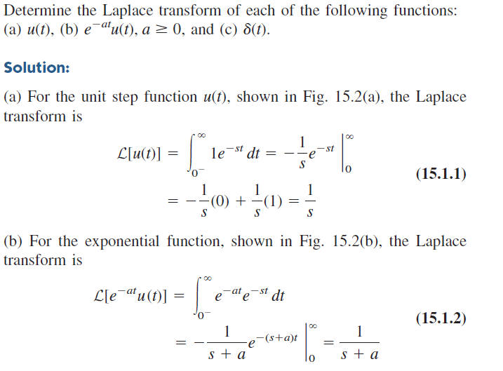
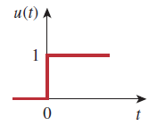
Laplace transform
Laplace transform review
To guruantee that what we use is unilateral, the function is normally multiplied by step function.

Slide 6
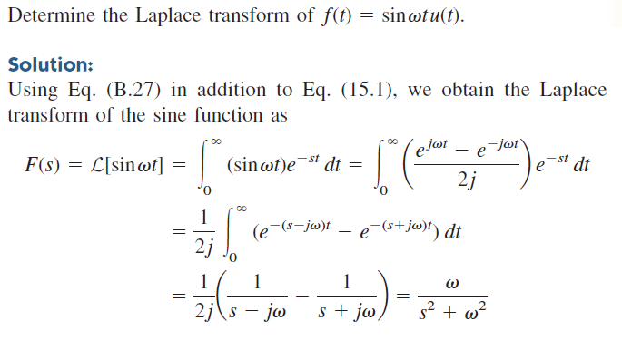
Laplace transform
Laplace transform review

Slide 7
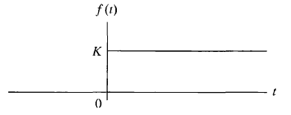
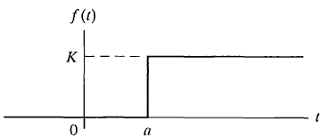
Laplace transform
Singularity functions
Step function

Slide 8
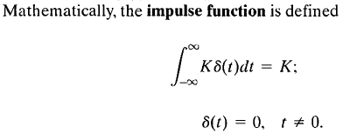
Laplace transform
Singularity functions
Sometimes the derivative function of the derivative needs to be defined in order for the derivative of the function to have laplace transform. For that we use impulse function.

Slide 9
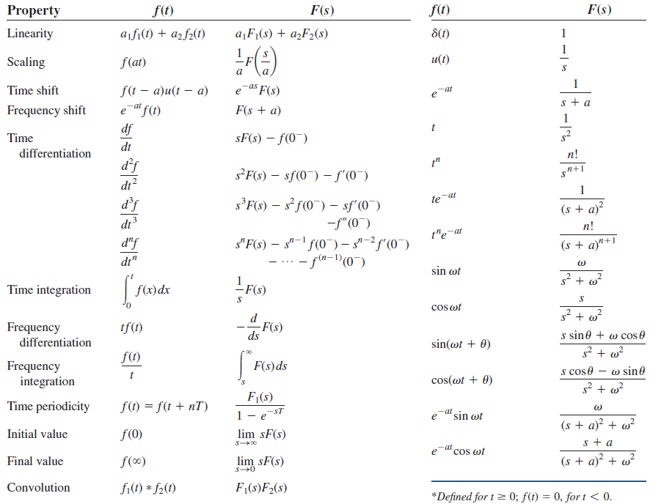
Laplace transform
Laplace transform properties (functional and operational)

Slide 10
Laplace transform
Inverse Laplace transform: we avoid using the complex integral of the inverse laplace by using the operational and functional properties of the transforms.
Having a specific laplace domain function, we can use partial fraction technique to find the inverse.
N(s): Numerator
D(s): Denominator
Poles are the roots of the denominator
Having a specific laplace domain function, we can use partial fraction technique to find the inverse. And then use the table to get back to the time domain.
Please review the four cases of partial fraction: simple poles, repeated poles
complex poles and repeated complex poles

Slide 11
Laplace transform
Initial and final value theorems: Before making the effort to perform the inverse transform of a response in the laplace domain, it is better to check whether it agrees with the expected behaviour of the system or not. And if it does agree, then we perform the transform. To check that we use the initial and final value theorems.
initial value theorem()
initial value theorem

Slide 12
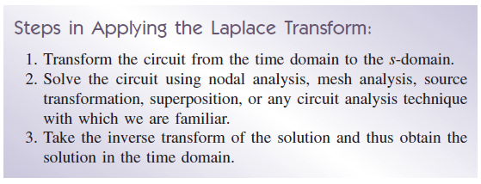
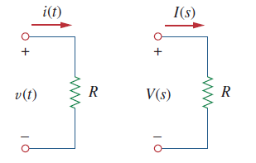
Laplace transform
Steps for solving the circuit in laplace domain
Component models in the laplace domain
Resistor:
What is the unit of I(s) and V(s).

Slide 13
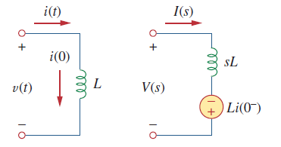
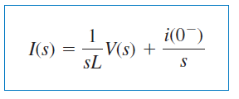
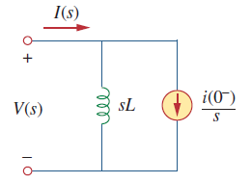
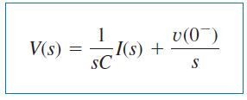
Laplace transform
Components in the laplace domain
Inductor:
Capacitor:

Slide 14
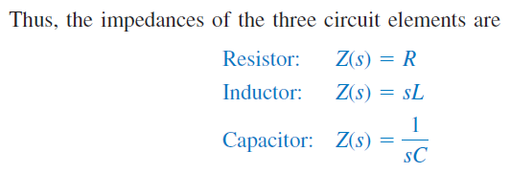
Laplace transform
When the initial condition is zero
Impedances in the laplace domain: they are defined as:
Addmittance:
Dependent sources

Slide 15
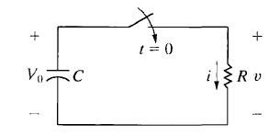
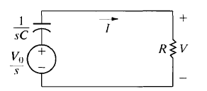
Laplace transform
Natural response of RC circuit ( in time domain and laplace domain):
Test using initial and final value theorems!!

Slide 16
Laplace transform
Example

Slide 17
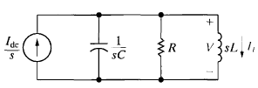
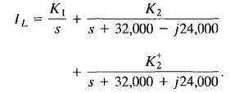
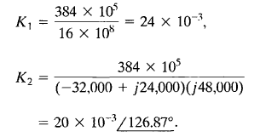
Laplace transform
Step response of parallel RLC
Nodal analysis:

Slide 18
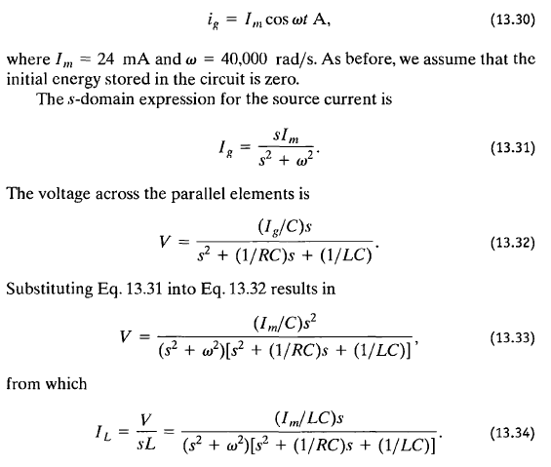
Laplace transform
Transient response of parallel RLC sinusoidal input

Slide 19
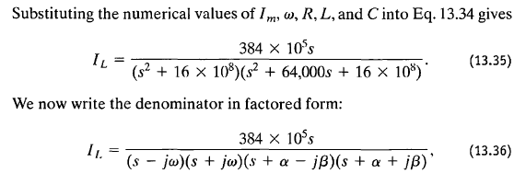
Laplace transform
Transient response of parallel RLC sinusoidal input

Slide 20
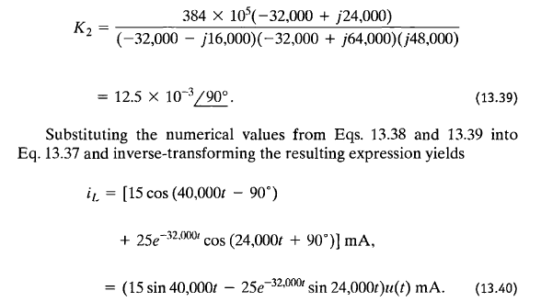
Laplace transform
Transient response of parallel RLC sinusoidal input

Slide 21
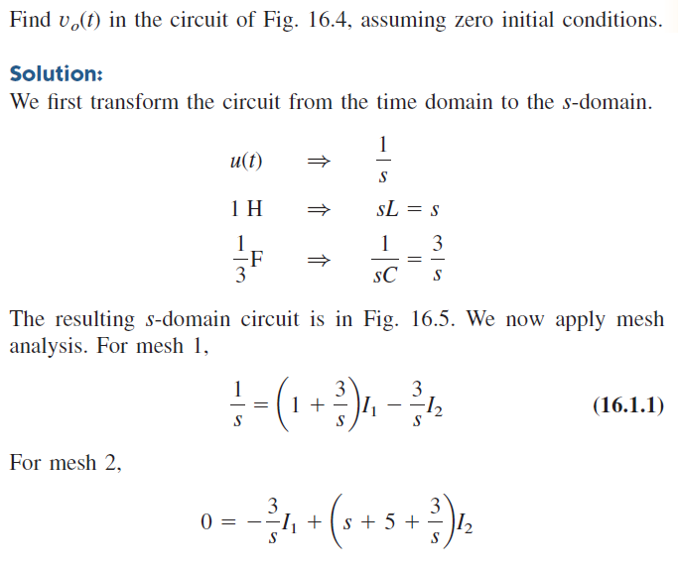
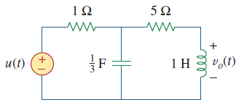
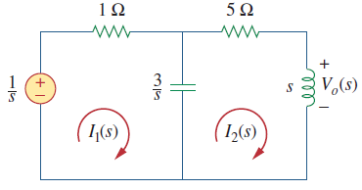
Laplace transform
Example 1:

Slide 22
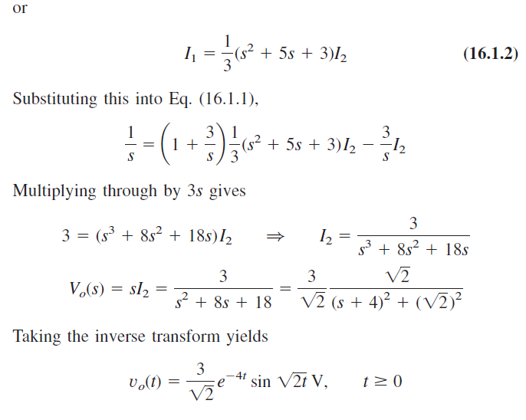
Laplace transform
Example 1:

Slide 23
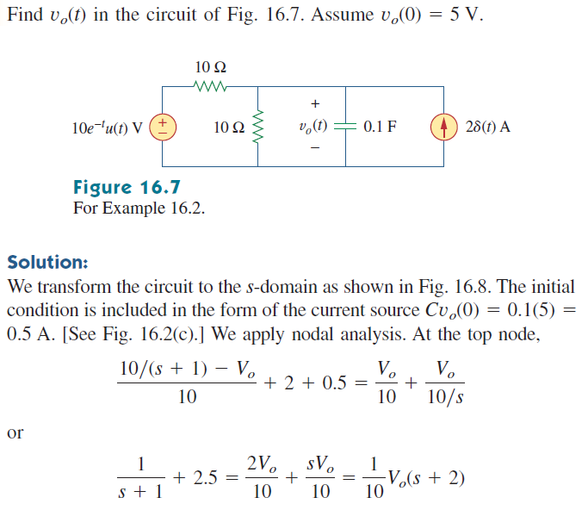
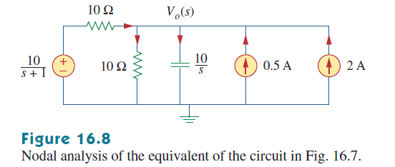
Laplace transform
Example 2:

Slide 24
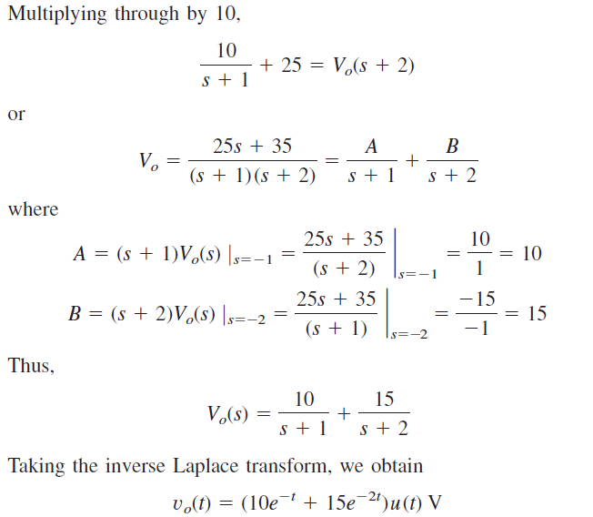
Laplace transform
Example 2:

Slide 25
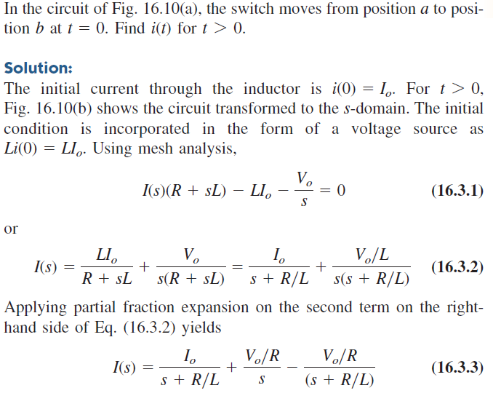
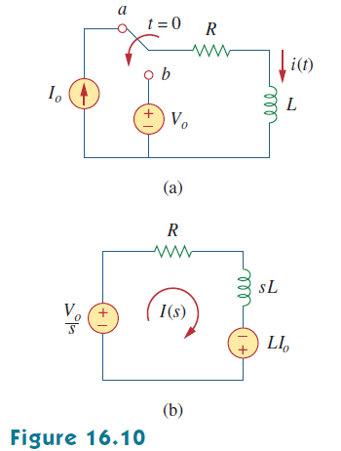
Laplace transform
Example 3:

Slide 26
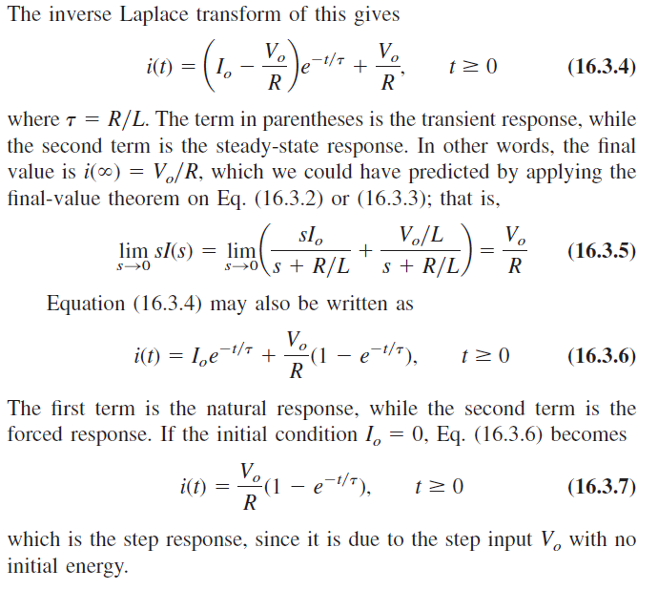
Laplace transform
Example 3:

Slide 27
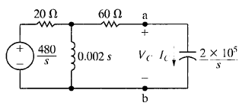
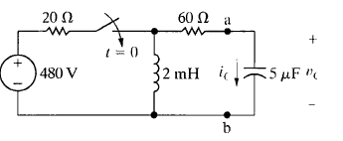
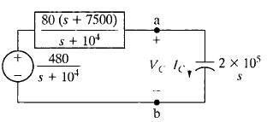
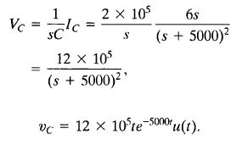
Laplace transform
Thevenin‘s equivalent circuit:

Slide 28
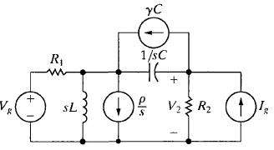
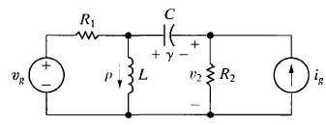
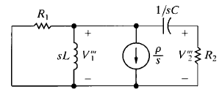
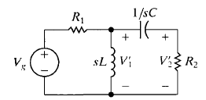
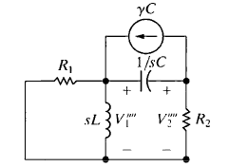
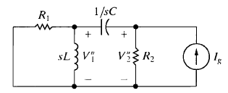
Laplace transform
Superposition theory
Source 1:
Source 3:
Source 2:
Source 4:

Slide 29
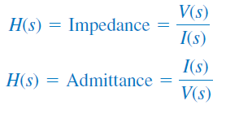
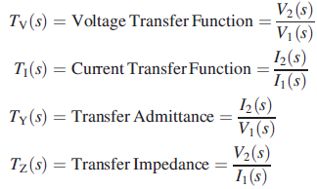
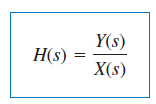
Laplace transform
Network Functions (Transfer functions and input impedance)
Driving point impedance or admittance ( voltage to current on the same port.

Slide 30
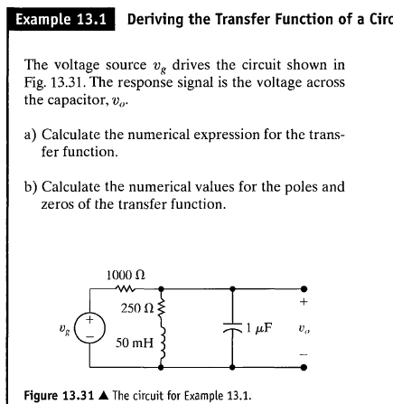
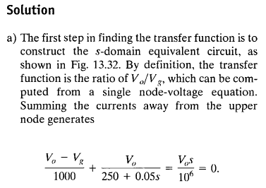
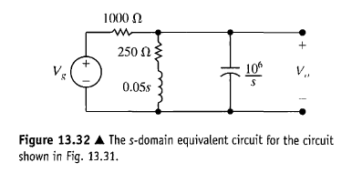
Laplace transform
The Transfer Function Example:

Slide 31
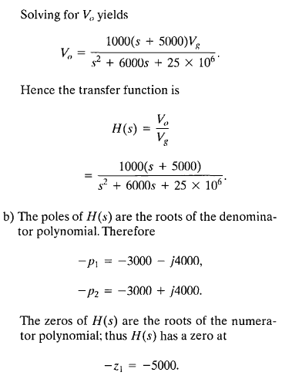
Laplace transform
The Transfer Function Example:
Important

Slide 32
Laplace transform
The transfer function in partial fraction: The transfer function is a rational function and can be expanded in partial fraction, the poles resulting from the transfer function are responsible for the transient effect in the response. But the input poles are responsible for the steady state.
Can there be transient response without initial conditions?
Can there be natural response without initial conditions?
Pole zero diagrams
Comment on impulse responce and time invariance.

Slide 33
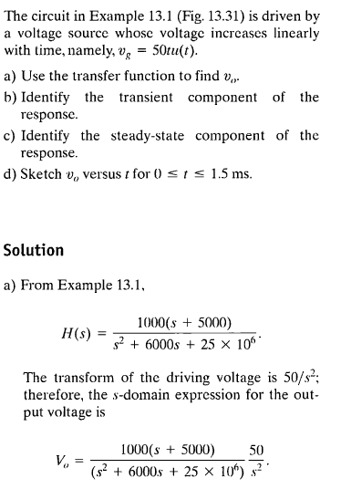
Laplace transform

Slide 34
Laplace transform

Slide 35
Laplace transform
The transfer function and the steady state response

Slide 36
Laplace transform
The transfer function and the steady state response

Slide 37
Laplace transform
How to generate impulses:

Slide 38
Laplace transform
How to generate impulses:

Slide 39
Laplace transform
Benefits of impulse and impulse response:
Any signal can be represented by an infinite number of impulses given by
Knowing how the system respond to one impulse can lead to knowing the response to any signal, given that the system is linear and time invariant. This result is given by the convolution integral.

Slide 40
Laplace transform
Impulse sources:

Slide 41
Laplace transform
Impulse sources: as if you have initial condition on the inductor released

Slide 42
Laplace transform
Impulse sources:

