Slide 1
Electrical Engineering Department
Signals & Systems
ENEE 334
3 Credit Hours
First Semester 2014/2015
Instructor : Dr. Atheer Barghouthi
Date : 08.09.2014

Slide 2
Intended Learning Outcomes (ILO’s)
To understand the concepts of signals and systems for both continuous and discrete case
To be able to define the proper signal model and to classify signals
To be able to classify the systems and their characteristics
To be able to determine and analyze system response for the elementary signals
To be able to apply the Laplace transform in system analysis
To be able to understand and determine the Fourier series and transform
To be able to determine and analyze the system frequency response
To be able to understand discrete signals and systems models
To be able to define LTI discrete system using difference equations and transfer functions
To be able to convert between continuous and discrete signals and system models
To be able to understand the Z-transform and its applications in signal and systems
To be able to understand practical applications of signals and systems
To understand and apply the integral form of system solution(convolution)

Slide 3
Signals & Systems
A signal is a physical quantity that changes with one independent variable or more (time, space)
A signal is represented and modeled as a mathmetical function of an independent variable. Examples of signals: Voltage v(t), Temperature T(t), Pressure P(t), Image I(x,y)
A system is an interconnection of components that achieves a specific task. A system can consist of an interconnection of subsystems where each subsystem achieves a certain function and the system all together achieves a tast or more than one task. A system is modeled in terms of mathematical equations (algebraic equations,differential equations, difference equation).
For systems to be useful, they need signals to excite them (input to them), and they process input signal to generate another processed signal or signals (signal processing and processors)
The goal is to develop mathmetical models for signals and systems that helps in analysing the response of a system to a certain input signal.
We will begin by studying different types of signals and there classifications.

Slide 4
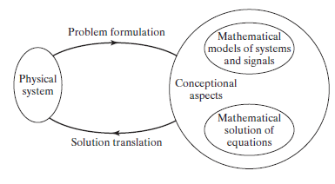
Signals & Systems
In order to predict and understand the behaviour of real world systems on the physical signals exciting them, we normally use conceptual models which is a way to simplify and represent the real system with another mathematical representation. Understanding this model helps in predicting the system behaviour for different excitations.
In modeling, signals are modeled by mathematical functions.
In modeling, systems are modeled by mathematical equations that operate on the input signals to the system, like differential equations, or difference equations, convolution integral
We are concerned with solving the system equations when excited by a specific signal, which gives us the expected response of the real system when excited by the physical signal.

Slide 5
Signal Classification (models)
1. Continuous or discrete
Continuous time continuous amplitude (Analog signal)
Continuous time discrete amplitude (Digital signal)
Discrete time continuous amplitude (Discrete signal)
Discrete time discrete amplitude (Digital signal, signal processing)
An analog signal can only be processed by analog systems, a digital signal can only be
processed by a digital system. To process a digital signal with an analog system and digital
to analog conversion is needed. To process an analog signal with a digital system analog to
digital conversion is needed.
Digital systems consists of digital gates, flip flops...
Analog systems consisto of R, L, C, Operational amplifiers...
Mixed (digital and analog) systems for converters
2. Periodic or aperiodic
3. Energy or Power
4. Deterministic or Random

Slide 6
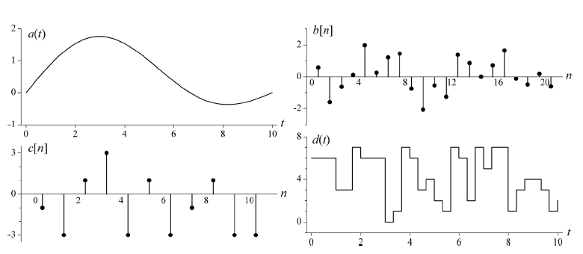
Signal Classification
Continuous time continuous
amplitude (Continuous Analog Signal)
Discrete time, continuous
amplitude (Discrete Analog Signal)
Discrete time discrete amplitude
(Discrete Digital Signal, Signal Processing)
Continuous time discrete
amplitude (Continuous Digital Signal)

Slide 7
Signal Classification
2. Periodic or Aperiodic
A signal x(t) is periodic, it should have infinite extent:
If x(t)=x(t+T) for all time, then the signal is periodic with a fundamental period of T,
otherwise the signal is Aperiodic.
If x(t) has a period T then it is also periodic for nT where n is integer, that is why T is
called the Fundamental period (smallest one)
Example: x(t)= cos(wt), take T=2*pi/w => x(t+T)= cos(w(t+ 2pi/w))= coswt for all time
The sum of two or more sinusoids is periodic only if the ratio between their periods is rational number
A rational number is a number which can be written as A/B, where A and B are both integers. Pi is irrational.
Example: x(t)= sin(10*pi*t)+ sin (20*pi*t) and y(t)= sin(10*pi*t)+ sin (31t)
x(t) is periodic T1=1/5, T2=1/10, T2/T1=1/2 rational => it is periodic
y(t) is Aperiodic T1=1/5, T2=2*pi/31, T2/T1= 10*pi/31 irrational => Aperiodic

Slide 8
Signal Classification
2. Periodic or Aperiodic
Example: x(t)= sin(10*pi*t)+ sin (20*pi*t) and y(t)= sin(10*pi*t)+ sin (31t)
x(t) is periodic T1=1/5, T2=1/10, T2/T1=1/2 rational => it is periodic
y(t) is Aperiodic T1=1/5, T2=2*pi/31, T2/T1= 10*pi/31 irrational => Aperiodic
To calculate the period of the summation of two sinusoids if it is periodic:
For two sinusoids take the ratio T2/T1=N/M, simplify the ration N/M, then the fundamental perios is MT2=NT1=T0
How is it done for three sinudoids?

Slide 9
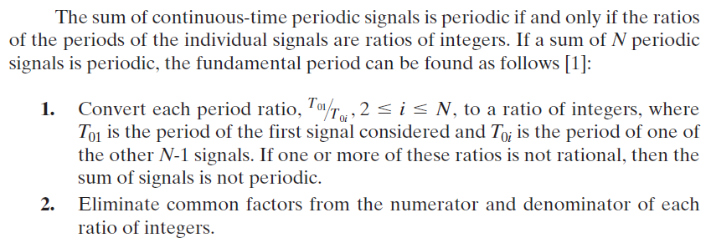
Signal Classification
2. Periodic or Aperiodic
How is it done for three or more sinudoids?

Slide 10
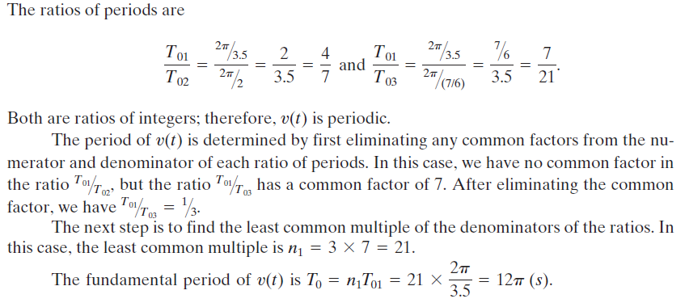
Signal Classification
2. Periodic or Aperiodic

Slide 11
Signal Classification
2. Periodic or Aperiodic

Slide 12
Signal Classification
3. Energy or Power or neither: notice that the magnitude is taken inside th integral if the signal is complex
Energy of a signal f(t) is defined as
Energy within a specific time interval [T₁, T₂]
A signal is said to be energy signal if it has finite energy over all time => P = 0
A signal is said to be power signal if it has finite power over all time => E = infinity
If a signal has neither finite power nor finite energy it is classified as neither. Ex. x(t) = t
Most of the periodic signals are power signals and its power can be calculated easily from
Ex: is Acos(wt) energy or power signal?
It is power signal, the value of the power integral is (A^2)/2

Slide 13
Signal Classification
Note: an energy signal can have power if we look at only a range of time and not all time
Note: a power signal can have non infinity if we look at only a range of time and not all time.
4. Deterministic or Random
Deterministic signals are totally specified at any point in time by a function
x(t)= cos(t), x(t)= 1/t
random signals can not be specified at any point in time by a function and take random
values at a given instant in time, like noise

Slide 14
Operations on Signals
1. Time shift x(t-b) is a shifted version of x(t), like in radar
2. Time scaling x(at) compresses the signal if a>1 and stretches it if a<1
To do this just scale the axis of the original signal by (1/a)
3. Time reversal x(-t) is a reflected version of x(t)
4. Time transformation x(at+b) is a shifted and time scaled version of x(t), the shape of the signal is preserved. To plot this signal from x(t), we shift by b and then we multiply the values on the axis by 1/a, after that we redraw the plot on the new axis.
5. Amplitude transformation (amplitude scaling a, shifting b) y(t)= ax(t)+b

Slide 15
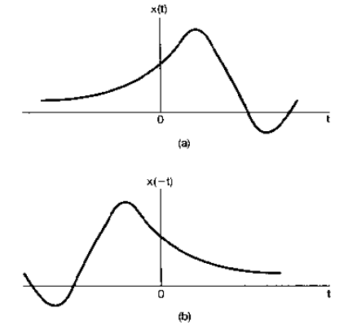
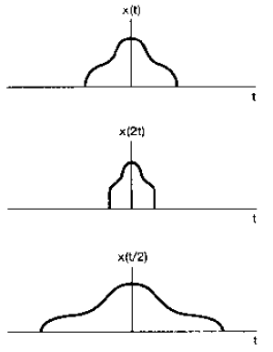
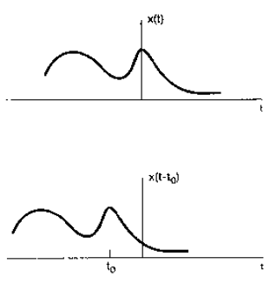
Operations on Signals
Time scaling
Time shift
Time reversal
Ex.Tape recording

Slide 16
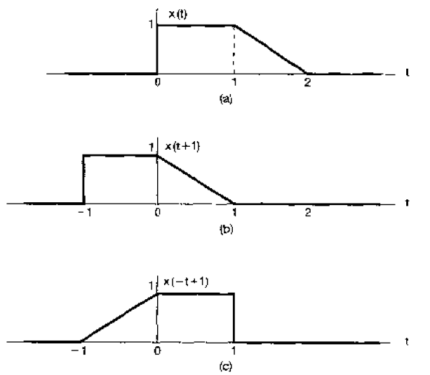
Operations on Signals
Test your understanding by drawing each case alone and compare your drawing with the result given:

Slide 17
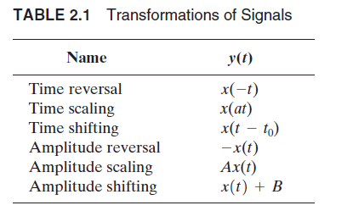
Operations on Signals

Slide 18
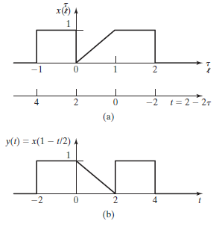
Operations on Signals
Another way for doing time transformation:

Slide 19
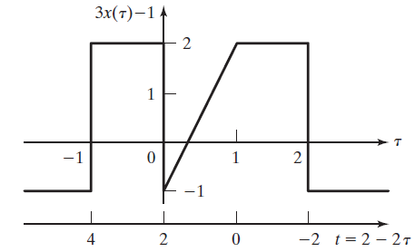
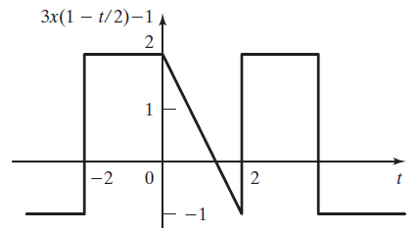
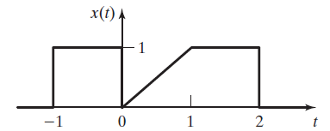
Operations on Signals

Slide 20
Common Signals
Some signals can make the understanding, analysis, and design of the systems easier
a. Exponentials: where c and a can bea real or complex
The real exponential signal decaying or growing: the importance of this signal comes from
the solution of first order ordinary differential equation systems such as RL, RC circuits.

Slide 21
Common Signals
The periodic complex exponential signal (Represented by Phasors in phasor domain), benefits of using the complex exponential over the real cosine or sine, is that the operations are performed easily on exponentials (integration, differentiation) which makes the analysis easier.
Euler‘s Formula:
Periodicity:
Definition:

Slide 22
Common Signals

Slide 23
Common Signals
Power included in complex exponential and its relation to the power in cosine:
Notice that for calculating the power and energy of complex signals the magnitude of the signal is included in the integration and not the signal it self.
The total normalized power to 1 ohm is:

Slide 24
Common Signals
Frequency domain representation of compex exponentials and the concept of spectrum or spectral density:
A signal can be equivalently expressed in frequency domain other than time domain. This representation can make analysis easier as will be seen in the coming chapters. The complex exponential, sines, and cosines are one of the most important categories of signals, that is why we will do their frequency representation. In the future we will learn this transformation for any signal.
Time domain and frequency domain of sines, cosines and complex exponential:
Time domain
Phasor or frequency domain
This can be represented in frequency domain as amplitude and phase spectrum, this shows
The amplitude and phase as a plot with the frequency axis.

Slide 25
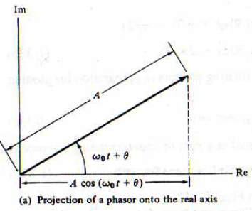
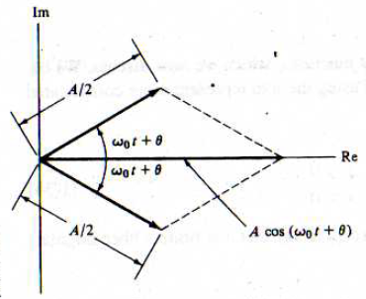
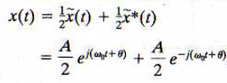
Common Signals
Frequency domain representation of compex exponentials and the concept of spectrum or spectral density:
The concept of rotating phasors:
One complex vector rotating with the speed of the angular frequency
Two complex vectors rotating with the speed of the angular frequency and minus the angular frequency

Slide 26
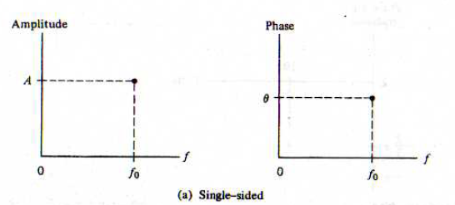
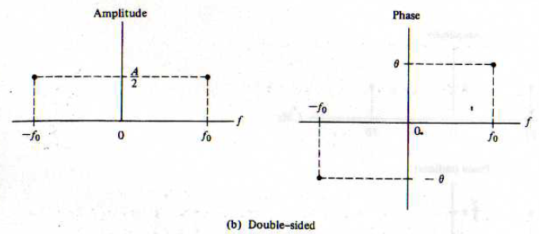
Common Signals
Frequency domain representation of compex exponentials and the concept of spectrum or spectral density:
Double side band DSB and single side band SSB amplitude and phase spectrum:
Note: negative frequency does not exist in real world, they are only model to make things symmetric and easier

Slide 27
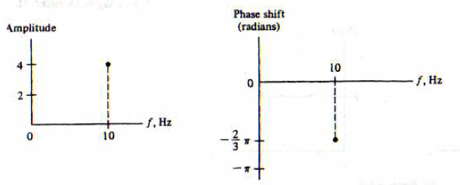
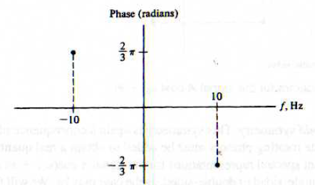
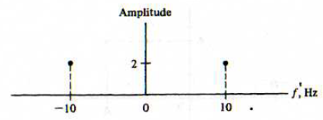
Common Signals
Examples of spectrum representation:
SSB
DSB

Slide 28
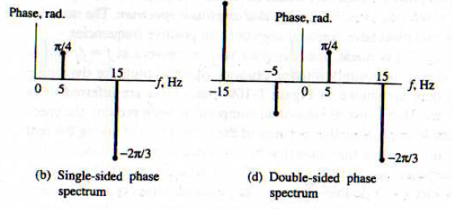
Common Signals
Examples of spectrum representation:

Slide 29
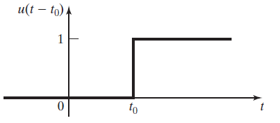
Common Signals
b. The singularity functions: Singularity the name comes from the discontinuity of the functions or their derivatives at a specific point which is called singularity point. This class of signals helps making the analysis of systems easier. In addition, other signals can be written as superposition of singularity functions.
1. The unit step function:
Notice that the step function is undefined at 0 which is singularity point.
Integrating a singularity function gives a lower index

Slide 30
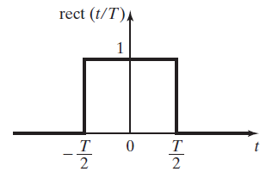
Common Signals
The unit step function is often used to switch other signals, Ex:
The rectangular signal can be defined as superposition of step functions:

Slide 31
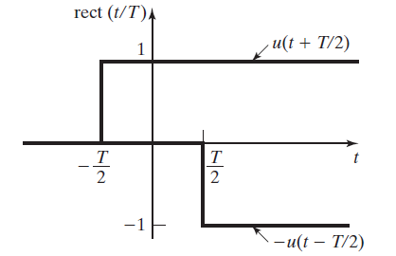
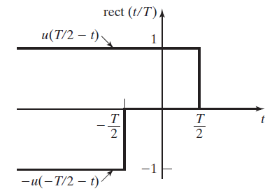
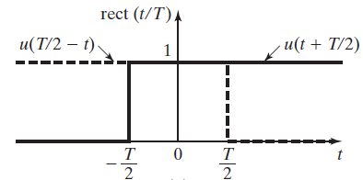
Common Signals

Slide 32
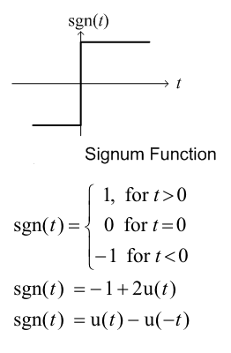
Common Signals
Signum function definition:

Slide 33
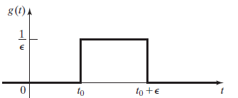
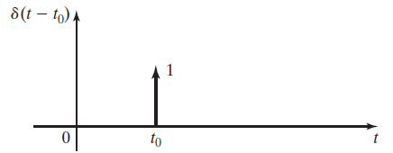
Common Signals
2. The unit impulse function (dirac, delta): this is useful in defining the derivative at discontinuity, as it is thederivative of the step function, any signal can be written as a linear combination of the impulse function:
The value of the impulse function is zero every where, but the origin. At the origin it is infinite. The impulse signal has unity area:

Slide 34
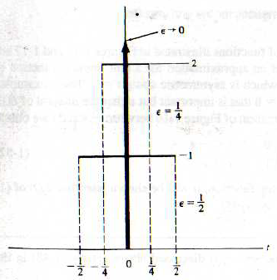
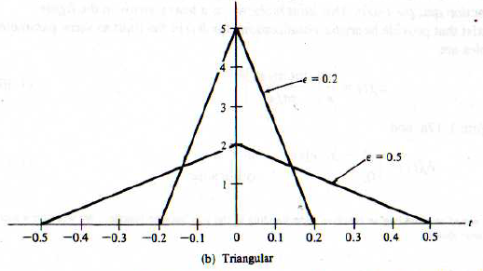
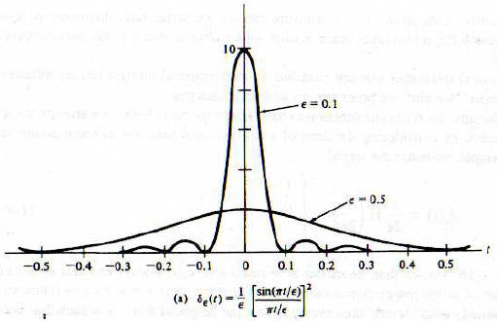
Common Signals
Possible definitions of unit impulse signal

Slide 35
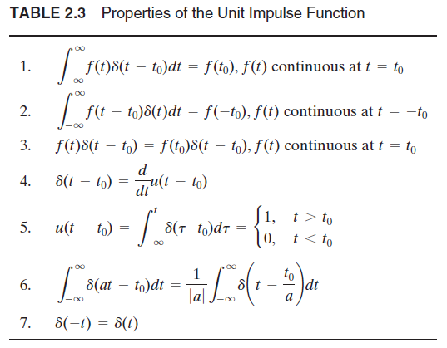
Common Signals
Properties of unit impulse:
Notice that t₀ should be in the integral range otherwise the result is 0
Convolution property
Derivative :

Slide 36
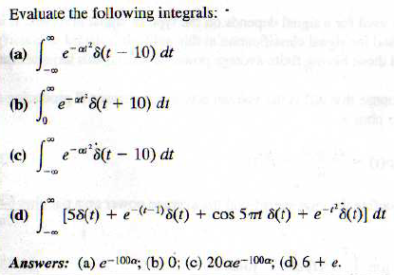
Common Signals
Examples applying impulse properties:

Slide 37
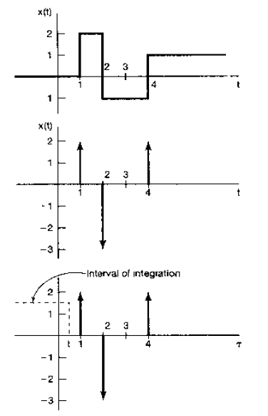
Common Signals
Unit impulse as the derivative of step functions:

Slide 38
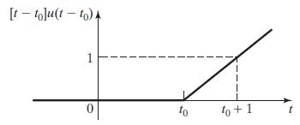
Common Signals
3. The unit ramp function: the integral of the unit step function
r(t-t₀)=u₋₂(t-t₀) =(t-t₀)u(t-t₀)

Slide 39
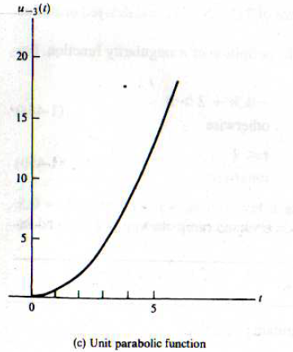
Common Signals
3. The parabolic function: the integral of the ramp function

Slide 40
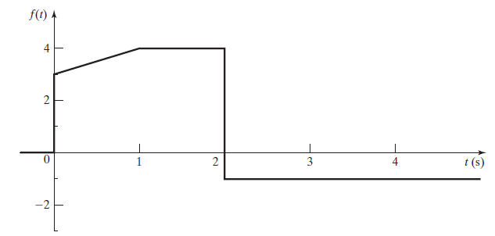
Common Signals
Representing waveforms in terms of singularity functions:
Drawing a function composed of singulartiy functions
Deriving a singularity function from a plot.

Slide 41
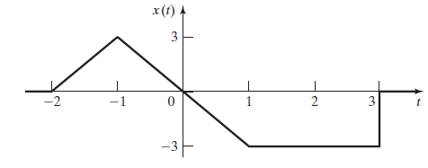
Common Signals
Representing waveforms in terms of singularity functions:
2. Deriving a singularity function from a plot.

Slide 42
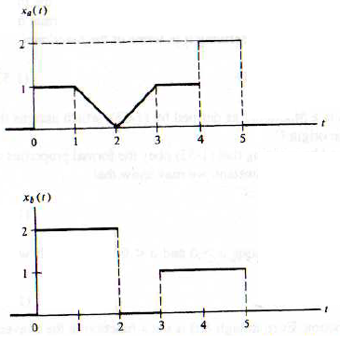
Common Signals
Representing waveforms in terms of singularity functions:
2. Deriving a singularity function from a plot: two ways, the addition of singularity functions, or switching them by the step function(multiplication)

Slide 43
Common Signals
Frequency domain representation of compex exponentials and the concept of spectrum or spectral density:
The power spectral density of a power signal:
To find the power from the frequency domain representation of the signal a power spectral denstiy function is defined whose integral is the total power. The unit of the power spectral density is Watt/Hz.
The energy spectral density of an energy signal:To find the energy from the frequency domain representation of the signal an energy spectral denstiy function is defined whose integral is the total power. The unit of the power spectral density is Joule/Hz.

Slide 44
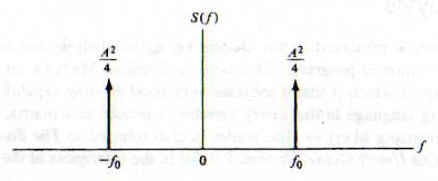
Common Signals
Frequency domain representation of compex exponentials and the concept of spectrum or spectral density:
The power spectral density of a power signal example:to get the power spectrum from the amplitude spectrum we square the rms value of the amplitude for SSB and square the amplitude in DSB:
Power spectrum in
= (A^2)/2

Slide 45
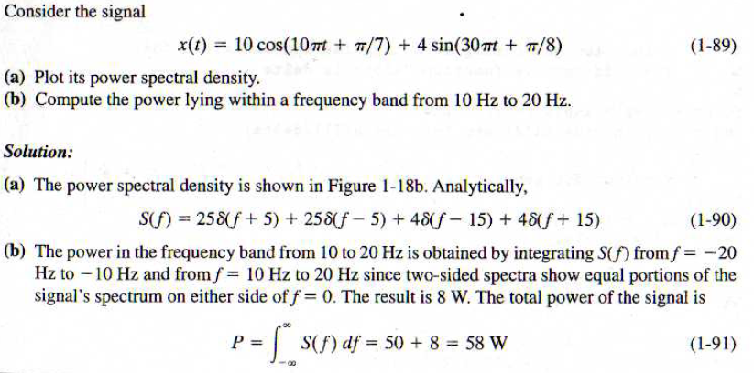
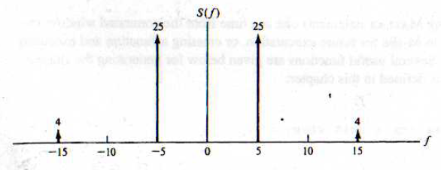
Common Signals
Example power spectrum and total power:

Slide 46
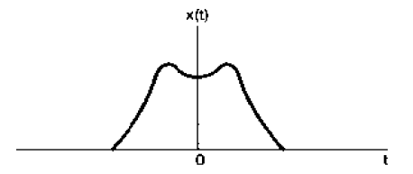
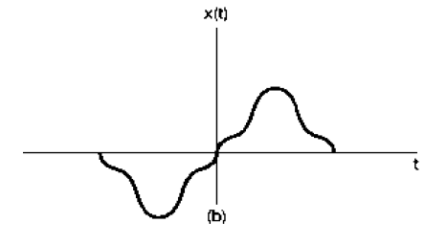
Signal Characteristics
Even and Odd signals:
A signal is said to be even if x(-t)=x(t)
A signal is said to be odd if x(-t)=- x(t)

Slide 47
Signal Characteristics
Even and Odd signals:
Solving the two equations for the even and odd parts:
Average value of signal definition

Slide 48
Signal Characteristics
Orthogonality:
In vetor space a basis is a set of independent functions that is able to span the vector space by linear combinations.
In the signal space, orthogonal signals can act as basis for a corresponding signal space.
Orthogonal signals: two signals are said to be orthogonal over the period [a, b] if the integral of their product over this interval is zero.
For periodic signals:

Slide 49
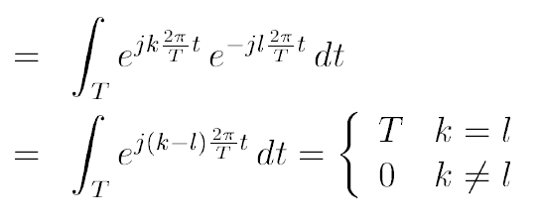
Signal Characteristics
Orthogonality: Harmonically related complex exponentials are orthogonal.
When k is not equal l the signals are orthogonal
When n is not equal m the signals are orthogonal

