Slide 1
Electrical Engineering Department
Signals & Systems
ENEE 334
3 Credit Hours
Second Semester 2014
Instructor : Dr. Atheer Barghouthi
Date : 01.07.2014

Slide 2
Intended Learning Outcomes (ILO’s)
To understand the concepts of signals and systems for both continuous and discrete case
To be able to define the proper signal model and to classify signals
To be able to classify the systems and their characteristics
To be able to determine and analyze system response for the elementary signals
To be able to apply the Laplace transform in system analysis
To be able to understand and determine the Fourier series and transform
To be able to determine and analyze the system frequency response
To be able to understand discrete signals and systems models
To be able to define LTI discrete system using difference equations and transfer functions
To be able to convert between continuous and discrete signals and system models
To be able to understand the Z-transform and its applications in signal and systems
To be able to understand practical applications of signals and systems
To understand and apply the integral form of system solution(convolution)

Slide 3
Signals & Systems
A system is an interconnection of components that achieves a specific task. A system can consist of an interconnection of subsystems where each subsystem achieves a certain function and the system all together achieves a tast or more than one task. A system is modeled in terms of mathematical equations.
For systems to be useful, they need signals to excite them, and they process and input signal to generate another processed signal or signals (signal processing and processors)
We developed signal models in the previous chapter, now we will conside system mathmetical models that helps in analysing the response of a system to a certain input signal.
System analysis: given a system and excitation signal, predict the outputs.
System design: given a desired response and excitation, design the system to achieve that.
Linear time invariant (LTI) systems are one of the most important categories which will be considered in this course, powerful analysis techniques exist for these systems, many real world systems behave in this way, and knowing how to solve such systems suggest methods to solve nonlinear systems.

Slide 4
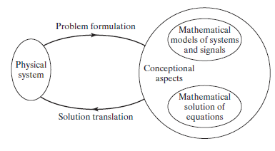
Signals & Systems
In order to predict and understand the behaviour of real world systems on the physical signals exciting them, we normally use conceptual models which is a way to simplify and represent the real system with another mathematical representation. Understanding this model helps in predicting the system behavious for different excitations.
In modeling, systems are modeled by mathematical equations the operate on the input signals to the system, like differential equations, or difference equations( fordisctrete systems), convolution integral, and frequency domain analysis. Systems map the input signals into output signals.
We are concerned with solving the system equations when excited by a specific signal, which gives us the expected response of the real system when excited by the physical signal.

Slide 5
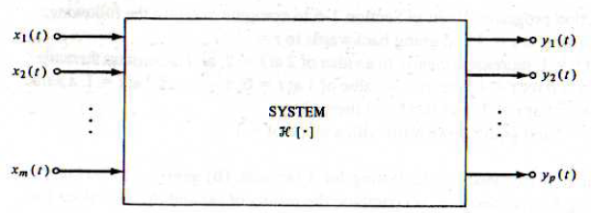
Signals & Systems
System representation: inputs are called causes or stumuli, outputs are called response or effects.

Slide 6
Signals & Systems
Examples of systems descriptions, mapping of input to output using operations:
A system can be described by a differential equations (like RC, RLC circuits). The differential equation must be solved for the forced and natural responses (zero input and zero state responses). The general model of such systems
In an LTI system, the coefficients in the differential equation must be constant, otherwise,
it will be time variant. Additianally, to be linear, the coeffiecients must not depend on the
the dependent variable
The order of the system is the highest derivative of the dependent variable

Slide 7
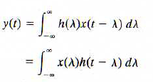
Signals & Systems
2. Instantaneous system, non-dynamic: Algebraic equations
3. LTI systems with given impulse response, the convolution integral can be used

Slide 8
Signals & Systems
Three basic methods for finding the response f LTI system:
Solving differential equations with constant coeffiecients (like RC, RLC circuits)
For the forced and natural response or the zero input and zero state responses.
2. Performing the superposition (convolution) integral for zero initial conditions (to be learnt in this chapter)
3. Frequency domain analysis using Fourier‘s and Laplace‘s transforms.(to be learnt in coming chapters)

Slide 9
Signals & Systems
Systems Properties:
Continuous & discrete
Time invariant(fixed) and time variant
Linear and nonlinear
Causal and non causal
Dynamic and Instantaneous (memoryless, zero memory)
Invertible system: One to one function

Slide 10
Signals & Systems
Systems Properties:
1. Continuous & discrete: analog and digital systems
2. Time invariant(fixed) and time variant: does the system change with time or not? In time invariant system a shift in the input signal only shifts the output signal.

Slide 11
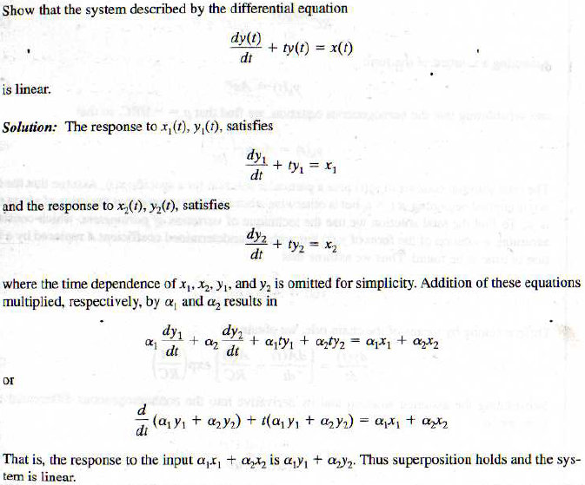
Signals & Systems
Systems Properties:
3. Linear and nonlinear: the superposition principle applies.

Slide 12
Signals & Systems
Systems Properties:
4. Causal and non causal: The system cannot depend on future values of the input. As a result, if the two input are equal before t_{0,} the system response should be equal, regardless of what happens after t_{0.}
5. Dynamic and Instantaneous (memoryless, zero memory) systems: Instantaneous systems has no memory and thus depend only on the present values of the input. Dynamic systems has memory and depend on past and present values of the input

Slide 13
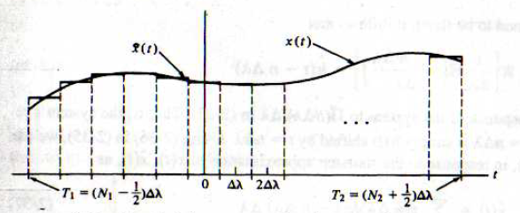
Convolution integral
For linear time invariant system with zero initial conditions, the system can be described by the convolution integral.
First the impulse response h(t) of the system must be found. The impulse response is the output of the system due to an impulse function applied at t=0. For causal system h(t)=0 when t<0, because there is no input for t<0, and in a causal system there should be no output if there is no input.
Any input to the system can be described as superposition of impulses:

Slide 14
Convolution integral
Assume the response to a rectangular pulse is named:
From linearity and time invariance the response to each pulse in the input can be found and superposition applied to find the total response:
Both are equivalent

Slide 15
Convolution integral
Properties of convolution:

Slide 16
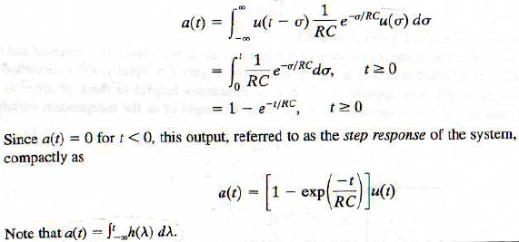
Convolution integral
If we have the impulse response of a system, we can predict its response to any input using the convolution integral, examples:

Slide 17
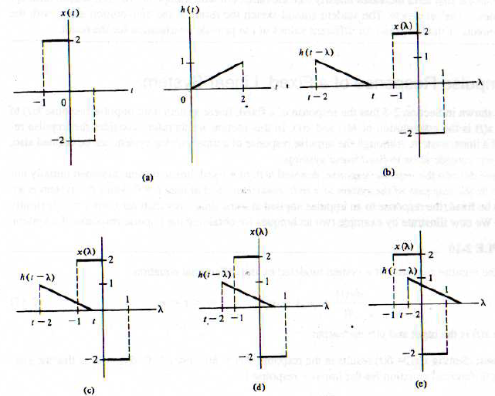
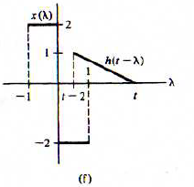
Convolution integral
Example: finding the convolution graphically:

Slide 18
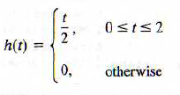
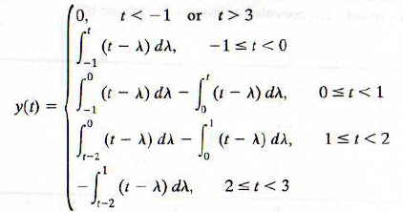
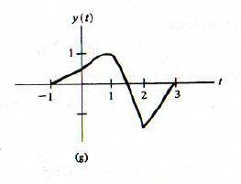
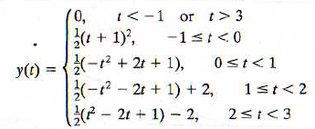
Convolution integral
Example: finding the convolution graphically:
=>

Slide 19
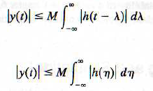
BIBO Stability
A system to work properly it must be stable. BIBO stability means bounded input must give a bounded output
bounded input
Sufficient and necessary condition: if h(t) is bounded, the system is BIBO stable. If h(t) is not bounded, system is BIBO unstable
To give bounded output

Slide 20
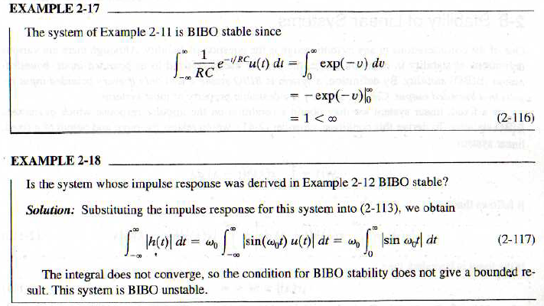
BIBO Stability
Examples:

Slide 21
Impulse response from ODE
Solving for the impulse response from a general differential equation LTI systems:
Example 1:
Example 2:
Example 3:

Slide 22
Eigen functions of linear systems and Frequency response of LTI

Slide 23
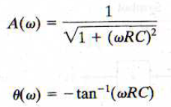
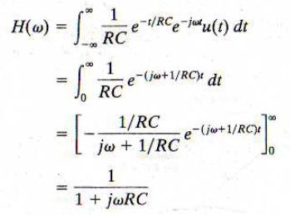
Eigen functions of linear systems and Frequency response of LTI
Example: find the frequency response of the following system described by h(t)

Slide 24
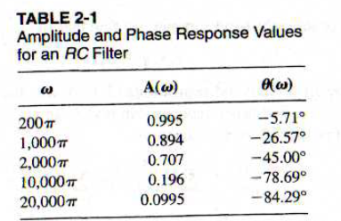
Eigen functions of linear systems and Frequency response of LTI
Example: find the frequency response of the following system described by h(t)

Slide 25
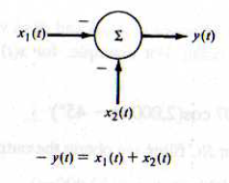
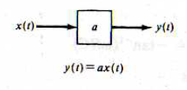
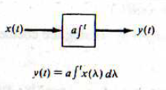
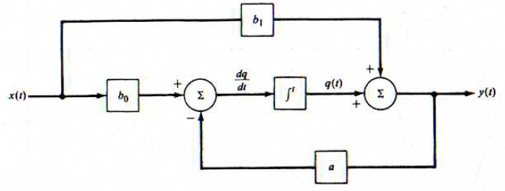
System modeling and simulation
This is normally used to implement the system using operational amplifiers or in system software programs like matlab simulink. To do this the system is divided into basic building blocks, adders, multipliers, integrators. Any nth order differential equation with constant coefficients can be build using this.
Reminder:
Even and odd parts of signals
Distortion in signals
Spectrum has no negative amp.

Slide 26
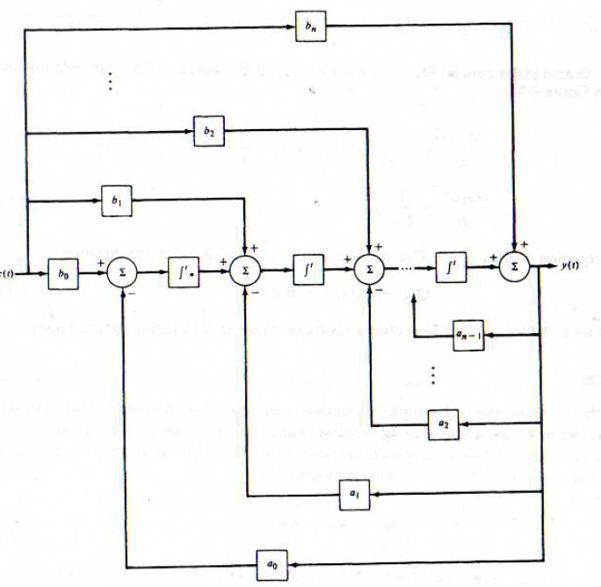
System modeling and simulation

