Slide 1
Electrical Engineering Department
Signals & Systems
ENEE 334
3 Credit Hours
Second Semester 2014
Instructor : Dr. Atheer Barghouthi
Date : 01.07.2014

Slide 2
Intended Learning Outcomes (ILO’s)
To understand the concepts of signals and systems for both continuous and discrete case
To be able to define the proper signal model and to classify signals
To be able to classify the systems and their characteristics
To be able to determine and analyze system response for the elementary signals
To be able to apply the Laplace transform in system analysis
To be able to understand and determine the Fourier series and transform
To be able to determine and analyze the system frequency response
To be able to understand discrete signals and systems models
To be able to define LTI discrete system using difference equations and transfer functions
To be able to convert between continuous and discrete signals and system models
To be able to understand the Z-transform and its applications in signal and systems
To be able to understand practical applications of signals and systems
To understand and apply the integral form of system solution(convolution)

Slide 3
Fourier Series
As was discussed in the previous chapter, the frequency domain can simplify the differential equation of an LTI system to algebraic equations which are easily solved. Knowing that the complex exponential and the cosine and sine are eigne functions of the linear system, the response to such functions is easily found be multiplying the amplitudes of the input and the amplitude response and adding the phases of the input and phase response of the system.
In this chapter we will find out that periodic power signals can be represented as a sum of either sines and cosines or complex exponentials which makes the calculation of the system response to such signals easy, by using the frequency domain presented in the precious chapter.
We will begin the chapter by showing qualitatively how the summation of sines and cosines with frequency which is a multiple of a fundamental frequency results in different periodic waveforms.
We will then find quantitatively the results of such representation (Fourier‘s series)

Slide 4
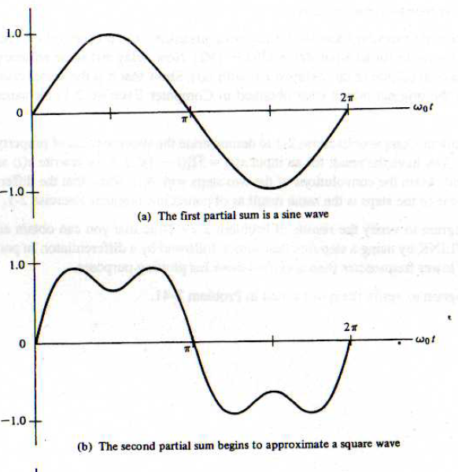
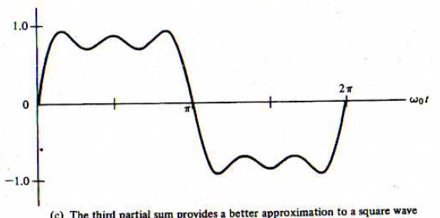
Fourier Series
As was discussed in the previous chapter, the frequency domain can simplify the

Slide 5
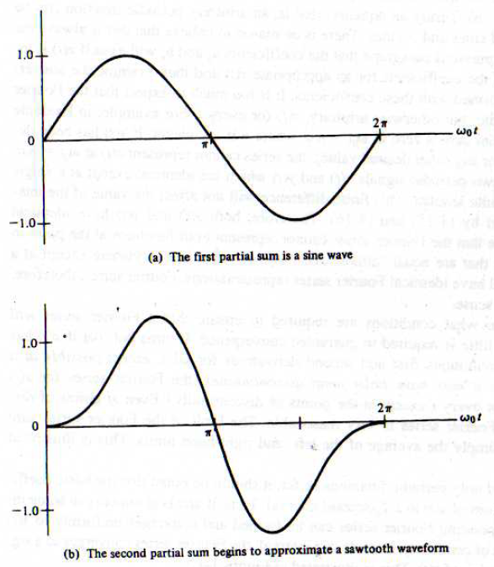
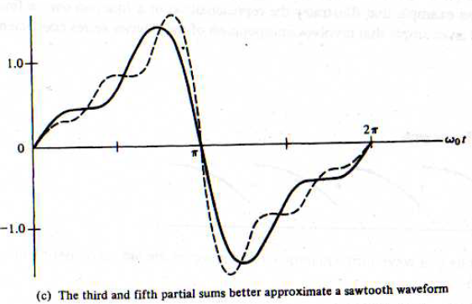
Fourier Series
As was discussed in the previous chapter, the frequency domain can simplify the

Slide 6
Trigonometric Fourier Series
The average value(remember the orthogonality of sines and cosines):
The cosinecoeffcients(remember the orthogonality of sines and cosines):

Slide 7
Trigonometric Fourier Series
The cosine coefficients(remember the orthogonality of sines and cosines):

Slide 8
Trigonometric Fourier Series
The cosine coefficients(remember the orthogonality of sines and cosines):
The sine coefficients(remember the orthogonality of sines and cosines):similarly

Slide 9
Trigonometric Fourier Series
Convergence criteria: If the periodic signal satisfies Dirichlet’s conditions. At continuity point the representation converges with zero error. At discontinuous point the Gibb’s Phenomenon is noticed were there is always oscillation near the discontinuity. At discontinuity the representation converges to the average value.

Slide 10
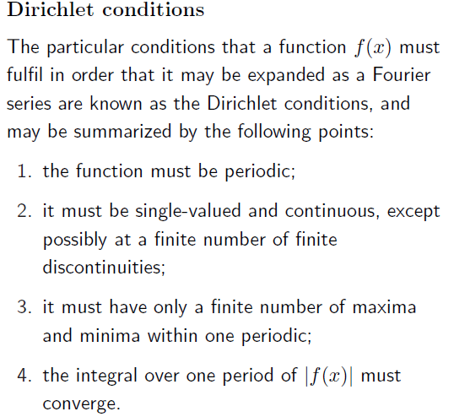
Trigonometric Fourier Series

Slide 11
Trigonometric Fourier Series
Fourier series for non periodic signals:

Slide 12
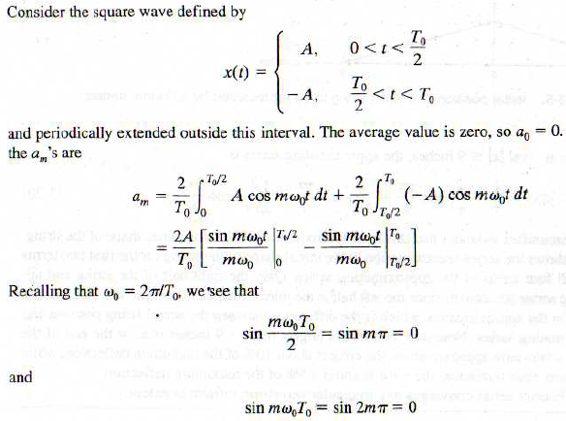
Trigonometric Fourier Series
Ex.:

Slide 13
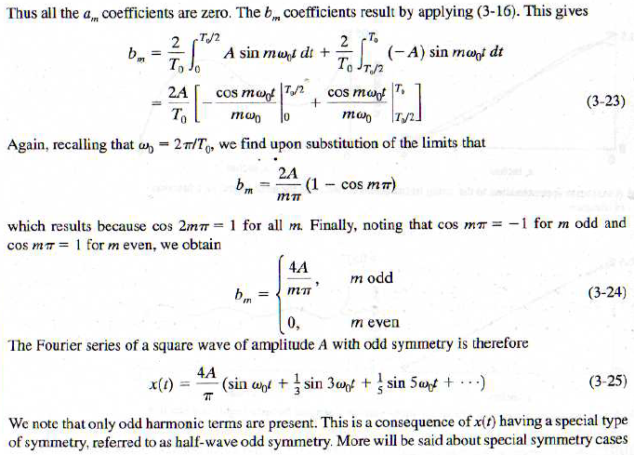
Trigonometric Fourier Series
Ex.:

Slide 14
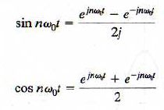
The Complex Fourier Series
The complex Fourier series is simpler than the trigonometric one, because only one coefficient is needed and not three. The complex Fourier series also gives directly the DSB spectrum of the signal in question.

Slide 15
The Complex Fourier Series
Finding the complex series coefficient: multiply x(t) with

Slide 16
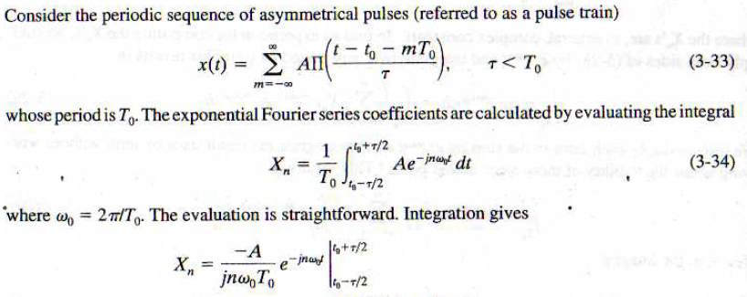
The Complex Fourier Series
Relation between trigonometic series and complex exponential
Ex.

Slide 17
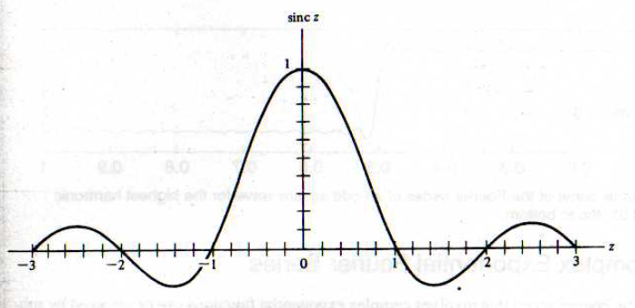
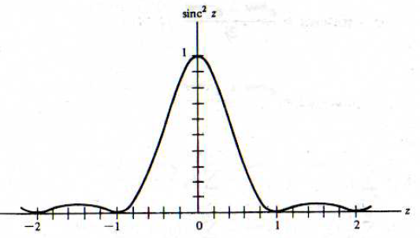
The Complex Fourier Series
The sinc function

Slide 18
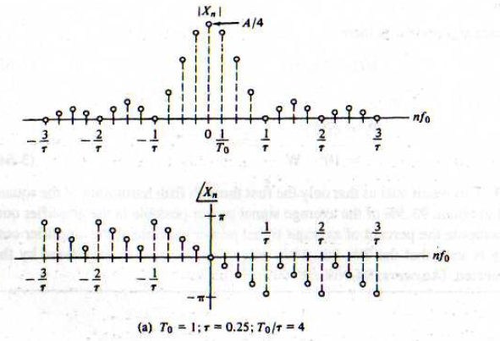
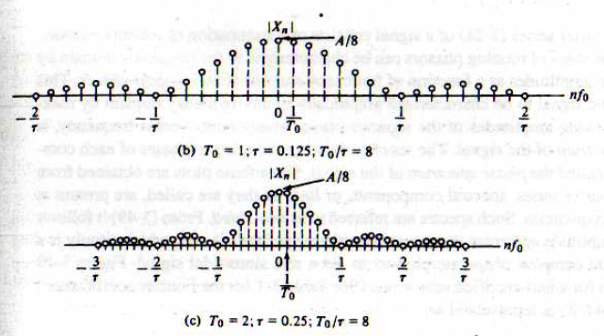
The Complex Fourier Series
The sinc function

Slide 19
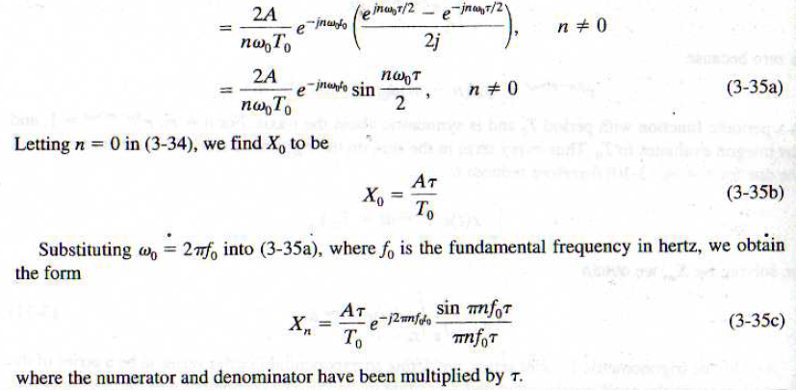
The Complex Fourier Series
Relation between trigonometic series and complex exponential
Ex.

Slide 20
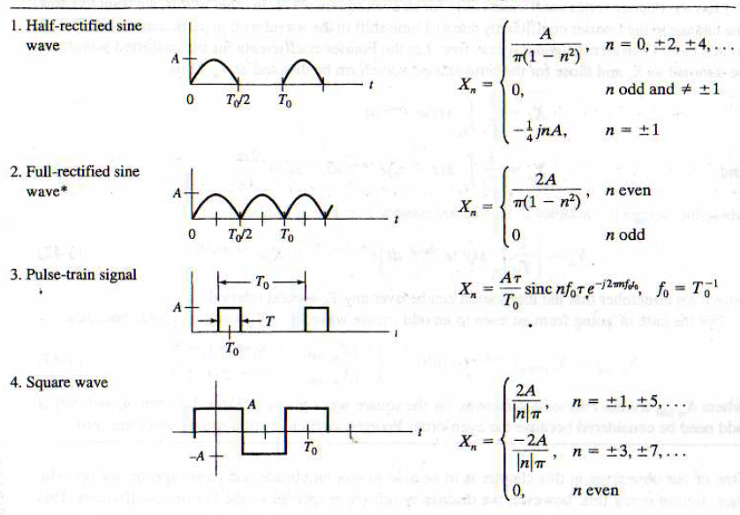
The Complex Fourier Series
Examples of important signals Fouier series coefficients

Slide 21
The Complex Fourier Series
Examples of important signals Fouier series coefficients

Slide 22
Relation between complex Fourier series and trigonometric Fourier series
The trigonometric Fourier series corresponds to the SSB spectrum(no negative frequencies)
The complex Fourier series corresponds to the DSB spectrum(negative frequencies)
For real signals:
The DSB amplitude spectrum is an even function of frequency
The DSB phase spectrum is an odd function of frequency
For odd functions the cosine coefficients are zero so is the average value, this means Xm is pure imaginary. For even functions the sine coefficients are zero, which means Xm is purely real.

Slide 23
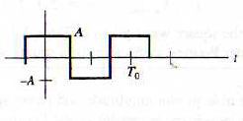
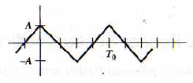
Relation between complex Fourier series and trigonometric Fourier series

Slide 24
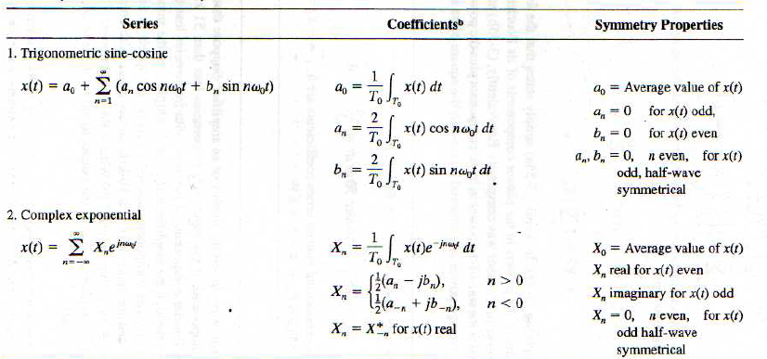
Relation between complex Fourier series and trigonometric Fourier series

Slide 25
Parseval’s Theory
The average power in the time domain is the some of power of each component in the frequency domain:

Slide 26
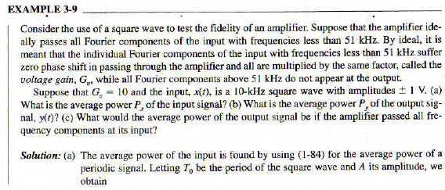
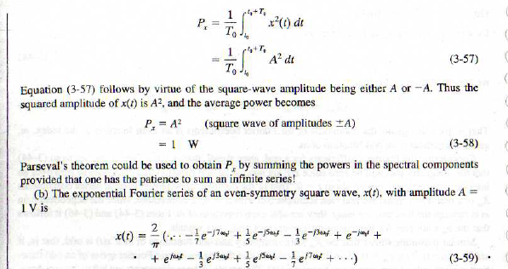
Parseval’s Theory
Ex.

Slide 27
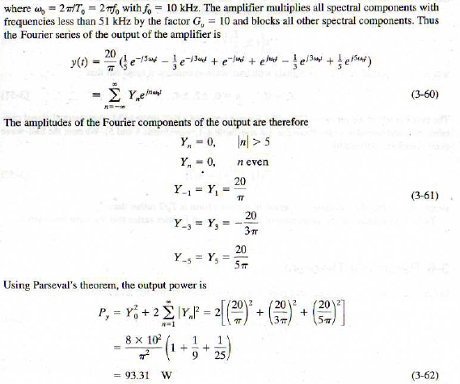
Parseval’s Theory
Ex.

Slide 28
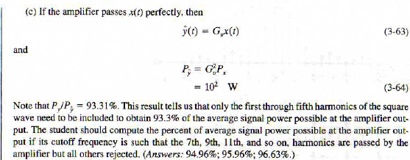
Parseval’s Theory
Ex.

Slide 29
Steady state response of an LTI system to periodic input

Slide 30
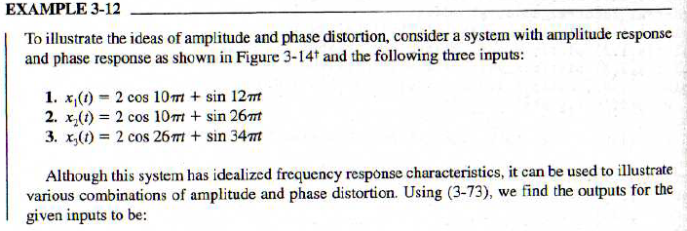
Distorsion

Slide 31
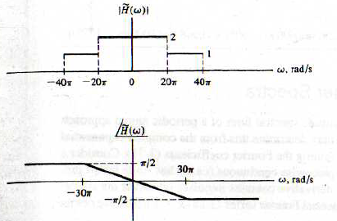
Distorsion

