Slide 1
Electrical Engineering Department
Signals & Systems
ENEE 334
3 Credit Hours
Summer Semester 2014
Instructor : Dr. Atheer Barghouthi
Date : 13.08.2014

Slide 2
Discrete Time Signals & Systems
What is discrete signal (discrete time)?
A discrete is a signal which is defined only at a specific points of time, at the other instants it is undefined, and there is no interest to define it.
Where does a discrete time signal comes from?
A discrete signal can be generated in two ways:
By sampling a continuous signal and defining the discrete signal at only those samples.
A discrete signal can be generated directly without sampling, inside digital computers
CDs, ...
Studying discrete signals and system beginning from the concept of sampling a continuous signal helps in connecting the theory of continuous signals and systems with the theory of discrete signals and systems
What is the goal of this chapter?
Finding analysis techniques for discrete systems and signals to describe their response to a certain input. We will define the difference equation,the convolution summation and the Z-transform.
Finding a synthesis technique to build systems that can process discrete systems..

Slide 3
Discrete Time Signals & Systems
1. Continuous or discrete
Continuous time continuous amplitude (Analog signal)
Continuous time discrete amplitude (Digital signal)
Discrete time continuous amplitude (Discrete signal)
Discrete time discrete amplitude (Digital signal, signal processing)
An analog signal can only be processed by analog systems, a digital signal can only be
processed by a digital system. To process a digital signal with an analog system and digital
to analog conversion is needed. To process an analog signal with a digital system analog to
digital conversion is needed.
Digital systems consists of digital gates, flip flops...
Analog systems consisto of R, L, C, Operational amplifiers...
Mixed (digital and analog) systems for converters

Slide 4
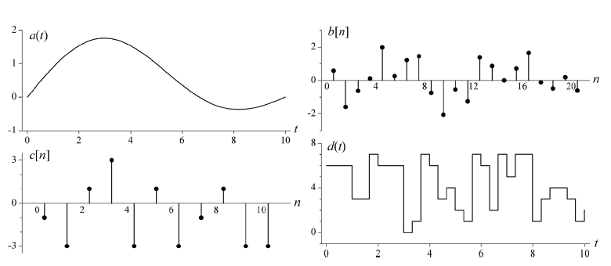
Discrete Time Signals & Systems
Continuous time continuous
amplitude (Analog signal)
Discrete time, continuous
amplitude (Discrete signal)
Discrete time discrete amplitude
(Digital signal, signal processing)
Continuous time discrete
amplitude (Digital signal)

Slide 5
Discrete Time Signals & Systems
Analog to digital conversion: to get a digital signal from an analog signal a system which is called an analogto digital convertor is used. This system consists of three subsystems (blocks):
The sampler which generates a discrete time continuous amplitude signal from the continuous signals
The quantizer which generates a discrete time discrete amplitude signal from the output of the sampler
The encoder which changes the discrete time discrete amplitude signal at the output of the quantizer into bits which are only two levels either 1 or 0
Continuous time continuous amplitue
Continuous time discrete amplitue
Continuous time continuous amplitue
Digital Signal
Sampler
Quantizer
Encoder

Slide 6
Sampling
Sampling is the processes of converting continuous-time analog signal, x_{a}(t), into a discrete-time signal by taking the “samples” at discrete-time intervals
Sampling analog signals makes them discrete in time but still continuous valued
If done properly (Nyquist theorem is satisfied), sampling does not introduce distortion
Sampled values:
The value of the function at the sampling points
Sampling interval:
The time that separates sampling points (interval b/w samples), T_{s}
If the signal is slowly varying, then fewer samples per second will be required than if the waveform is rapidly varying
So, the optimum sampling rate depends on the maximum frequency component present in the signal

Slide 7
Analog-to-digital conversion is (basically) a 2 step process:
Sampling
Convert from continuous-time analog signal x_{a}(t) to discrete-time continuous value signal x(n)
Is obtained by taking the “samples” of x_{a}(t) at discrete-time intervals, T_{s}
Quantization
Convert from discrete-time continuous valued signal to discrete time discrete valued signal

Slide 8
Sampling
Sampling Rate (or sampling frequency f_{s}):
The rate at which the signal is sampled, expressed as the number of samples per second (reciprocal of the sampling interval), 1/T_{s} = f_{s}
Nyquist Sampling Theorem (or Nyquist Criterion):
If the sampling is performed at a proper rate, no info is lost about the original signal and it can be properly reconstructed later on
Statement:
“If a signal is sampled at a rate at least, but not exactly equal to twice the max frequency component of the waveform, then the waveform can be exactly reconstructed from the samples without any distortion”

Slide 9
Ideal Sampling ( or Impulse Sampling)
Therefore, we have:
Take Fourier Transform (frequency convolution)

Slide 10
Sampling
If R_{s} < 2B, aliasing (overlapping of the spectra) results
If signal is not strictly bandlimited, then it must be passed through Low Pass Filter (LPF) before sampling
Fundamental Rule of Sampling (Nyquist Criterion)
The value of the sampling frequency f_{s} must be greater than twice the highest signal frequency f_{max} of the signal
Types of sampling
Ideal Sampling
Natural Sampling
Flat-Top Sampling

Slide 11
Ideal Sampling ( or Impulse Sampling)
Is accomplished by the multiplication of the signal x(t) by the uniform train of impulses (comb function)
Consider the instantaneous sampling of the analog signal x(t)
Train of impulse functions select sample values at regular intervals
Fourier Series representation:

Slide 12
Ideal Sampling ( or Impulse Sampling)
This shows that the Fourier Transform of the sampled signal is the Fourier Transform of the original signal at rate of 1/T_{s}

Slide 13
Ideal Sampling ( or Impulse Sampling)
As long as f_{s}> 2f_{m},no overlap of repeated replicas X(f - n/T_{s}) will occur in X_{s}(f)
Minimum Sampling Condition:
Sampling Theorem: A finite energy function x(t) can be completely reconstructed from its sampled value x(nTs) with
provided that =>

Slide 14
Ideal Sampling ( or Impulse Sampling)
This means that the output is simply the replication of the original signal at discrete intervals, e.g

Slide 15
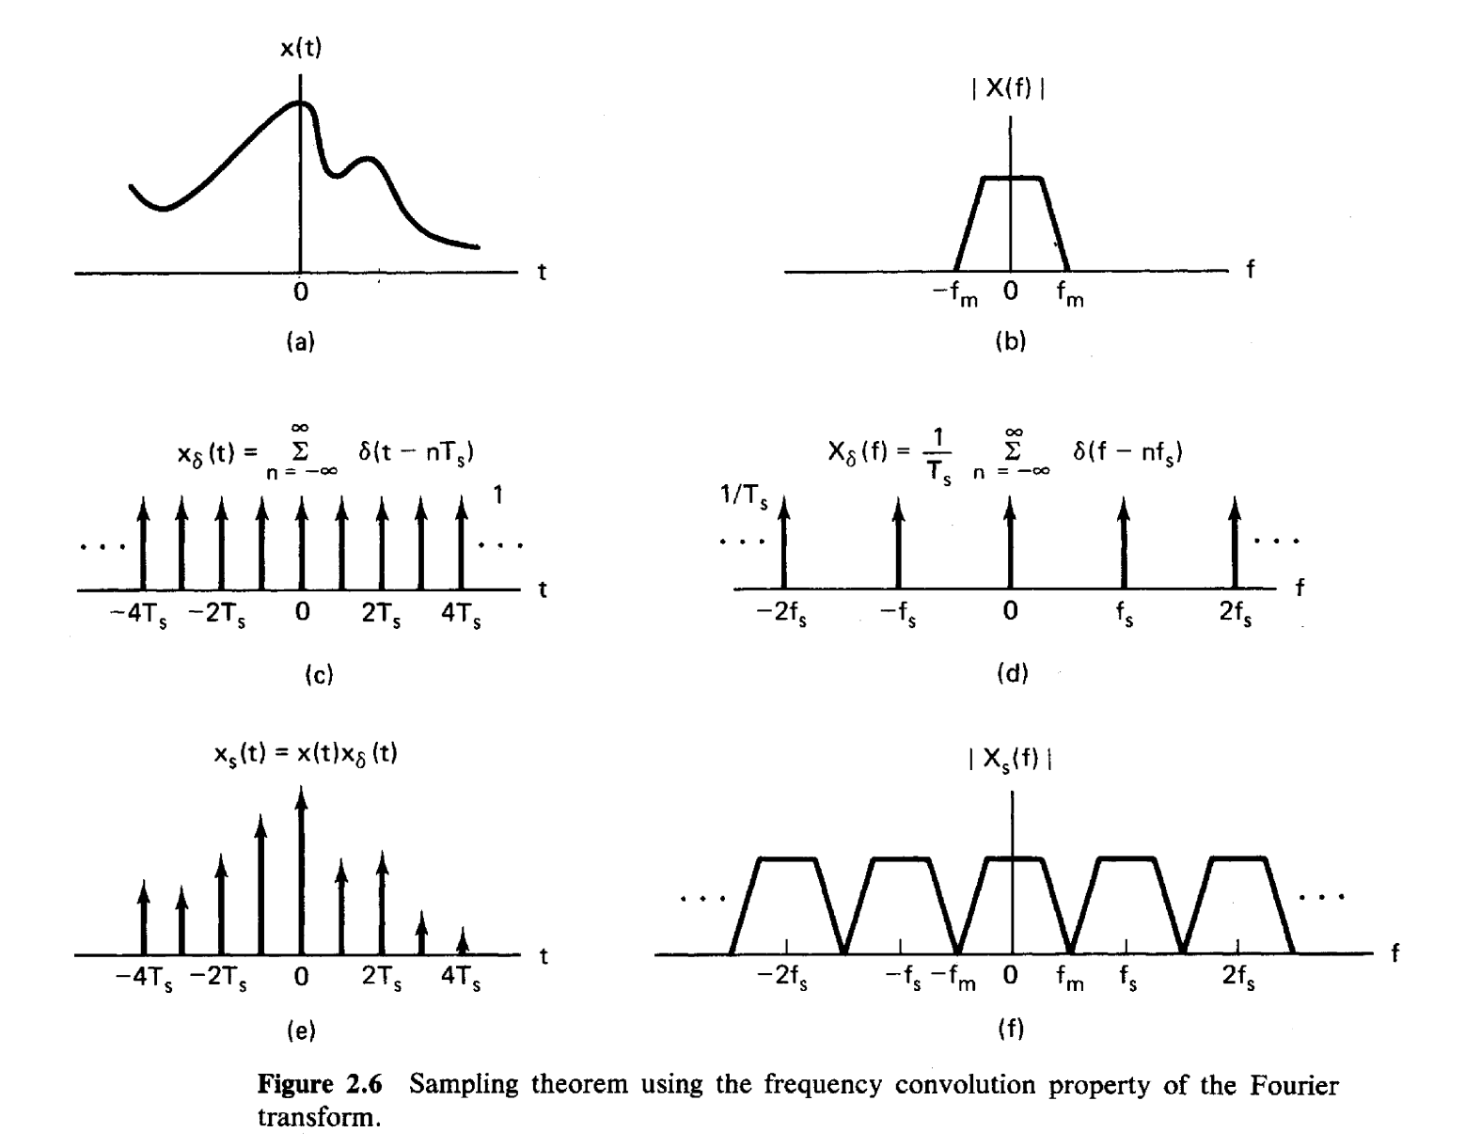
T_{s} is called the Nyquist interval: It is the longest time interval that can be used for sampling a bandlimited signal and still allow reconstruction of the signal at the receiver without distortion

Slide 16
Practical Sampling
In practice we cannot perform ideal sampling
It is practically difficult to create a train of impulses
Thus a non-ideal approach to sampling must be used
We can approximate a train of impulses using a train of very thin rectangular pulses:
Note:
Fourier Transform of impulse train is another impulse train
Convolution with an impulse train is a shifting operation

Slide 17
Natural Sampling
If we multiply x(t) by a train of rectangular pulses x_{p}(t), we obtain a gated waveform that approximates the ideal sampled waveform, known as natural sampling or gating (see Figure 2.8)

Slide 18
Each pulse in x_{p}(t) has width T and amplitude 1/T_{s}
The top of each pulse follows the variation of the signal being sampled
X_{s} (f) is the replication of X(f) periodically every f_{s} Hz
X_{s} (f) is weighted by C_{n} ← Fourier Series Coeffiecient
The problem with a natural sampled waveform is that the tops of the sample pulses are not flat
It is not compatible with a digital system since the amplitude of each sample has infinite number of possible values
Another technique known as flat top sampling is used to alleviate this problem

Slide 19
Flat-Top Sampling
Here, the pulse is held to a constant height for the whole sample period
Flat top sampling is obtained by the convolution of the signal obtained after ideal sampling with a unity amplitude rectangular pulse, p(t)
This technique is used to realize Sample-and-Hold (S/H) operation
In S/H, input signal is continuously sampled and then the value is held for as long as it takes to for the A/D to acquire its value

Slide 20
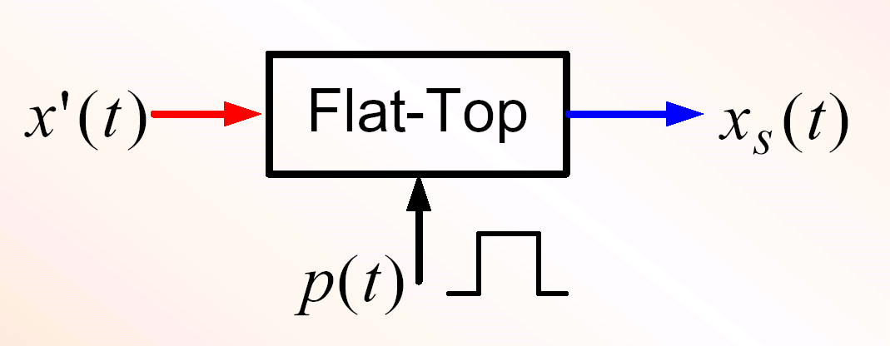
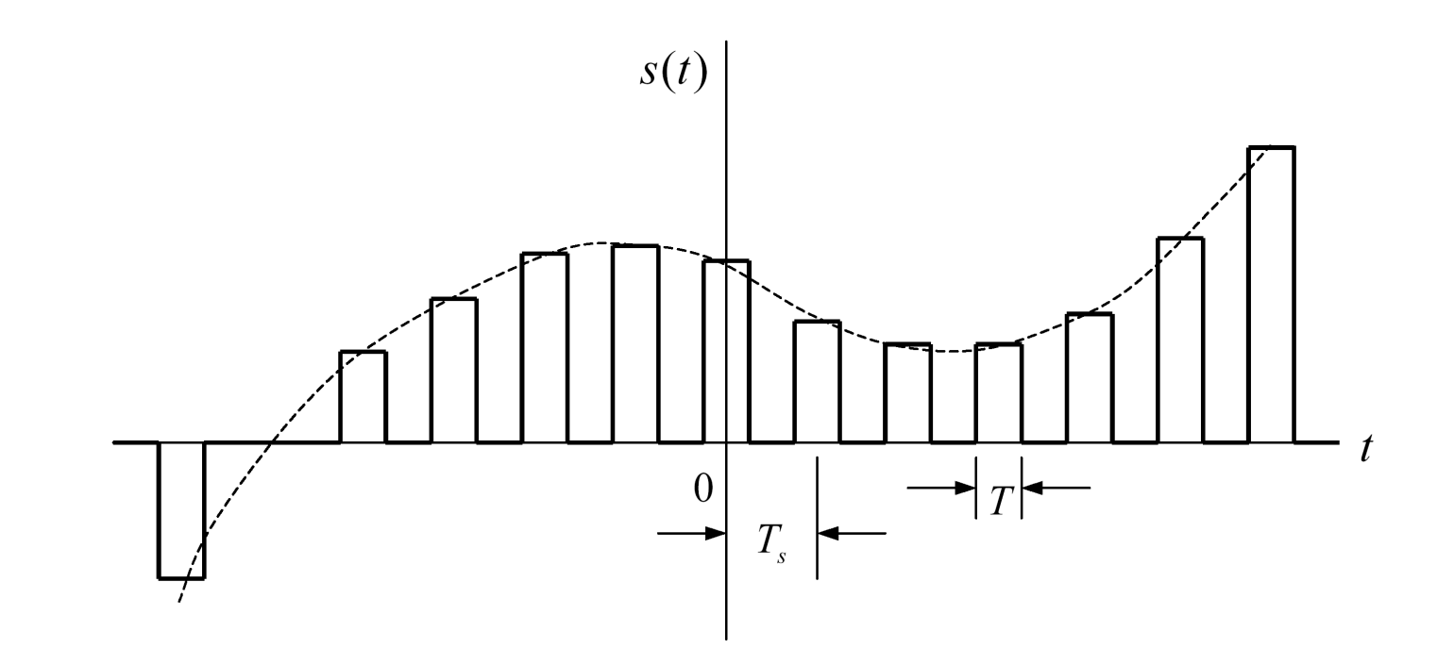
Flat top sampling (Time Domain)

Slide 21
Taking the Fourier Transform will result to
where P(f) is a sinc function

Slide 22
Flat top sampling (Frequency Domain)
Flat top sampling becomes identical to ideal sampling as the width of the pulses become shorter

Slide 23
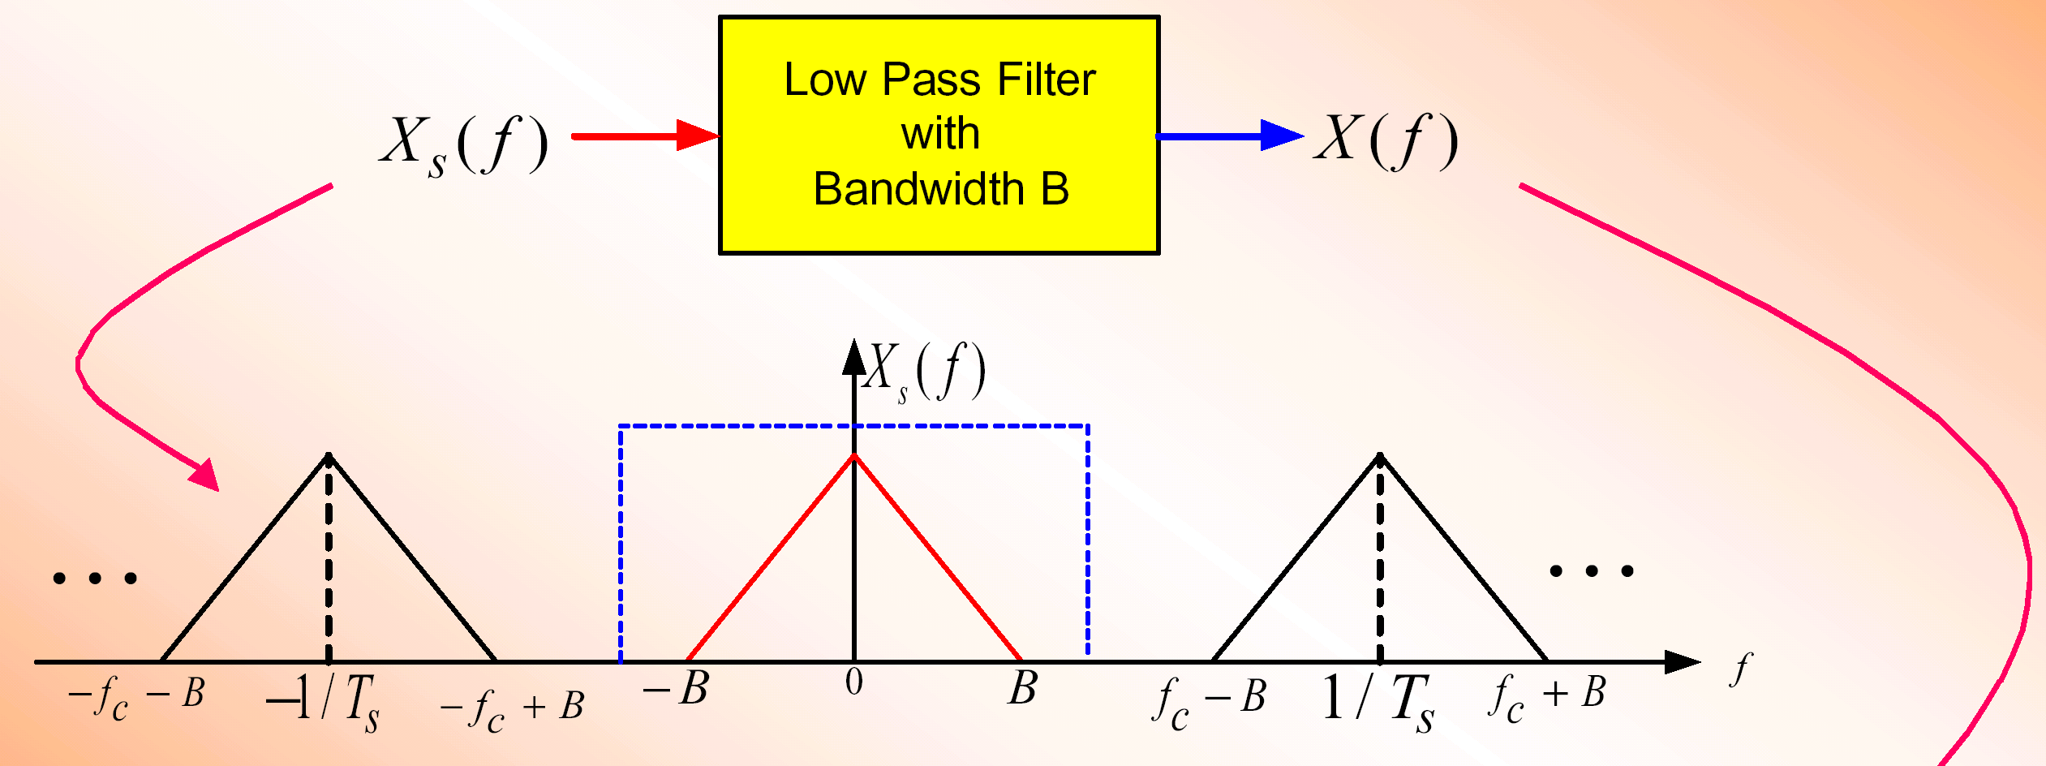
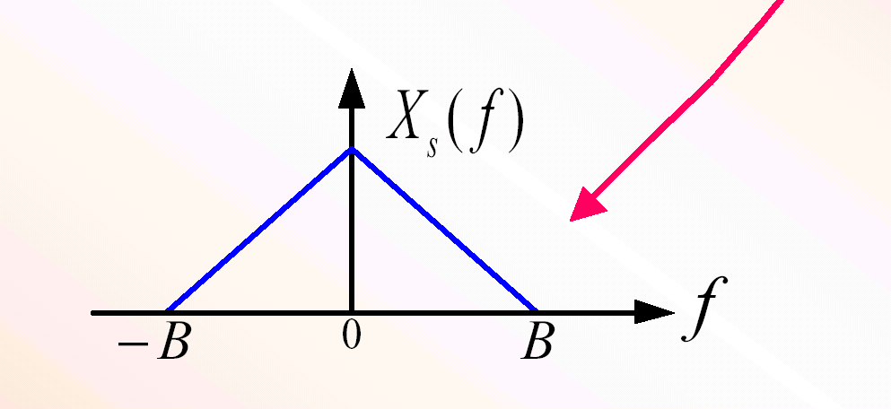
Recovering the Analog Signal
One way of recovering the original signal from sampled signal X_{s}(f) is to pass it through a Low Pass Filter (LPF) as shown below
If f_{s} > 2B then we recover x(t) exactly
Else we run into some problems and signal is not fully recovered

Slide 24
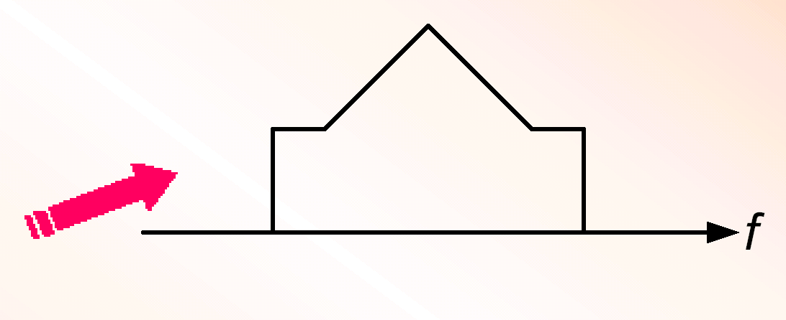
Undersampling and Aliasing
If the waveform is undersampled (i.e. fs < 2B) then there will be spectral overlap in the sampled signal
The signal at the output of the filter will be
different from the original signal spectrum
This is the outcome of aliasing!
This implies that whenever the sampling condition is not met, an irreversible overlap of the spectral replicas is produced

Slide 25
This could be due to:
x(t) containing higher frequency than were expected
An error in calculating the sampling rate
Under normal conditions, undersampling of signals causing aliasing is not recommended

Slide 26
Solution 1: Anti-Aliasing Analog Filter
All physically realizable signals are not completely bandlimited
If there is a significant amount of energy in frequencies above half the sampling frequency (f_{s}/2), aliasing will occur
Aliasing can be prevented by first passing the analog signal through an anti-aliasing filter (also called a prefilter) before sampling is performed
The anti-aliasing filter is simply a LPF with cutoff frequency equal to half the sample rate

Slide 27
Aliasing is prevented by forcing the bandwidth of the sampled signal to satisfy the requirement of the Sampling Theorem

Slide 28
Solution 2: Over Sampling and Filtering in the Digital Domain
The signal is passed through a low performance (less costly) analog low-pass filter to limit the bandwidth.
Sample the resulting signal at a high sampling frequency.
The digital samples are then processed by a high performance digital filter and down sample the resulting signal.

Slide 29
Summary Of Sampling
Ideal Sampling
(or Impulse Sampling)
Natural Sampling
(or Gating)
Flat-Top Sampling
For all sampling techniques
If fs > 2B then we can recover x(t) exactly
If fs < 2B) spectral overlapping known as aliasing will occur

Slide 30
Example 1:
Consider the analog signal x(t) given by
What is the Nyquist rate for this signal?
Example 2:
Consider the analog signal x_{a}(t) given by
What is the Nyquist rate for this signal?
What is the discrete time signal obtained after sampling, if f_{s}=5000 samples/s.
What is the analog signal x(t) that can be reconstructed from the sampled values?

Slide 31
Practical Sampling Rates
Speech
- Telephone quality speech has a bandwidth of 4 kHz (actually 300 to 3300Hz)
- Most digital telephone systems are sampled at 8000 samples/sec
Audio:
- The highest frequency the human ear can hear is approximately 15kHz
- CD quality audio are sampled at rate of 44,000 samples/sec
Video
- The human eye requires samples at a rate of at least 20 frames/sec to achieve smooth motion

Slide 32
Pulse Code Modulation (PCM)
Pulse Code Modulation refers to a digital baseband signal that is generated directly from the quantizer output
Sometimes the term PCM is used interchangeably with quantization

Slide 33
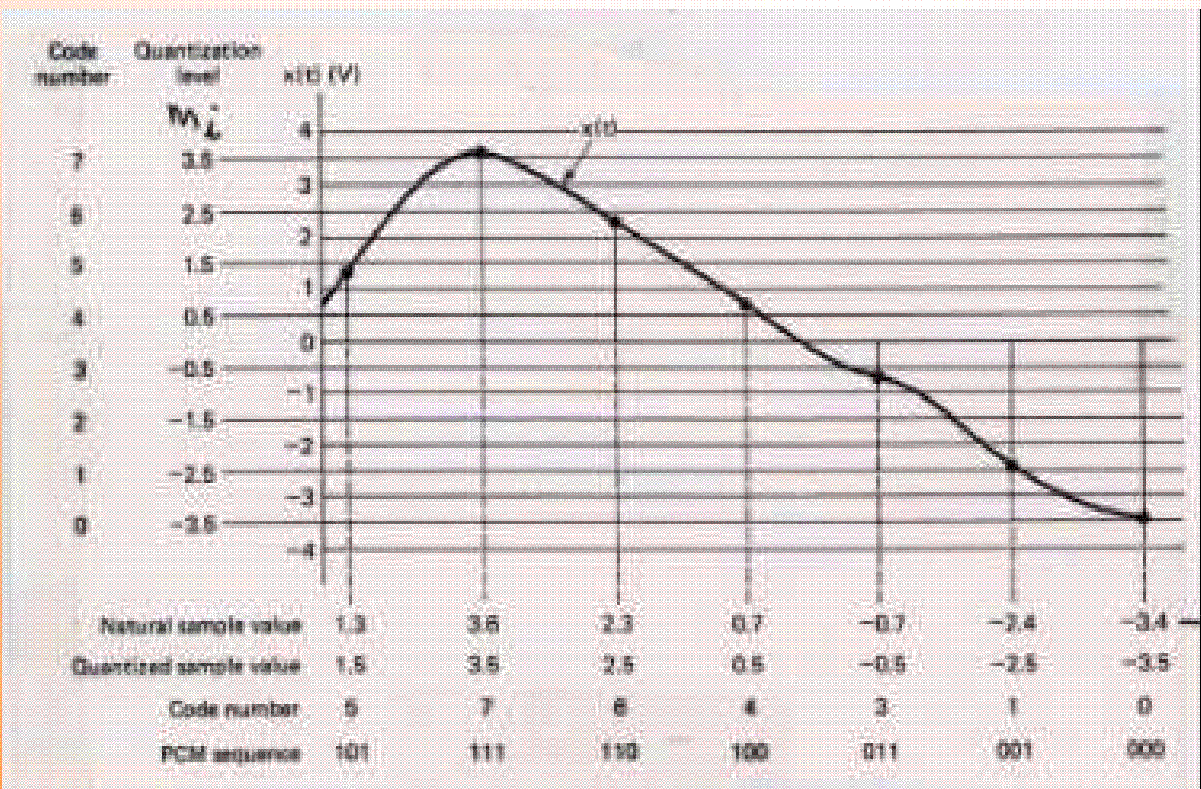
See Figure 2.16 (Page 80)

Slide 35
Discrete Time Signals & Systems
Discrete signal classification
1.Power vs energy

Slide 36
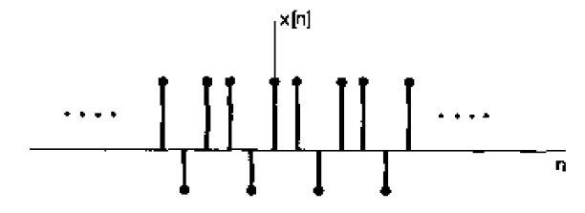
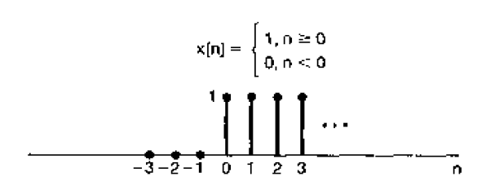
Discrete Time Signals & Systems
Discrete signal classification
1.Periodic vs Aperiodic

Slide 37
Discrete Time Signals & Systems
Discrete signal singularity functions
1.The unit impulse

Slide 38
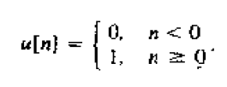
Discrete Time Signals & Systems
Discrete signal singularity functions
1.The unit step

Slide 39
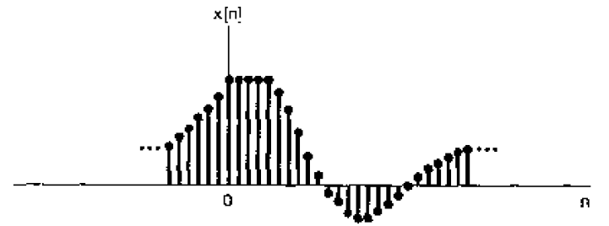
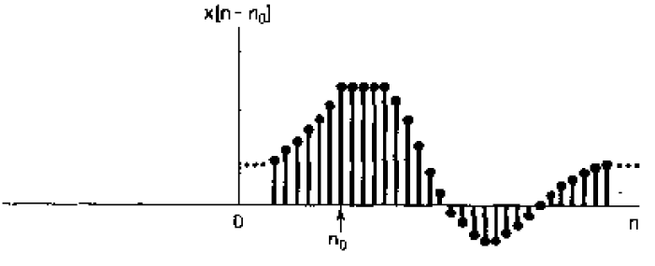
Discrete Time Signals & Systems
Operations on discrete signals
1.Time shift

Slide 40
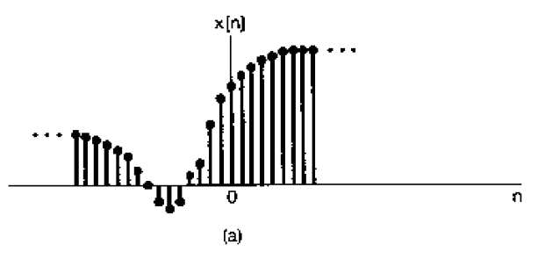
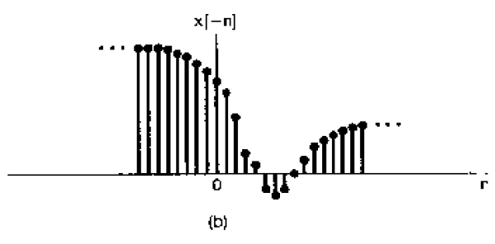
Discrete Time Signals & Systems
Operations on discrete signals
2.Time reversal

Slide 41
Discrete Time Signals & Systems
Operations on discrete signals
3.Amplitude scaling

Slide 42
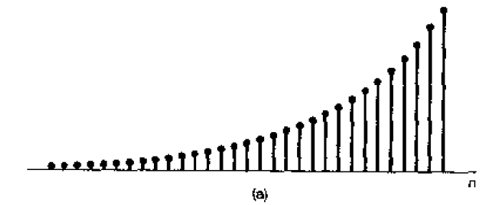
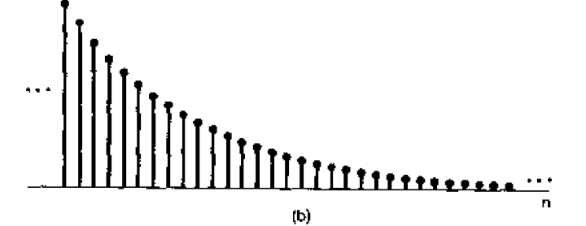
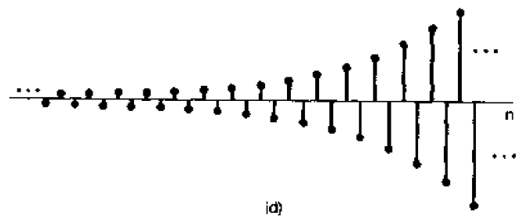
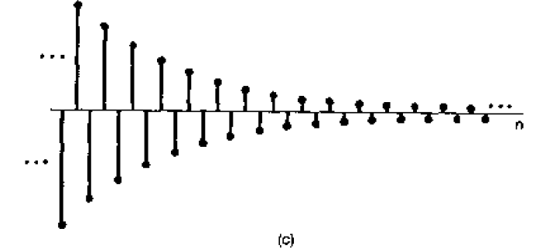
Discrete Time Signals & Systems
Discrete Real Exponentials

Slide 43
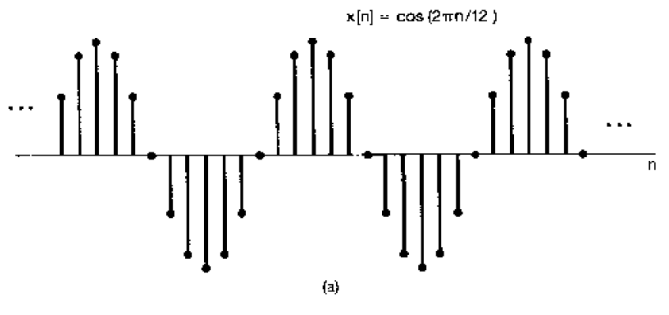
Discrete Time Signals & Systems
Discrete Exponentials

Slide 44
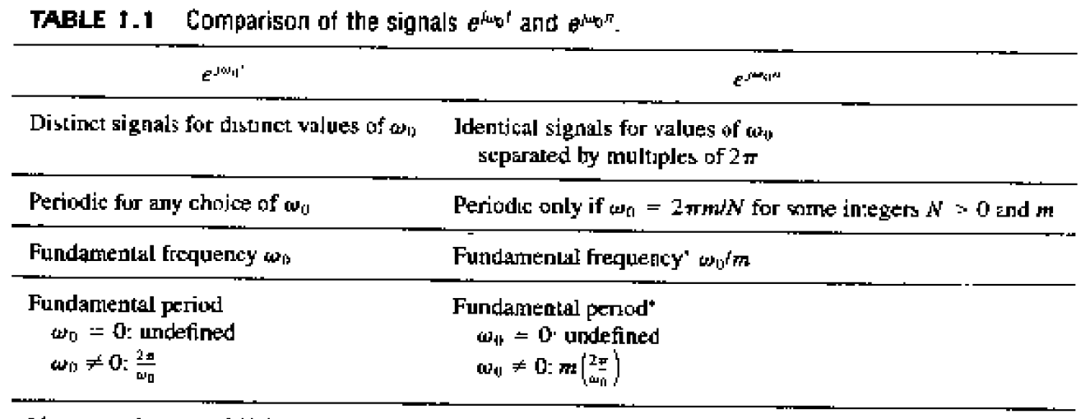
Discrete Time Signals & Systems
Discrete Exponentials

Slide 45
Discrete Time Signals & Systems
Example

Slide 46
Discrete Time Signals & Systems
Harmonically related complex exponentials

Slide 47
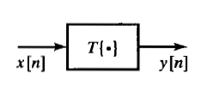
Discrete Time Signals & Systems
Discrete systems

Slide 48
Discrete Time Signals & Systems
Discrete systems

