Slide 1




BIRZEIT UNIVERSITY
Faculty of Engineering and Technology
Department of Electrical and Computer Engineering
Modern Communication Systems, ENEE3306
Dr. Mohammad Jubran
Lecture 4

Slide 2
M-ary Signaling Techniques - Introduction
BIRZEIT UNIVERSITY
ECE
  There are benefits to be gained when M-ary (M = 4) signaling methods are used rather than straightforward binary signaling.
  In general, M-ary communication is used when one needs to design a communication system that is bandwidth efficient.
  Unlike QPSK and its variations, the gain in bandwidth is accomplished at the expense of error performance.
  To use M-ary modulation, the bit stream is blocked into groups of λ bits ⇒ the number of bit patterns is M = 2.
  The symbol transmission rate is rs = 1/Ts = 1/(λTb) = rb/λ symbols/sec ⇒ there is a bandwidth saving of 1/λ compared to binary modulation.
  Shall consider M-ary ASK, PSK, QAM (quadrature amplitude modulation) and FSK.
© Dr. Mohammad Jubran
Modern Communication Systems, ENEE3306
Lecture 4 - Slide 2

Slide 3
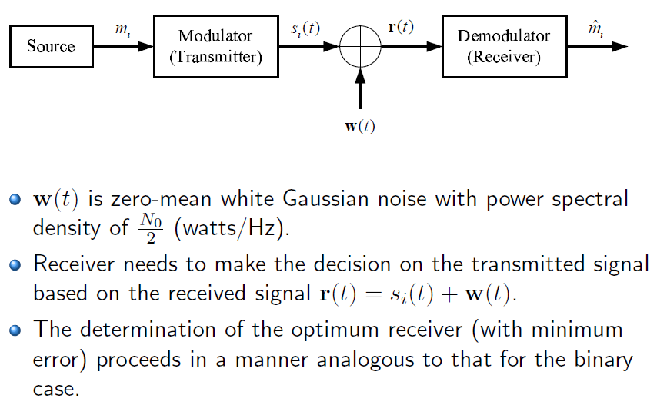
M-ary Signaling Techniques - Optimum Receiver for M-ary Signaling
BIRZEIT UNIVERSITY
ECE
© Dr. Mohammad Jubran
Modern Communication Systems, ENEE3306
Lecture 4 - Slide 3

Slide 4
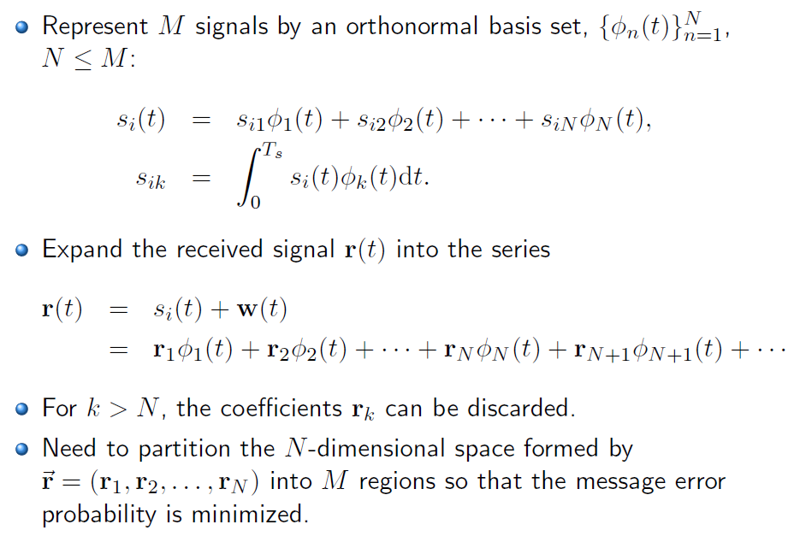
M-ary Signaling Techniques - Optimum Receiver for M-ary Signaling
BIRZEIT UNIVERSITY
ECE
© Dr. Mohammad Jubran
Modern Communication Systems, ENEE3306
Lecture 4 - Slide 4

Slide 5
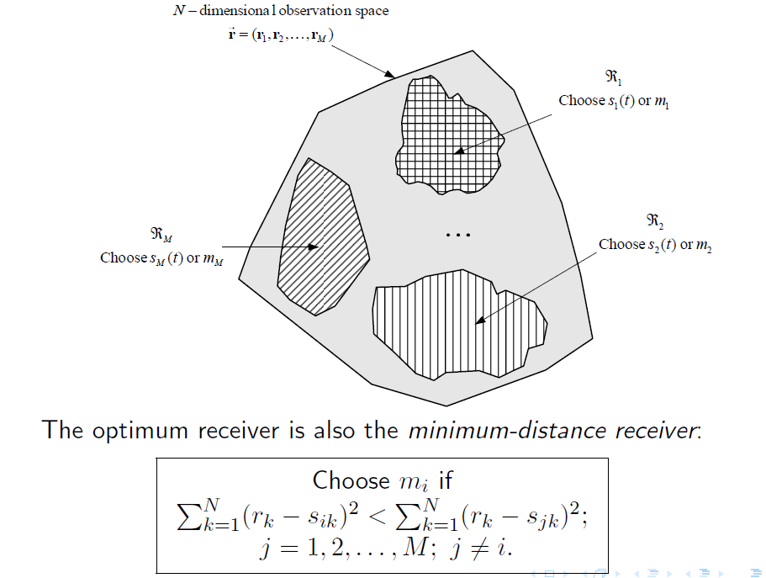
M-ary Signaling Techniques - Optimum Receiver for M-ary Signaling
BIRZEIT UNIVERSITY
ECE
© Dr. Mohammad Jubran
Modern Communication Systems, ENEE3306
Lecture 4 - Slide 5

Slide 6
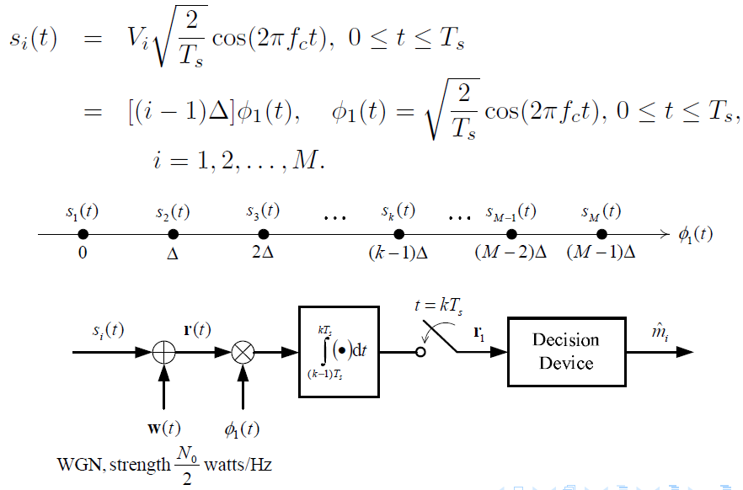
M-ary Signaling Techniques - M-ary Coherent Amplitude-Shift Keying (M-ASK)
BIRZEIT UNIVERSITY
ECE
© Dr. Mohammad Jubran
Modern Communication Systems, ENEE3306
Lecture 4 - Slide 6

Slide 7
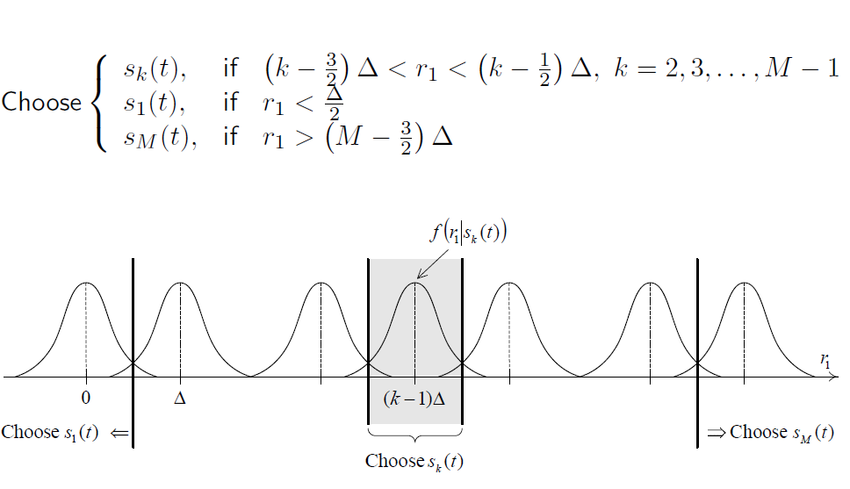
M-ary Signaling Techniques - M-ary Coherent Amplitude-Shift Keying (M-ASK)
BIRZEIT UNIVERSITY
ECE
© Dr. Mohammad Jubran
Modern Communication Systems, ENEE3306
Lecture 4 - Slide 7

Slide 8
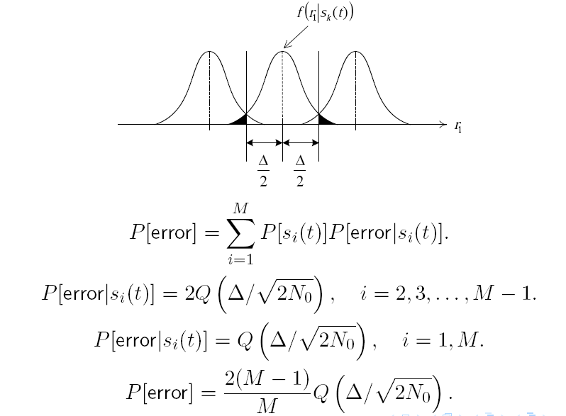
M-ary Signaling Techniques - M-ary Coherent Amplitude-Shift Keying (M-ASK)
BIRZEIT UNIVERSITY
ECE
© Dr. Mohammad Jubran
Modern Communication Systems, ENEE3306
Lecture 4 - Slide 8

Slide 9
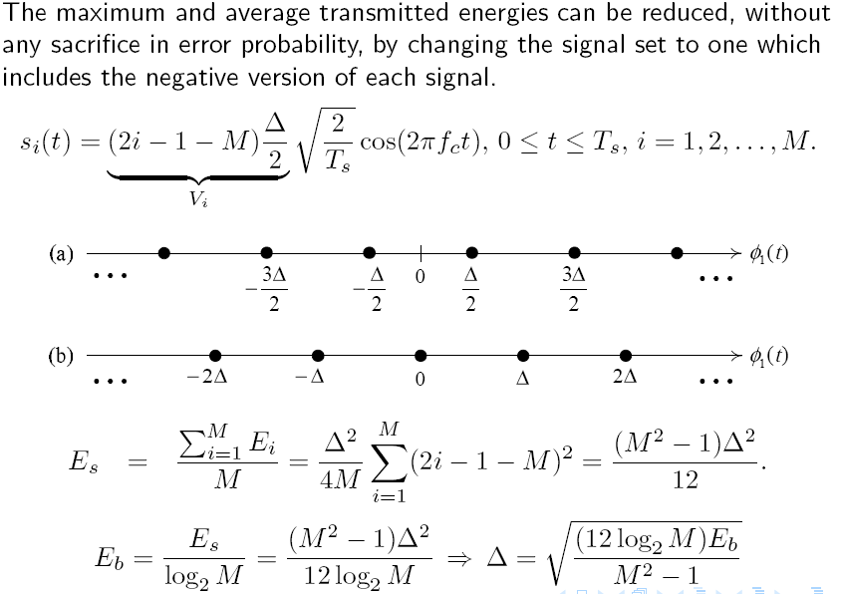
M-ary Signaling Techniques - Modified M-ASK Constellation
BIRZEIT UNIVERSITY
ECE
© Dr. Mohammad Jubran
Modern Communication Systems, ENEE3306
Lecture 4 - Slide 9

Slide 10
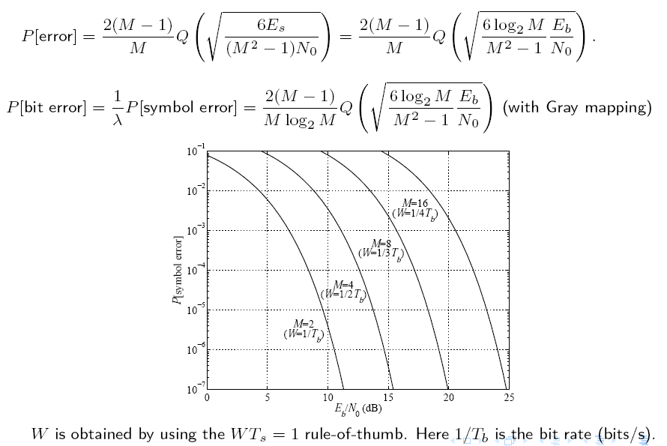
M-ary Signaling Techniques - Probability of Symbol Error for M-ASK
BIRZEIT UNIVERSITY
ECE
© Dr. Mohammad Jubran
Modern Communication Systems, ENEE3306
Lecture 4 - Slide 10

Slide 11
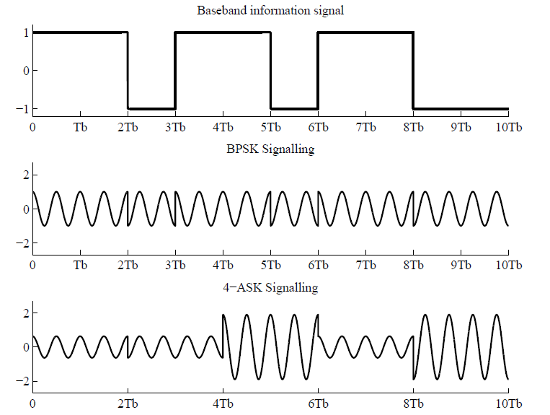
M-ary Signaling Techniques – Example of BPSK and 4-ASK
BIRZEIT UNIVERSITY
ECE
© Dr. Mohammad Jubran
Modern Communication Systems, ENEE3306
Lecture 4 - Slide 11

Slide 12
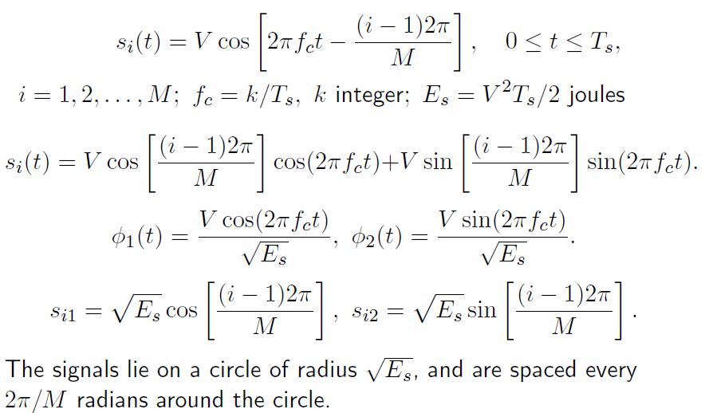
M-ary Signaling Techniques – M-ary Phase-Shift Keying (M-PSK)
BIRZEIT UNIVERSITY
ECE
© Dr. Mohammad Jubran
Modern Communication Systems, ENEE3306
Lecture 4 - Slide 12

Slide 13
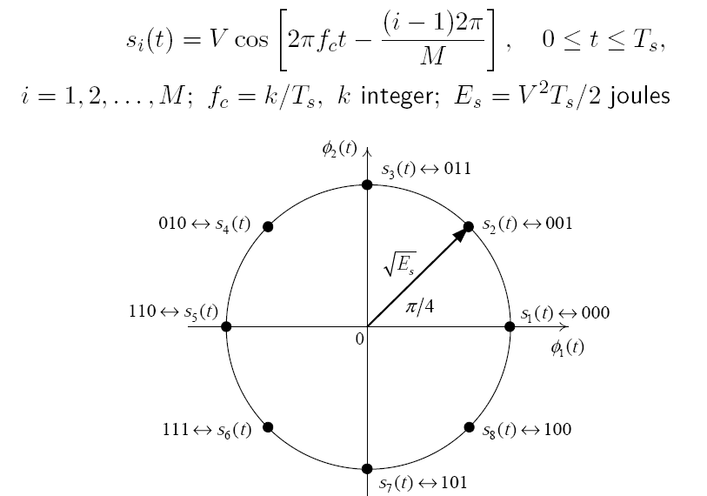
M-ary Signaling Techniques – Signal Space Plot of 8-PSK
BIRZEIT UNIVERSITY
ECE
© Dr. Mohammad Jubran
Modern Communication Systems, ENEE3306
Lecture 4 - Slide 13

Slide 14
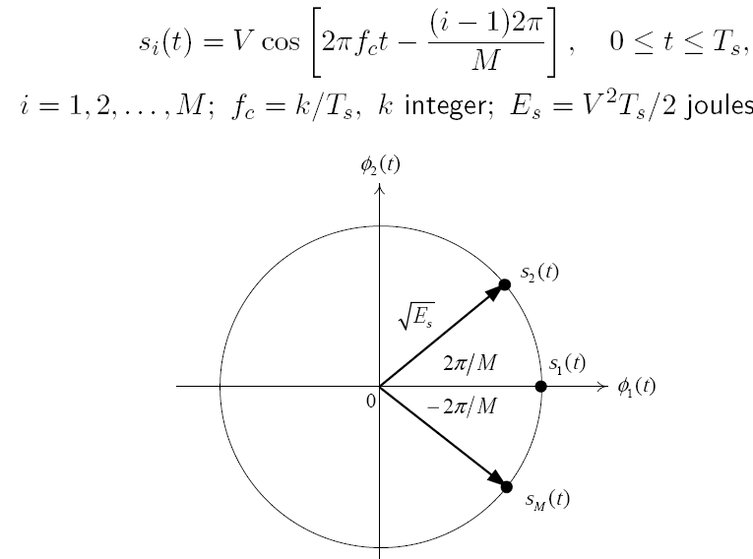
M-ary Signaling Techniques – Signal Space Plot of M-PSK
BIRZEIT UNIVERSITY
ECE
© Dr. Mohammad Jubran
Modern Communication Systems, ENEE3306
Lecture 4 - Slide 14

Slide 15
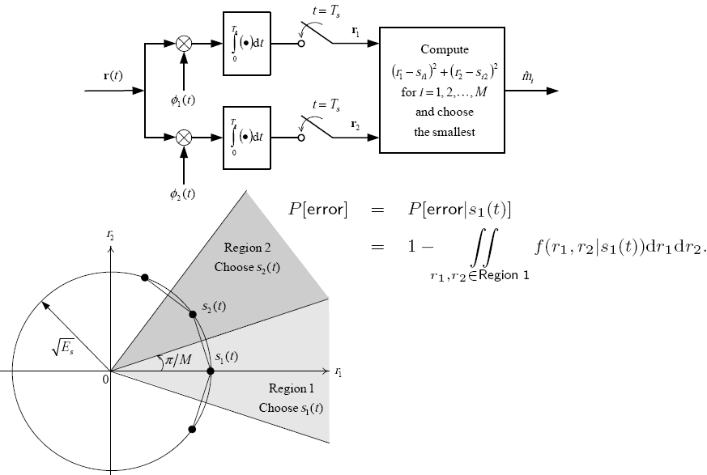
M-ary Signaling Techniques – Optimum Receiver for M-PSK
BIRZEIT UNIVERSITY
ECE
© Dr. Mohammad Jubran
Modern Communication Systems, ENEE3306
Lecture 4 - Slide 15

Slide 16
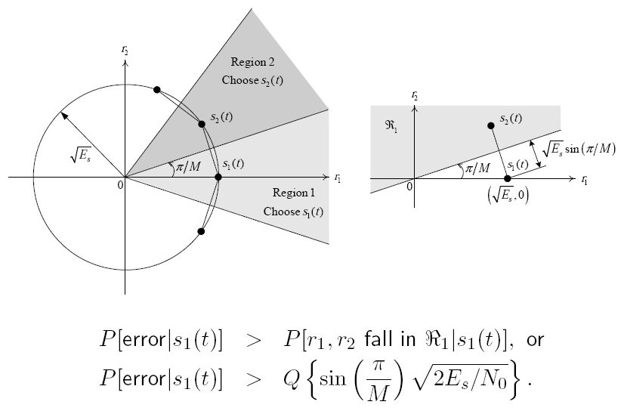
M-ary Signaling Techniques – Lower Bound of P[error] of M-PSK
BIRZEIT UNIVERSITY
ECE
© Dr. Mohammad Jubran
Modern Communication Systems, ENEE3306
Lecture 4 - Slide 16

Slide 17
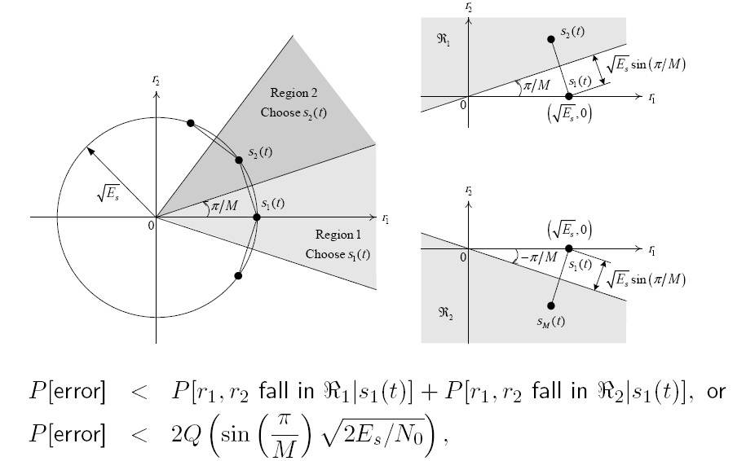
M-ary Signaling Techniques – Upper Bound of P[error] of M-PSK
BIRZEIT UNIVERSITY
ECE
© Dr. Mohammad Jubran
Modern Communication Systems, ENEE3306
Lecture 4 - Slide 17

Slide 18
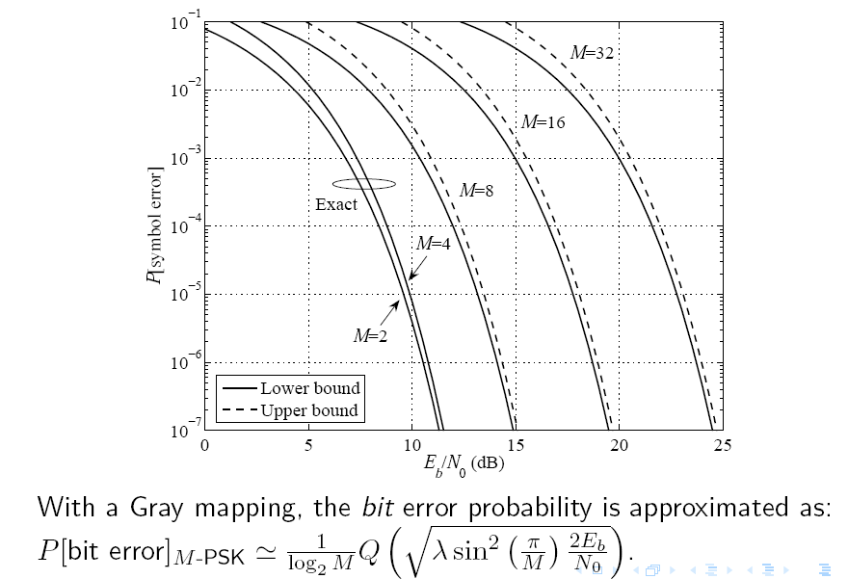
M-ary Signaling Techniques – Symbol Error Probability of M-PSK
BIRZEIT UNIVERSITY
ECE
© Dr. Mohammad Jubran
Modern Communication Systems, ENEE3306
Lecture 4 - Slide 18

Slide 19
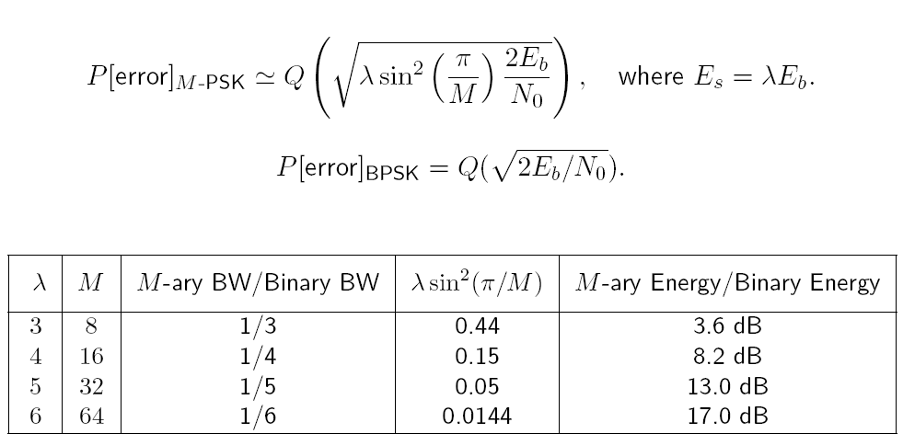
M-ary Signaling Techniques – Comparison of BPSK and M-PSK
BIRZEIT UNIVERSITY
ECE
© Dr. Mohammad Jubran
Modern Communication Systems, ENEE3306
Lecture 4 - Slide 19

Slide 20
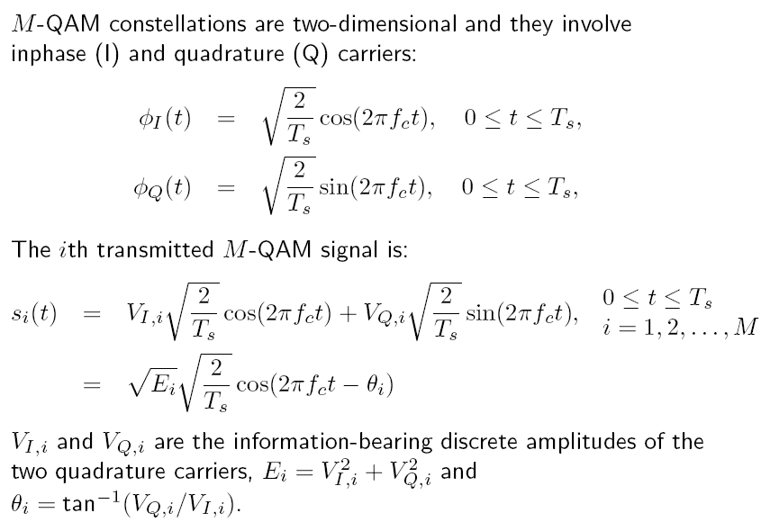
M-ary Signaling Techniques – M-ary Quadrature Amplitude Modulation (M-QAM)
BIRZEIT UNIVERSITY
ECE
© Dr. Mohammad Jubran
Modern Communication Systems, ENEE3306
Lecture 4 - Slide 20

Slide 21
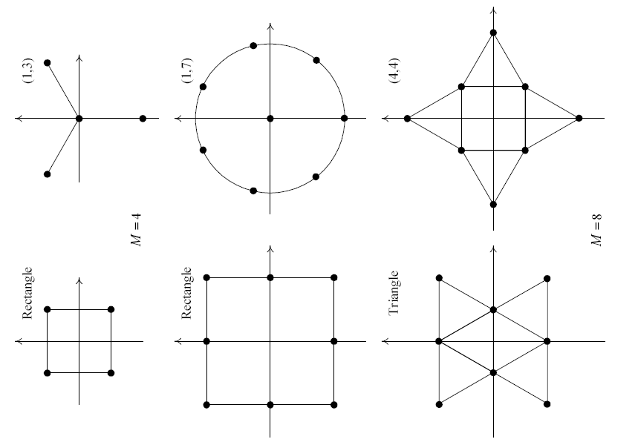
M-ary Signaling Techniques – M-ary Quadrature Amplitude Modulation (M-QAM)
BIRZEIT UNIVERSITY
ECE
© Dr. Mohammad Jubran
Modern Communication Systems, ENEE3306
Lecture 4 - Slide 21

Slide 22
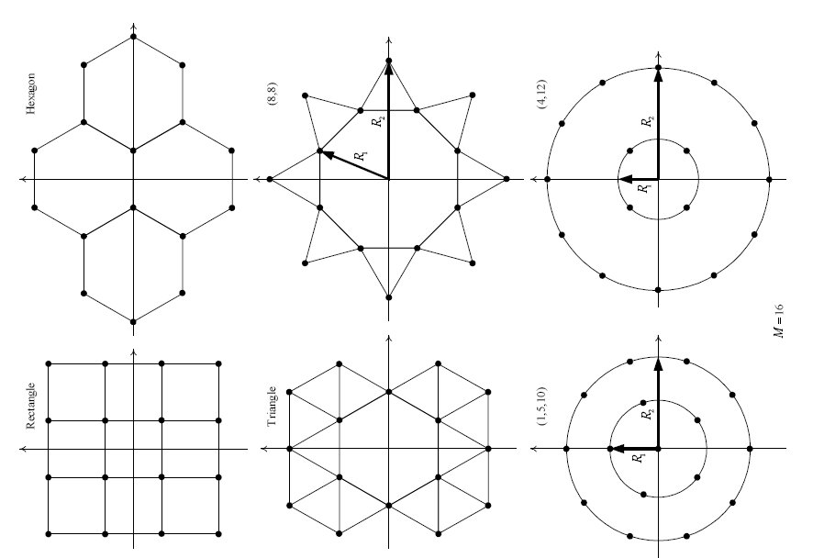
M-ary Signaling Techniques – M-ary Quadrature Amplitude Modulation (M-QAM)
BIRZEIT UNIVERSITY
ECE
© Dr. Mohammad Jubran
Modern Communication Systems, ENEE3306
Lecture 4 - Slide 22

Slide 23
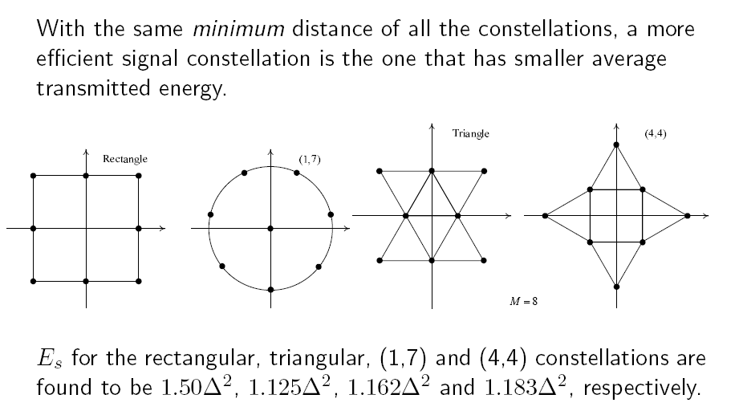
M-ary Signaling Techniques – A Simple Comparison of M-QAM Constellations
BIRZEIT UNIVERSITY
ECE
© Dr. Mohammad Jubran
Modern Communication Systems, ENEE3306
Lecture 4 - Slide 23

Slide 24
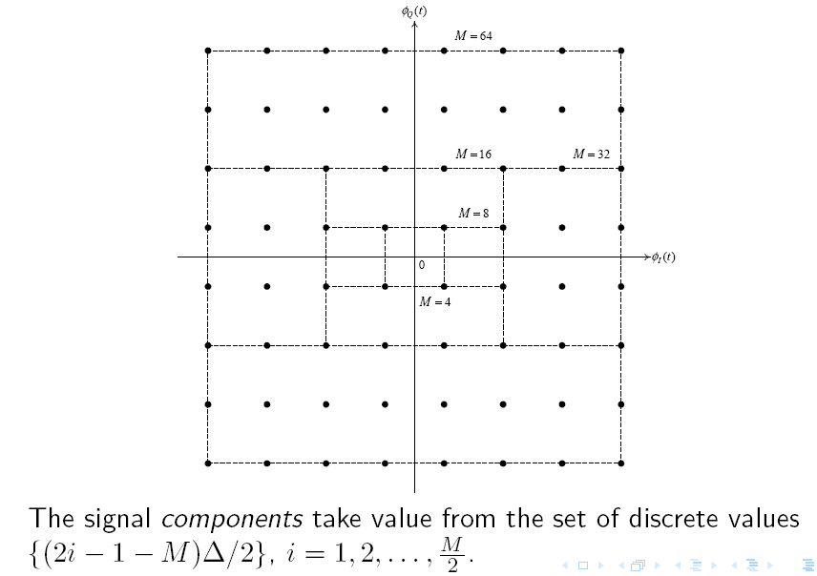
M-ary Signaling Techniques – Rectangular M-QAM
BIRZEIT UNIVERSITY
ECE
© Dr. Mohammad Jubran
Modern Communication Systems, ENEE3306
Lecture 4 - Slide 24

Slide 25
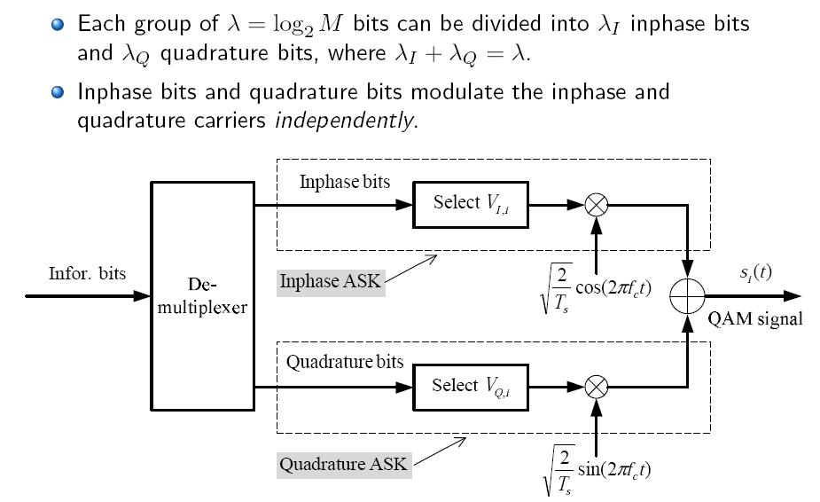
M-ary Signaling Techniques – Modulation of Rectangular M-QAM
BIRZEIT UNIVERSITY
ECE
© Dr. Mohammad Jubran
Modern Communication Systems, ENEE3306
Lecture 4 - Slide 25

Slide 26
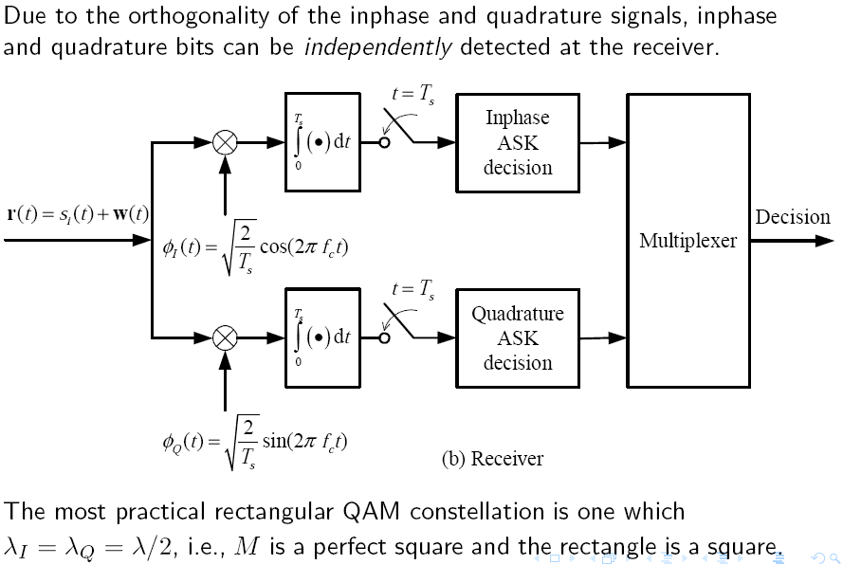
M-ary Signaling Techniques – Demodulation of Rectangular M-QAM
BIRZEIT UNIVERSITY
ECE
© Dr. Mohammad Jubran
Modern Communication Systems, ENEE3306
Lecture 4 - Slide 26

Slide 27

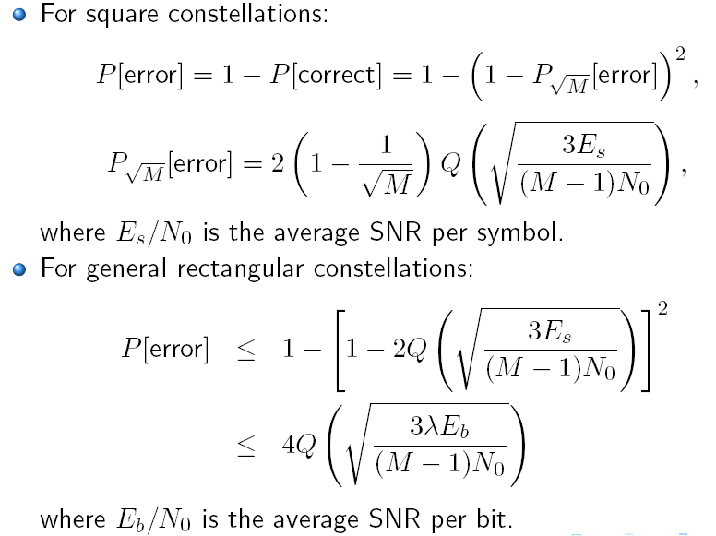
M-ary Signaling Techniques – Symbol Error Probability of M-QAM
BIRZEIT UNIVERSITY
ECE
© Dr. Mohammad Jubran
Modern Communication Systems, ENEE3306
Lecture 4 - Slide 27

Slide 28
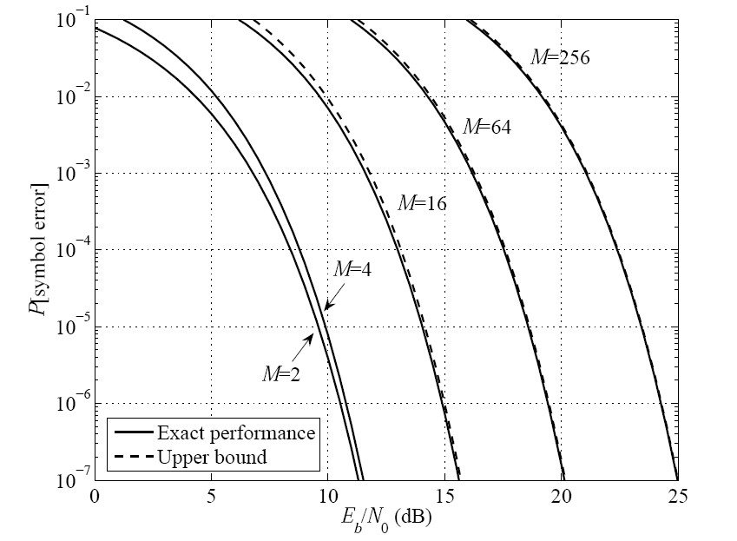
M-ary Signaling Techniques – M-ary Quadrature Amplitude Modulation (M-QAM)
BIRZEIT UNIVERSITY
ECE
© Dr. Mohammad Jubran
Modern Communication Systems, ENEE3306
Lecture 4 - Slide 28

Slide 29
Performance Comparison of M-PSK and M-QAM
BIRZEIT UNIVERSITY
ECE
© Dr. Mohammad Jubran
Modern Communication Systems, ENEE3306
Lecture 4 - Slide 29

Slide 30
Performance Comparison of M-ASK, M-PSK, M-QAM
BIRZEIT UNIVERSITY
ECE
© Dr. Mohammad Jubran
Modern Communication Systems, ENEE3306
Lecture 4 - Slide 30

Slide 31
M-ary Coherent Frequency-Shift Keying (M-FSK)
BIRZEIT UNIVERSITY
ECE
© Dr. Mohammad Jubran
Modern Communication Systems, ENEE3306
Lecture 4 - Slide 31

Slide 32
Minimum-Distance Receiver of M-FSK
BIRZEIT UNIVERSITY
ECE
© Dr. Mohammad Jubran
Modern Communication Systems, ENEE3306
Lecture 4 - Slide 32

Slide 33
Symbol Error Probability of M-FSK
BIRZEIT UNIVERSITY
ECE
© Dr. Mohammad Jubran
Modern Communication Systems, ENEE3306
Lecture 4 - Slide 33

Slide 34
Symbol Error Probability of M-FSK
BIRZEIT UNIVERSITY
ECE
© Dr. Mohammad Jubran
Modern Communication Systems, ENEE3306
Lecture 4 - Slide 34

Slide 35
Bit Error Probability of M-FSK
BIRZEIT UNIVERSITY
ECE
© Dr. Mohammad Jubran
Modern Communication Systems, ENEE3306
Lecture 4 - Slide 35

Slide 36
Power-Bandwidth Plane (At P[error] = 10⁻⁵)
BIRZEIT UNIVERSITY
ECE
© Dr. Mohammad Jubran
Modern Communication Systems, ENEE3306
Lecture 4 - Slide 36

Slide 37
Shannon’s Channel Capacity
BIRZEIT UNIVERSITY
ECE
© Dr. Mohammad Jubran
Modern Communication Systems, ENEE3306
Lecture 4 - Slide 37

Slide 38
Shannon’s Capacity Curve
BIRZEIT UNIVERSITY
ECE
© Dr. Mohammad Jubran
Modern Communication Systems, ENEE3306
Lecture 4 - Slide 38

Slide 39
Spectrum Efficiency of DVB-S2 Standard
BIRZEIT UNIVERSITY
ECE
The original DVB-S system, on which DVB-S2 is based, specifies the use of QPSK modulation along with various tools for channel coding and error correction. Further additions were made with the emergence of DVB-DSNG (Digital Satellite News Gathering), for example allowing the use of 8PSK and 16QAM modulation. DVB-S2 benefits from more recent developments and has the following key technical characteristics:
There are four modulation modes available, with QPSK and 8PSK intended for broadcast applications in non-linear satellite transponders driven close to saturation. 16APSK and 32APSK, requiring a higher level of C/N, are mainly targeted at professional applications such as news gathering and interactive services.
DVB-S2 uses a very powerful Forward Error Correction scheme (FEC), a key factor in allowing the achievement of excellent performance in the presence of high levels of noise and interference.
Adaptive Coding and Modulation (ACM) allows the transmission parameters to be changed on a frame by frame basis depending on the particular conditions of the delivery path for each individual user.
DVB-S2 offers optional backwards compatible modes that use hierarchical modulation to allow legacy DVB-S receivers to continue to operate, whilst providing additional capacity and services to newer receivers.
© Dr. Mohammad Jubran
Modern Communication Systems, ENEE3306
Lecture 4 - Slide 39

Slide 40
Spectrum Efficiency of DVB-S2 Standard
BIRZEIT UNIVERSITY
ECE
DVB-S2 delivers excellent performance, coming close to the Shannon limit, the theoretical maximum information transfer rate in a channel for a given noise level. It can operate at carrier-to-noise ratios from -2dB (i.e., below the noise floor) with QPSK, through to +16dB using 32APSK. The table overleaf (Figure 1) shows the improvements in efficiency that DVB-S2 delivers when compared to DVB-S with typical TV broadcast parameters, with gains in the useful bitrate of more than 30% in each case.
© Dr. Mohammad Jubran
Modern Communication Systems, ENEE3306
Lecture 4 - Slide 40

Slide 41
Spectrum Efficiency of DVB-S2 Standard
BIRZEIT UNIVERSITY
ECE
© Dr. Mohammad Jubran
Modern Communication Systems, ENEE3306
Lecture 4 - Slide 41

Slide 42
Spectrum Efficiency of DVB-S2 Standard
BIRZEIT UNIVERSITY
ECE
© Dr. Mohammad Jubran
Modern Communication Systems, ENEE3306
Lecture 4 - Slide 42

