Slide 1
Internal Combustion Engines
ENME 535
Department of Mechanical and Mechatronics Engineering
Dr. Mohammad Karaeen
Chapter 5
Compression Ignition Engines
Notes:
Diagnostic Trouble Code
DCT

Slide 2
5.1- Introduction:
In CIE satisfactory operation depends on proper control of the air motion and fuel injection.
The ideal combustion system should have:
High output (bmep).
High efficiency
Rapid combustion
Clean exhaust
To be silent
To some extent these are conflicting requirements, for instance engine output is limited by smoke levels

Slide 3
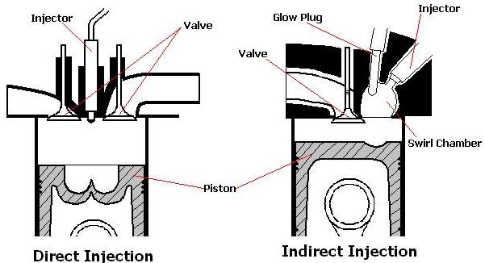
5.2-Combustion Chambers:
There are two main classes of combustion chambers
1- Direct injection (DI) into the main chamber.
2- Indirect injection (IDI), into some form of divided chamber.

Slide 4
5.2.1. Direct Injection Combustion Chambers (DI):
In this type of C.C there are many shapes which aimed to give equally good performance in terms of fuel economy. power and emissions, this means that the shape is less critical than careful design of the air motion and fuel injection.
Air motion inside the cylinder is very important in direct injection diesel engine

Slide 5
Shapes of C.C direct injection :
Shallow bowl C.C Hemispherical C.C

Slide 6
Shapes of C.C direct injection :
Cylindrical Deep Toroidal

Slide 7
Swirl: It is the rotation of air about the cylinder axis. It can be induced by surrounded or masked inlet valves and by the design of inlet passage.
$$swirl ratio=\frac{swirl speed (rpm)}{engine speed (rpm)}$$
Average value of swirl during induction and compression stroke is measured

Slide 8
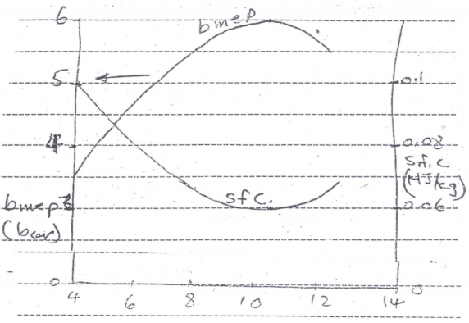
This curve shows the results which the swirl could be varied. The results for a constant fuel flow rate. The optimum swirl optimum economy and power output is about 10.5

Slide 9
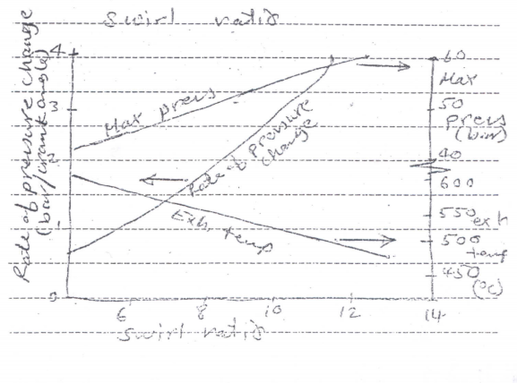
The maximum pressure and rate of pressure rise were both high, which caused noisy and rough running
Increasing swirl will increase the convection heat transfer coefficient from the gas to the cylinder walls, This will reduce the exhaust temperature and increase the heat transfer to the coolant.

Slide 10
5.2.2 Indirect injection combustion chambers (IDI)
Indirect injection C.C.s have a divided C.C.s in some form of pre-Chamber in which the fuel is injected and a main chamber with a piston and valves. This type was developed chiefly for use in small high speed engines. in an attempt to overcome some of the limitations of the open chamber type.

Slide 12
In this type the following possibilities may be realized
Extremely high air velocity through the throat during the compression stroke, which caused turbulence and swirl in the pre- chamber.
Very high pressure rise in the pre-chamber takes place within this space whose structure is so strong.

Slide 13
3. The mixing process may be greatly accelerated by the early stages of the combustion is incomplete in the pre-chamber because of insufficient air. and the high pressure developed by the early part of combustion projects the unburned fuel, together with early combustion products into the other part of the chamber with very high velocities, thus causing rapid mixing with the air in the space over the piston.

Slide 14
5.2.3-Comparison of Combustion Chambers
Advantages of indirect injection C.C.
Ability to use fuels of poorer ignition quality by using the heaters in the pre-chamber especially at cold starting
Ability to use single-hole injection nozzles and moderate injection pressures and to tolerate greater degrees of nozzle fouling
Ability to use higher fuel-air ratios without smoke. This ability would give higher max output

Slide 15
Disadvantages
More expensive cylinder constriction.
More difficulty cold starting because of greater heat loss through the throat
Poorer fuel economy due to greater heat losses and pressure losses through the throat which results in lower thermal efficiency and higher pumping loss .

Slide 16
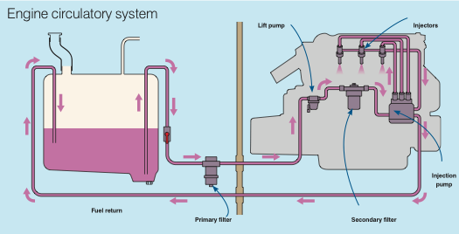
5.3- Fuel system in CIE

Slide 17
Fuel system in CIE
Fuel system is shown in the figure, generally the fuel tank is below the injector pump level the lift pump provides a constant-pressure fuel supply to the injector pump (about 0.75 bar The secondary filter contains the pressure-regulating valve, and the fuel bleed also removes any air from the fuel. Air in injection pump leads to incorrect metered amount of fuel, water and others impurities must be removed from fuel because of the fine clearance in the injection pump and injector

Slide 18
Diesel fuel pump and injector

Slide 19
5.4 Induction and Exhaust Processes
The Induction and exhaust processes are controller by valves in the combustion chamber, since the flow can be controlled by the piston moving past ports in the cylinder

Slide 20
5.4.1-Valves
The main type of valves which is commonly used is the poppet valve. In engines with this type of valves (overhead valves - ohv)the cam shaft is either mounted in the cylinder block, or in the cylinder head (overhead camshaft).

Slide 21
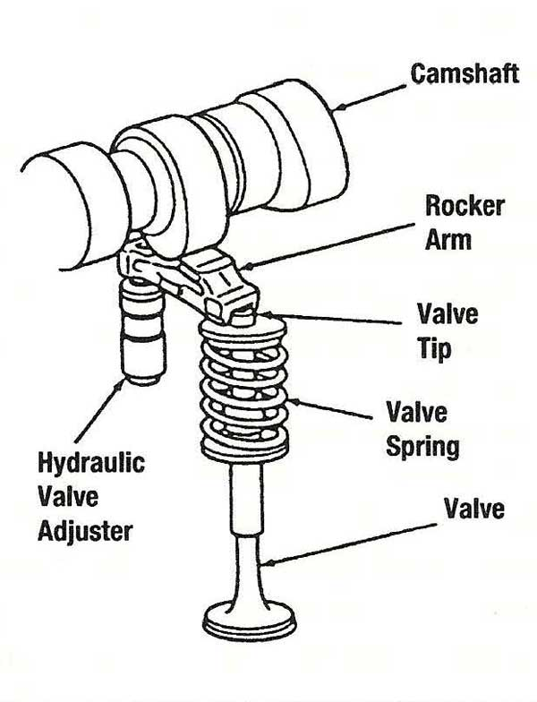

Slide 22
Advantages:
Cheap
Gives larger values of valve low area to piston area than most other types
Good flow properties
Easy lubrication, less friction than other types
Disadvantages:
High exhaust valve temperature, and difficult cooling.

Slide 23
5.4.2 Flow Characteristics.
The orifice area can be defined as
Ae= $π$D L
Where D= valve diameter
L= valve lift
Discharge coefficient CD= Ae/Ac
Where Ae is the effective area

Slide 24
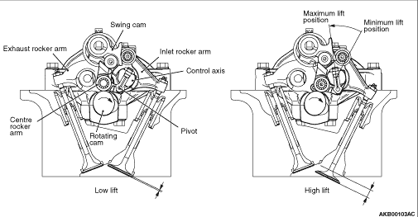
Discharge coefficient varies with valve lift and flow rate, i.e. non- dimensional valve lift (Lv/Dv) and Reynold number.

Slide 25
In case of exhaust valve the range of pressure ratios across the exhaust valve is much greater than that across the inlet valve, for this reason the area of the exhaust valve is usually less than the inlet valve is about 85% of the inlet valve

Slide 26
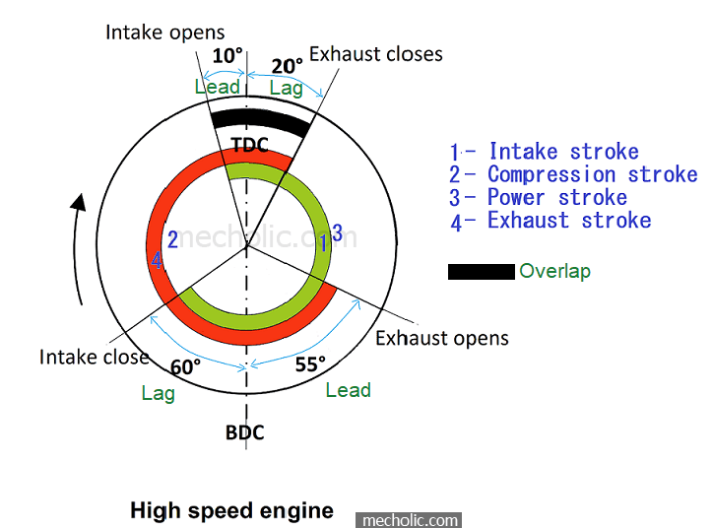
5.3 Valve timing
Valve timing is shown for a four stroke engine.
The overlap period is the period which at which both inlet and exhaust valves are opened

Slide 27
In SIE the overlap is larger. The part throttle and idling operation in the induction manifold pressure is relatively low, this may cause back-flow of the exhaust. Also at full load it is not economical since unburned mixture will pass straight through the engine when both valves are open at tdc.

Slide 28
These problems are avoided in a turbocharged engines with in-cylinder fuel injection.

Slide 29
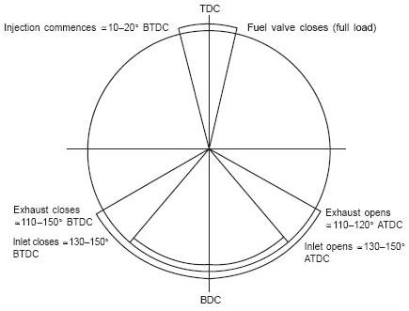
Two stroke timing
In two stroke engine the timing is controlled by the ports. the overlap period occurs near the bdc while the two inlet and exhaust ports are opened.

