Slide 1
Internal Combustion Engines
ENME 535
Department of Mechanical and Mechatronics Engineering
Dr. Mohammad Karaeen
Chapter 6
TESTING AND PERFORMANCE OF ICE
Notes:
Diagnostic Trouble Code
DCT

Slide 2
6.1 Measurements of air/fuel ratio
The practical determination of the air/fuel ratio consists of measuring the rate at which air and fuel are consumed by the engine.
Fuel can be measured by several means such as flow meters or calibrated glasses etc.

Slide 3
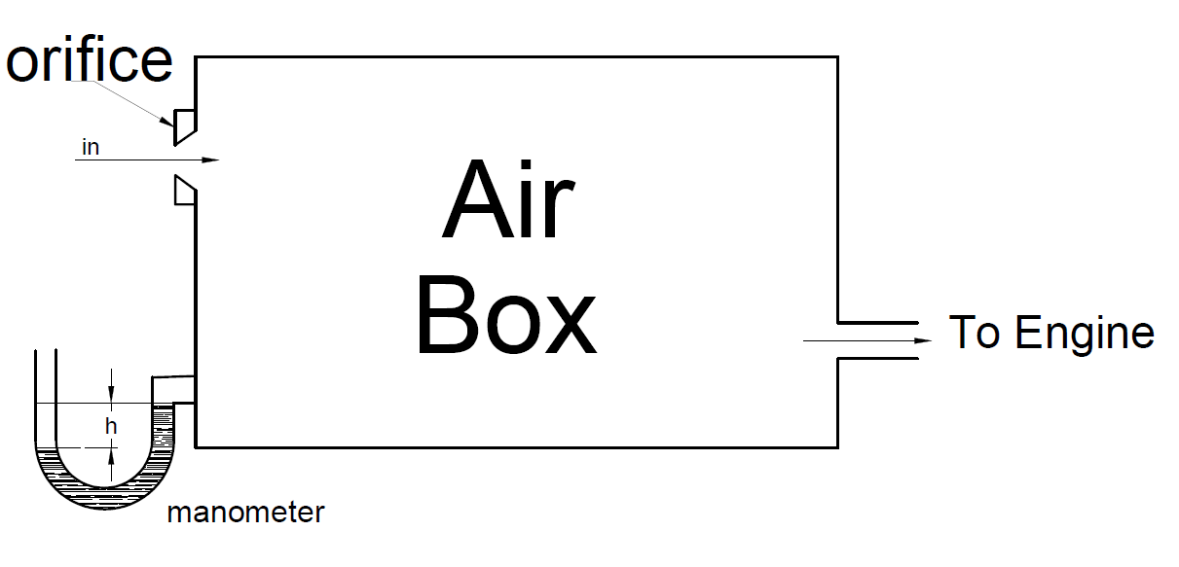
Air flow is measured using a relatively large air box. With an orifice at its inlet. It should and be large enough to damp out the pulsation in flow and be free of resonances in the normal steed range of engine.

Slide 4
Pressure drop can be measured across the orifice by manometer, and the mass flow rate is :
$$m_{a}=C_{d}A_{o}\sqrt{{2∗g∗h∗ρ}_{f}∗ρ_{a}}$$
Where:
$m_{a}$ = mass flow rate air (kg/s)
$C_{d}$= discharge coefficient of the orifice $A_{o}=$orifice cross-section area (m)
H= hight difference in the manometer (m)
$ρ_{f}$=density of manometer fluid (kg/$m^{3}$ )
$ρ_{a}$= density of air $=\frac{P}{R_{n}∗T}$ (kg/$m^{3}$)

Slide 5
6.2 Indicated Power:
Measurement of indicated power can be done by one of the following methods:-
Indicator diagram
The area of the PV diagram can be found. This area is corresponding to the indicated work per cylinder per cycle. The area can be found by cutting squares of the diagram or by a plan meter. The plan meter is a mechanical device that computes The area of the diagram by tracing the perimeter

Slide 6
2. Motoring:
Using an electrical dynamometer being used as a motor instead of a generator in order to motor the engine at the firing speed with the fuel supply cut off. Measuring the break power of the engine in the normal way at certain speed, then using the dynamometer to give the same speed with the fuel supply cut off this will give the indicated power of the engine and the mechanical efficiency of the engine can be used. This is the main advantage of using the electrical dynamometer.

Slide 7
3. Morse Test.
This test is only applicable to multi-cylinder engines. The engine is run at the required speed and the torque is measured. One cylinder is cut out. By shorting the plug if in S.I.E or by disconnecting an injector of C.I .
Engine is under test. The speed falls because of the loss power with one cylinder cut our, but is restored by reducing the load. The torque is measured again when the speed has its original value

Slide 8
If the values of i.p of cylinders are denoted by I1, I2, I3 and I4 and the power loss in each cylinder L1, L2, L3 and L4. Then the value of break power B at the test speed with all cylinders firing is given by :
B = ($I_{1}$ - $L_{1}$) +$(I_{2}$ - $L_{2}$) + ($I_{3}$ - $L_{3}$) + ($I_{4}$ - $L_{4}$)
Disconnect Cylinder 1:
B1 = ($0$ - $L_{1}$) +$(I_{2}$ - $L_{2}$) + ($I_{3}$ - $L_{3}$) + ($I_{4}$ - $L_{4}$)
By cutting out each cylinder in turn the values I2, I3, and I4 can be obtained.
Then I = $I_{1}$ +$I_{2}$ + $I_{3}$ + $I_{4}$

Slide 9
The deficiencies of Morse Test method are:
The friction loss is different between firing and motoring.
The mixture distribution between cylinders is upset when one of them is cut off.

Slide 10
4.Willan’s Line:
This method is applicable to C.I.E only, because this type of engines has nearly linear relationship between b.p & fuel consumption.
At constant engine speed the load is reduced in increments and corresponding b.p is in the figure.
The graph drawn called the “Willan’s line” as in steam engines.
This line is extrapolated back to cut the b.p axis at point A.

Slide 11
OA is the power loss of the engine at that speed.
The disadvantage of this method is that fuel relation between b.p and fuel consumption is not straight line.

