Slide 1
Internal Combustion Engines
ENME 535
Department of Mechanical and Mechatronics Engineering
Dr. Mohammad Karaeen
Chapter 7
SUPERCHARGING & TURBOCHARCHING
Notes:
Diagnostic Trouble Code
DCT

Slide 2
7.1 Introduction:
Supercharging is the introduction of air (or air fuel mixture) into an engine cylinder at a density greater than ambient This allows a proportional increase in the fuel that can be burned and hence raises the potential power output. The principal objective is to increase power output, not to improve efficiency, although the efficiency may benefit.

Slide 3
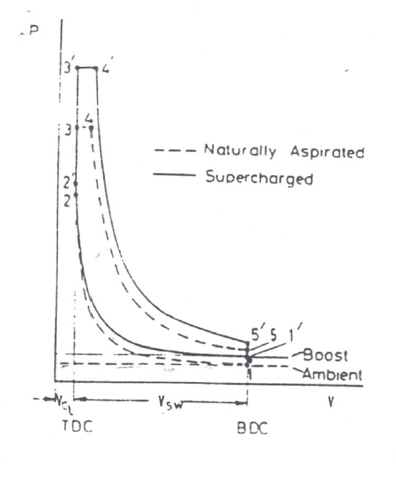
The effect of supercharging on power output can be seen from the cylinder pressure volume diagram (PV). The figure compares the naturally aspirated and supercharged ideal cycle The supercharged cycle starts at higher pressure (and density) point 1’ extra fuel can be Burned between 2'-4' because more air is available

Slide 4
Two things are clear
The supercharged engine has a greater power output.
Much higher maximum pressure .
Unless the engine is designed to be supercharged the high maximum pressure may not be acceptable. The engine may not withstand the stresses involved. By reducing the compression ratio the clearance volume is increased and maximum pressure will be reduced.
If the CR is suitably chosen. the maximum pressure in the supercharged engine can equal that of the naturally aspirated engine the power output of the supercharged engine remains greater than that of the naturally aspirated engine

Slide 5
7.2 Mechanical Supercharging
In order to obtain high inlet air density to the engine, work must be done to compress ambient air up to the boost pressure at that point. A compressor is driven from the crankshaft of the engine. This is a conventional mechanically driven supercharger. The power required to drive this compressor must be debited from the indicated power (P-V diagram) output. Fortunately when fitting a mechanically driven supercharger to an engine it is insured that the indicated power output rises sufficiently to more than compensate for the power required of the supercharger and any additional frictional losses

Slide 6
The losses to drive the compressor made it necessary to look for another types of supercharging

Slide 7
7.3 Turbocharging
Turbocharging is a specific method of supercharging. An attempt is made to use the energy of the hot exhaust gas of the engine to drive the supercharging compressor. It is clear that it is no longer necessary to debit the power requirement of the compressor from the indicated power of the engine .

Slide 8
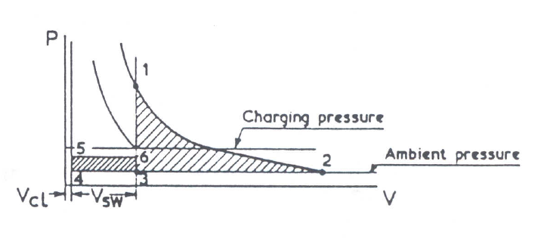
The ideal available exhaust energy is shown in the figure. The energy consist of the "blow- down” energy after reversible adiabatic condition 1(where the exhaust valve opens) to ambient pressure at point 2. area 1-2-3. and the work done by the piston in displacing remaining exhaust expansion from gas, area 3-4-5-6

Slide 9
7.3.1 Constant Pressure Turbocharging
In this type of turbocharging the multi cylinder engines. The exhaust manifolds from all cylinders are connected to a common large chamber This leads to a single turbocharger turbine. A reciprocating engine is inherently an unsteady flow device, each cylinder exhausting in turn at intervals during the cycle

Slide 10
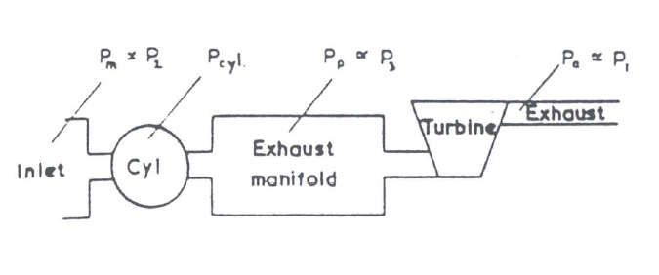
When the exhaust valve of a cylinder opens, the gas expands down to the constant pressure in the exhaust manifold without doing useful work. However not al of the "puls" energy is lost. From the law of conservation of energy the only energy actually lost between cylinder and turbine will be due to heat transfer. With a well-insulated manifold, this loss will be very small and can be neglected.
Consider what happens to the gas leavening the cylinder, expanding down into the exhaust manifold then flowing through the turbine

Slide 11
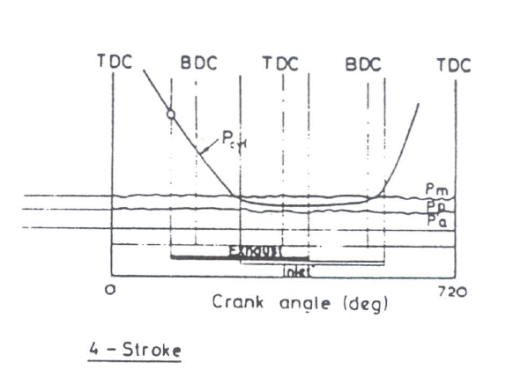
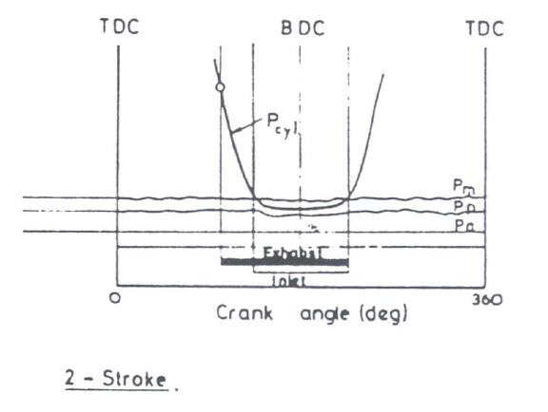
The enthalpy/entropy diagram is shown. (the diagram can be considered as temperature entropy diagram for perfect gas. Point 01 denotes stagnation conditions in the cylinder and h is the stagnation enthalpy of the gas in the cylinder. (Pp=P3) is the pressure in the exhaust manifold and P4, is the pressure at turbine exit normally equal to the atmospheric pressure Pa.

Slide 12
7.3.2 Puls Turbocharging
In the puls system turbocharging a try to improve the transmission of energy from the cylinder to the turbine, The principle can be explained with reference to a single-cylinder engine fitted with a single turbocharger (although it is not normally used with such an engine).

Slide 13
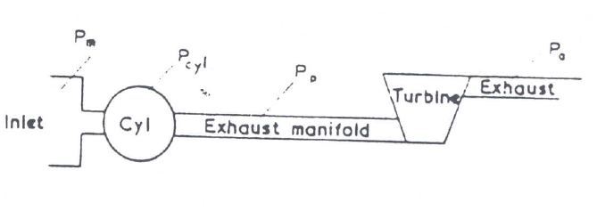
A short narrow pipe ensures that some of the kinetic energy of the gas leaving the exhaust port is maintained and not destroyed in sudden expansion. The kinetic energy is partially transmitted to the turbine in the form of pressure wave The figure shows a typical pressure/time diagram in the cylinder and in the pipe. Compared with the constant pressure system the exhaust manifold pressure is no longer constant.

Slide 14
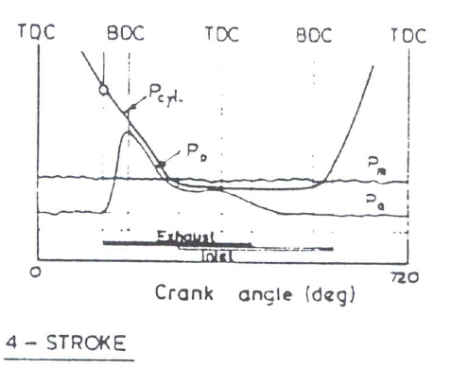
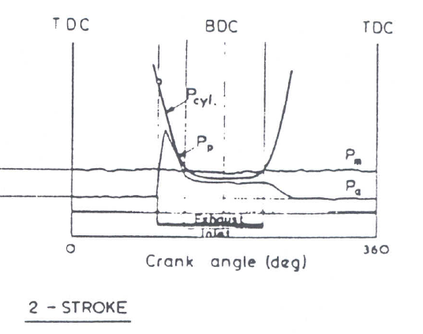
It is clear that the gas flow into the turbine is highly unsteady and will in fact be zero for much of the time When the pressure arrives the turbine entry, the turbine will tend to accelerate when the pressure wave decays the turbine will tend to decelerate due to the power absorption of the compressor For this system to work well attempts must be made to reduce the low unsteadiness at the turbine entry
Reducing the flow unsteadiness is by connecting the narrow exhaust pipes from several cylinders to a common turbine .

Slide 15
7.3.3 Comparison between constant Pr & Puls Turbocharging
Constant pressure turbocharging has a steady turbine entry conditions with time. Thus all the losses in the turbine that results from unsteady flow are absent.
Single entry turbine may be used with const. press TC while more than turbine entry is used in puls TC.
Single turbocharger can be used on all multi-cylinder engines in const. Press TC It will be a large unit which has lower losses and hence have higher efficiency .
The exhaust manifold in const. Press TC is simple to construct although it may rather bulky .
The major disadvantage of the const, press TC system arises when the engine load is suddenly increased or a rapid engine speed increase is required. The pressure in the large volume is slow to rise. hence the energy available at the turbine increases only gradually. Turbocharger and engine response will be poor .

Slide 16
7.3.4 Charge cooling
The compression of air in the compressor is accompanied by a temperature rise. This temperature rise will depend on the pressure ratio and the efficiency of the compressor. Anything that helps to reduce the inlet manifold air temperature will increase the density of the air and consequently increases the mass of air in the cylinders. It follows that reducing this temperature will enable more fuel to be burnt and the power output to increase.

Slide 17
Since the compressor or delivery temperature is greater than the ambient temperature it is possible to use a simple heat exchanger to reduce T2 .
Since the charge cooler is fitted between the compressor and engine, it is often called an intercooler, or sometimes after cooler .
The effectiveness ($ε$) Can be defined as Follows
$ε=\frac{T_{2a}−T_{2h}}{T_{2a}−T_{w}}$

Slide 18
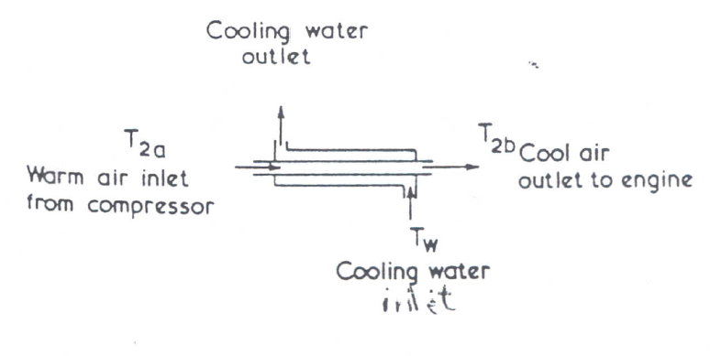
The effectiveness ($ε$) Can be defined as Follows
$ε=\frac{T_{2a}−T_{2h}}{T_{2a}−T_{w}}$
Where $T_{2a}$ =warm air inlet From compressor
$T_{2h}$=cool air outlet to engine
$T_{w}$=cooling water inlet
Inlet

Slide 19
7.4 Turbocharging Systems
Turbocharging has become the preferred form of increasing the output of virtually every type of Diesel engine, additionally, improving many other operational factors, such as specific fuel consumption. operational flexibility, noise…etc.
Some turbocharging systems will be discussed in the following sections:

Slide 20
7.4.1 Compound Engines
In the conventional turbocharged engine. the turbocharger relies on exhaust gas energy to provide supercharging boost pressure to the engine. Under some circumstances this energy, due to low turbocharger system efficiency. is not enough to provide a reasonable level of boost (specially at low engine speeds). In this situation it might be useful to help drive the turbocharger compressor from the crank shaft

Slide 21
This rises the boost pressure and hence the power output at low speed. Such an engine would have an attractive low-speed torque output. This is called the compound engine

Slide 22
Disadvantages:
Typical rotational speeds of engine and TC differ by at least (10). times in magnitude. A high gear ratio is required, which at the turbocharger end. might involve gear running between 20.000 & 100.000 rpm .The reliability and efficiency of such a gear drive is questionable.

Slide 23
Disadvantages:
2. At high engine speeds and loads the power output of the turbocharger turbine is enough, and the turbocharger speed rise more rapidly than engine speed. If a fixed gear connects the two the turbocharger will be restrained and the relatively low rotational speed of the turbine limits the benefit obtained .
To solve this problem a variable gear ratio between the engine and turbocharger must be done, but this introduces obvious mechanical difficulties

Slide 24
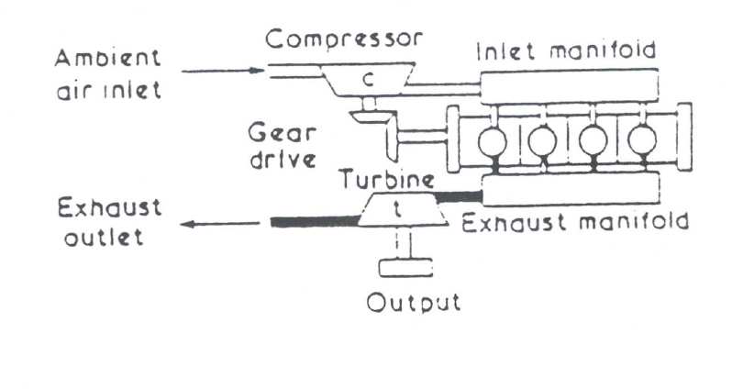
7.4.2 Gas Generator Power Plant
In this type of engine the compressor is driven mechanically from an engine with no net crankshaft power output. The turbine is not connected to the compressor but its output will be taken directly replacing the engine as a power source. The engine and compressor combination alone would form a self-supporting gas-generator (that is. generate a high energy exhaust gas flow)

Slide 25
7.5 Turbocharger Thermodynamics
The work done by or to a turbomachine can be derived from 1 Low as follows:
Q – W= m [(h2 + kE2 + PE2) - (h1+KE1+ PE1)]
Where:
Q =heat transfer rate to the system
W= work transfer rate from the system
h= specific inthulpy
kE= specific kinetic energy
PE =specific potential energy
And neglecting KE and potential energy and
Q -W =mCp (T2 – T1) …….(1)

Slide 26
7.5.1 Compressor Insentropic Efficiency
$ηc=\frac{h_{2s}−h_{1}}{h_{2}−h_{1}}$
and for a perfect gas $c_{p}$=constant
$ηc=\frac{T_{2s}−T_{1}}{T_{2}−T_{1}}$

Slide 27
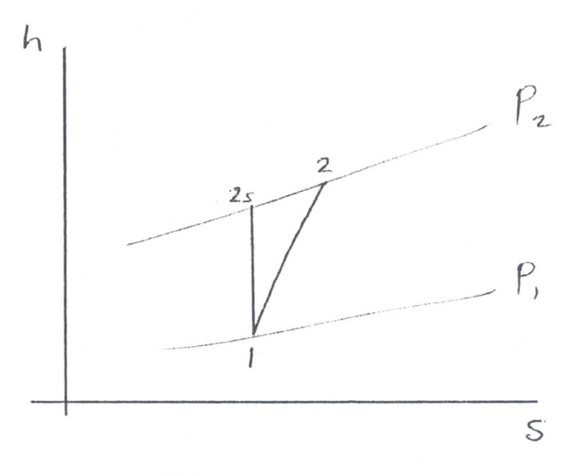
For isentropic compression
$$\frac{p_{2}}{p_{1}}=[{\frac{T_{2S}}{T_{1}}] }^{γ/{γ−1}}$$
$ηc=\frac{T_{1}[\frac{T_{2S}}{T_{1}}−1]}{T_{2}−T_{1}}$ $=\frac{T_{1}[({\frac{p_{2}}{p_{1}})}^{\frac{γ−1}{γ}}−1]}{T_{2}−T_{1}}$
$$ηc=\frac{ ({\frac{p_{2}}{p_{1}})}^{\frac{γ−1}{γ}}−1}{\frac{T_{2}}{T_{1}}−1}$$

Slide 28
7.5.2 Turbine Isentropic Efficiency:
$η_{t}$=$\frac{Actual Work}{Isentropic Work}$
$η_{t}=\frac{h_{3}−h_{4}}{h_{3}−h_{4s}}$
and perfect gas $C_{p}$ =constant

Slide 29
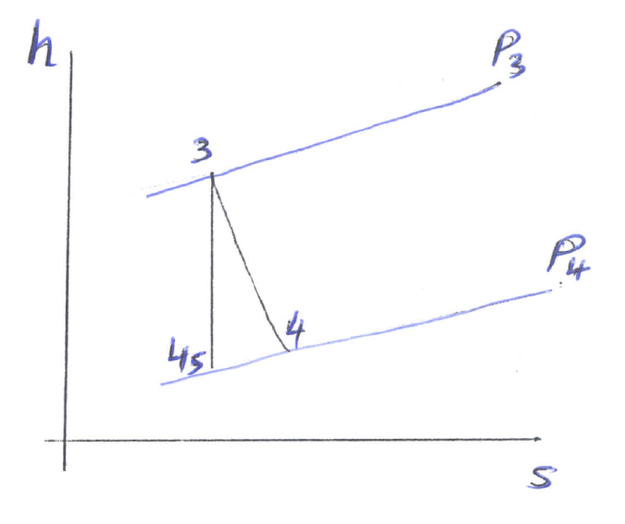
For isentropic expansion
$$\frac{p_{3}}{p_{4}}=({\frac{T_{3}}{T_{4S}})}^{\frac{γ}{γ−1}}$$
From which
$η_{t}=\frac{ 1−\frac{T_{4}}{T_{3}}}{1−({\frac{p_{4}}{p_{3}})}^{\frac{γ−1}{γ}}}$

Slide 30
7.5.3 Turbocharger Mechanical Efficiency
$η_{m}$=$\frac{m_{d}{∗C}_{pa }∗(T_{2}−T_{1})}{m_{d+1}{∗C}_{pa }∗(T_{3}−T_{4})}$

