Slide 1
Birkenhead masterplan urban regeneration
Birkenhead, Merseyside, England, UK. between Birkenhead Park and The West Float of the docks
Fayrouz Abed
Daad Samara
Saleh Jbr

Slide 2
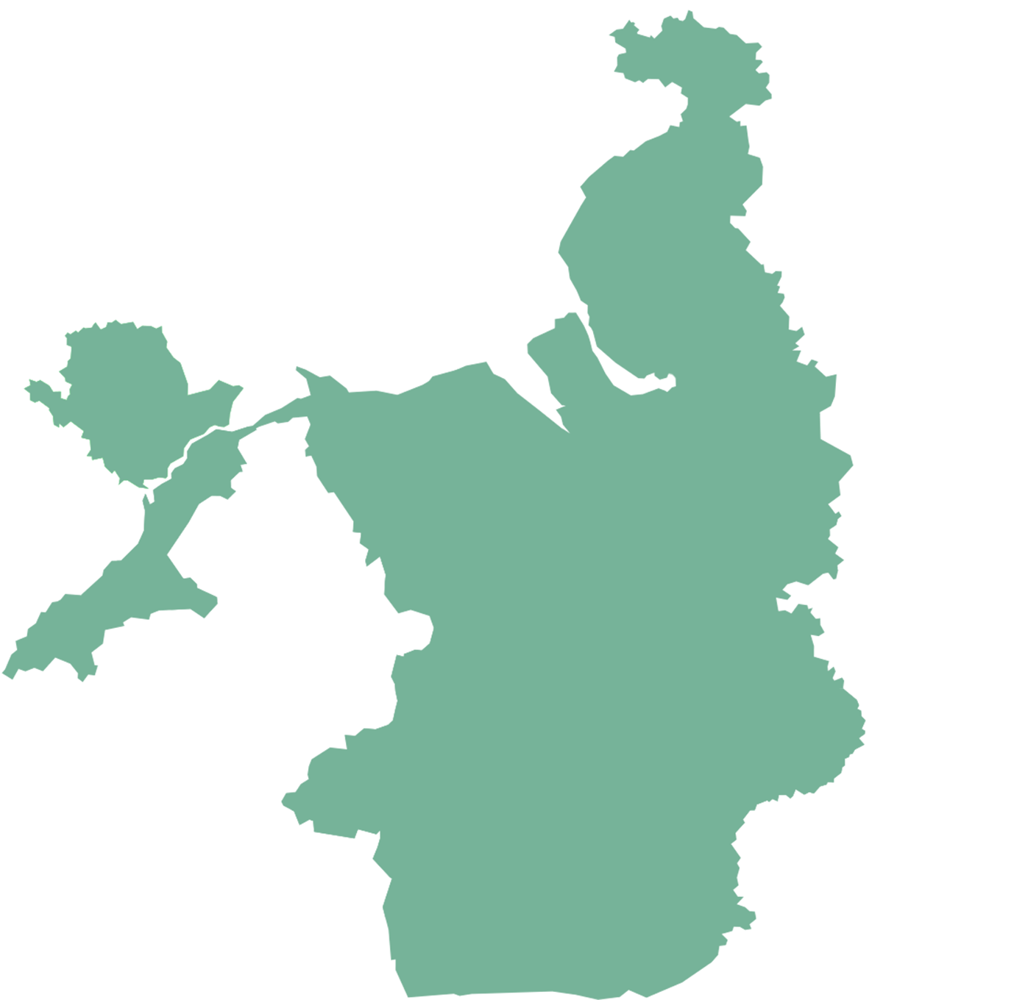
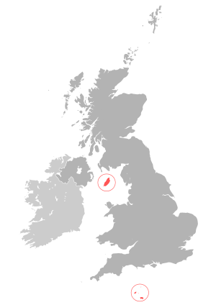
L O C A T I O N
Birkenhead, Merseyside, England, UK
Merseyside, Liverpool, England, UK.

Slide 3
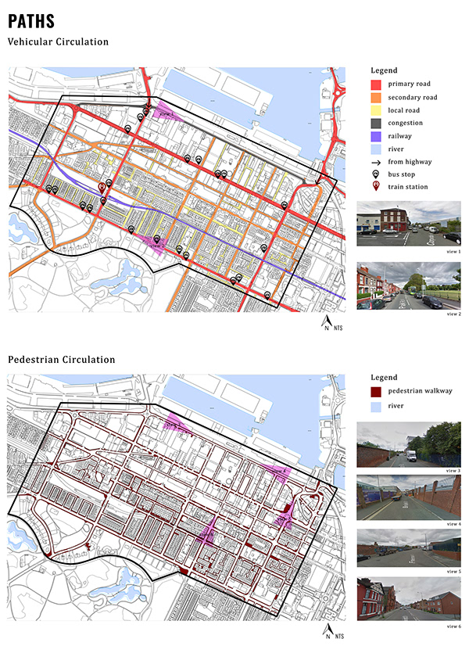
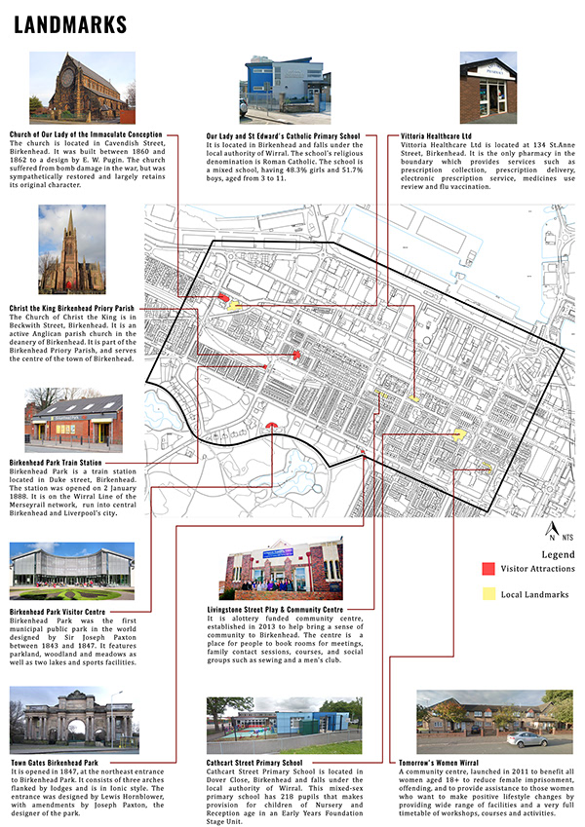
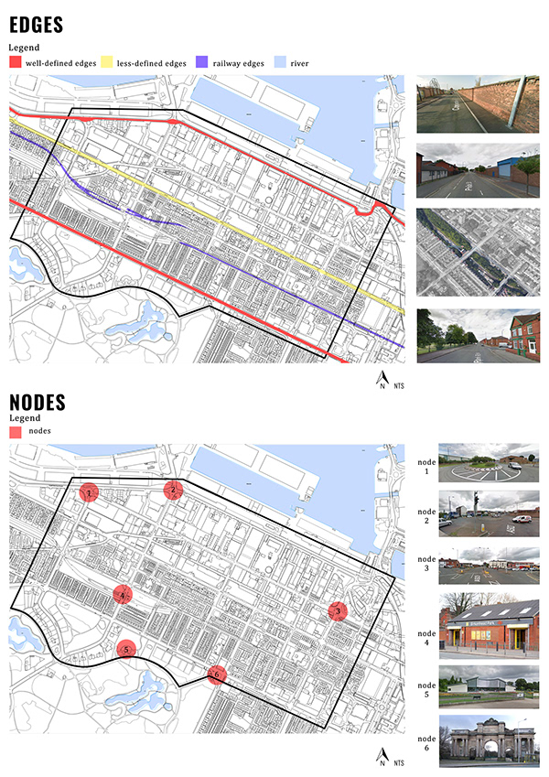
S I T E A N A L Y S I S

Slide 4
PHASING
PHASE II
PHASE III
PHASE I
10 years development
-Loop of tramline and connect with Wirral Water’s at south area
-Shift of urban food hall to develop the south of the city.
-Old food hall becomes permanent all . - Old heavy industry move to the edge towards the west dock.
-Upgrade retained existing row houses to an house !”
30years development
-Development of core zone.
-Formation of green spin and link to Wirral Water’s Sky City.
-Formation of Urban Square and High Street at core zone.
-Loop all tramlines.
-Town houses renovation
5 years development
-Kick- start of the development by converting an abandoned warehouse to an urban food hall and pop - up market to regenerate the local economy.
-Reintroduce tram services in the city from existing Birkenhead Park train station )
-Propose a green spline and links to wiral water's me direct people to the urban food Mall
-Retain existing row houses and upgrade in 10 years development”

Slide 5
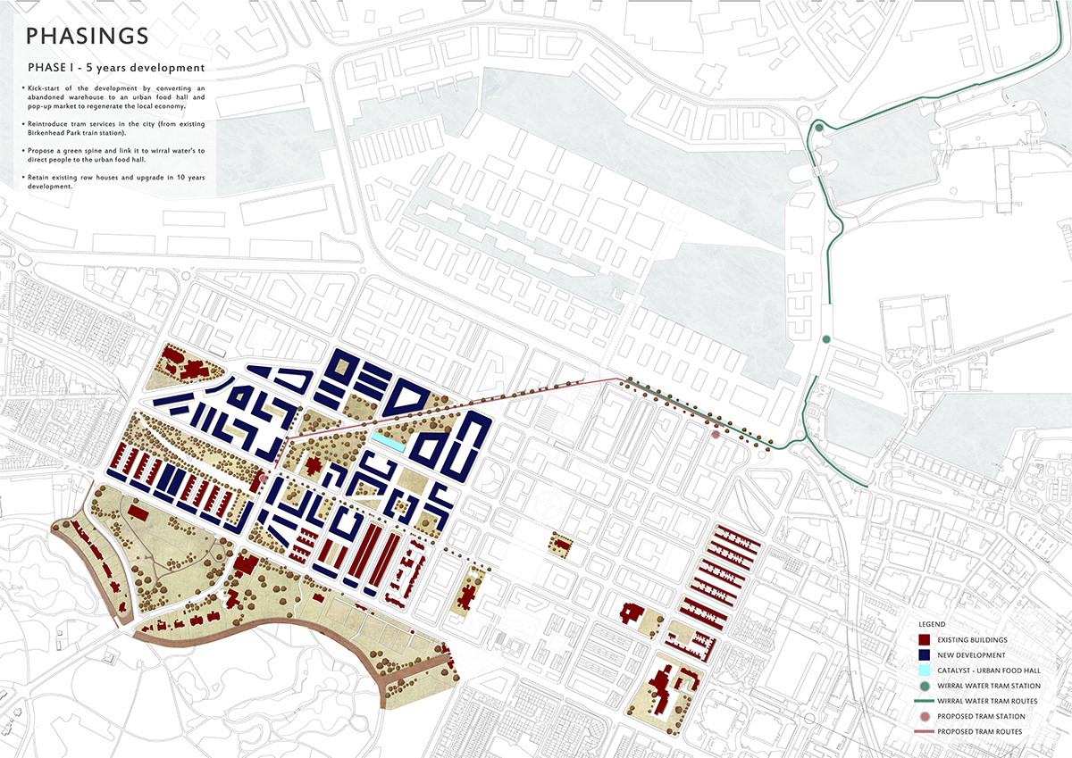
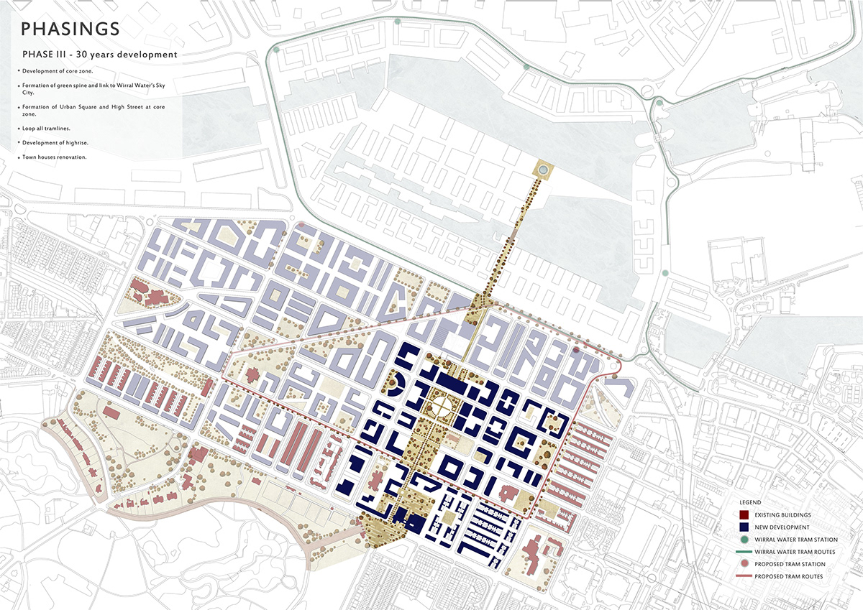
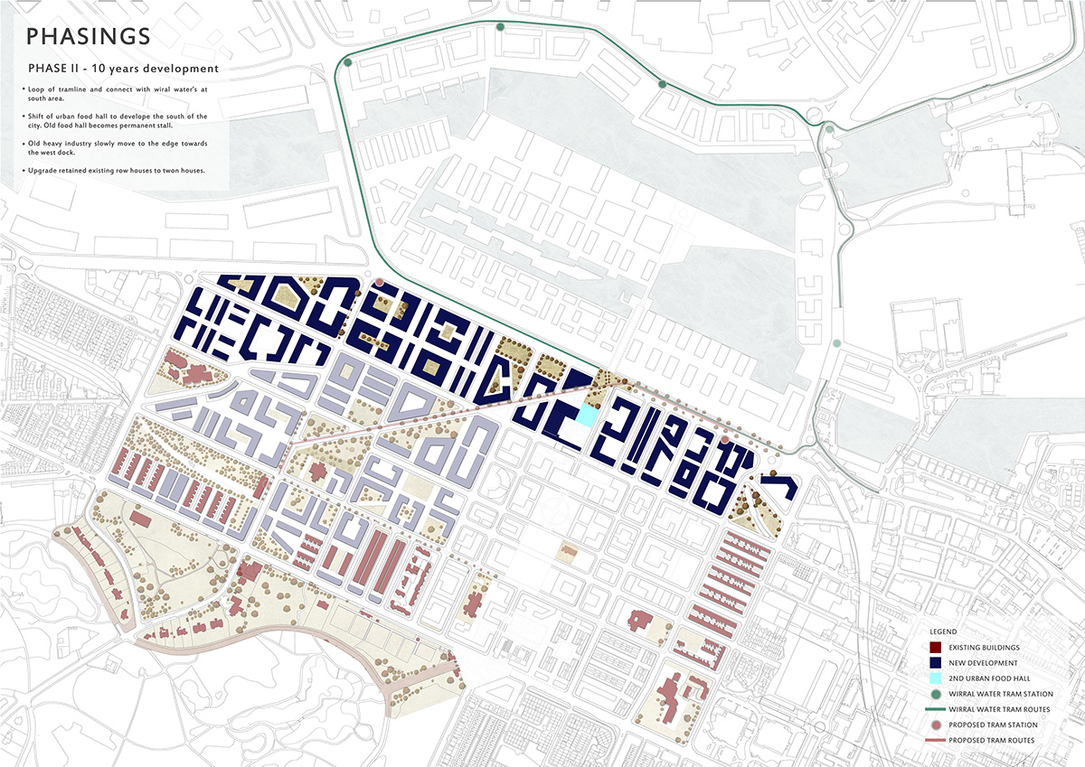
P H A S I N G

Slide 6
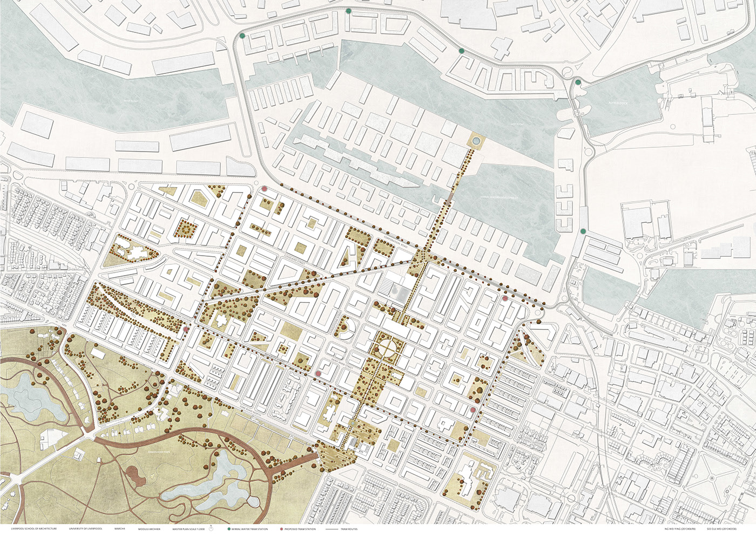
Birkenhead master plan in final phasing - 30 years time.

Slide 7
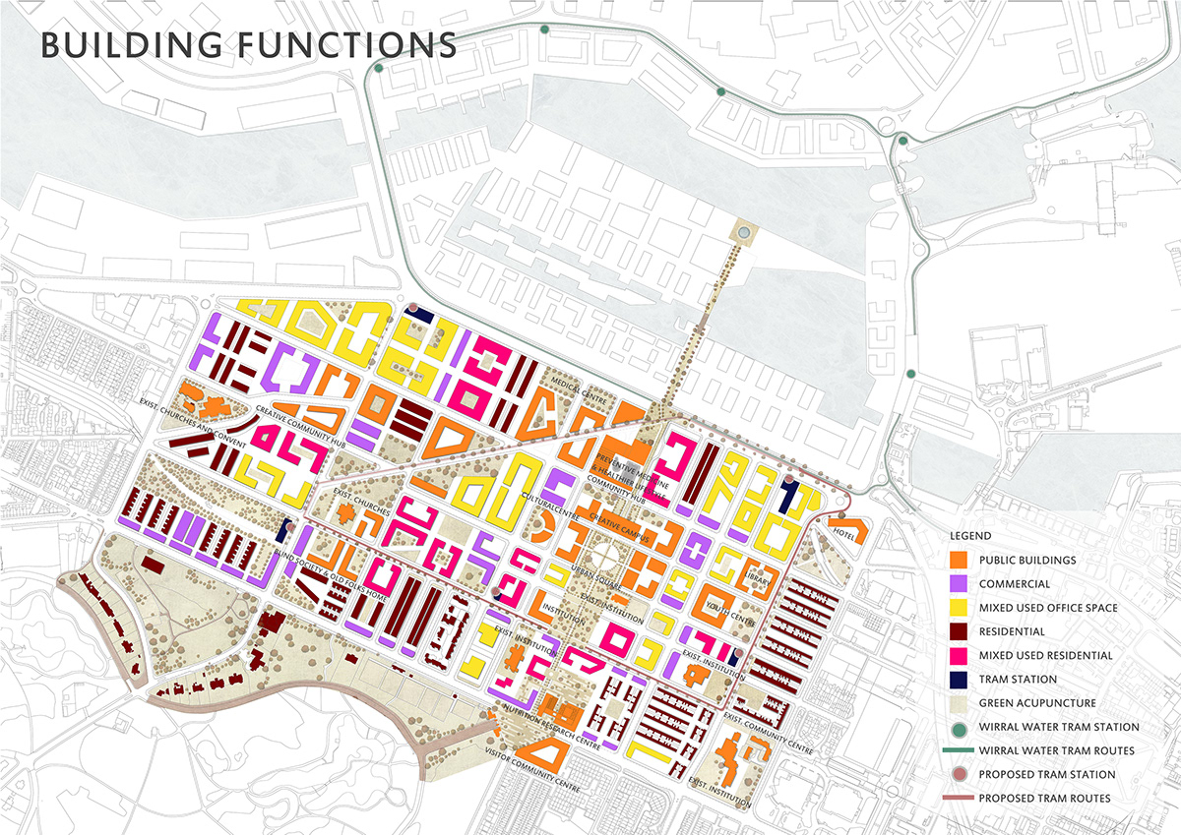

Slide 8
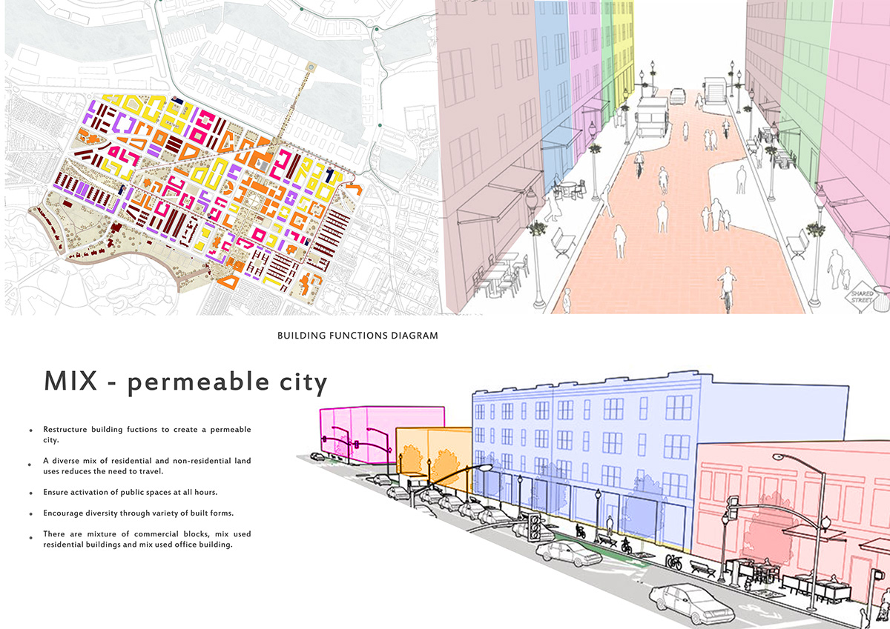

Slide 9
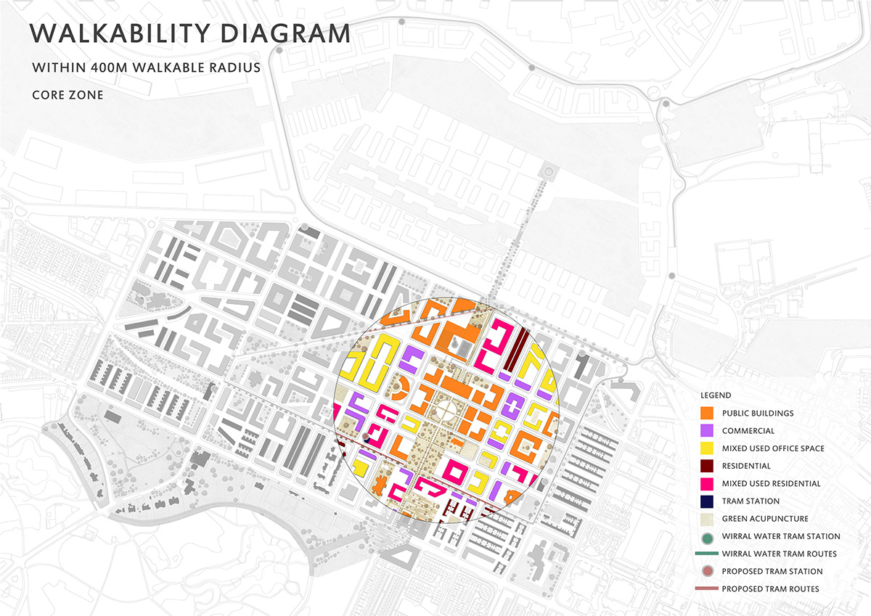

Slide 10
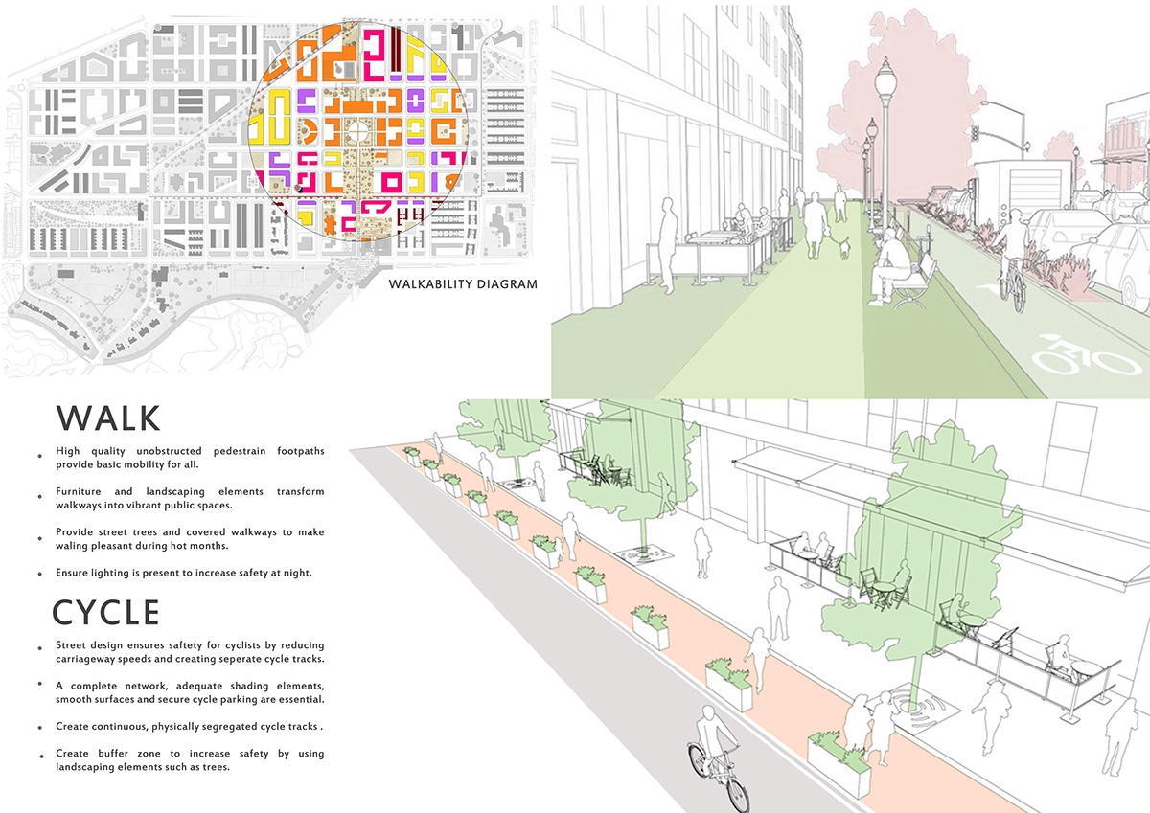

Slide 11
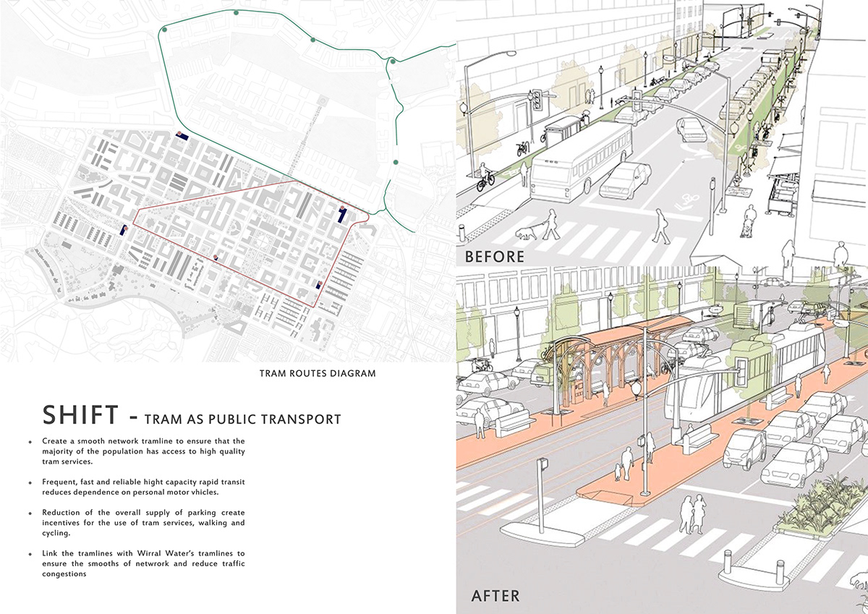

Slide 12
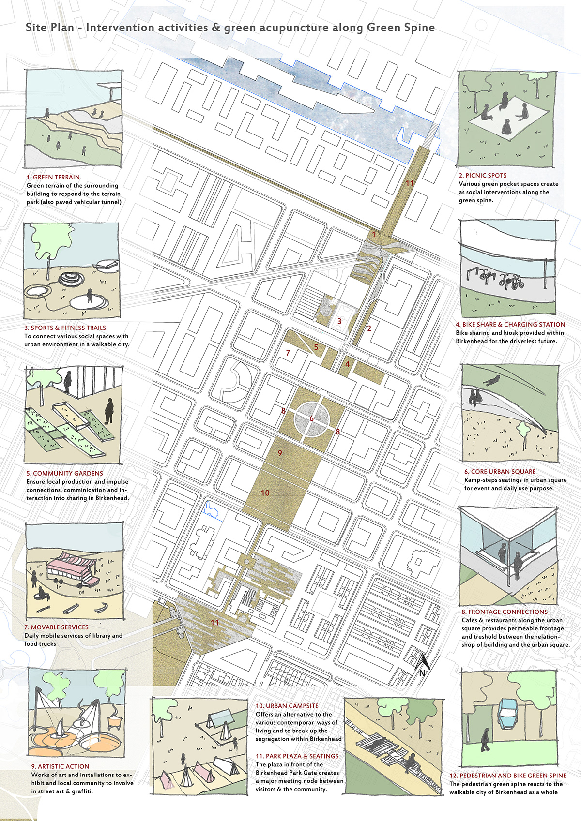
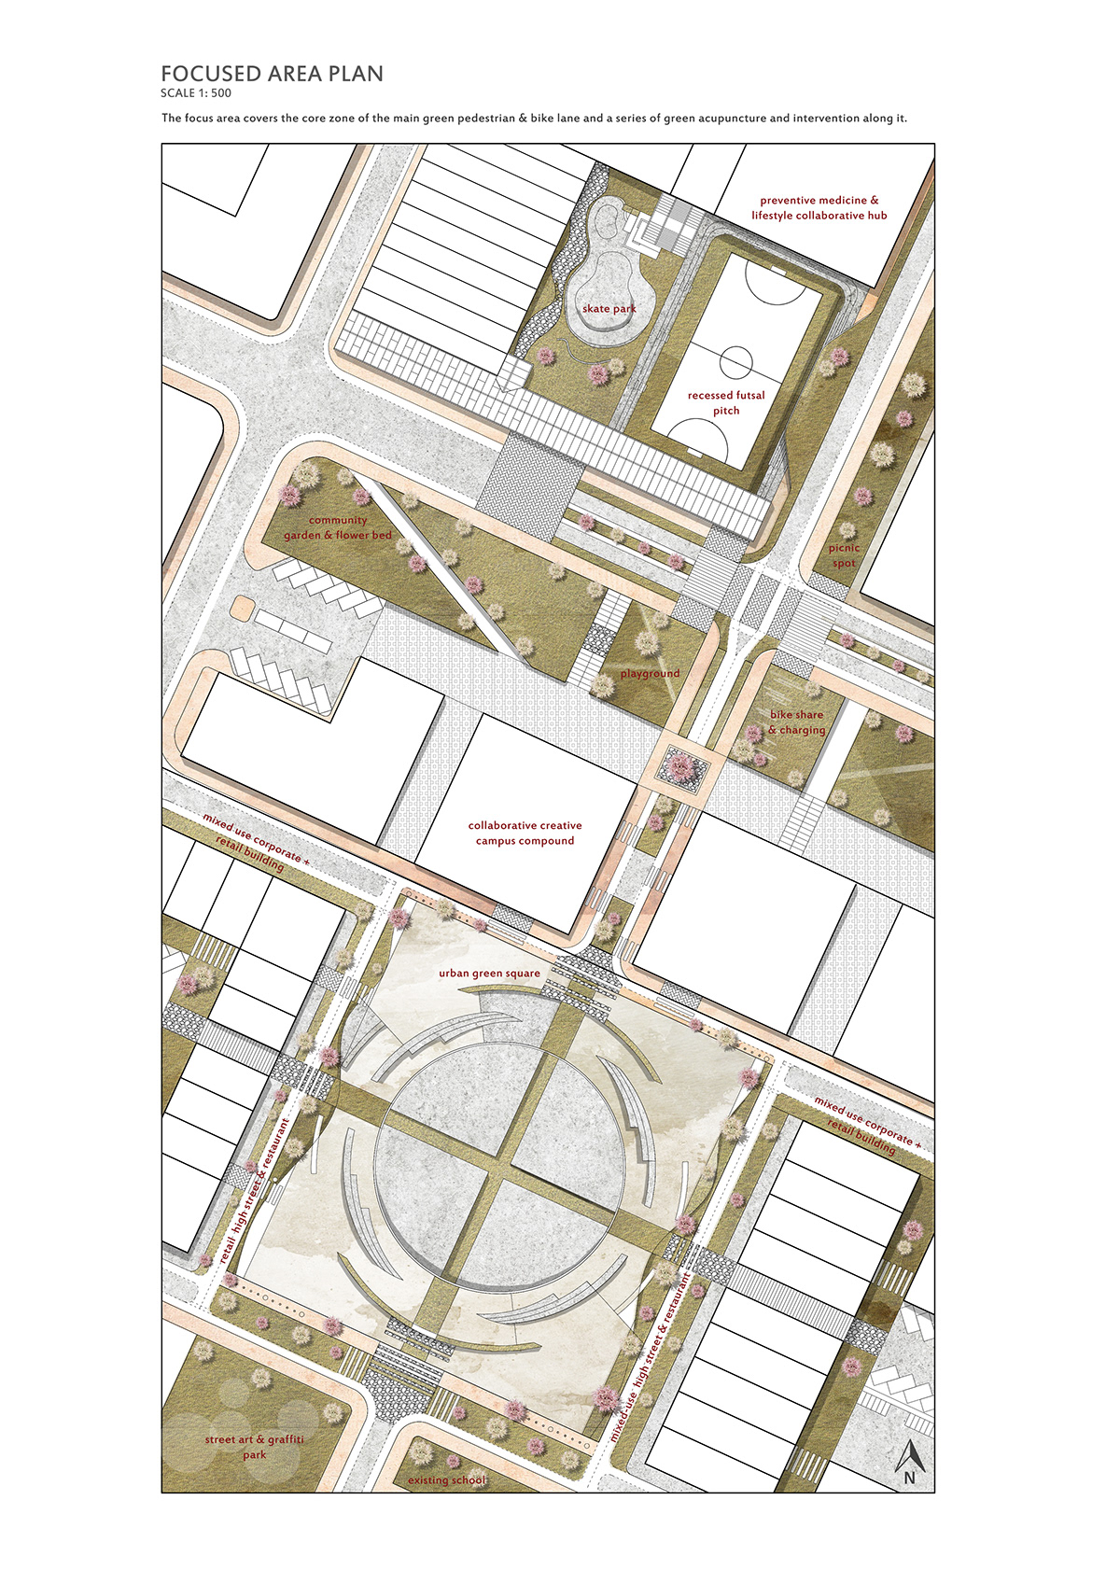
G R E E N S P I N E
FOCUS

Slide 13
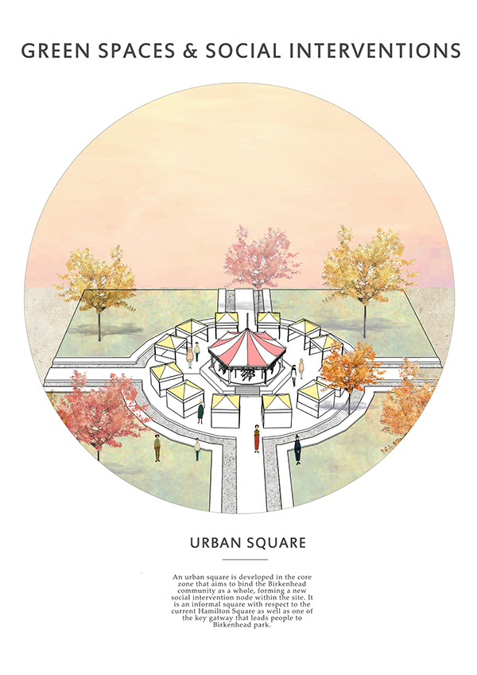
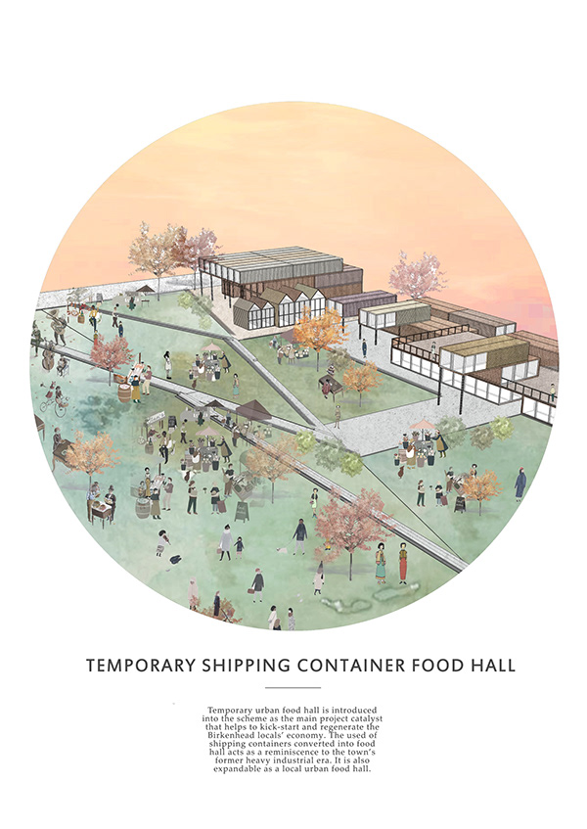
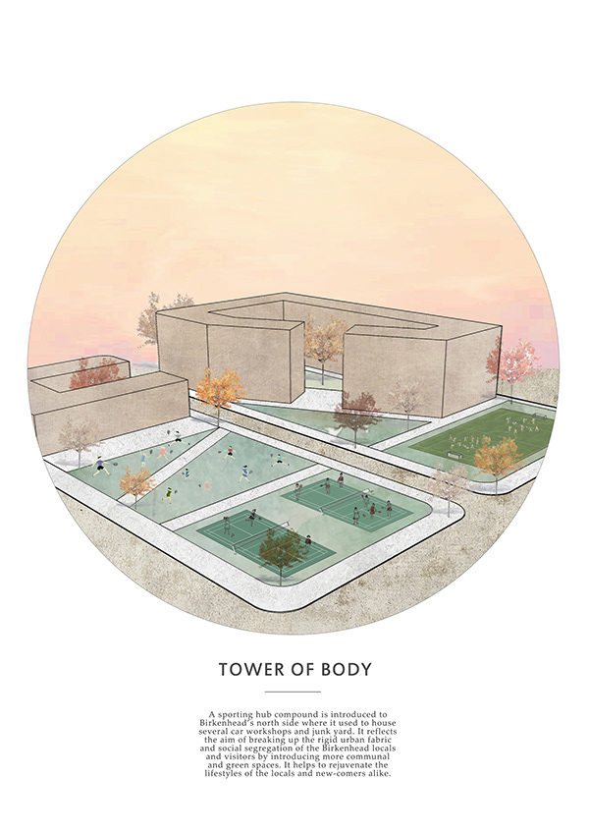

Slide 14
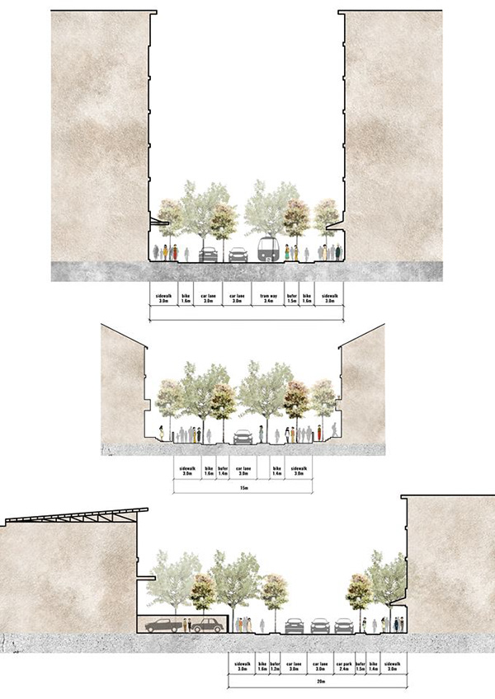
SECTIONS

Slide 15
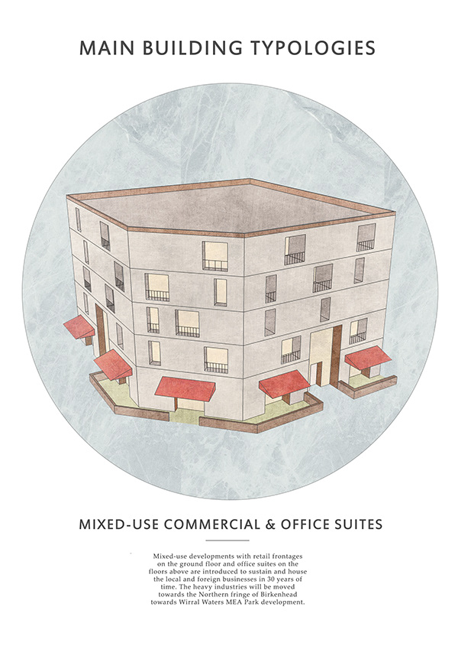
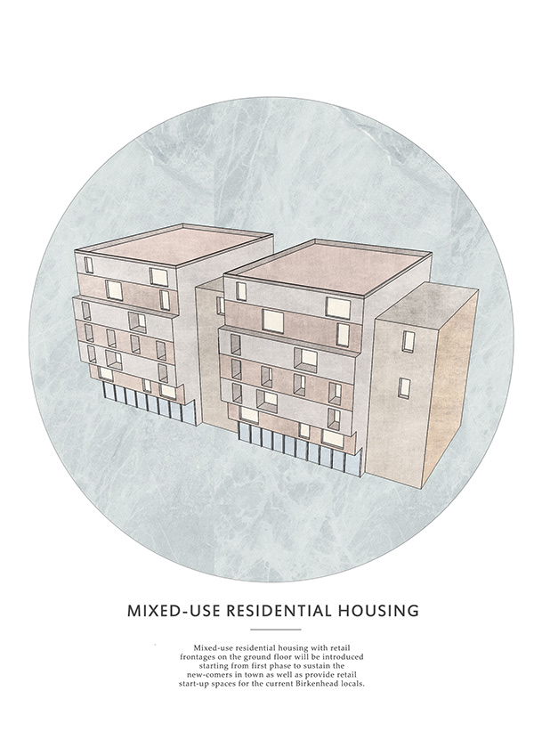
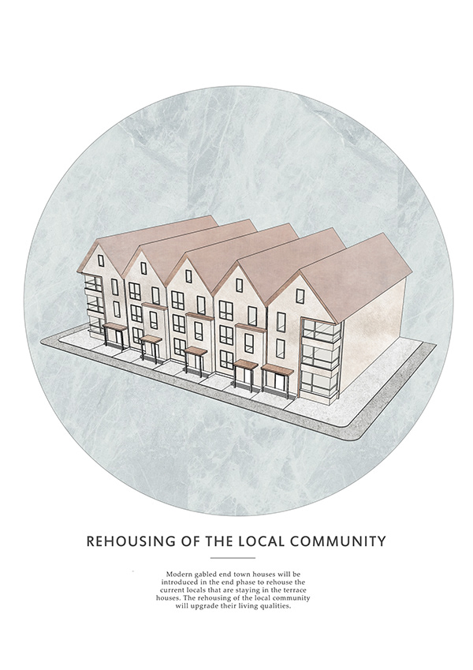

Slide 16
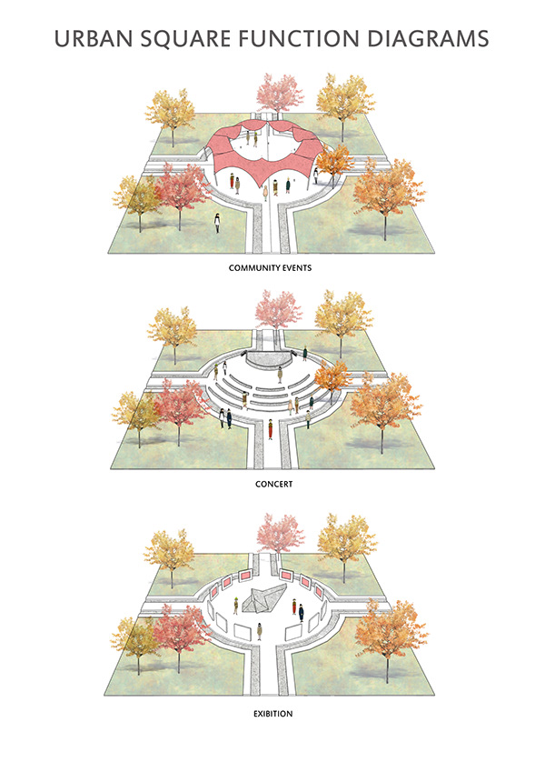
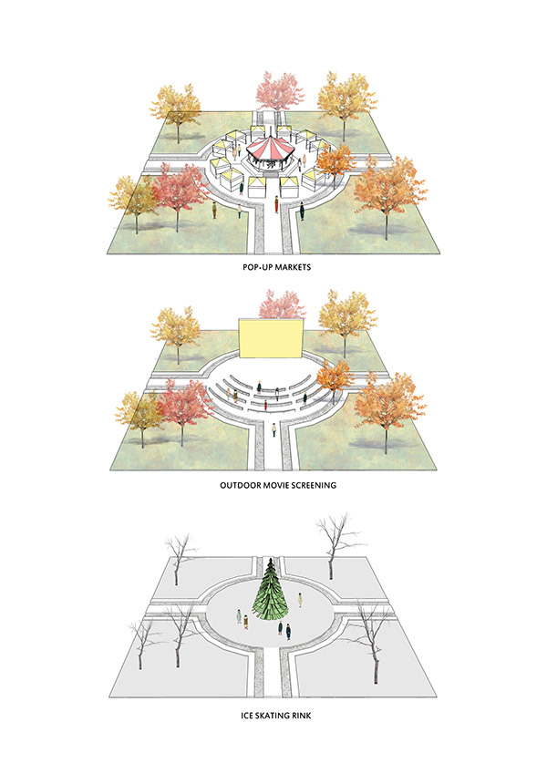
U R B A N S Q U A R E

