Slide 1
Indoor plant (house plants)

Slide 2
Indoor plant (house plants)
Foliage plants
Air plants
Palms
Finger –leaved
Climbers and trailers
Baby –bearing plants
Herringbone plants
Lobbed and star-leaved plants
Living stones
Insect eater
Spear-leaved
Bushy upright
Bushy plants
trees

Slide 3
Air plants
Tillandsia sp.

Slide 4
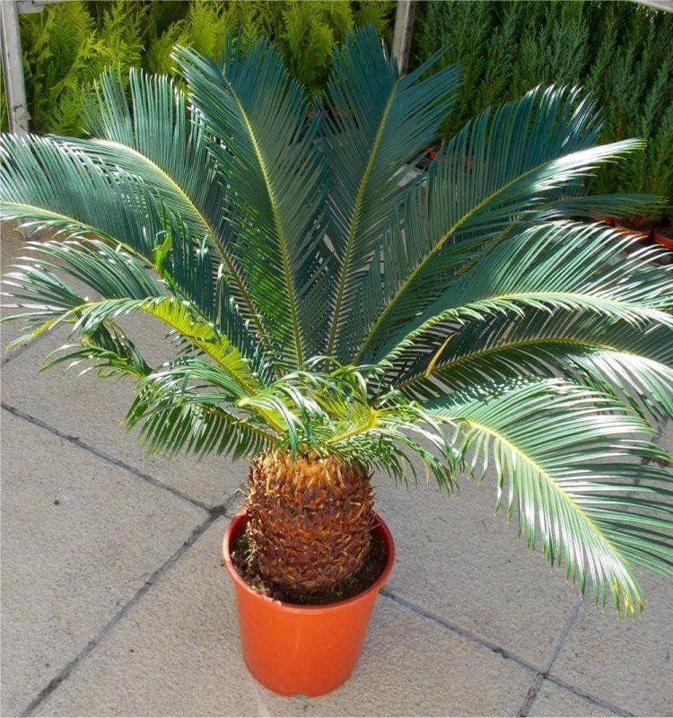
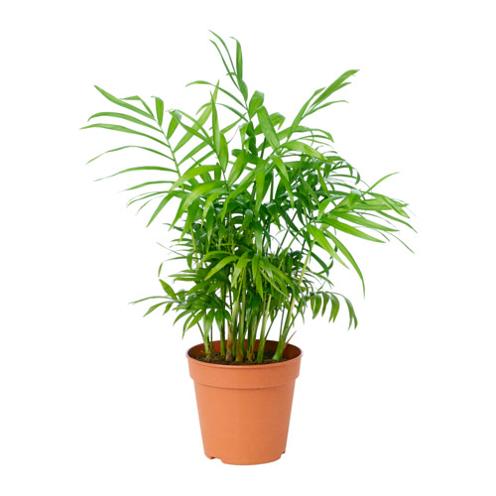
palms
Neanthe bella
Cycus revoluta
Howea forsteriana.

Slide 5
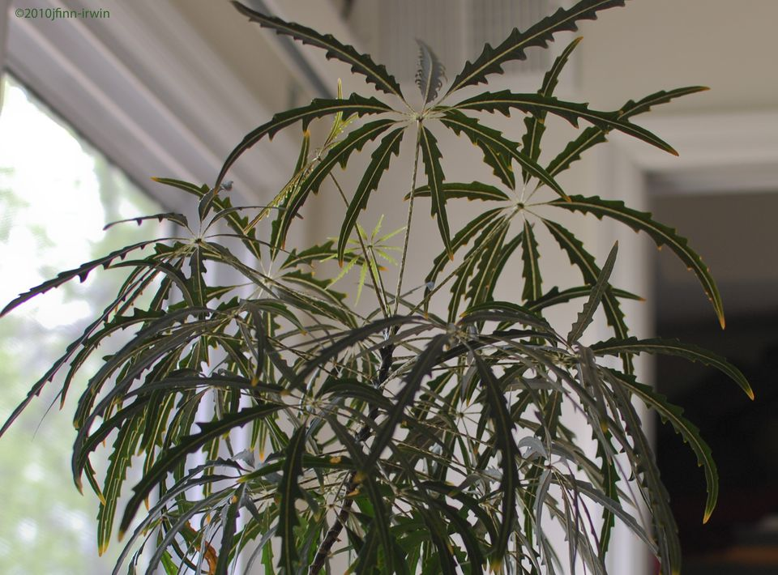
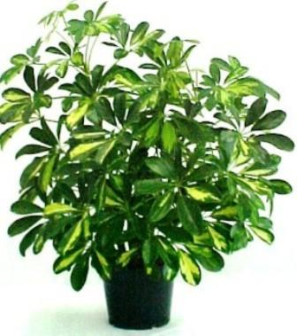
Finger –leaved
Schefflera actinophylla
Dizycotheca elegantisima

Slide 6
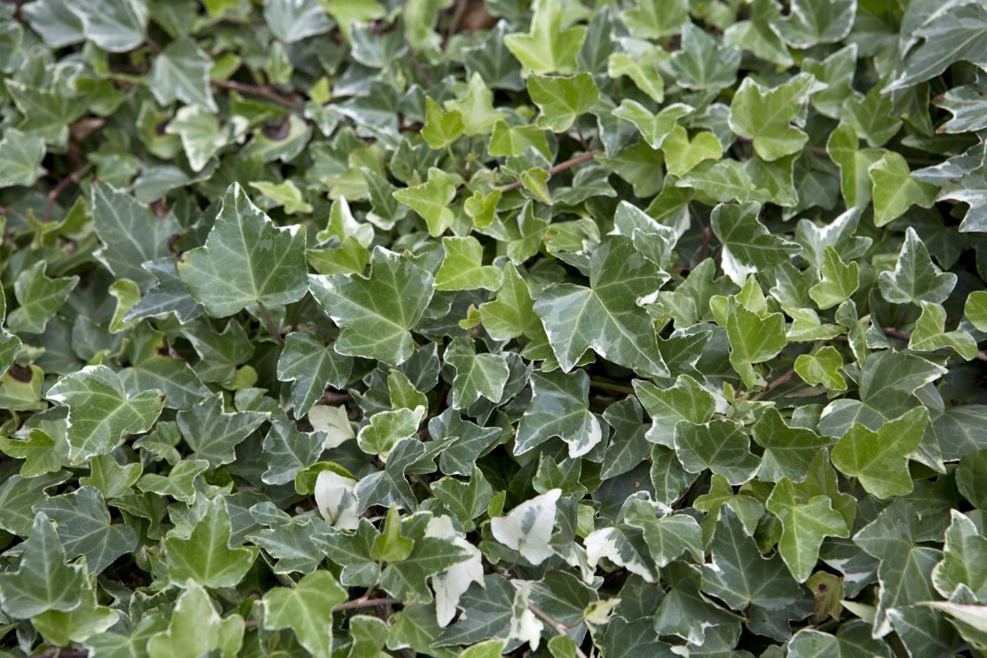
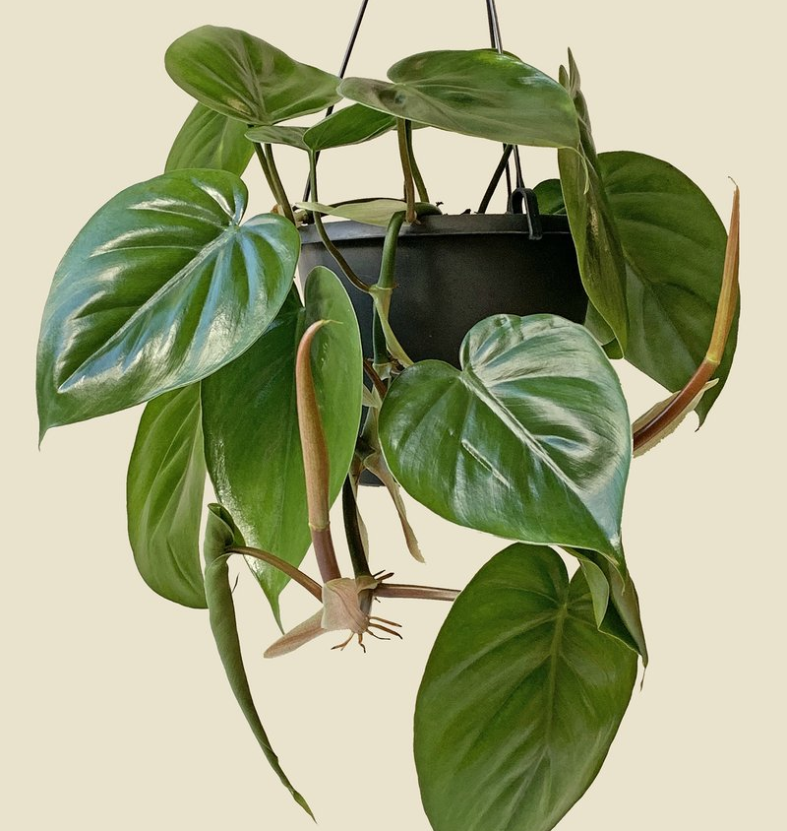
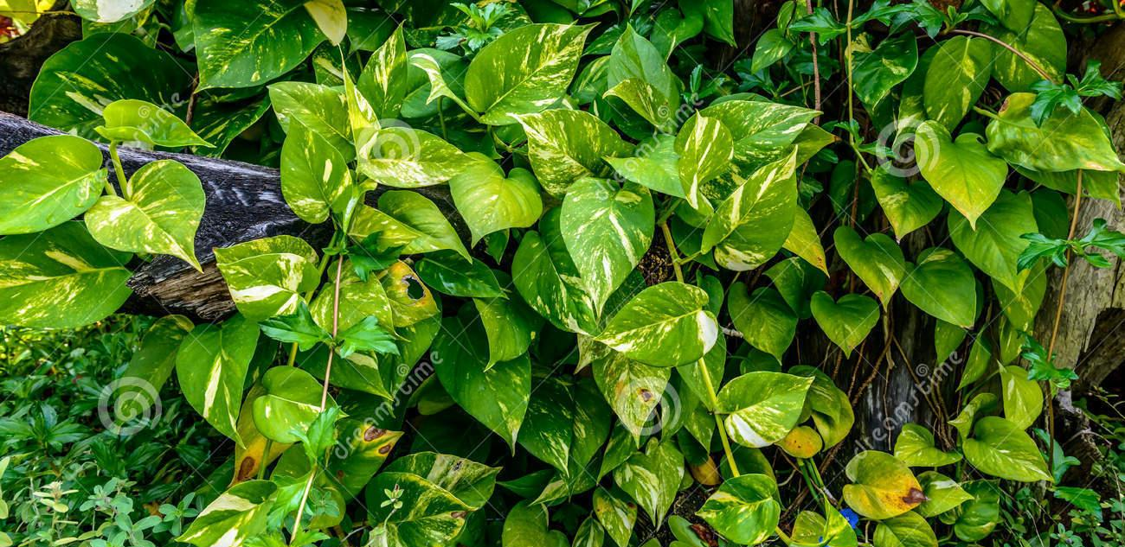
Climbers and trailers
Hedra helix
Philodendron scadens
Scindapsus aureus

Slide 7
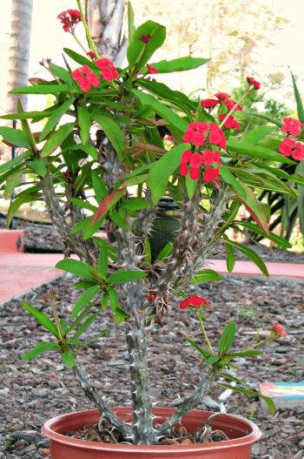
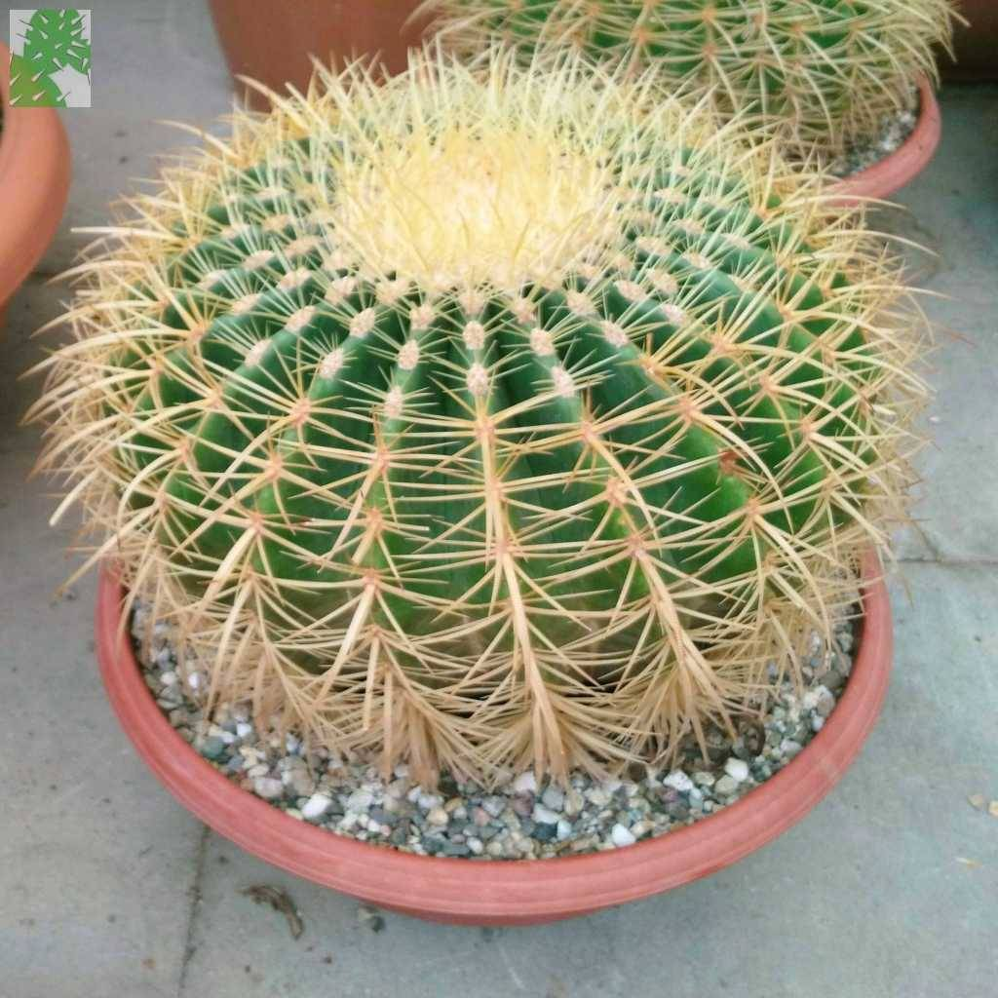
Spiny- stemmed house plants
cacti
Non cacti
echinocactus grusonii
Euphorbia milii

Slide 8
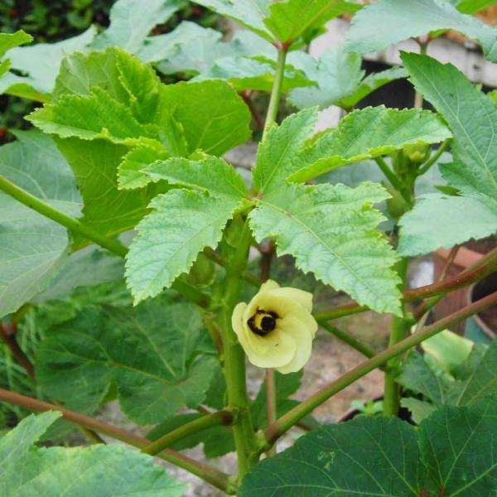
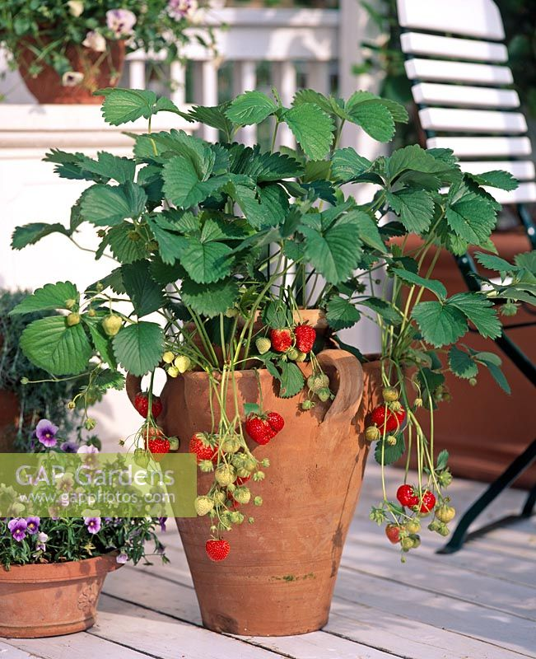
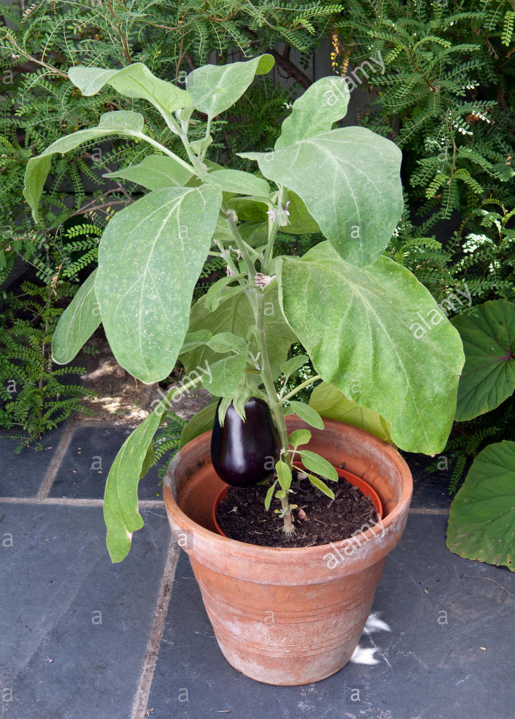
fruiting
solanum melogina
hibiscus esculentus بامية
fragaria vesca
فراولة
solanum melogina
باذنجان

Slide 9
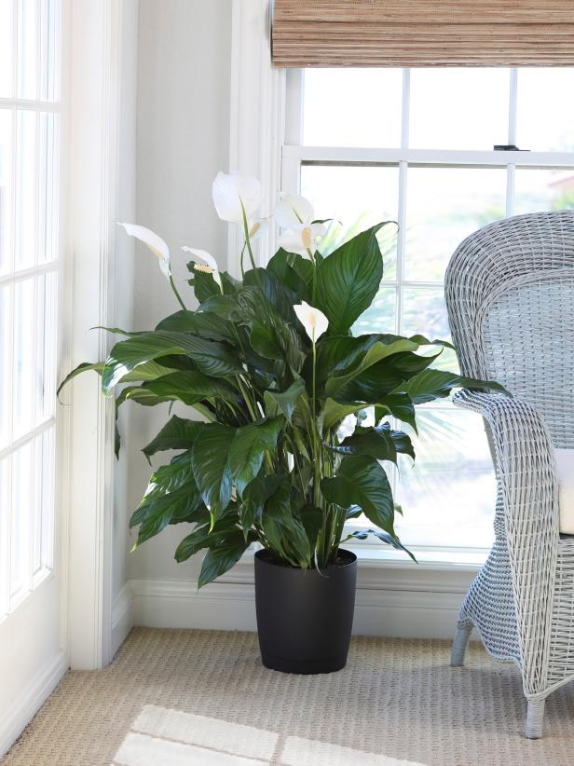
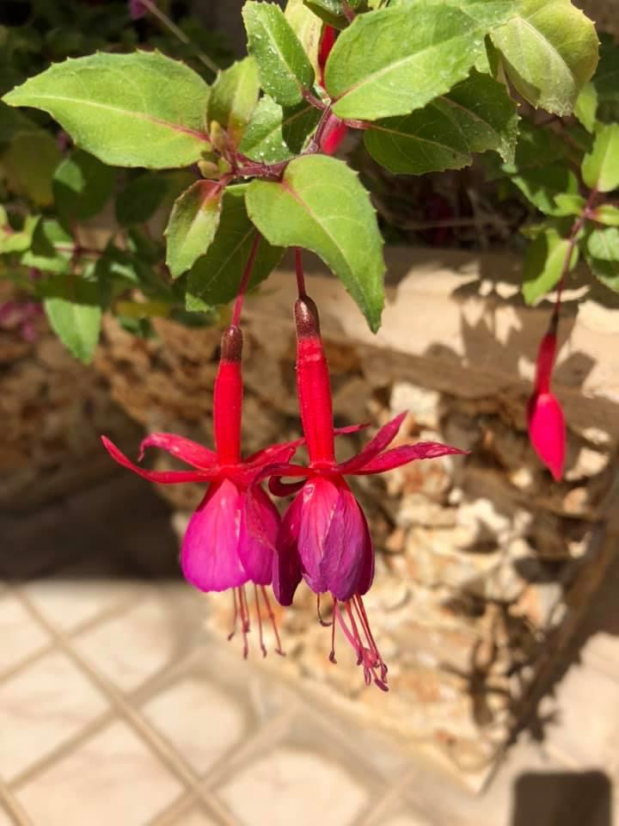
flowering
Fucia
Spathyphllium

Slide 10
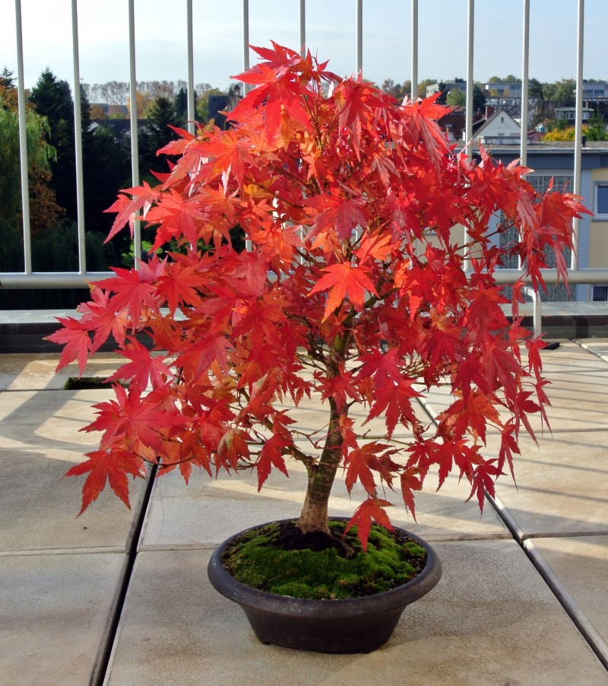
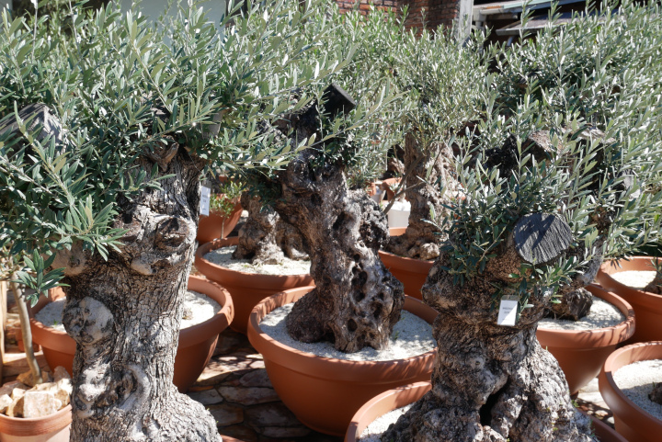
bonsai
Acer palmatum
Olea europea

Slide 11
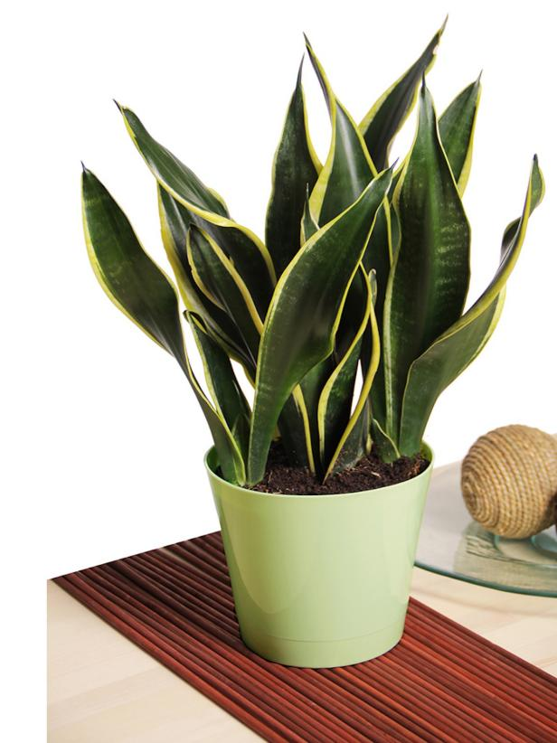
Senseveria

Slide 12
Hedra helix

