Slide 1
HORTICULTURE AND ICOLOGY
(ENPL234)
PALEsTINIAN PLANTS
AMAL DAR BADER

Slide 2
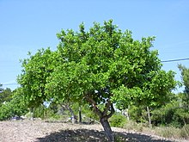
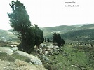
Mediterranean zone
Ceratonia siliqua
Evergreen tree
Its leaves are small green compound
Its shades are great
Not recommended for use in gardens
Its fruits are edible
Ceratonia siliqua
الخروب
Cupressus sempervirens
Evergreen tree
Its leaves are green, needle
Frequently used as a decoration for gardens and shades
Grow hierarchically
It is 3 meters long
Cupressus sempervirens
السرو

Slide 3
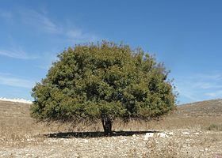
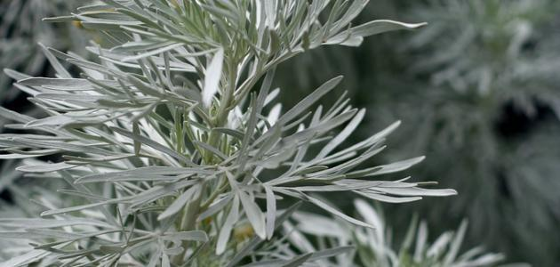
Irano _ Terano zone
Pistacia palaestina
Evergreen perennial tree
Wide shades
It reaches a length of ten meters
Its leaves are green, small and needle
Multiple logs
Pistacia palaestina
البطم
ARTEMISIA
Perennial shrub
Its longitudinal leaves are small gray
It reaches a length of sixty centimeters
Used in the gardens as a ground cover
ARTEMISIA
الشيح

Slide 4
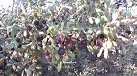
Sahara Arabian zone
sarcooiterium spinosum
shrub
Forklift
Its leaves are light green toothed
It reaches a length of sixty centimeters and extends widely
Stumps are gray
Rhamnus lycioides
السويد
Rhamnus lycioides
Perennial plant
Its leaves are medium-sized, soft green and light
Stumps are gray
It is three meters long
Toxic to humans
Its branches are intertwined
Birds prefer to stay there
sarcooiterium spinosum
النتش

Slide 5
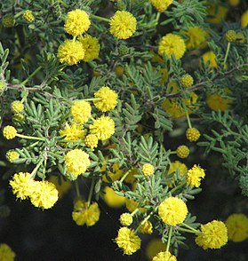
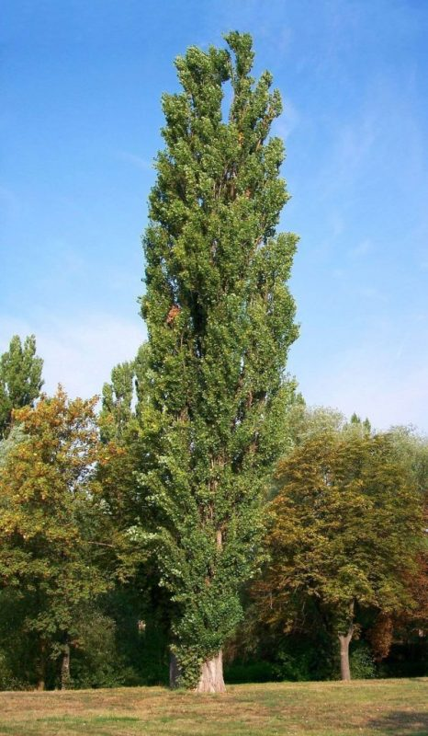
Sudanese zone
Racosperma
shrub
It grows to two meters or more
The leaves are small, long, rough and dark green in color
Used for decoration and shades
Its flowers are bright yellow, and it smells good
Deciduous tree
It reaches 13 meters
Its leaves are dense, smooth, green and on the other side, gray
Used as a garden slaughterhouse
Racosperma
أكاسيا
Populus alba
Populus alba
الحور

