Slide 1
HORTICULTURE AND ICOLOGY ENPL236 WILD PLANTS Amal DAR BADER

Slide 2
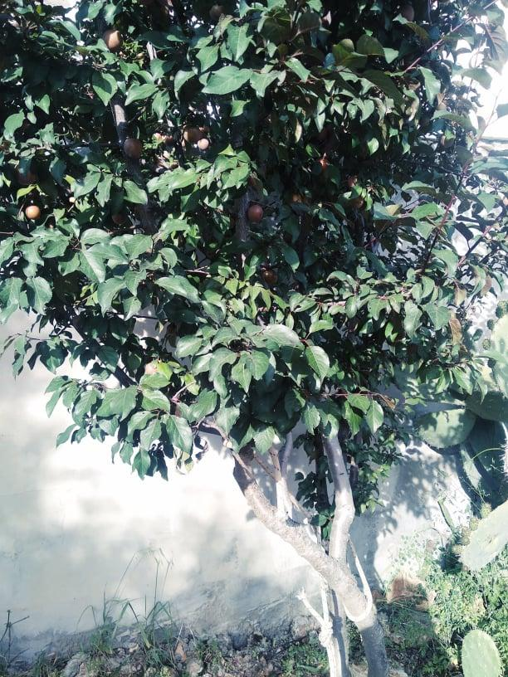
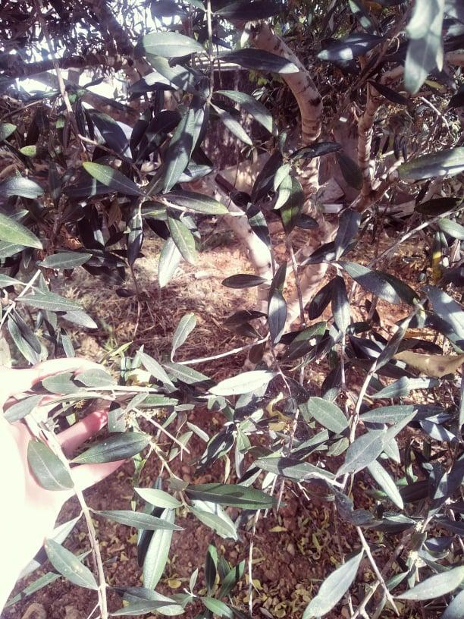
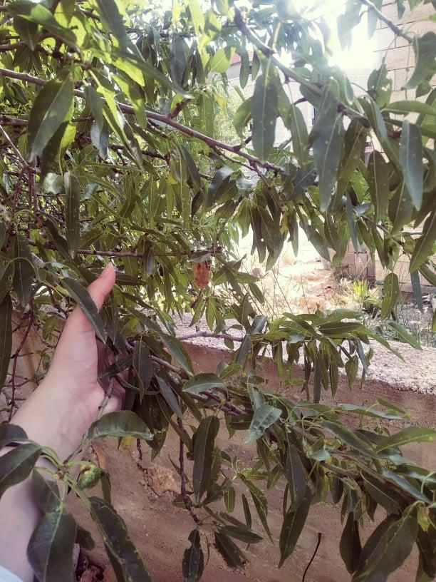
TREES
Its leaves are shiny, dark green and on the other side are white, the bark is solid gray, edible, and reaches a length of four meters
Its leaves are soft green, compound, their flowers are white, edible or bark brown up to seven meters in length
Its leaves are smooth, longitudinal, green, red-red, bark red, edible, up to seven meters long
كرز أحمر
Prunus Cerasus
زيتون
Olea Europaea
لوز
Prunus dulcis

Slide 3
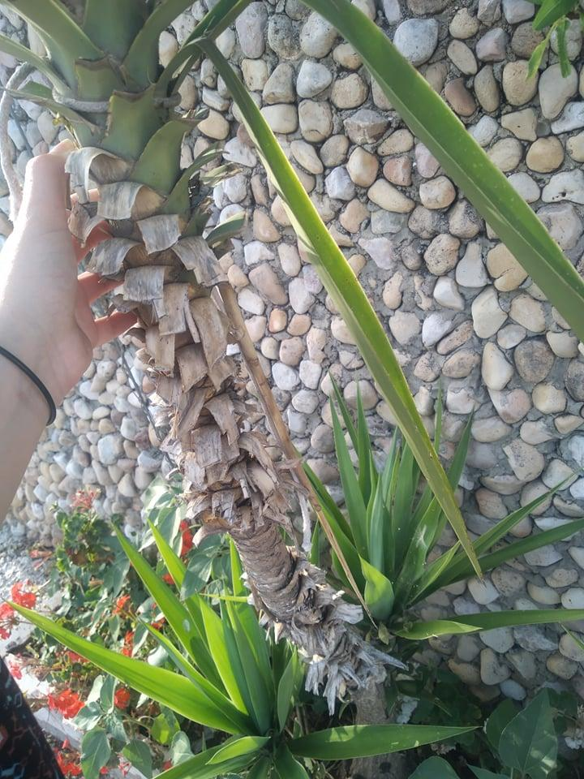
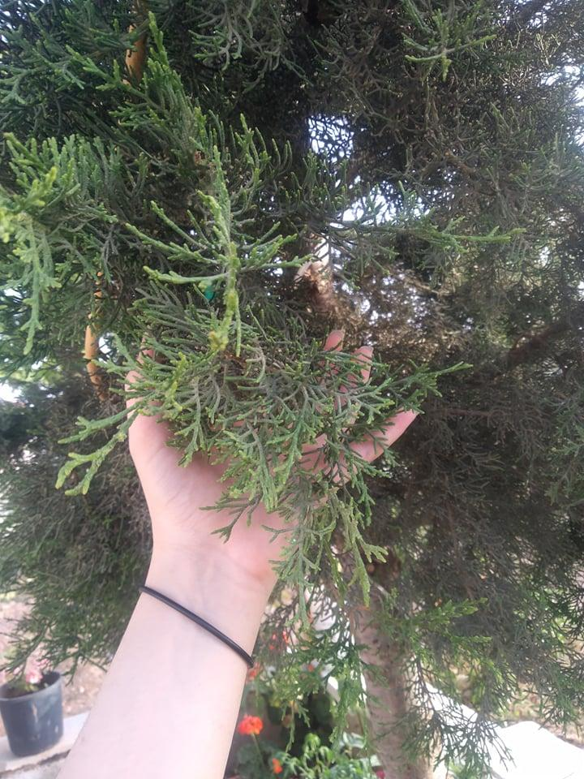
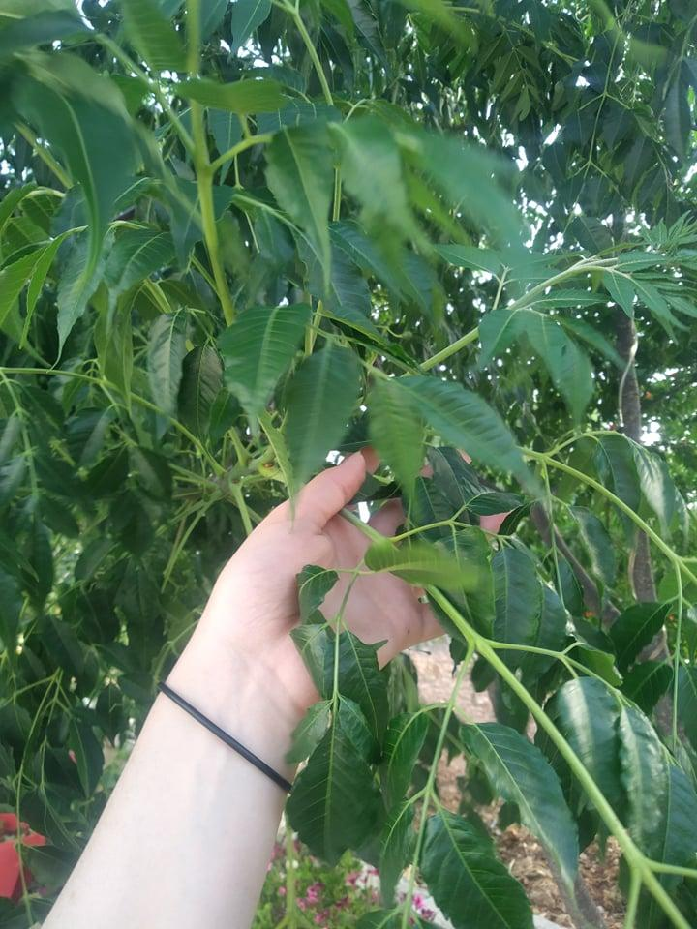
Its leaves are green, shiny, succulent, long that ends with needle appendages. Its bark is a light brown layer of up to six meters in length.
Its leaves are dark green, coarse, needle-shaped, conical, bark grayish-brown, up to twelve meters long
Its leaves are dark green, soft compound, purple flowers, bark is solid gray, toxic, up to five meters long
يكة
Yucca Treculeana
سرو
Cupressus Lusitanica
الليلك
Melia Azedarach

Slide 4
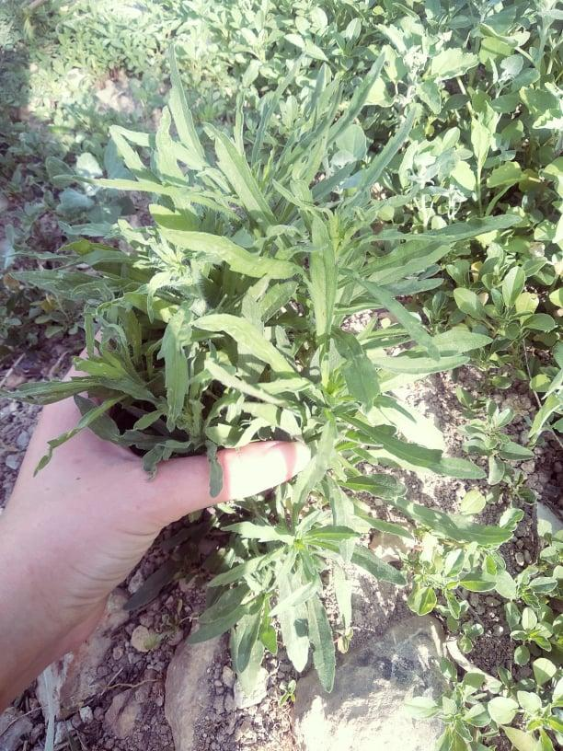
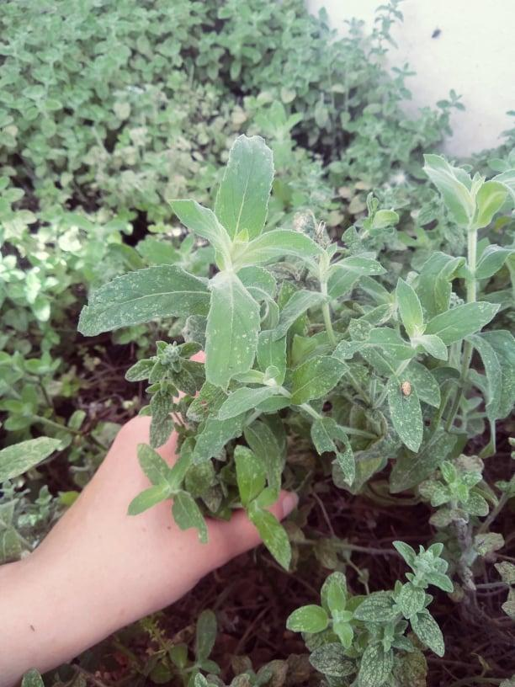
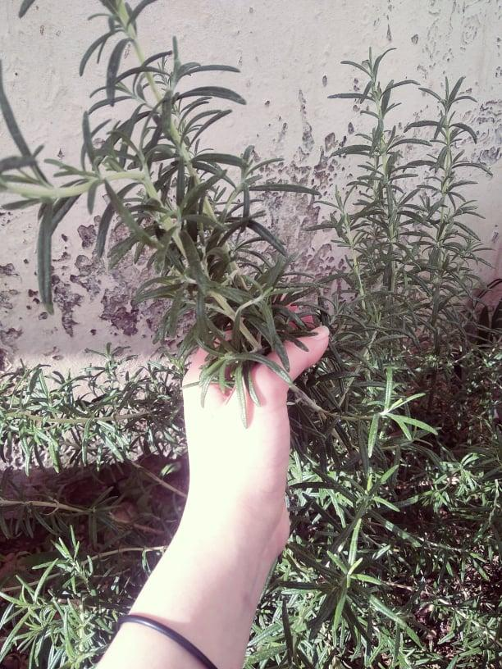
Shrubs
Its leaves are green to gray, compound, edible, and its bark is solid brown, with a length of thirty cm
Its leaves are dark green, longitudinal, soft, needle, violet flowers, bark, grayish-brown, up to forty cm long
Its leaves are light green, compound longitudinal, velvety texture, and its bark is soft green, reaching a length of forty cm,
طيون
Pittricha Viscosa
نعناع بري
Mentha Pulegium
حصى اللبان
Rosmarinus Officinalis

Slide 5
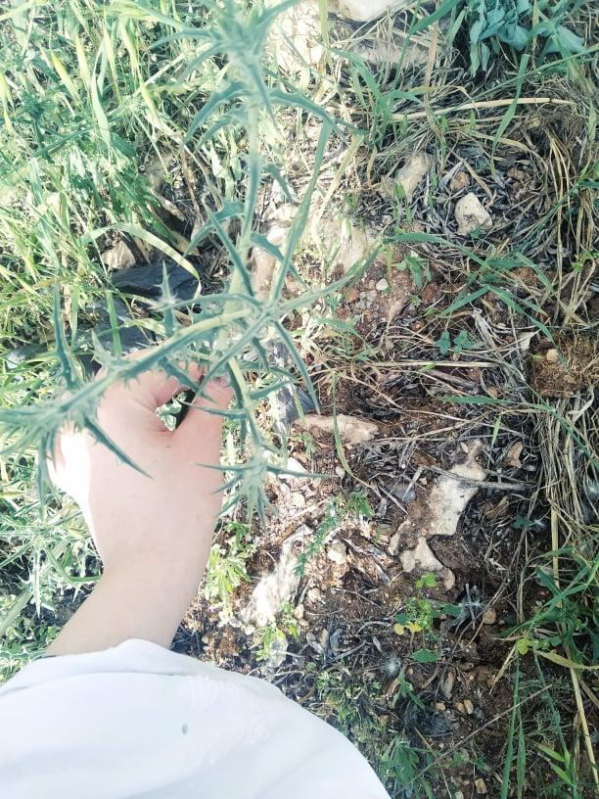
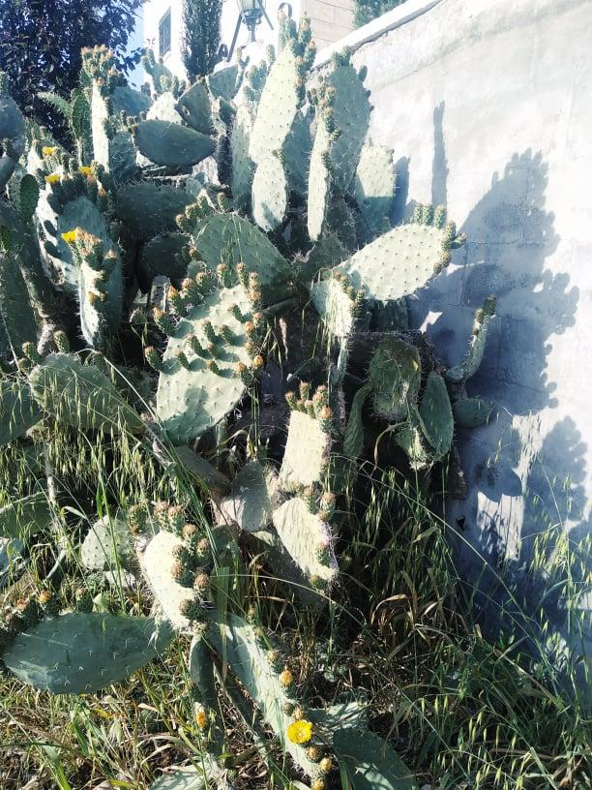
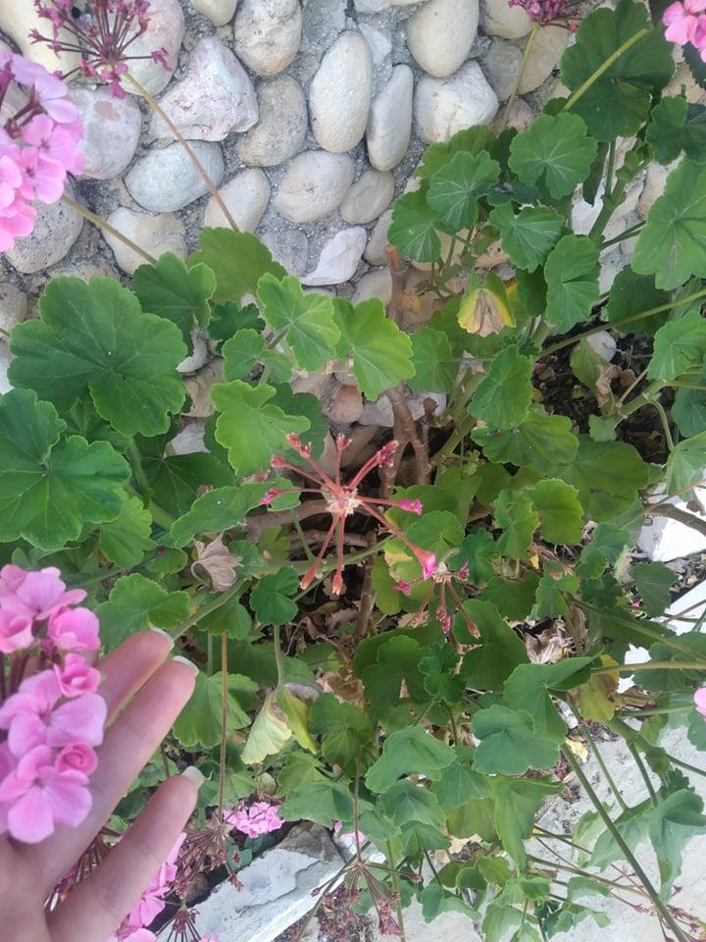
Its leaves are light green tending to gray, longitudinal, needle, thorny, yellow-orange flowers, medium-hard bark gray in color, reaching a length of thirty cm
Its leaves are green, very broad, bearing thorny apples, succulent, orange flowers, green succulent bark, edible up to two and a half meters long
Its leaves are light green, broad, medium in size, soft, multi-colored flowers, bark brown, up to thirty cm in length
قنطريون
Centaurea
صبر
Opuntia Ficus
سأصلي
Pelargonium

Slide 6
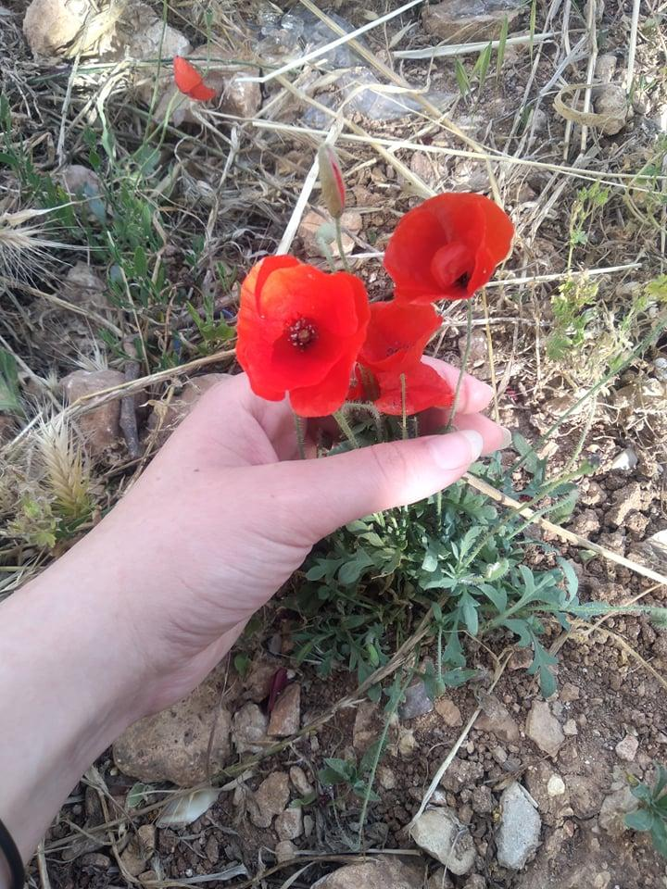
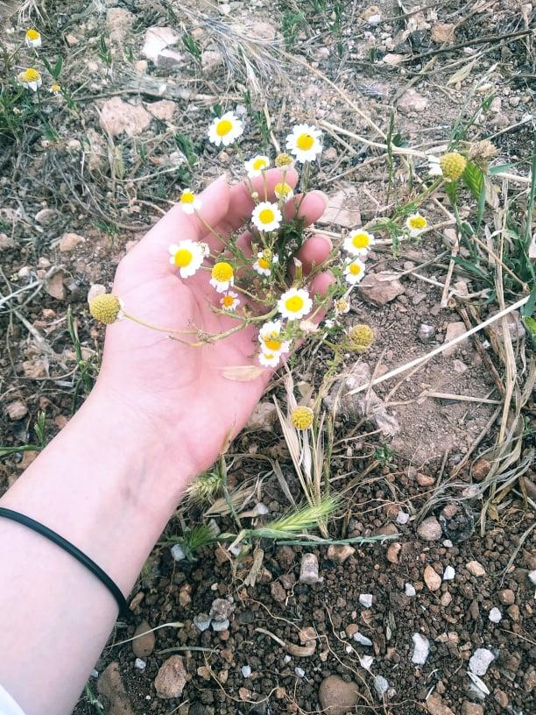
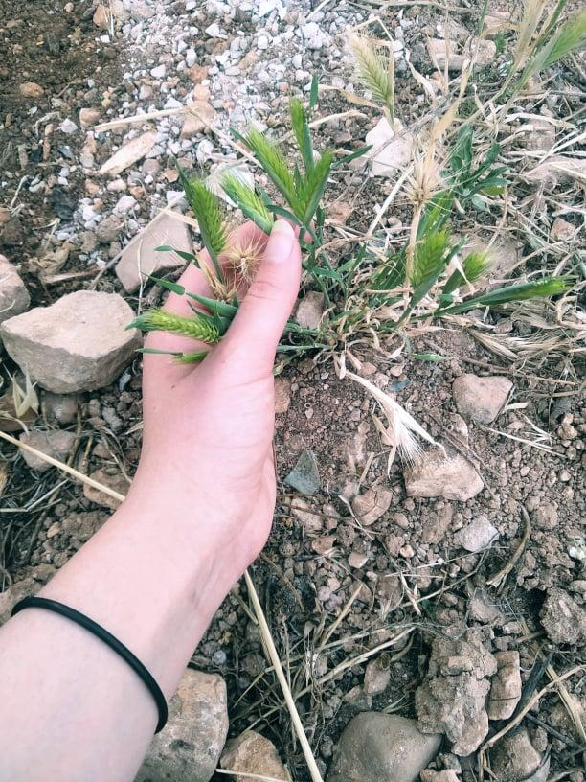
Annuals
Its leaves are light green, lush, soft velvet, red flowers, green bark, up to ten cm long.
Its leaves are green, fresh, small longitudinally growing in groups, flowers are white with yellow, edible, and its bark is soft green, reaching a length of eight centimeters.
Its leaves are dark green, succulent, long and soft, fruits are spike shaped with feathery apples, their bark is soft yellow, reaching a length of ten cm.
شقائق النعمان
Anemone Coronaria
أقحوان
Matricaria
شعير الديب
Hordeum Marinum

Slide 7
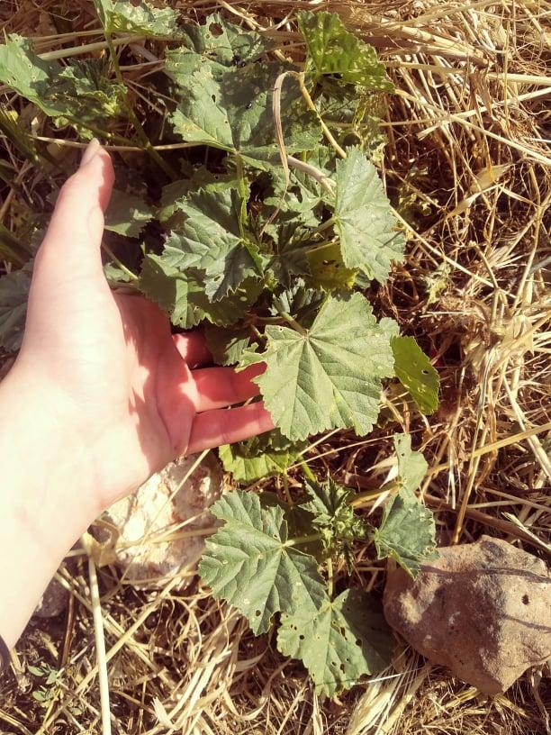
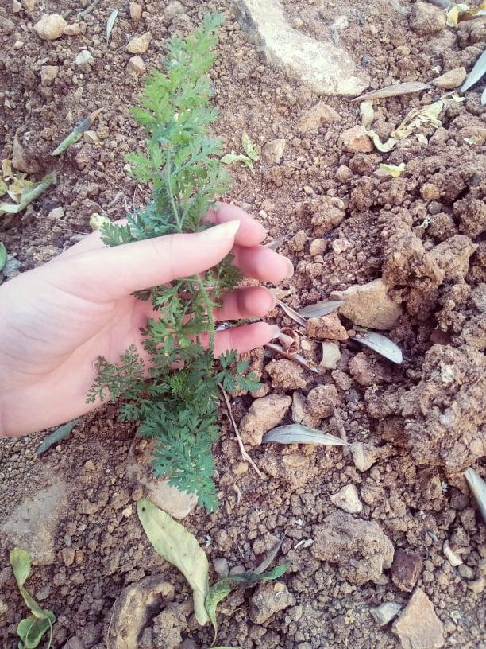
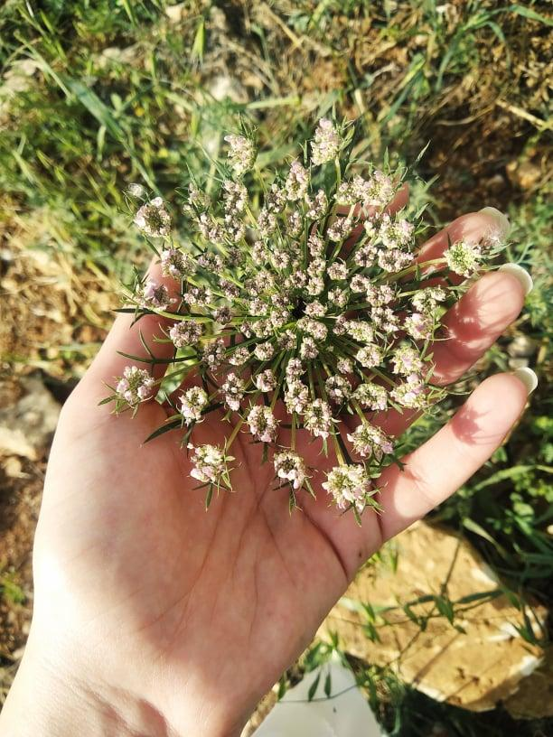
Its leaves are fresh green, small mushrooms, grow in groups, edible, and white flowers with a length of seven cm
Its leaves are green, small, succulent, needle, small white flowers that grow in large groups, and have a solid green border, reaching a length of one and a half meters
Its leaves are dark green, rough, broad, edible, and have a soft, bitter, up to five cm length.
خبيزة
Malva Pusilla
بقدونس
Petro Selinum Crispum
جزر بري
Paucus Caratu

Slide 8
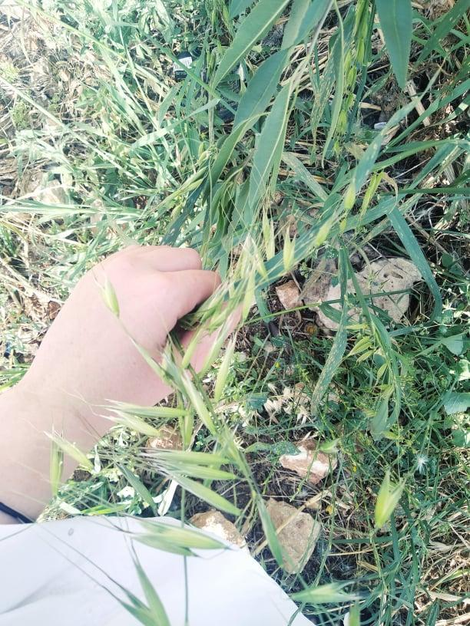
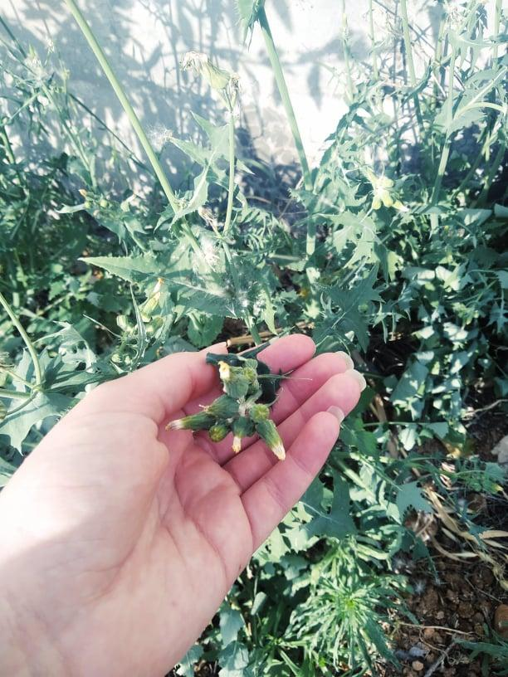
Its leaves are dark green, and on the other side are gray, rough and longitudinal, carrying thorny appendages, their flowers are yellowish-white, and their bark is solid gray, reaching a length of thirty cm.
Its leaves are dark green, jagged, long ending with needle appendages, its fruits are small, needle, edible longitudinal, their bark is soft yellow, the length of which reaches a meter
شوفان بري
Avena Sterilis
خس بري
Lactucsa Srriola

Slide 9
THE END

